Slide 1

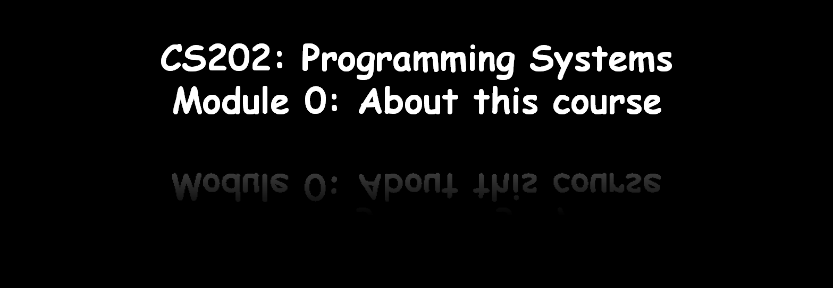
Dr. Tran Minh Triet

Slide 2
Objectives
to prepare students for programming in the upper division 3xx and 4xx level classes.
to introduce students to object-oriented programming.
to experience object oriented design and programming.
… Do you expect more?

Slide 3
Minor objectives
to “feel” how to organize a software and reuse components and patterns
to introduce students to GUI programming

Slide 4
Instructor and Teaching Assistants
Instruction:
  Dr. Tran Minh Triet tmtriet@fit.hcmus.edu.vn Room I. 82
Teaching Assistants:
  MSc. Dang Binh Phuong dbphuong@fit.hcmus.edu.vn Room I. 63
  Dang Thi Thanh Nguyen dttnguyen@fit.hcmus.edu.vn Room I. 82
  Nguyen Huy Khanh nhkhanh@fit.hcmus.edu.vn Room I. 82
  Nguyen Son Hoang Quoc nshquoc@fit.hcmus.edu.vn Room I. 82

Slide 5
Exams and Marking
Assignments: 40%
  Weekly assignments: 10%
  Final lab assignment: 30%
Mid-term exam : 25%
Final exam: 35%
Bonus (advanced Modules, seminars…): +10→20%

Slide 6
Tentative schedule
Module 1: Introduction of Object-Oriented Programming
Module 2: Class and object concepts and declaration
Module 3: Class and object concepts and declaration (cont.)
Module 4: Constructor and Destructor
Module 5: Operators
Midterm Examination ☹

Slide 7
Tentative schedule (cont.)
Module 6: Inheritance
Module 7: Polymorphism
Module 8: Relationships between classes
Module 9: Design Patterns
Module 10: Review for the final
Final Examination !!!

Slide 8
References
Main Book:
  C++ Primer, Fourth Edition,
  Stanley B. Lippman, Josée Lajoie, Barbara E. Moo
  Addison Wesley Professional, 2005

Slide 9
References
Slides
  Course CS202: Programming Systems
  Instructor: MSc. Karla Fant,
  Portland State University
  Course CS202: Programming Systems
  Instructor: Dr. Dinh Ba Tien,
  University of Science, VNU-HCMC
  Course DEV275: Essentials of Visual Modeling with UML 2.0
  IBM Software Group

Slide 10
References
Further readings:
  Effective C++, 3rd Edition,
  Scott Meyers, Addison-Wesley Professional, 2005
  The C++ Programming Language
  Bjarne Stroustrup, Addison-Wesley, 2000.
Technical references (GUI programming with C++)
  Ivor Horton’s Beginning Visual C++ 2005
  Ivor Horton, Wiley Publishing, Inc., 2006
  Ivor Horton’s Beginning Visual C++ 2008
  Ivor Horton, Wiley Publishing, Inc., 2008

