Slide 1

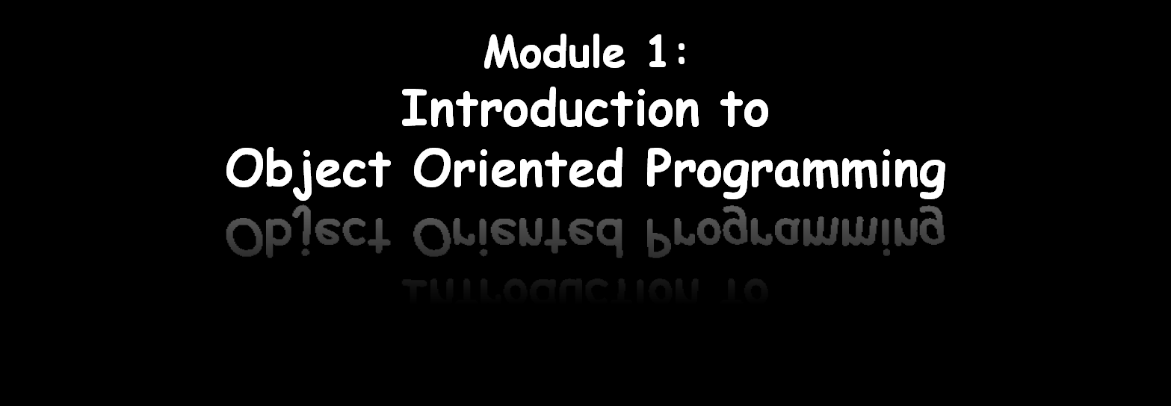
Dr. Tran Minh Triet

Slide 2
Acknowledgement
This presentation reuses materials from:
  Course CS202: Programming Systems
  Instructor: MSc. Karla Fant,
  Portland State University
  Course CS202: Programming Systems
  Instructor: Dr. Dinh Ba Tien,
  University of Science, VNU-HCMC
  Course DEV275: Essentials of Visual Modeling with UML 2.0
  IBM Software Group

Slide 3
Outline
Introduction
Procedural vs. OO Programming
Four principles of OO
Other issues

Slide 4


Slide 5
The History of Object Technology
Major object technology milestones
Simula
C ++
The UML
1967
Late 1980s
1996
1972
1991
2004
Smalltalk
Java
UML 2
Notes:
Essentials of Visual Modeling w/ UML 2.0 - Instructor Notes
Object technology is not a new idea. It has been around for over 30
years. Below is a brief history of the major milestones in the history of object technology.
In 1967, Simula was designed and became the first language to use objects and classes.
In 1972, Alan Kay and others at Xerox PARC created Smalltalk whose roots were tied to Simula. In 1980, Smalltalk became the first commercial release of an object-oriented programming environment.
Bjarne Stroustrop, the originator of the C language, released C++ to the public in the late 1980’s. C++ was not an entirely new language, but an extension of C abilities.
In 1991, James Gosling created a language named Oak that was the predecessor to Java. It was created because his development team at Sun Microsystems was writing software for information appliances. He found that C++ was too complex and insecure for the job. Therefore, he created the Oak language.
UML 2.0 replaces UML version 1.4. Released in 2004, the Object Management Group (OMG) developed two complementary specifications called the Infrastructure and Superstructure specification. The Infrastructure defines the foundational language constructs required for UML 2.0 and serves as an architectural foundation. The Superstructure defines the user level constructs. Together, they constitute a complete specification for the UML 2.0 modeling language.
Review these milestones with the students so that they garner a perspective on object technology’s history.
This slide was included to show students that object technology is not new. It has been around for a long time and is a proven and fairly mature technology.

Slide 6
Object-oriented concepts
Learning OO concepts is not accomplished by learning a specific development method or a set of tools.
But, it is a way of thinking.

Slide 7
Object-oriented concepts (cont)
For examples:
Many people are introduced to OO concepts via one of these development methods or tools.
  Many C programmers were first introduced to object orientation by migrating directly to C++, before they were even remotely exposed to OO concepts.
  Some software professionals were first introduced to object orientation by presentations that included object models using UML

Slide 8
Problems!!!
Learning a programming language is an important step, but it is much more important to learn OO concepts first.
  Developers who claim to be C++ programmers are simply C programmers using C++ compilers.
  Learning UML before OO concepts is similar to learning how to read an electrical diagram without first knowing anything about electricity.

Slide 9
Even worse!!!
A programmer can use just enough OO features to make a program incomprehensible to OO and non-OO programmers alike.

Slide 10
Practice
Using the data structure struct, implement the following structures and functions:
  struct Point: data structure for a 2-D point.
  struct Triangle: contains the information of the 3 vertices
  A function to calculate a distance between 2 points
  Functions to calculate the perimeter and area of a triangle.
  We already know everything about OOP???

Slide 11
OO concepts
It is very important that
while you're on the road to OO development, you first learn the fundamental OO concepts.

Slide 12
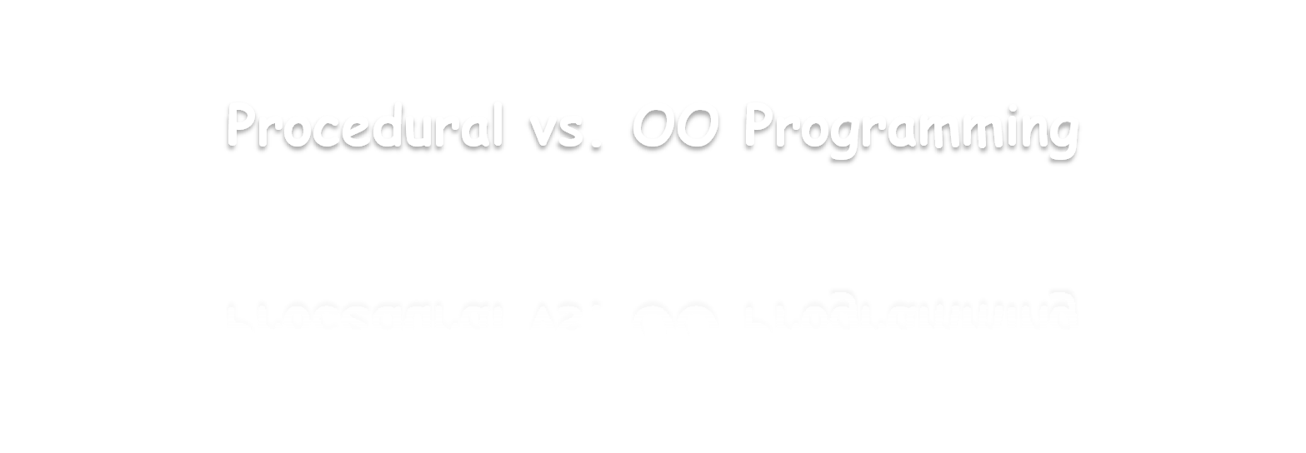

Slide 13
Procedural vs. OO Programming
An object is an entity
that contains both data and behaviours
In procedural programming:
  Code is placed into totally distinct functions or procedures.
  Data is placed into separate structures, and is manipulated by these functions or procedures.

Slide 14
Procedural vs. OO Programming (cont)
In OO programming: the attributes and behaviours are contained within a single object
In procedural programming: the attributes and behaviours are normally separated.

Slide 15
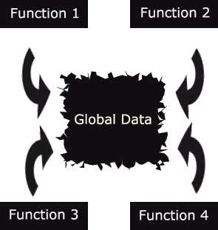
Why do we change from procedural to OO programming?

Slide 16
Why do we change from procedural to OO programming?
In procedural programming:
  Data is separated from the procedures.
  Sometimes it is global → easy to modify data that is outside your scope
  This means that access to data is uncontrolled and unpredictable.
  Having no control over the data → testing and debugging are much more difficult.

Slide 17
Why do we change from procedural to OO programming?
Objects solve these problems by combining data and behaviours into a complete package.
In a proper OO design: there is no global data (we expect ;-)

Slide 18
Objects (again!)
Objects do contain:
  Integers, and strings… → attributes.
  Methods (i.e. functions) → behaviours.
In an object, methods are used to operate on the data.
You can control access to
members of an object (both attributes and methods).

Slide 19


Slide 20
Basic Principles of Object Orientation
Object Orientation
Abstraction
Encapsulation
Modularity
Hierarchy
Notes:
Essentials of Visual Modeling w/ UML 2.0 - Instructor Notes
There are four basic principles of object orientation:
Abstraction
Encapsulation
Modularity
Hierarchy
Introduce the four basic principles of OO.
Be sure the students understand objects before you begin this next section.
You’ve introduced objects first to help students better apply each of these principles.

Slide 21
What Is Abstraction?
The essential characteristics of an entity that distinguishes it from all other kinds of entities.
Defines a boundary relative to the perspective of the viewer.
Is not a concrete manifestation, denotes the ideal essence of something.

Slide 22
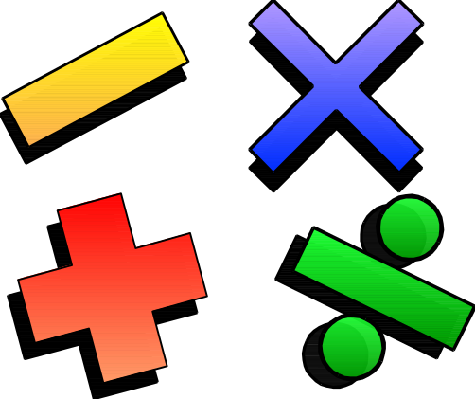
Example: Abstraction
Student
Professor
Course Offering (9:00 a.m.,
Monday-Wednesday-Friday)
Course (e.g. Algebra)
Notes:
Essentials of Visual Modeling w/ UML 2.0 - Instructor Notes
The following are examples of abstraction:
A student is a person enrolled in classes in the university.
A professor is a person teaching classes at the university.
A course is a class offered by the university.
A course offering is a specific offering for a course including the days of the week and the times.
Explain how these are examples of abstraction.

Slide 23
What Is Encapsulation?
Hides implementation from clients.
  Clients depend on interface.
Improves Resiliency
Notes:
Essentials of Visual Modeling w/ UML 2.0 - Instructor Notes
Encapsulation can be defined as:
The physical localization of features (for example, properties, behaviors) into a single blackbox abstraction that hides their implementation (and associated design decisions) behind a public interface. (Dictionary of Object Technology, Firesmith, Eykholt, 1995.)
Encapsulation is often referred to as “information hiding,” making it possible for the clients to operate without knowing how the implementation implements the interface.
Encapsulation eliminates direct dependencies on the implementation (clients depend on/use the interface). Thus, it’s possible to change the implementation without updating the clients as long as the interface is unchanged.
Clients are not affected by changes in implementation, thus reducing the “ripple effect,” where a correction to one operation forces the corresponding correction in a client operation and so on. As a result of encapsulation, maintenance is easier and less expensive.
Encapsulation offers two kinds of protection. It protects an object’s internal state from being corrupted by its clients and client code from changes in the object’s implementation.
Define the concept of encapsulation to the students.
Encapsulation is putting the “data bits” and operations that manipulate them in the same place.
Encapsulation does NOT allow direct manipulation of things that have been encapsulated without using the supplied interface.
An example is a car’s accelerator. Generally speaking, you put your foot down and the car goes faster. You don’t worry about the cables, electronics, engine, and the rest.

Slide 24
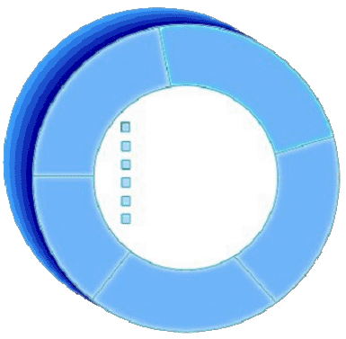
Encapsulation Illustrated
AcceptCourseOffering()
SubmitFinalGrades()
Name: J Clark
Employee ID: 567138
HireDate: 07/25/1991
Status: Tenured
Discipline: Finance
MaxLoad:4
SetMaxLoad(4)
SetMaxLoad()
Professor Clark needs to be able to teach four classes in the next semester.
TakeSabbatical()
Professor Clark
Notes:
Essentials of Visual Modeling w/ UML 2.0 - Instructor Notes
The key to encapsulation is an object’s message interface. The object interface ensures that all communication with the object takes place through a set of predefined operations. Data inside the object is only accessible by the object’s operations. No other object can reach inside the object and change its attribute values.
For example, Professor Clark needs to have her maximum course load increased from three classes to four classes per semester. Another object makes a request to Professor Clark to set the maximum course load to four. The attribute, MaxLoad, is then changed by the SetMaxLoad() operation.
Encapsulation is beneficial in this example because the requesting object does not need to know how to change the maximum course load. In the future, the number or variables that are used to define the maximum course load may be increased, but it doesn’t affect the requesting object. It depends on the operation interface for the Professor Clark object.
Point out that the requesting object does not need to know the structure of the Professor object to request a state change.
The object that owns the attributes is the only one allowed to change its own attributes.
Note that encapsulation can also be illustrated using interfaces. However, the scope of this course does not include this discussion.

Slide 25
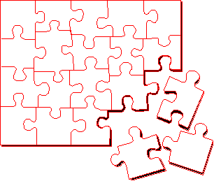
What Is Modularity?
Breaks up something complex into manageable pieces.
Helps people understand complex systems.
Notes:
Essentials of Visual Modeling w/ UML 2.0 - Instructor Notes
Modularity can be defined as:
The logical and physical decomposition of things (for example, responsibilities and software) into small, simple groupings (for example, requirements and classes, respectively), which increase the achievements of software-engineering goals. (Dictionary of Object Technology, Firesmith, Eykholt, 1995.)
Another way to manage complexity is to break something that is large and complex into a set of smaller, more manageable pieces. These pieces can then be independently developed as long as their interactions are well understood.
Packages (described later in the course) support the definition of modular components.
Explain the concept of modularity to the students.
Modularity supports a separation of concerns.

Slide 26


Example: Modularity
For example, break complex systems into smaller modules.
Billing
System
Course
Catalog
System
Course Registration System
Student
Management
System
Notes:
Essentials of Visual Modeling w/ UML 2.0 - Instructor Notes
Often, the system under development is too complex to understand. To better understand this, imagine that the system is broken into smaller blocks that are maintained independently. Breaking down a system in this way is called modularity. It is critical for understanding a complex system.
For example, the system under development is a Course Registration System. The system itself is too large and abstract to understand the details. Therefore, the development team broke this system into three modular systems, each independent of the others.
Billing System
Course Catalog System
Student Management System
A car is an example of modularity. It is made of up of a body, chassis, engine, wheels, and so on.

Slide 27
What Is Hierarchy?
Increasing
abstraction
Asset
BankAccount
Security
RealEstate
Decreasing
abstraction
Savings
Checking
Stock
Bond
Elements at the same level of the hierarchy should be at the same level of abstraction.
Notes:
Essentials of Visual Modeling w/ UML 2.0 - Instructor Notes
Hierarchy can be defined as:
Any ranking or ordering of abstractions into a tree-like structure. Kinds: Aggregation hierarchy, class hierarchy, containment hierarchy, inheritance hierarchy, partition hierarchy, specialization hierarchy, type hierarchy. (Dictionary of Object Technology, Firesmith, Eykholt, 1995.)
Hierarchy organizes in a particular order or rank (for example, complexity, responsibility, and so on). This organization is dependent on perspective. Using a hierarchy to describe differences or variations of a particular concept provides for more descriptive and cohesive abstractions and a better allocation of responsibility.
In any one system, there may be multiple abstraction hierarchies (for example, a financial application may have different types of customers and accounts).
Hierarchy is neither an organizational chart nor a functional decomposition.
Hierarchy is a taxonomic organization. The use of hierarchy makes it easy to recognize similarities and differences. For example, botany organizes plants into families. Chemistry organizes elements into a periodic table.
Explain the concept of hierarchy to the students.
Hierarchy is a taxonomic organization. The use of hierarchy makes it easy to recognize similarities and differences.
A taxonomic organization is one that represents an orderly classification. For example, plants and animals are classified taxonomically.
Note that this is not part of the UML notation. UML notation is discussed later.

Slide 28


Slide 29
Software Design
Reusability
  Portable and independent components can be reused in many systems
Extensibility
  Support external plug-ins
Flexibility
  Change will be easy when new data/features added
  Modifications are less likely to break the system
  Localize effect of changes

Slide 30
Create a system: designing process
Divide a system in terms of components
Divide components in terms of sub-components
Abstraction
  Hides details of components that are irrelevant to the current design phase
Component identification is top-down
  Decompose system into smaller, simple components
Integration is bottom-up
  Combining small components
Design is applied using a paradigm: procedural, modular, objectoriented

Slide 31
Abstraction
Procedural design
  Define set of functions to accomplish task
  Pass information from function to function
Modules (modular design)
  Define modules, where each has data and procedures
  Each module has a public and a private section
  Works as a scoping mechanism
Classes/Objects (object-oriented design)
  Abstract Data Types
  Divide project in set of cooperating classes
  Each class has a very specific functionality
  Classes can be used to create multiple instances of objects

