Slide 1


Dr. Tran Minh Triet

Slide 2
Acknowledgement
Slides
  Course CS202: Programming Systems
  Instructor: MSc. Karla Fant,
  Portland State University
  Course CS202: Programming Systems
  Instructor: Dr. Dinh Ba Tien,
  University of Science, VNU-HCMC
  Course DEV275: Essentials of Visual Modeling with UML 2.0
  IBM Software Group

Slide 3
Outline
Introduction to inheritance
Hierarchical organization of concepts
Types of inheritance
Derived class
  Constructor
  Destructor
  Copy constructor & assignment operator

Slide 4
Introduction
A new concept does not come alone. When we introduce a class of car or employee for example. It may lead us to describe:
  wheel, engine, driver etc.
  Or: manager, director…
To model them, we can use class. However, how can we model the relationship between them?
In addition, re-usability of existing classes is one of the features of OOP.

Slide 5
Inheritance
C
A B
A B
* common attribs/functions - only in A + only in B
* * * * *
- *- - - *- *- - * - - *
+ * + + + * + * + * + + + * +
- - - - - - - - -
+ + + + + + + + + +

Slide 6
Inheritance
E
D
D E
* existing attrib/functions - new attrib/functions for D
* * * * *
- *- - - *- *- - * - - *
* * * * *
- - - - - - - - -

Slide 7
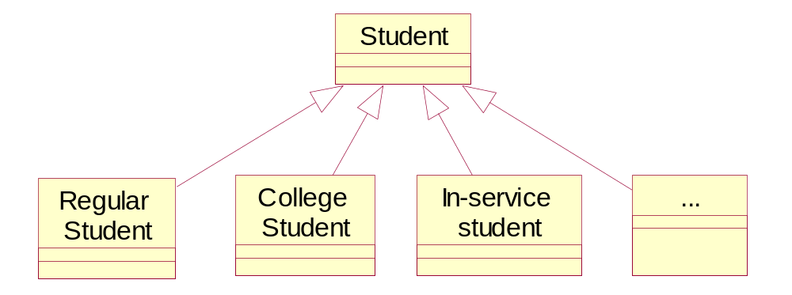
An example
Base class
inherit
Derived classes

Slide 8















Classify the following types of units into groups and subgroups
Barbarian-Axe Swinger
Catapult
Balloon
Doctor
Musketeer
Cook
Steam Giant
Swordsman
Ram
Gyrocopter
Phalanx
Slinger
Cannon
Spearman
Archer

Slide 9
Hierarchical organization of concepts
A group of concepts is divided into sub-groups according to some criterion.
Example: Types of units are classified according to their means of transportation
GroundUnit
Air
AirUnit
Swordsman
Phalanx
Slinger
Musketeer
Archer
Spearman
Barbarian-Axe Swinger
Doctor
Cook
Balloon
Gyrocopter
You should use only one criterion at a time to classify a group of concepts.
Ram
Steam Giant
Catapult
Cannon

Slide 10
Catapult
Barbarian-Axe Swinger
Gyrocopter
Balloon
Swordsman
Air Units
Ground units VS Air units
Cook
Musketeer
Ground Units
Ram
Steam Giant
Doctor
Phalanx
Slinger
Spearman
Archer
Cannon

Slide 11
Hierarchical organization of concepts
Concepts are recursively classified into subgroups
GroundUnit
Air
AirUnit
Swordsman
Phalanx
Slinger
Musketeer
Archer
Spearman
Barbarian-Axe Swinger
Doctor
Cook
Balloon
Gyrocopter
Ram
Steam Giant
Catapult
Cannon

Slide 12
Catapult
Steam Giant
Machine Units
Gyrocopter
Balloon
Ram
Cannon
Air Units
Machine Units VS Organic Units
Organic Units
Swordsman
Phalanx
Musketeer
Cook
Doctor
Slinger
Spearman
Archer
Barbarian-Axe Swinger

Slide 13
Catapult
Steam Giant
Machine Units
Gyrocopter
Balloon
Ram
Cannon
Funtionality of units
Air Units
Support Units
Melee Units
Swordsman
Archer
Spearman
Long-Ranged Units
Cook
Phalanx
Barbarian-Axe Swinger
Musketeer
Slinger
Doctor

Slide 14
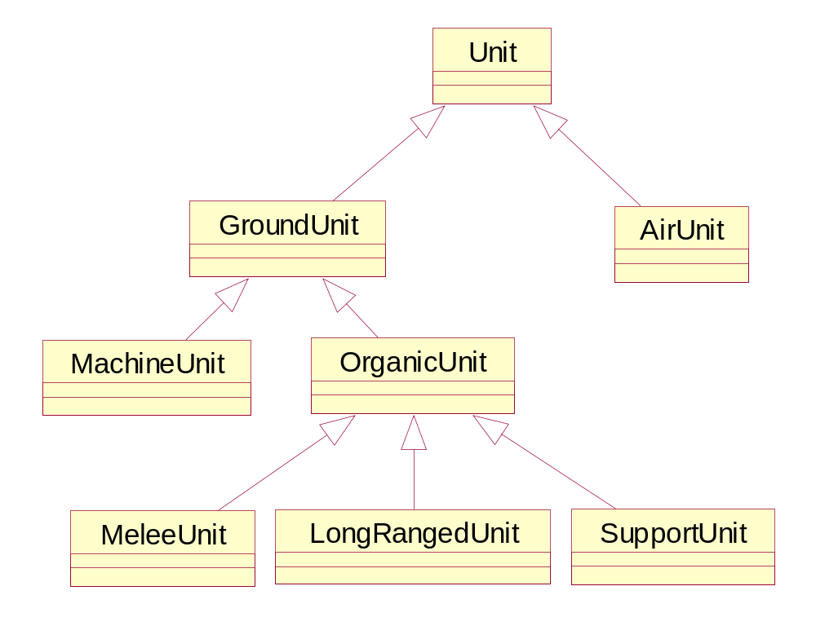
Ram
Steam Giant
Balloon
Gyrocopter
Cannon
Catapult
Swordsman
Phalanx
Slinger
Musketeer
Archer
Doctor
Cook
Spearman
Barbarian-Axe Swinger
It is possible to have different ways
to create logical hierarchical organization of concepts

Slide 15
Balloon
Gyrocopter
Cook
Doctor
Ram
Archer
Barbarian-Axe Swinger
Catapult
Slinger
Phalanx
Cannon
Spearman
Steam Giant
Musketeer
Swordsman

Slide 16
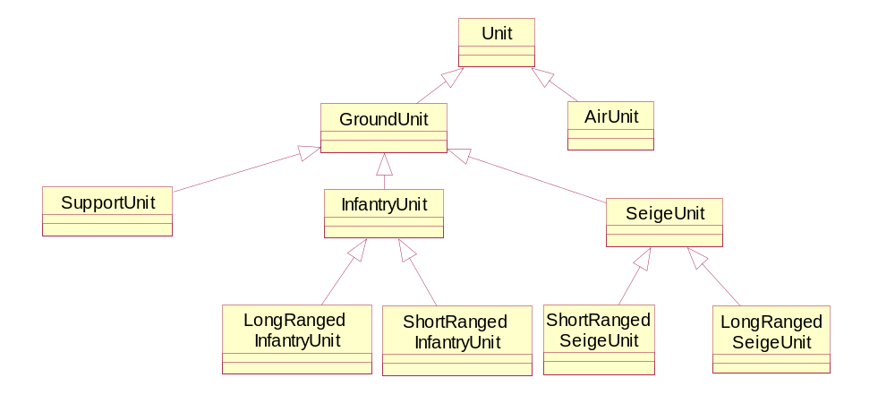
Balloon
Gyrocopter
Doctor
Cook
Steam Giant
Slinger
Ram
Catapult
Swordsman
Phalanx
Cannon
Musketeer
Archer
Spearman
Barbarian-Axe Swinger
It is possible to have different ways
to create logical hierarchical organization of concepts

Slide 17
Syntax
In C++, the inheritance is described as:
class <Derived Class> : <TypeOfInheritance> <Base class>
{
public:
<public attributes/functions>
private:
<private attributes/functions>
};

Slide 18
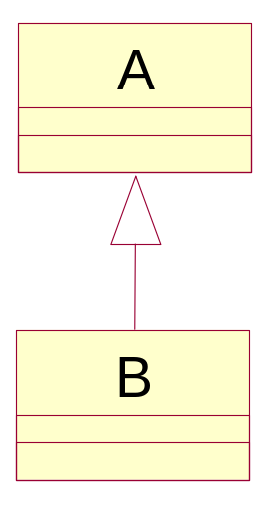
Inheritance: notes
Attributes/functions in public of A will become attributes/functions in B
Private attributes/functions of A will be part of B but it is only accessible via public or protected functions of A

Slide 19
protected keyword
protected attributes/functions of A is accessible from the derived class B but not from outside
class A
{
public:
...
protected:
int t;
};
class B: public A
{
public:
void Test()
{
cout << t;
}
...
};
Protected attribute of A

Slide 20
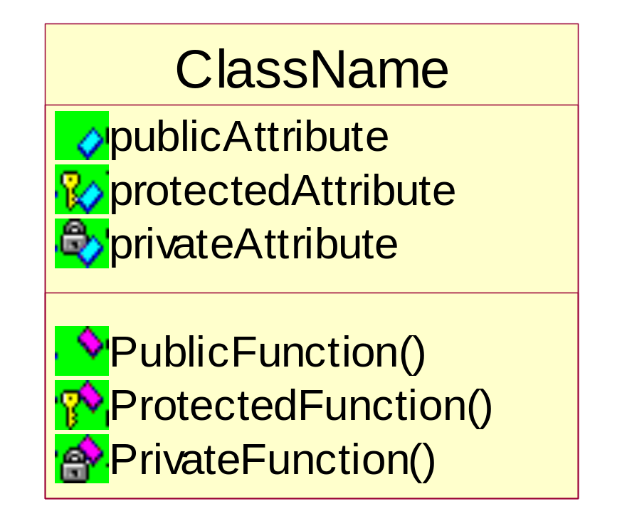
UML Notation of Visibility
Visibility of an attribute/function can be public, protected, or private
ClassName
+ publicAttribute
# protectedAttribute
- privateAttribute
or
+ PublicFunction
# ProtectedFunction
- PrivateFunction

Slide 21
Types of inheritance (in C++)
There are 3 types of inheritance in C++:
public inheritance
protected
private
Notes: from now on, if there is no mention of what type of inheritance, it means public inheritance

Slide 22
Types of inheritance (in C++)
public: public and protected of the base class become public and protected of the derived class.
protected: public and protected of the base class become protected of the derived class.
private: public and protected of the base class become private of the derived class.

Slide 23

Types of inheritance (in C++)
class B: public A
A
B
Public
attributes/functions
Public
attributes/functions
Protected
attributes/functions
Protected
attributes/functions
Private
attributes/functions
X
Private
attributes/functions

Slide 24
Types of inheritance (in C++)
class B: protected A
A
B
Public
attributes/functions
Public
attributes/functions
Protected
attributes/functions
Protected
attributes/functions
Private
attributes/functions
X
Private
attributes/functions

Slide 25
Types of inheritance (in C++)
class B: private A
A
B
Public
attributes/functions
Public
attributes/functions
Protected
attributes/functions
Protected
attributes/functions
Private
attributes/functions
X
Private
attributes/functions

Slide 26
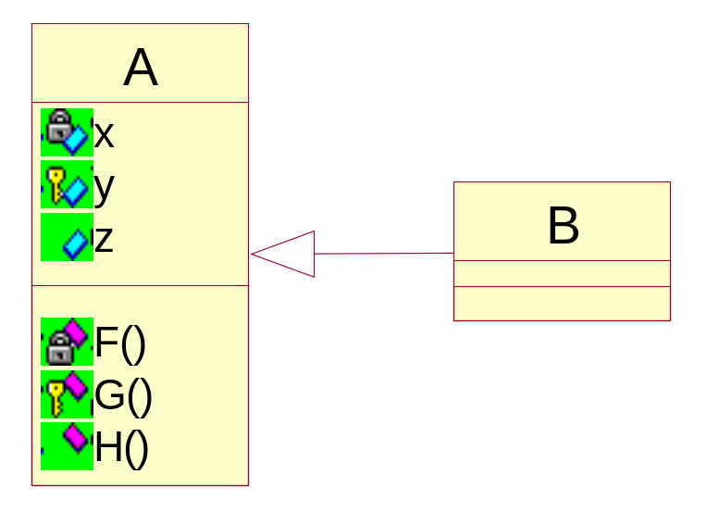
Types of inheritance (in C++)
Class B has:
  Attribute y (protected)
  Attribute z (public)
  Function G (protected)
  Function H (public)
Type of inheritance: public

Slide 27
Types of inheritance (in C++)
Class B has:
  Attribute y (protected)
  Attribute z (protected)
  Function G (protected)
  Function H (protected)
Type of inheritance: protected

Slide 28
Types of inheritance (in C++)
Class B has:
  Attribute y (private)
  Attribute z (private)
  Function G (private)
  Function H (private)
Type of inheritance: private

Slide 29
Inheritance: member functions
Member functions of the base class are inherited in the derived class, except:
  Constructors
  Destructors
  Assignment operators
Notes: private member functions of the base class are inherited but only accessible via other public/protected functions of A

Slide 30
Constructors in inheritance
When a new object of a derived class is created
  The constructor of the base class is invoked first.
  Then, the constructor of the derived class is invoked.
  In the constructor of the derived class, we can specify which constructor of the base class is called. Otherwise, the default constructor of the base class will be invoked.

Slide 31
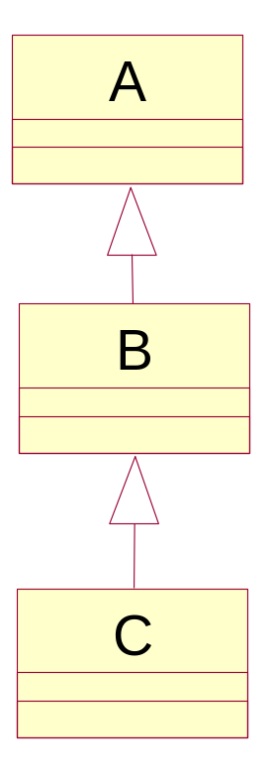
Constructors in inheritance
Notes:
The constructor of the derived class is able to specify the constructor of the immediate base class to be called.
X

Slide 32
An example
class A
{
public:
A();
A(int);
};
class B : public A
{
public:
B(int);
};
class A
{
public:
A();
A(int);
};
class B : public A
{
public:
B(int t) : A(t)
{ //...
}
};

Slide 33
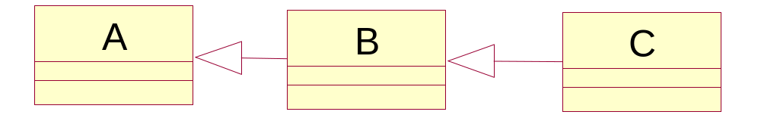
An example
A()
B()
C()
A(int)
B(int, int)
C(int)
B(int, int, char)
C(int, int)

Slide 34
An example
A()
B()
C()
A(int)
B(int, int)
C(int)
B(int, int, char)
C(int, int)
C myObj;
The constructor of A is invoked: A()
The constructor of B is invoked: B()
The constructor of C is invoked: C()

Slide 35
An example
A()
B()
C()
A(int)
B(int, int)
C(int)
B(int, int, char)
C(int, int)
C myObj(5, 7);
The constructor of A is invoked: A(int)
The constructor of B is invoked: B(int, int, char)
The constructor of C is invoked: C(int, int)

Slide 36
Destructor in inheritance
When an object of the derived class finishes its lifespan:
  The destructor of the derived class is invoked first.
  Then, the destructor of the base class is called later.
Example:
  when an object of C is destroyed, the following functions will be invoked: ~C() → ~B() → ~A()

Slide 37
“Re-define” member functions
Sometimes, we need to “re-define” the member functions of the base class in the derived class.
  It can be done by re-defining the functions inside the derived class
Notes: this re-definition will hide other overloading member functions of this function from the base class.

Slide 38
An example
class A {
public:
void test();
void test(int);
void test(int, int);
...
};
class B : public A
{
public:
void test(int);
};
int main()
{
B b;
int x, y;
...
b.test(x); // OK
b.test(x, y); //error
...
}
This function
will hide other overloading functions inherited from A

Slide 39
using keyword
class A {
public:
void test();
void test(int);
void test(int, int);
...
};
class B : public A
{
public:
using A::test;
void test(int);
};
int main()
{
B b;
int x, y;
...
b.test(x); // OK
b.test(x, y); //OK
...
}
B uses overloading functions inherited from A

Slide 40
Assignment operator
It is not inherited from the base class
To implement the assignment operator for the derived class:
  Calling the assignment operator of the base class to assign data members of the base class part in the two objects first.
  Then, implement the assignment for data member of the derived class part.

Slide 41
An example
B& B::operator=(const B& src)
{
if (this == &src)
return *this;
A::operator=(src);
delete [] ptr;
iSize = src.iSize;
ptr = new int [iSize];
for (int i=0; i<iSize; ++i)
ptr[i] = src.ptr[i];
return *this;
}

