Slide 1

Dr. Tran Minh Triet

Slide 2
Acknowledgement
Slides
  Course CS202: Programming Systems
  Instructor: MSc. Karla Fant,
  Portland State University
  Course CS202: Programming Systems
  Instructor: Dr. Dinh Ba Tien,
  University of Science, VNU-HCMC
  Course DEV275: Essentials of Visual Modeling with UML 2.0
  IBM Software Group

Slide 3
Outline
IS-A relationship
Initialization of a pointer to base class
Static binding
Typecasting of a pointer to an object
Virtual functions and polymorphism
Pure virtual functions
Abstract class

Slide 4
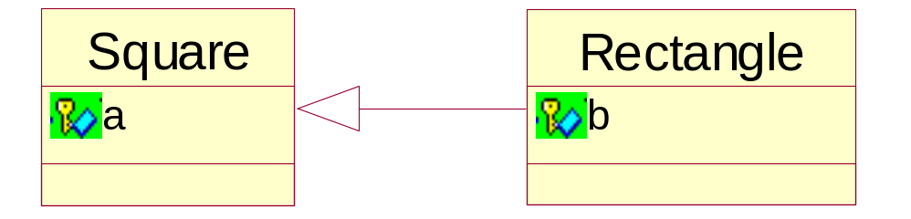
IS-A relationship
Do not implement inheritance when you only want to use some attributes or behaviors of an existing class.
The inheritance is only applied when there is a “IS-A” relationship between classes
  E.g. Dog is an animal. Or, employer is an employee.
Is it logical?

Slide 5
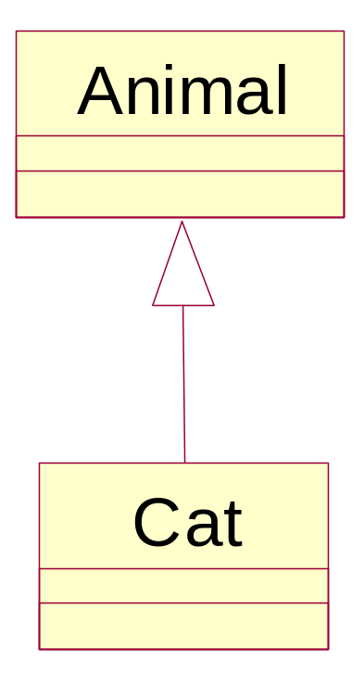
An example
Cat “is an” animal.
class Animal
{
...
};
class Cat: public Animal
{
...
};

Slide 6
A pointer to base class
A pointer to base class can be assigned with the address of an object of the derived class.
For example:
Animal *pAni;
Cat c;
pAni = &c; //OK

Slide 7
Implicit type conversion in inheritance
It is normal to pass a derived class variable to a function with an argument of base class data type.
The compiler will do an implicit conversion.
Animal::Process(const Animal &a);
int main()
{
Cat c;
Animal::Process(c); //OK
}

Slide 8
Initialization of a pointer to base class
A* pA;
pA can be instantiated:
pA = new X(…);
where X is A or X is a class derived from A

Slide 9
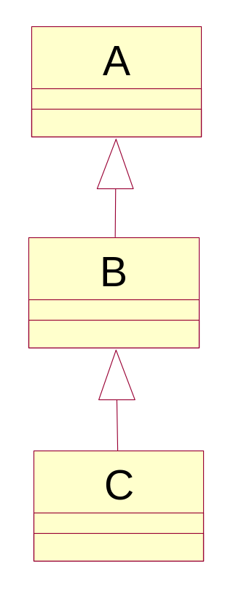

Initialization of a pointer to base class
A* pA;
pA = new A(…);
pA = new B(…);
pA = new C(…);

Slide 10

Initialization of a pointer to base class
B* pB;
pB = new A(…);
pB = new B(…);
pB = new C(…);

Slide 11
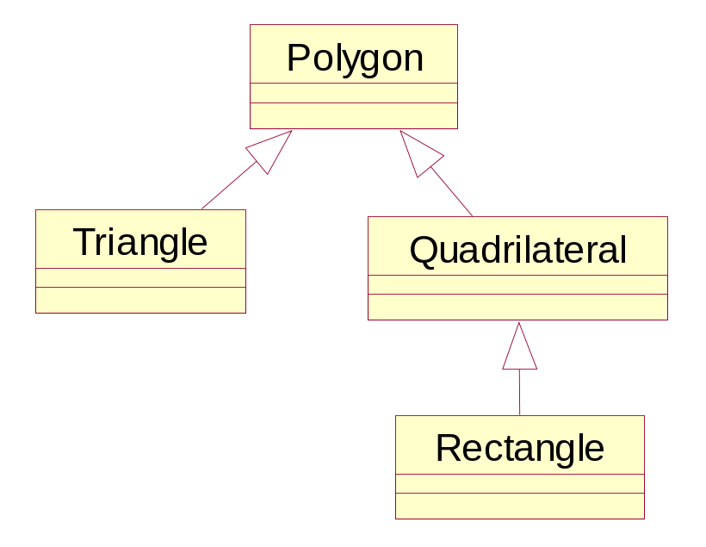

Initialization of a pointer to base class
You are requested to create a polygon
CPolygon* pShape;
You can draw a triangle
pShape = new Triangle(…);
or a quadrilateral
pShape = new Quadrilateral(…);
or a rectangle
pShape = new Rectangle(…);

Slide 12
Initialization of a pointer to base class
You are requested to create a quadrilateral
CQuadrilateral* pShape;
You can draw a rectangle
pShape = new Rectangle(…);
or a quadrilateral
pShape = new Quadrilateral(…);
You cannot draw a triangle
pShape = new Triangle(…);
You cannot draw a general polygon (e.g. pentagon)
pShape = new Polygon(…);

Slide 13
Static binding
Consider the following situation:
class A has void Print()
class B also has void Print()
class C has void Print() too
int main() {
C varC;
B varB;
varB.Print();
varC.Print();
varC.B::Print();
}
// Print() of B
// Print() of C
// Print() of B

Slide 14
Static binding
Another example:
int main()
{
A varA;
B varB;
C varC;
A *var1, *var2;
var1 = &varC;
var2 = &varB;
var1->Print();
var2->Print();
}
var1 is formally a pointer to class A
// Print() of A
// Print() of A
var1 is actually pointed to an object of class C

Slide 15
Typecasting of pointer to an object
Formally, pA is a pointer to an object of class A
A* pA;
Actually, pA is currently pointer to an object of
class X
pA = new X(…);
pA can be typecasted to a pointer to an object
of class Y where Y is X or Y is a base class of X
Y* pY;
pY = (Y*)pA;

Slide 16
Typecasting of pointer to an object
pShape is formally a pointer to a quadrilateral
CQuadrilateral* pShape;
Actually, pShape is a pointer to a rectangle
pShape = new Rectangle(…);

Slide 17
Typecasting of pointer to an object
pShape is currently pointed to a polygon
Polygon* p = (Polygon*)pShape;
pShape is currently pointed to a rectangle
Rectangle* p = (Rectangle *)pShape;

Slide 18
Typecasting of pointer to an object
We no longer need this object
delete pShape;
Now, pShape is re-instantiated as a pointer to a quadrilateral
pShape = new Quadrilateral(…);

Slide 19
Typecasting of pointer to an object
pShape is currently pointed to a polygon
Polygon* p = (Polygon*)pShape;
We are not sure if pShape is currently pointed to a rectangle
Rectangle* p = (Rectangle *)pShape;

Slide 20
Method invocation
pA -> F(…);
F(…) must be a member function of the current formal type of pA
The actual behavior of F(…) should correspond to the actual type of pA

Slide 21
Method Invocation
class Polygon
{
public:
double Surface();
double Draw();
}
class Triangle:
public Polygon
{
public:
double Surface();
double Draw();
}
class Quadrilateral :
public Polygon
{
public:
double Surface();
double Draw();
}
class Rectangle:
public Quadrilateral
{
public:
double Surface();
double Draw();
}

Slide 22
Method Invocation
Polygon myPolygon;
myPolygon.Draw();
Triangle myTriangle;
myTriangle.Draw();
Polygon* pPolygon;
pPolygon = new Triangle(…);
pPolygon->Draw();

Slide 23
Method Invocation
Quadrilateral* pPolygon;
pPolygon = new Rectangle(…);
pPolygon->Draw();
…
// IN CLASS DEMO

Slide 24
Virtual Method Invocation
class Polygon
{
public:
virtual double Surface();
virtual double Draw();
}
class Triangle:
public Polygon
{
public:
virtual double Surface();
virtual double Draw();
}
class Quadrilateral :
public Polygon
{
public:
virtual double Surface();
virtual double Draw();
}
class Rectangle:
public Quadrilateral
{
public:
virtual double Surface();
virtual double Draw();
}

