Slide 1
ITEC 2140 - Brannock
I HEAR AND I FORGET
I SEE AND I REMEMBER
I DO AND I UNDERSTAND
Confucius

Slide 2
The Java Programming Language
Simple
Safe
Platform-independent (“write once, run anywhere”) - java compiles to byte code
JVM – Java Virtual Machine – one for each platform -
Rich library - API
English “like” (Human readable) – Compiler converts this to something the CPU will understand

Slide 3
ch01/hello/HelloPrinter.java – Our first program
1 public class HelloPrinter
2 {
3 public static void main(String[] args)
4 {
5 // Display a greeting in the console window
6
7 System.out.println("Hello, World!");
8 }
9 }
Program Run:
Hello, World!

Slide 4
The Structure of a Simple Program: Class Declaration
Classes are the fundamental building blocks of Java programs:
public class HelloPrinter
starts a new class
Every source file can contain at most one public class
The name of the public class must match the name of the file containing the class:
Class HelloPrinter must be contained in a file named HelloPrinter.java

Slide 5
The Structure of a Simple Program: main Method
Every Java application contains a class with a main method
When the application starts, the instructions in the main method are executed
public static void main(String[] args)
{
. . .
}
declares a main method
Memorize this!!!!!

Slide 6
The Structure of a Simple Program: Comments
The first line inside the main method is a comment:
// Display a greeting in the console window
Compiler ignores any text enclosed between // and end of the line
Use comments to help human readers understand your program
What if we remove the // at the beginning of a line?
Another way to comment
/* Display a greeting in the console window
This is a multiline comment */

Slide 7
The Structure of a Simple Program: Statements
The body of the main method contains statements inside the curly brackets ({})
Each statement ends in a semicolon (;)
Statements are executed one by one
Our method has a single statement:
System.out.println("Hello, World!");
which prints a line of text:
Hello, World

Slide 8

The Structure of a Simple Program: Method Call
System.out.println("Hello, World!");
is a method call
A method call requires:
The object that you want to use (in this case, System.out)
The name of the method you want to use (in this case, println)
Parameters enclosed in parentheses (()) containing any other information the method needs (in this case, "Hello, World!")

Slide 9
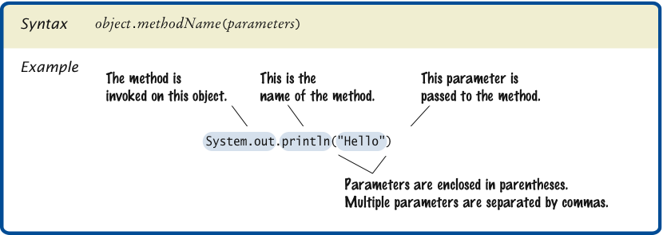
Syntax 1.1 Method Call

Slide 10
Typing (Editing), Compiling and Running a Java Program
Use an IDE (Integrated Development Environment) that contains an editor to enter and modify the program text
Java is case-sensitive
Be careful to distinguish between upper- and lowercase letters
Lay out your programs so that they are easy to read
The Java compiler translates source code into class files that contain instructions for the Java virtual machine
A class file has extension .class
The compiler does not produce a class file if it has found errors in your program
The Java virtual machine loads instructions from the program's class file, starts the program, and loads the necessary library files as they are required

Slide 11
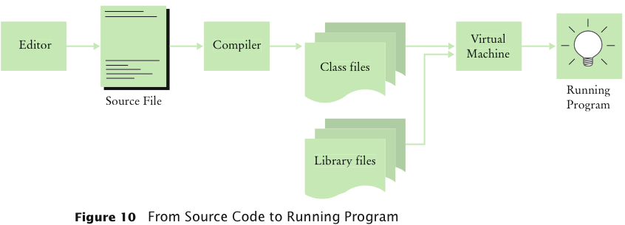
From Source Code to Running Program

Slide 12
Errors
Compile-time error: A violation of the programming language rules that is detected by the compiler (syntax error)
System.ou.println("Hello, World!);
Run-time error: Causes the program to take an action that the programmer did not intend (logic error)
System.out.println("Hello, Word!"); System.out.println(1/0);
Error Management
Learn about common errors and how to avoid them
Use defensive programming strategies to minimize the likelihood and impact of errors
Apply testing and debugging strategies to flush out those errors that remain

Slide 13
Algorithms
Algorithm: A sequence of steps
Algorithm for deciding which car to buy, based on total costs:
For each car, compute the total cost as follows:
annual fuel consumed = annual miles driven / fuel efficiency
annual fuel cost = price per gallon x annual fuel consumed
operating cost = 10 x annual fuel cost
total cost = purchase price + operating cost
If total cost1 < total cost2
Choose car1
Else
Choose car2
Pseudocode: An informal description of an algorithm:

Slide 14
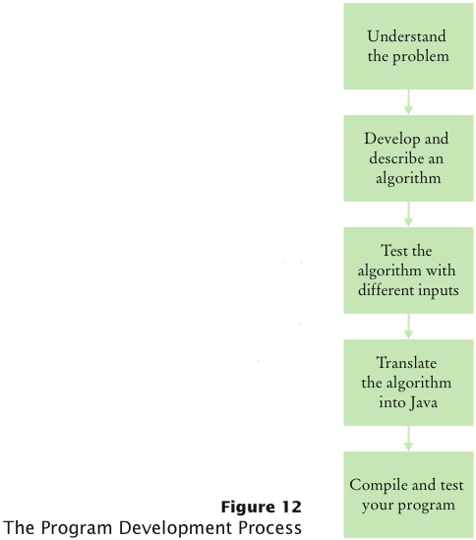
Program Development Process

Slide 15
Self Check
Investment Problem: You put $10,000 into a bank account that earns 5 percent interest per year. How many years does it take for the account balance to be double the original?
Algorithm:
Start with a year value of 0 and a balance of $10,000.
Repeat the following steps while the balance is less than $20,000.
Add 1 to the year value.
Multiply the balance value by 1.05 (a 5 percent increase).
Suppose the interest rate was 20 percent. How long would it take for the investment to double?
Answer: 4 years:
0 10,000
1 12,000
2 14,400
3 17,280
4 20,736

Slide 16
Self Check
Suppose your cell phone carrier charges you $29.95 for up to 300 minutes of calls, and $0.45 for each additional minute, plus 12.5 percent taxes and fees. Give an algorithm to compute the monthly charge for a given number of minutes.
Answer:
Is the number of minutes at most 300?
If so, the answer is $29.95 × 1.125 = $33.70.
If not,
Compute the difference: (number of minutes) – 300.
Multiply that difference by 0.45.
Add $29.95.
Multiply the total by 1.125. That is the answer.

