Slide 1
Types
A type defines a set of values and the operations that can be carried out on the values
Examples:
13 has type int
"Hello, World" has type String
System.out has type PrintStream
Java has separate types for integers and floating-point numbers
The double type denotes floating-point numbers
A value such as 13 or 1.3 that occurs in a Java program is called a number literal
Number types are primitive types
Numbers are not objects
Numbers can be combined by arithmetic operators such as +, -, and *

Slide 2
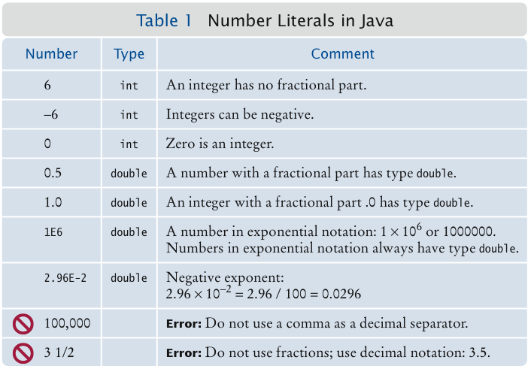
Number Literals

Slide 3
Self Check
What is the type of the values 0 and "0"?
Which number type would you use for storing the area of a circle?
Why is the expression 13.println() an error?
Write an expression to compute the average of the values x and y.

Slide 4
Variables
Use a variable to store a value that you want to use at a later time
A variable has a type, a name, and a value:
String greeting = "Hello, World!”
PrintStream printer = System.out;
int width = 13;
Variables can be used in place of the values that they store:
printer.println(greeting);
// Same as System.out.println("Hello, World!”)
printer.println(width);
// Same asSystem.out.println(20)
It is an error to store a value whose type does not match the type of the variable:
String greeting = 20; // ERROR: Types don’t match

Slide 5
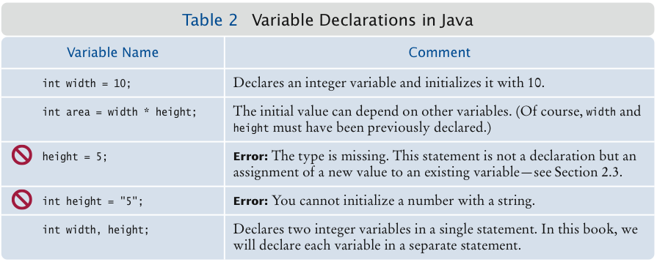
Variable Declarations

Slide 6
Identifiers
Identifier: name of a variable, method, or class
Rules for identifiers in Java:
Can be made up of letters, digits, and the underscore (_) and dollar sign ($) characters
Cannot start with a digit
Cannot use other symbols such as ? or %
Spaces are not permitted inside identifiers
You cannot use reserved words such as public
They are case sensitive
By convention, variable names start with a lowercase letter
“Camel case”: Capitalize the first letter of a word in a compound word such as farewellMessage
By convention, class names start with an uppercase letter

Slide 7
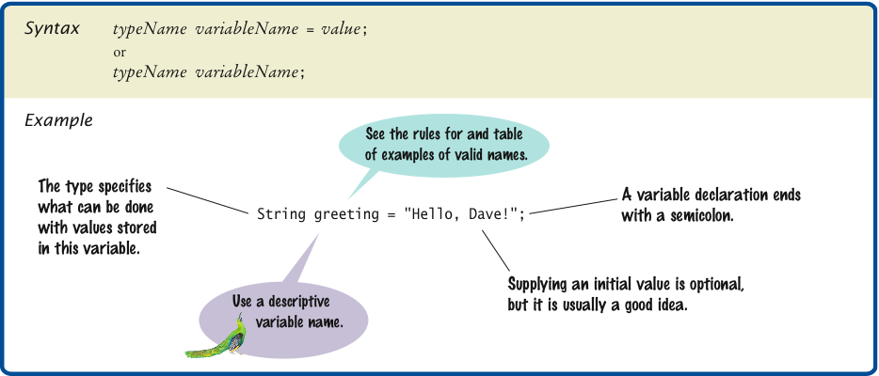
Syntax 2.1 Variable Declaration

Slide 8
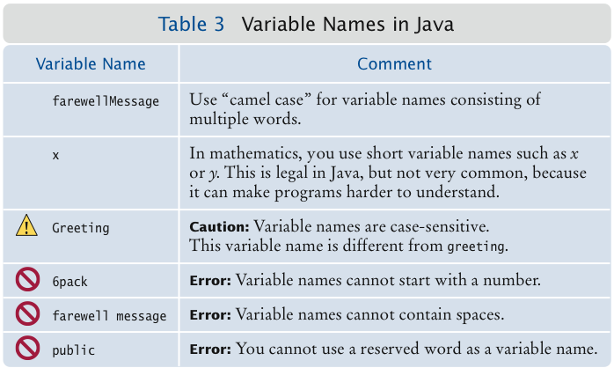
Variable Names

Slide 9
Self Check
Which of the following are legal identifiers?
Greeting1
g
void
101dalmatians
Hello, World
<greeting>
Answer: Only the first two are legal identifiers
Define a variable to hold your name. Use camel case in the variable name.

Slide 10
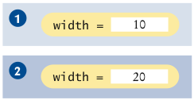

The Assignment Operator
Assignment operator: =
Used to change the value of a variable:
int width= 10;
width = 20;

Slide 11

Uninitialized Variables
It is an error to use a variable that has never had a value assigned to it:
int height;
width = height; // ERROR—uninitialized variable height
Remedy: assign a value to the variable before you use it:
int height = 30;
width = height; // OK
Even better, initialize the variable when you declare it:
int height = 30;
int width = height; // OK

Slide 12
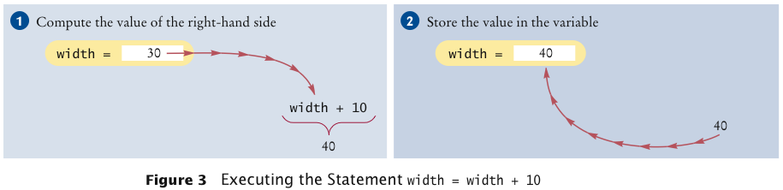
Assignment
The right-hand side of the = symbol can be a mathematical expression:
width = width + 10;
Means:
compute the value of width + 10
store that value in the variable width
Is 12 = 12 a valid expression in the Java language?
How do you change the value of the greeting variable to
"Hello, Nina!"?

Slide 13
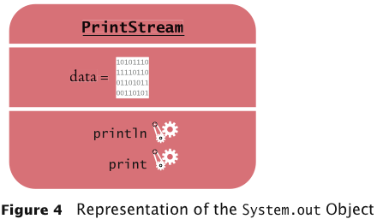
Objects and Classes
Object: entity that you can manipulate in your programs (by calling methods)
Each object belongs to a class
Example: System.out belongs to the class PrintStream

Slide 14
Methods
Method: sequence of instructions that accesses the data of an object
You manipulate objects by calling its methods
Class: declares the methods that you can apply to its objects
Class determines legal methods:
String greeting = "Hello";
greeting.println() // Error
greeting.length() // OK
Public Interface: specifies what you can do with the objects of a class

Slide 15
String Methods
length: counts the number of characters in a string:
String greeting = "Hello, World!";
int n = greeting.length(); // sets n to 13
toUpperCase: creates another String object that contains the characters of the original string, with lowercase letters converted to uppercase:
String river = "Mississippi";
String bigRiver = river.toUpperCase();
// sets bigRiver to "MISSISSIPPI"
When applying a method to an object, make sure method is defined in the appropriate class:
System.out.length(); // This method call is an error

Slide 16
Self Check
How can you compute the length of the string "Mississippi"?
How can you print out the uppercase version of
"Hello, World!"?
Is it legal to call river.println()? Why or why not?

Slide 17
Parameters
Parameter: an input to a method
Implicit parameter: the object on which a method is invoked (in front of the dot):
System.out.println(greeting)
Explicit parameters: all parameters except the implicit parameter (inside of the parenthesis):
System.out.println(greeting)
Not all methods have explicit parameters:
greeting.length() /* has no explicit parameter – nothing in the parenthesis */

Slide 18
Return Values
Return value: a result that the method has computed for use by the code that called it:
int n = greeting.length(); // return value stored in n
//an int
You can also use the return value as a parameter of another method:
System.out.println(greeting.length());
Method call has
String river = "Mississippi";
String bigRiver = river.replace(“issipp”, “our”);
// sets bigRiver to “Missouri"
one implicit parameter: the string "Mississippi"
two explicit parameters: the strings "issipp" and "our"
a return value: the string "Missouri"

Slide 19
Self Check
What are the implicit parameters, explicit parameters, and return values in the method call river.length()? (String river = “Mississippi”; )
What is the result of the call river.replace("p", "s")?
What is the result of the call greeting.replace(“Hello", “Brannock").length()? (String greeting = “Hello”;)
How is the toUpperCase method defined in the String class?

Slide 20
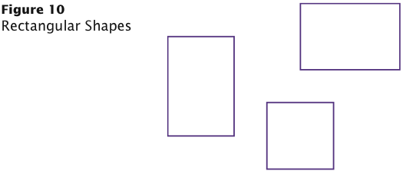
Rectangular Shapes and Rectangle Objects
Objects of type Rectangle describe rectangular shapes:

Slide 21
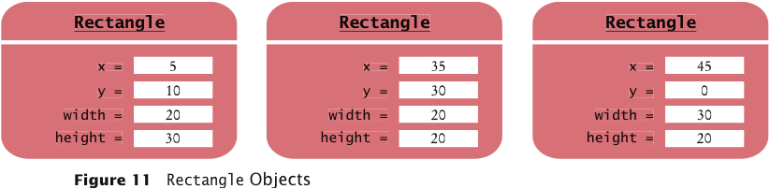
Rectangular Shapes and Rectangle Objects
A Rectangle object isn’t a rectangular shape – it is an object that contains a set of numbers that describe the rectangle:
Constructing an object
new Rectangle(5, 10, 20, 30)
Detail:
The new operator makes a Rectangle object
It uses the parameters (in this case, 5, 10, 20, and 30) to initialize the data of the object
It returns the object
Usually the output of the new operator is stored in a variable:
Rectangle box = new Rectangle(5, 10, 20, 30);

Slide 22
Constructing Objects
Construction: the process of creating a new object
The four values 5, 10, 20, and 30 are called the construction parameters
Some classes let you construct objects in multiple ways:
new Rectangle()
// constructs a rectangle with its top-left corner
// at the origin (0, 0), width 0, and height 0

Slide 23
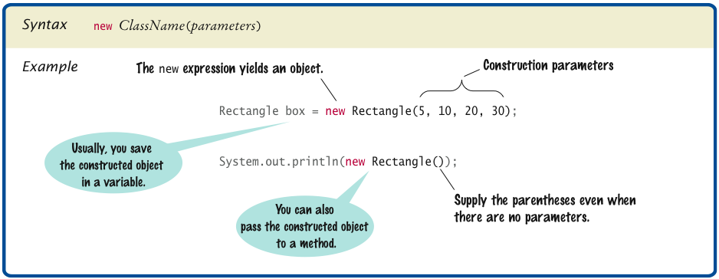
Syntax 2.3 Object Construction

Slide 24
Self Check
How do you construct a square with center (100, 100) and side length 20?
Answer:
new Rectangle(90, 90, 20, 20)
The getWidth method returns the width of a Rectangle object. What does the following statement print?

Slide 25
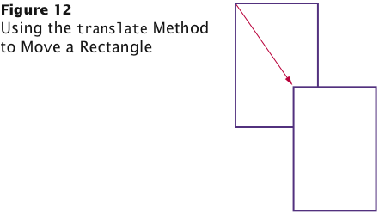
Accessor and Mutator Methods
Accessor method: does not change the state of its implicit parameter:
double width = box.getWidth();
Mutator method: changes the state of its implicit parameter:
box.translate(15, 25);

Slide 26
Self Check
Is the toUpperCase method of the String class an accessor or a mutator?

Slide 27
The API Documentation
API: Application Programming Interface
API documentation: lists classes and methods in the Java library
http://java.sun.com/javase/7/docs/api/index.html

Slide 28
Packages
Package: a collection of classes with a related purpose
Import library classes by specifying the package and class name:
import java.awt.Rectangle;
You don’t need to import classes in the java.lang package such as String and System

Slide 29
Self Check
Look at the API documentation of the String class. Which method would you use to obtain the string "hello, world!" from the string "Hello, World!"?
In the API documentation of the String class, look at the description of the trim method. What is the result of applying trim to the string " Hello, Space ! "? (Note the spaces in the string.)
The Random class is defined in the java.util package. What do you need to do in order to use that class in your program?

Slide 30
Implementing a Test Program
Provide a tester class.
Supply a main method.
Inside the main method, construct one or more objects.
Apply methods to the objects.
Display the results of the method calls.
Display the values that you expect to get.

