Slide 1
Decisions
Big Java by Cay Horstmann
Copyright © 2009 by John Wiley & Sons. All rights reserved.

Slide 2
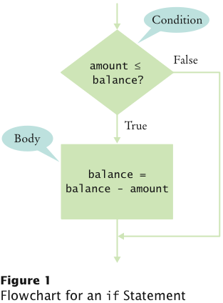
The if Statement
The if statement lets a program carry out different actions depending on a condition
if (amount <= balance)
{
balance = balance – amount;
System.out.println("Here! Money");
}

Slide 3
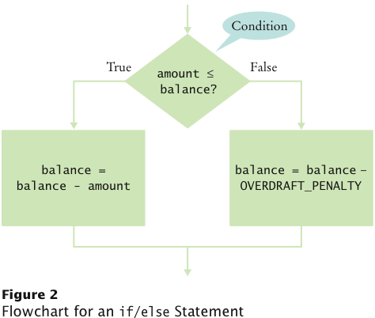
The if/else Statement
if (amount <= balance)
{
balance = balance – amount;
}
else
{
balance = balance – amount;
balance = balance – OVERDRAFT_PENALTY;
}

Slide 4
Statement Types
Simple statement:
balance = balance - amount;
Compound statement:
if (balance >= amount) balance = balance - amount;
Block statement:
{
double newBalance = balance - amount;
balance = newBalance;
}
What is logically wrong with the statement
if (amount <= balance)
newBalance = balance - amount; balance = newBalance;
and how do you fix it?

Slide 5
Comparing Values: Relational Operators
The == denotes equality testing:
a = 5; // Assign 5 to a
if (a == 5) ... // Test whether a equals 5
Relational operators have lower precedence than arithmetic operators:
amount + fee <= balance

Slide 6
Comparing Strings
To test whether two strings are equal to each other, use equals method:
if (string1.equals(string2)) . . .
Don’t use == for strings!
if (string1 == string2) // Not useful
== tests identity, equals tests equal contents
Case insensitive test:
if (string1.equalsIgnoreCase(string2))

Slide 7
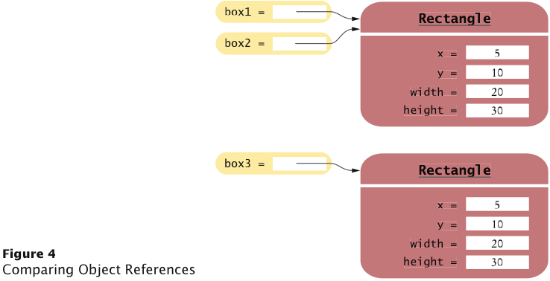
Comparing Objects
== tests for identity, equals for identical content
Rectangle box1 = new Rectangle(5, 10, 20, 30);
Rectangle box2 = box1;
Rectangle box3 = new Rectangle(5, 10, 20, 30);
box1 != box3, but box1.equals(box3)
What is the difference?

Slide 8
Testing for null
null reference refers to no object: String middleInitial = null; // Not set if ( ... ) middleInitial = middleName.substring(0, 1);
Can be used in tests: if (middleInitial == null) System.out.println(firstName + " " + lastName); else System.out.println(firstName + " " + middleInitial + ". " + lastName);
Use ==, not equals, to test for null
null is not the same as the empty string ""

Slide 9
Self Check
What is the value of s.length() if s is
the empty string ""?
the string " " containing a space?
null?
Answer: (c) an exception occurs.

Slide 10
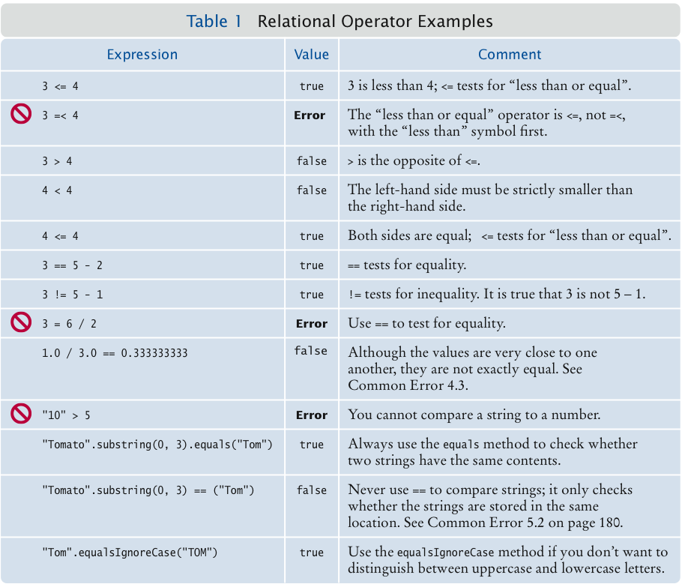
Relational Operator Examples

Slide 11
Multiple Alternatives: Sequences of Comparisons
if (condition₁)
{
statement₁; ...
}
else if (condition₂)
{
statement₂; ...
...
}
else
{
statement₄; ...
}
The first matching condition is executed
Order matters:
if (richter >= 0) // always passes
r = "Generally not felt by people";
else if (richter >= 3.5) // not tested
r = "Felt by many people, no destruction";
...

Slide 12
The Same? Order is Important
if (richter >= 0) // always passes​
{
r = "Generally not felt by people";
}​
else if (richter >= 3.5) // not tested​
{
r = "Felt by many people, no destruction";​
}
if (richter >= 3.5)
{
r = "Felt by many people, no destruction";
}
else if (richter >= 0)
{
r = "Generally not felt by people";
}

Slide 13
Multiple Alternatives: Sequences of Comparisons
Don’t omit else:
if (richter >= 8.0)
r = "Most structures fall";
if (richter >= 7.0) // omitted else--ERROR
r = "Many buildings destroyed";
richter = 9, mbd
if (richter >= 8.0)​
r = "Most structures fall";​
else if (richter >= 7.0)
r = "Many buildings destroyed";​
richter = 9, msf

Slide 14
Multiple Alternatives: Nested Branches
Branch inside another branch:
if (condition₁)
{
if (condition_{1a})
statement_{1a};
else
statement_{1b};
}
else
statement₂;

Slide 15
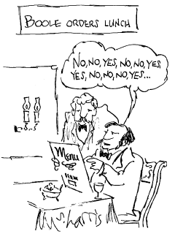
Using Boolean Expressions: The boolean Type
value of expression amount < 1000 is true or false
boolean type: one of these 2 truth values

Slide 16
Using Boolean Expressions
Method that returns a boolean value:
public boolean isOverdrawn()
{
return balance < 0;
}
Use in conditions:
if (harrysChecking.isOverdrawn())
Useful methods in Character class that return a boolean:
isDigit
isLetter
isUpperCase
isLowerCase

Slide 17
Using Boolean Expressions
if (Character.isUpperCase('ch')) ...
Useful methods in Scanner class that return boolean value: hasNextInt() and hasNextDouble():
if (in.hasNextInt()) n = in.nextInt();

Slide 18
Using Boolean Expressions: The Boolean (Logical) Operators
&& and
|| or
! not
if (0 < amount && amount < 1000) . . .
if (input.equals("S") || input.equals("M")) . . .
if (!(input.equals("S"))) input = "S" --> F
input = "3" -->"3" equal "S" --> !F --> T
Does int equal to "S" -> F
!F --> T

Slide 19
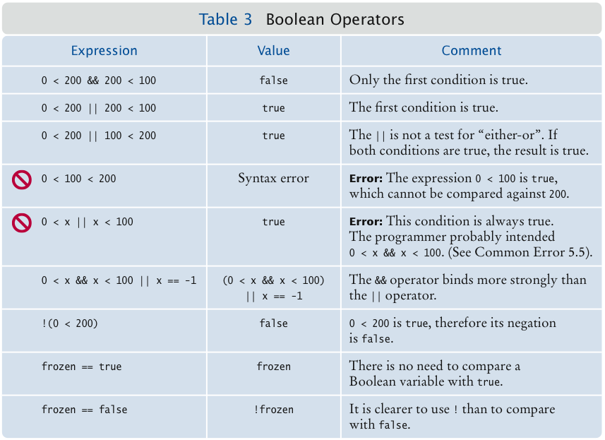
Boolean (Logical) Operators

Slide 20
Using Boolean Variables
private boolean isMarried;
Set to truth value:
isMarried = input.equals("M");
Use in conditions:
if (isMarried) ... else ...
if (!isMarried) ...
Also called flag
It is considered gauche to write a test such as
if (isMarried == true) ... // Don't
Just use the simpler test
if (isMarried) ...

Slide 21
Self Check 5.7
When does the statement
System.out.println (x > 0 || x < 0);
print false?
Rewrite the following expression, avoiding the comparison with false:
if (Character.isDigit(ch) == false) …
if (!Character.isDigit(ch))

