Slide 1
Methods and coding bats

Slide 2
The Java Library
As previously discussed, the Java API (library) consists of a series of classes
Each class contains subunits called methods
In other languages methods are sometimes called functions.
We call methods in the library to enhance our program.

Slide 3
Example
System.out is a class instance provided by the Java runtime environment
We often call the methods, print, println and printf that are part of this class
System.out.println(“Hello, World!”) is an example of calling a method on another class.

Slide 4
Scanner
Scanner is another class in the Java library.
Unlike System.out- it is not an instance of the class so we have to declare an instance of it in our program like so:
Scanner newInstance = new Scanner(System.in);
Once we do that – we can call its methods

Slide 5
Methods called in Scanner
We call them using the instance name rather than the class name
newInstance.nextLine()
newInstance.nextInt()

Slide 6
Creating our own methods
static public void main(String[] args) is a method required by ALL java programs
So far, we have only written programs that are entirely inside the main method

Slide 7
Defining Methods
A method is a collection of statements that are grouped together to perform an operation.

Slide 8
Method Signature/Declaration
Method signature is the combination of the method name and the parameter list.

Slide 9
Return Value Type
A method may return a value. The returnValueType is the data type of the value the method returns. If the method does not return a value, the returnValueType is the keyword void. For example, the returnValueType in the main method is void.

Slide 10
Solving codingbat problems
Our next lab will use the website codingbat.com
You will create an account and share your results with me
Codingbat has you create methods to solve increasing complex problems.

Slide 11
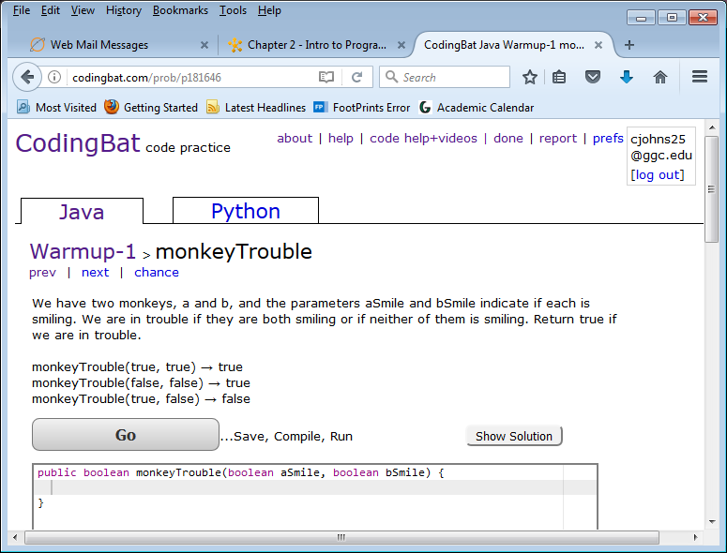
What a codingbat problem looks like

Slide 12
Problem description
We have two monkeys, a and b, and the parameters aSmile and bSmile indicate if each is smiling. We are in trouble if they are both smiling or if neither of them is smiling. Return true if we are in trouble.

Slide 13
Method header
public boolean monkeyTrouble(boolean aSmile, boolean bSmile) { }
This tells us we have two variables to work with aSmile which is of type boolean and bSmile which is also of type Boolean
Boolean types can be either true or false
It also tells us we must return a Boolean value

Slide 14
What do you do?
Write code between the curly braces that uses the parameters in the method header (aSmile and bSmile) to calculate a Boolean value
Return the Boolean value

