Slide 1
Chapter 5 Loops

Slide 2
THINK!!
Suppose that you need to print a string (e.g., "Welcome to Java!") a hundred times. It would be tedious to have to write the following statement a hundred times:
System.out.println("Welcome to Java!");
So, let’s make this easier!!

Slide 3
Three Kinds of Loops
while
for
do-while

Slide 4
Introducing while Loops
int count = 0;
while (count < 100) {
System.out.println("Welcome to Java");
count++;
}

Slide 5
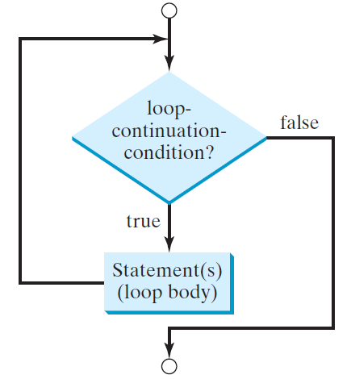
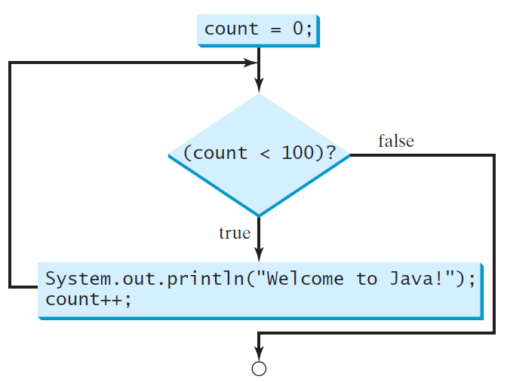
while Loop Flow Chart
int count = 0;
while (count < 100) {
System.out.println("Welcome to Java!");
count++;
}
while (loop-continuation-condition) {
// loop-body;
Statement(s);
}

Slide 6
while Loops (cont)
int count = 0;
while (count < 100) {
System.out.println("Welcome to Java");
count++;
}
Need to initialize the count
Need to decide when to terminate the loop
Need to increment count!!! (what happens if we don’t?)
How many times does this loop SOP?

Slide 7
You write it: Guessing Numbers
Write a class named GuessNumberWhile that randomly generates an integer between 0 and 100, inclusive. The program prompts the user to enter a number continuously until the number matches the randomly generated number. Use the Random class to generate an integer. For each user input, the program tells the user whether the input is too low or too high, so the user can choose the next input intelligently.
Hint: import the Random class
Create a new instance of the Random class (Random ran = new Random();
int myRandomInt = ran.nextInt(101); //does this generate a number [0, 100]?
//See API

Slide 8
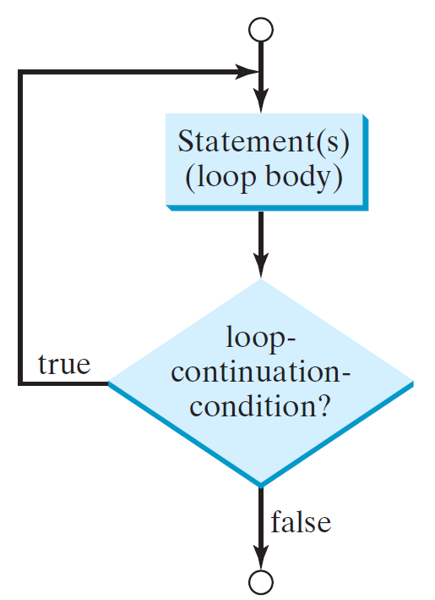
do-while Loop
do {
// Loop body;
Statement(s);
} while (loop-continuation-condition);

Slide 9
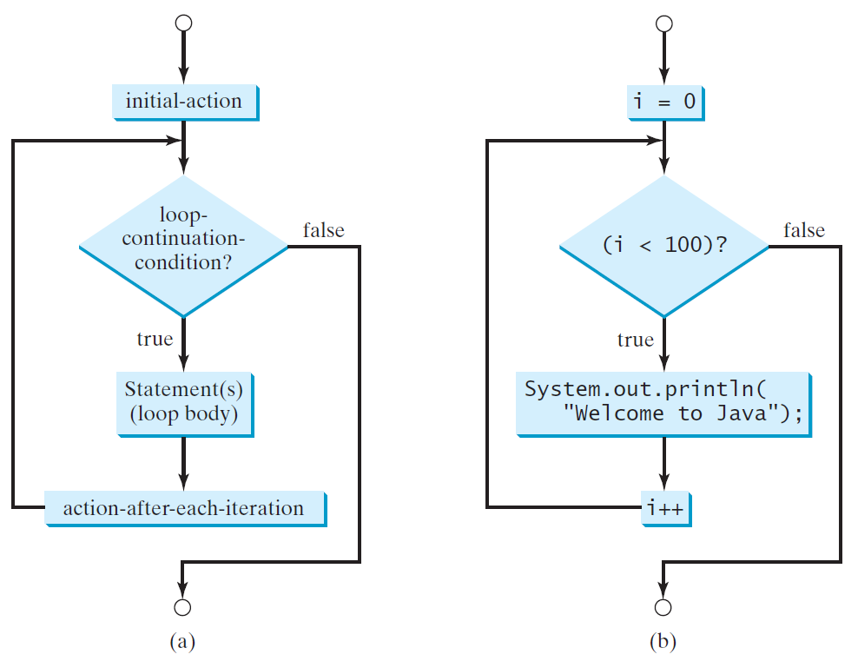
for Loops
for (initial-action; loop-continuation-condition; action-after-each-iteration) {
// loop body;
Statement(s);
}
int i;
for (i = 0; i < 100; i++) {
System.out.println(
"Welcome to Java!");
}

Slide 10
Write Your Class Using other Loop Types
GuessNumberWhile
GuessNumberFor
GuessNumberDoWhile

Slide 11
Loops
You have to know THREE major things in all loops:
When do I start the loop?
When do I end the loop?
How much do I increment or decrement?
What do I do in the loop? (The LOOP BODY)

Slide 12
When do I use what loop? Rules of thumb
for
Can happen no times
I have a definite ending, termination value
while
Can happen no times
I have an indefinite ending
do-while
Occurs at least ONCE

Slide 13
Which Loop to Use?
The three forms of loop statements, while, do-while, and for, are expressively equivalent; that is, you can write a loop in any of these three forms. For example, a while loop in (a) in the following figure can always be converted into the following for loop in (b):
A for loop in (a) in the following figure can generally be converted into the following while loop in (b) except in certain special cases (see Review Question 3.19 for one of them):

Slide 14
Caution
Adding a semicolon at the end of the for clause before the loop body is a common mistake, as shown below:
Logic Error
for (int i=0; i<10; i++);
{
System.out.println("i is " + i);
}

Slide 15
Caution, cont.
Similarly, the following loop is also wrong:
int i=0;
while (i < 10);
{
System.out.println("i is " + i);
i++;
}
In the case of the do loop, the following semicolon is needed to end the loop.
int i=0;
do {
System.out.println("i is " + i);
i++;
} while (i<10);
Logic Error
Correct

Slide 16
Recommendations
Use the one that is most intuitive and comfortable for you. In general, a for loop may be used if the number of repetitions is known, as, for example, when you need to print a message 100 times. A while loop may be used if the number of repetitions is not known, as in the case of reading the numbers until the input is 0. A do-while loop can be used to replace a while loop if the loop body has to be executed before testing the continuation condition.

Slide 17
Nested Loops
Problem: Write a program that uses nested for loops to print a multiplication table.

Slide 18
Problem: Predicting the Future Tuition
Problem: Suppose that the tuition for a university is $10,000 this year and tuition increases 7% every year. In how many years will the tuition be doubled?

Slide 19
Problem: Predicating the Future Tuition
double tuition = 10000; int year = 0 // Year 0
tuition = tuition * 1.07; year++; // Year 1
tuition = tuition * 1.07; year++; // Year 2
tuition = tuition * 1.07; year++; // Year 3
...

Slide 20
break

Slide 21
continue

Slide 22
Guessing Number Problem Revisited
Change the program for guessing a number. You can rewrite it using a break statement.

Slide 23
Problem: Displaying Prime Numbers
Problem: Write a program that displays the first 50 prime numbers in five lines, each of which contains 10 numbers. An integer greater than 1 is prime if its only positive divisor is 1 or itself. For example, 2, 3, 5, and 7 are prime numbers, but 4, 6, 8, and 9 are not.
Solution: The problem can be broken into the following tasks:
For number = 2, 3, 4, 5, 6, ..., test whether the number is prime.
Determine whether a given number is prime.
Count the prime numbers.
Print each prime number and print 10 numbers per line.

