Slide 1

Intermediate Programming
Chapter 8
Data Structures

Slide 2
Data Structure
A means to organize a collection of data
Not only stores the data
But also provides methods for accessing & manipulating the data

Slide 3
Why Data Structures
For a single or few data items, you can simply declare a variable & create an object to represent each item
Infeasible for a large collection, say of a million items
Representation & organization of data is crucial for the correctness & efficiency of your program

Slide 4
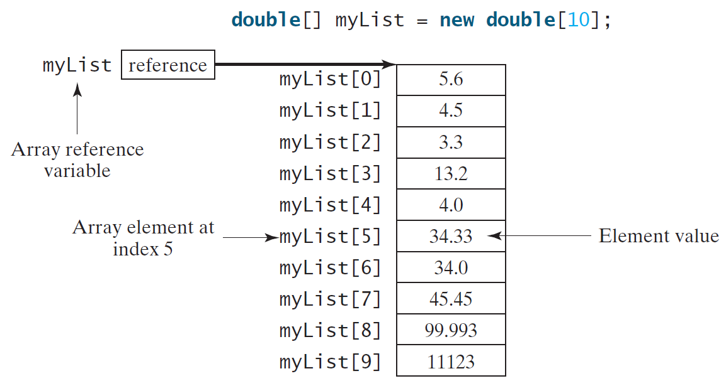
Array as a data structure
A sequence of contiguously located data of the same type

Slide 5
Drawback of arrays
An array is static – once created its length cannot be changed
Cannot add new elements to or remove existing elements from it
In most applications data needs to grow (and shrink)
Desire dynamic data structures that support efficient operations for insertion and deletion, among other important operations

Slide 6
Examples of Dynamic Data Structures
List
Stack
Queue
Priority Queue
Hash Map
Binary Search Tree (Tree Map)
…

Slide 7
Examples of Dynamic Data Structures
List
Stack
Queue
Priority Queue
Hash Map
Binary Search Tree (Tree Map)
…
This Course

Slide 8
Common Methods of Dynamic Data Structures
get (query)
set/put (update)
add/put (insert)
remove (delete)
contains
size
isEmpty
…

Slide 9
List

Slide 10
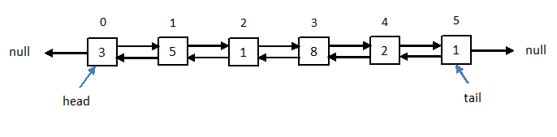
List
A sequentially ordered collection of (possibly duplicate) objects
Allows one to add new elements & remove existing elements
Adjacent elements may not reside in contiguous memory locations

Slide 11
Java List Interface
ArrayList
Iterable
Collection
List
LinkedList

Slide 12
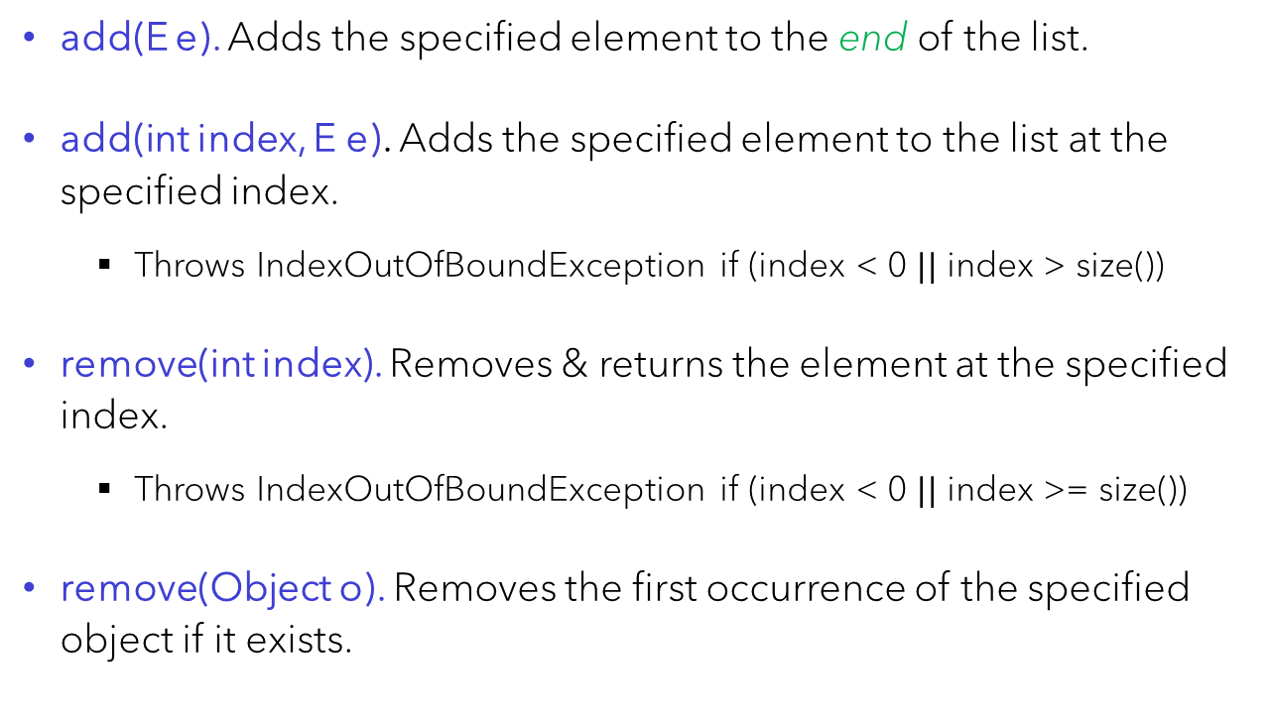
Methods of List<E>
add(E e). Adds the specified element to the end of the list.
add(int index, E e). Adds the specified element to the list at the specified index.
Throws IndexOutOfBoundException if (index < 0 $||$ index > size())
remove(int index). Removes & returns the element at the specified index.
Throws IndexOutOfBoundException if (index < 0 $||$ index >= size())
remove(Object o). Removes the first occurrence of the specified object if it exists.

Slide 13
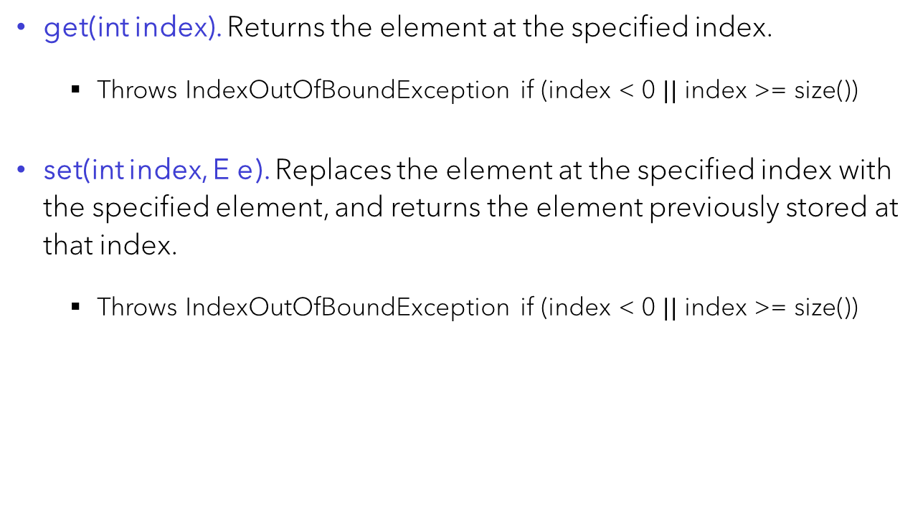
Methods of List<E>
get(int index). Returns the element at the specified index.
Throws IndexOutOfBoundException if (index < 0 $||$ index >= size())
set(int index, E e). Replaces the element at the specified index with the specified element, and returns the element previously stored at that index.
Throws IndexOutOfBoundException if (index < 0 $||$ index >= size())

Slide 14
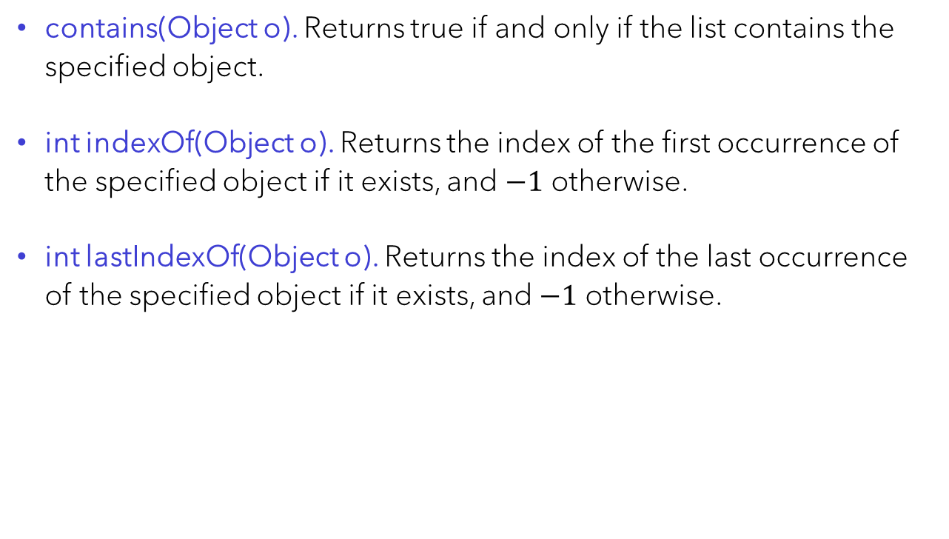
Methods of List<E>
contains(Object o). Returns true if and only if the list contains the specified object.
int indexOf(Object o). Returns the index of the first occurrence of the specified object if it exists, and $−1$ otherwise.
int lastIndexOf(Object o). Returns the index of the last occurrence of the specified object if it exists, and $−1$ otherwise.

Slide 15
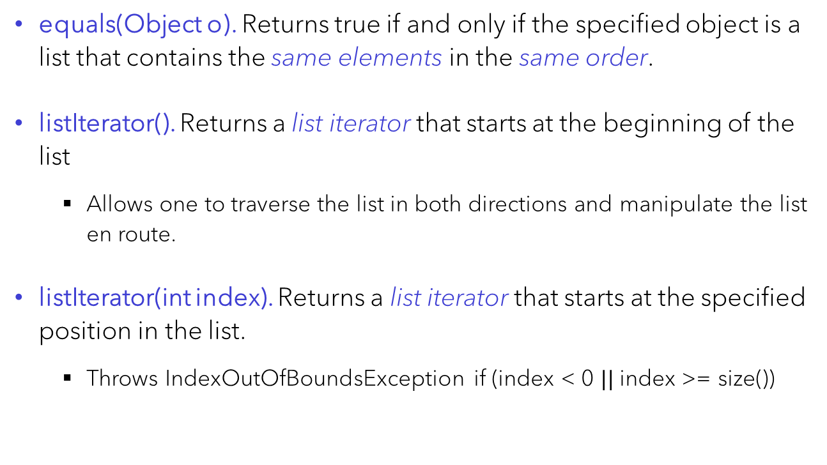
Methods of List<E>
equals(Object o). Returns true if and only if the specified object is a list that contains the same elements in the same order.
listIterator(). Returns a list iterator that starts at the beginning of the list
Allows one to traverse the list in both directions and manipulate the list en route.
listIterator(int index). Returns a list iterator that starts at the specified position in the list.
Throws IndexOutOfBoundsException if (index < 0 $||$ index >= size())

Slide 16
Methods of List<E>
size(). Returns the size of the list, i.e. # of elements in the list.
isEmpty(). Returns true if and only if the list is empty, i.e. size() == 0.
clear(). Clears the list.
Does NOT remove the elements of the list
Just creates a new empty list

Slide 17
Methods of List<E>
See here for all the methods of the List<E> interface as well as their detailed descriptions

Slide 18
Array List vs. Linked List
ArrayList
Iterable
Collection
List
LinkedList

Slide 19
Array List as a “resizable” array
The backing data structure is an array
When the array is full, a new array double the size is created as the backing array
Elements of the old array are copied into the new array
Resizing is expensive, but infrequent because the size doubles every time a larger array is needed

Slide 20
The ArrayList<E> Class
See here for details of the Java ArrayList<E> class

Slide 21
Linked List
Every list element, called a node, has
A data field
Two pointers – one to the previous & one to the next element
Pointers to the two ends of the list, called the head & the tail

Slide 22
Special LinkedList<E> Methods
It is easy to access and update both ends of a linked list
LinkedList<E> provides special methods involving just the head or tail of a linked list, in addition to the common methods of the List<E> interface

Slide 23
Special LinkedList<E> Methods
addFirst(E e). Adds the specified element to the head of the list.
addLast(E e). Adds the specified element to the tail of the list.
removeFirst(E e). Removes the node at the head & returns its data.
removeLast(E e). Removes the node at the tail & returns its data.
getFirst(). Returns the data at the head of the list.
getLast(). Returns the data at the tail of the list.

Slide 24
The LinkedList<E> Class
See here for details of the Java LinkedList<E> class

Slide 25
Traverse a list
Explicitly use a list iterator
See here for the Java ListIterator<E> interface
Use a foreach loop

Slide 26
Traverse a list
Explicitly use a list iterator
See here for the Java ListIterator<E> interface
Use a foreach loop if you only need to read from the list
Does not allow you to modify the list
Use indices and the get method

Slide 27
Traverse a list
Explicitly use a list iterator
See here for the Java ListIterator<E> interface
Use a foreach loop if you only need to read from the list
Does not allow you to modify the list
Use indices and the get method – Inefficient!
Unless the list is an array list
Should not be used if the list is a linked list or if the list type is unknown

Slide 28
Demonstrations
See ListDemo.java for a demonstration of basic list operations
See Sum.java for multiple ways to traverse a list
See RemoveOdds.java and AddAtIndex.java for an illustration of using a list iterator to add and remove elements

Slide 29
Notes on Efficiency – Array List vs. Linked List
Accessing elements by index is
Efficient for an array list – its backing data structure is an array
Inefficient for a linked list – requires searching the list for index
A linked list is more efficient for operations to the two ends, in particular the front
Adding to or removing from the front (i.e. index 0) of an array list is slow – it requires a shift of the entire list

Slide 30
Notes on Efficiency – Array List vs. Linked List
Both array lists and linked lists are inefficient for adding to or removing from a general position in the list
Both array lists and linked lists are inefficient for any method that requires a search of elements by value, e.g. contains(Object o), remove(Object o), indexOf(Object o)
In the worst case need to traverse the entire list
Lists are thus not ideal for apps that require a large number of search, update, insersion & deletion ops
For such apps one desire an efficient data structure like a Hash Map and Balanced Binary Search Tree – take 3150

Slide 31
Stack

Slide 32
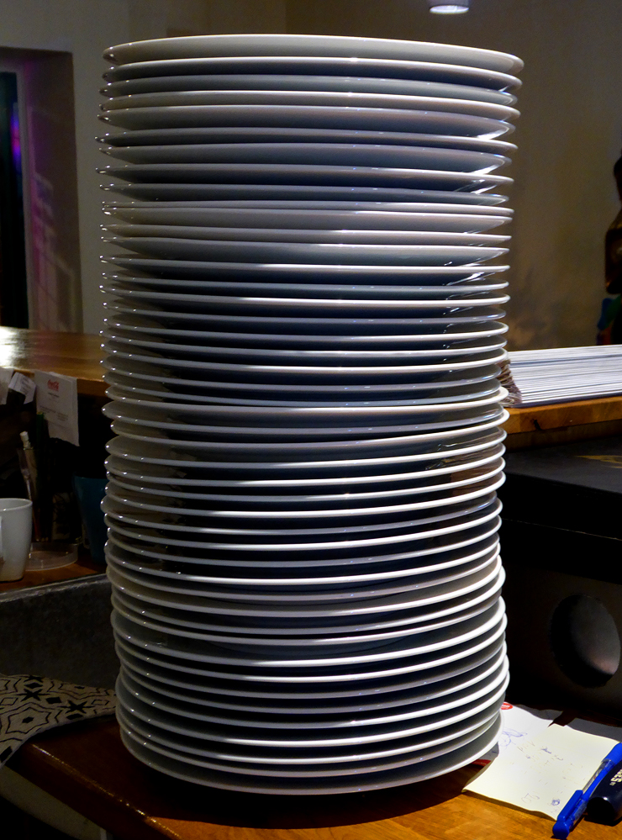
Stack

Slide 33
Stack
A special list where one end, the bottom, is closed
Only accessible from the other end, the top
I.e. insertion & deletion are only possible at the top

Slide 34
Stack Operations
Push: Add an element to the top of the stack
Pop: Remove the element from the top of the stack
Peek: Read the element at the top without removing it

Slide 35
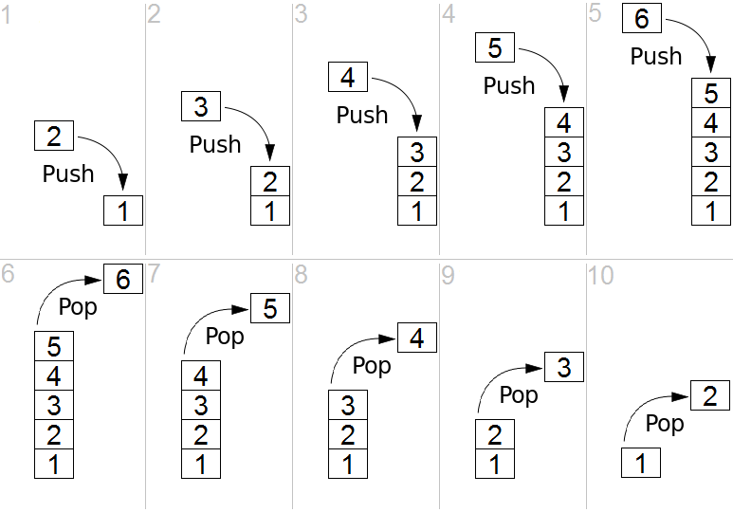
Stack Operations

Slide 36
Last in, first out (LIFO)
The last element that enters the stack is the first element that comes out
I.e. every time the stack is popped, the element that comes out is the most recently added element in the stack at the time

Slide 37
The Java Stack<E> Class
See here for details of the Java Stack<E> class

Slide 38
Demonstration
See StackDemo.java for a demonstration of basic stack operations

Slide 39
Many Applications of Stacks
The undo function of apps
App pushes user’s actions to a stack
Pops the stack to undo the most recent action as user presses undo

Slide 40
Many Applications of Stacks
Program execution
Runtime system maintains a call stack of all active methods/functions
The method at the top of the stack is the next one to execute
When a method (the caller) calls another method (the callee), the caller must suspend its execution until the callee returns
The runtime system pushes the caller to the top of the stack and executes the callee
When the callee returns, the system pops the stack and resumes the execution of the caller

Slide 41
Many Applications of Stacks
Recursion
All recursive methods are executed with a stack
Depth-First Search

Slide 42
Many Applications of Stacks
Parsing in compilers
When the source code of a program is compiled, the parser of the compiler uses a stack to parse the expressions and statements in the code for syntax errors

Slide 43
Problem Solving: Checking for Balanced Parentheses
A sequence of parentheses is balanced if every ')' closes a preceding '(', and every '(' is closed by a subsequent ‘)’
For example,
( ), ( )( ), ( ( ) ), and ( ( ) ( ) ) ( ) are balanced
)(, ( ) ) ), ( ( ( ) and ( )( ) )( are not balanced

Slide 44
Problem Solving: Checking for Balanced Parentheses
Problem: Decide whether a given sequence of parentheses is balanced
20th most frequently asked interview question according to LeetCode
Comes up in parsing of programs for syntax errors
Can you see how this is relevant?

Slide 45
Problem Solving: Checking for Balanced Parentheses
Observation: If a sequence is balanced, then as we process it from left to right, every ‘)’ closes the last preceding ‘(‘ that has not been closed
This is LIFO!

Slide 46
Problem Solving: Checking for Balanced Parentheses
Process the input from left to right
For every ‘(’, push it to the stack
For every ‘)’, pop the stack to find a matching ‘(‘. If the stack is empty, then the ‘)’ does not match a ‘(‘, so return false.
If the entire input has been processed but the stack is not empty, then some ‘(‘ is not matched by a ‘)’, so return false.
Return true if the entire input has been processed and the stack is empty

Slide 47
Problem Solving: Checking for Balanced Parentheses
Input: ( ( ( ) ( ) ) ) ( )

Slide 48
Problem Solving: Checking for Balanced Parentheses
Input: ( ( ( ) ( ) ) ) ( )
(

Slide 49
Problem Solving: Checking for Balanced Parentheses
Input: ( ( ( ) ( ) ) ) ( )
(
(

Slide 50
Problem Solving: Checking for Balanced Parentheses
Input: ( ( ( ) ( ) ) ) ( )
(
(
(

Slide 51
Problem Solving: Checking for Balanced Parentheses
Input: ( ( ( ) ( ) ) ) ( )
(
(
(

Slide 52
Problem Solving: Checking for Balanced Parentheses
Input: ( ( ( ) ( ) ) ) ( )
(
(

Slide 53
Problem Solving: Checking for Balanced Parentheses
Input: ( ( ( ) ( ) ) ) ( )
(
(
(

Slide 54
Problem Solving: Checking for Balanced Parentheses
Input: ( ( ( ) ( ) ) ) ( )
(
(
(

Slide 55
Problem Solving: Checking for Balanced Parentheses
Input: ( ( ( ) ( ) ) ) ( )
(
(

Slide 56
Problem Solving: Checking for Balanced Parentheses
Input: ( ( ( ) ( ) ) ) ( )
(
(

Slide 57
Problem Solving: Checking for Balanced Parentheses
Input: ( ( ( ) ( ) ) ) ( )
(

Slide 58
Problem Solving: Checking for Balanced Parentheses
Input: ( ( ( ) ( ) ) ) ( )
(

Slide 59
Problem Solving: Checking for Balanced Parentheses
Input: ( ( ( ) ( ) ) ) ( )

Slide 60
Problem Solving: Checking for Balanced Parentheses
Input: ( ( ( ) ( ) ) ) ( )
(

Slide 61
Problem Solving: Checking for Balanced Parentheses
Input: ( ( ( ) ( ) ) ) ( )
(

Slide 62
Problem Solving: Checking for Balanced Parentheses
Input: ( ( ( ) ( ) ) ) ( )
Input is processed & stack is empty
Return true

Slide 63
Problem Solving: Checking for Balanced Parentheses
Input: ( ) ) )

Slide 64
Problem Solving: Checking for Balanced Parentheses
Input: ( ) ) )
(

Slide 65
Problem Solving: Checking for Balanced Parentheses
Input: ( ) ) )
(

Slide 66
Problem Solving: Checking for Balanced Parentheses
Input: ( ) ) )

Slide 67
Problem Solving: Checking for Balanced Parentheses
Input: ( ) ) )
Stack is empty but input has not been processed
Return false

Slide 68
Problem Solving: Checking for Balanced Parentheses
Input: ( ( ( )

Slide 69
Problem Solving: Checking for Balanced Parentheses
Input: ( ( ( )
(

Slide 70
Problem Solving: Checking for Balanced Parentheses
Input: ( ( ( )
(
(

Slide 71
Problem Solving: Checking for Balanced Parentheses
Input: ( ( ( )
(
(
(

Slide 72
Problem Solving: Checking for Balanced Parentheses
Input: ( ( ( )
(
(
(

Slide 73
Problem Solving: Checking for Balanced Parentheses
Input: ( ( ( )
Input is processed but stack is not empty
Return false
(
(

Slide 74
Problem Solving: Checking for Balanced Parentheses
See Parentheses.java for the code of the method isBalanced

Slide 75
Problem Solving: Checking for Balanced Parentheses
Generalize it to handle different types of parentheses: { }, ( ), [ ]
Every open parenthesis must be closed by a closing parenthesis of the same type and every closing parenthesis closes an opening parenthesis of the same type in the correct order.
E.g.
{ ( [ ] ) } and ( )[ ]{ } are balanced
( ] and [ ( ] ) are not balanced
Exercise

Slide 76
Queue

Slide 77

Queue

Slide 78
Queue
A special list where elements are added only to the back & removed only from the front

Slide 79
First in, first out (FIFO)
The first element that enters the queue is the first element that comes out
First come first serve

Slide 80
Queue Operations
Add: Add an element to the back of the queue
Traditionally adding to a queue is called enqueue
Remove: Remove the element from the front of the queue
Traditionally adding to a queue is called dequeue
Peek: Read the element at the front without removing it

Slide 81
The Java Queue<E> Interface
In Java, Queue<E> is an interface, not a class
See here for details of the Java Queue<E> interface
A queue is usually created as a linked list
Queue<T> queue = new LinkedList<>( )

Slide 82
Demonstration
See QueueDemo.java for a demonstration of basic queue operations

Slide 83
Many Applications of Queues
All services & resource scheduling apps where customers are served on a first come, first serve basis
Breadth-First Search

Slide 84
Priority Queue

Slide 85
Priority Queue
A data structure for organizing a collection of elements each associated with a “priority”
The element with the “highest priority” is first served

Slide 86
A Real-Life Example – Emergency Room
Consider the waiting room of a hospital’s ER where patients wait to be admitted
Ideally the most ill patient should be first served
Idea to implement this:
Assign a "priority" to each patient based first on the severity of illness then on arrival time
When a patient room is available, admit the waiting patient with the "highest priority"

Slide 87

But what is priority?
Assume elements of the collection come from a class with a well-defined ordering
Can compare any two objects $x$ & $y$
Three possible outcomes:
$x<y$
$x=y$
$x>y$

Slide 88
But what is priority?
Some classes have a natural ordering
Integer with ascending order
String with alphabetic order
Any class that implements the Comparable interface has an ordering defined by its compareTo method

Slide 89
But what is priority?
May need to impose an ordering on demand
The class may not come with a natural ordering
The class may already have an ordering, but we need to compare its objects by a different order as demanded by the app
Java allows custom ordering defined using the Comparator interface

Slide 90
But what is priority?
A priority queue is collection of objects, each associated with a priority that is determined by a given ordering, natural or custom
The object with the "highest" priority is first served
Opposite notions of priority: Min vs. Max Priority Queue

Slide 91
Min vs. Max Priority Queue
In a min priority queue, smaller elements have higher priorities
In a max priority queue, larger elements have higher priorities
Note: smaller or larger is with respect to a specified ordering

Slide 92
Java PriorityQueue<E> Class
Based on a binary heap, the most common data structure for implementing priority queues
By default a min priority queue using the elements’ natural ordering (as defined by the compareTo method of the elements’ class)
Several ways to build a max heap
Supports custom comparators

Slide 93
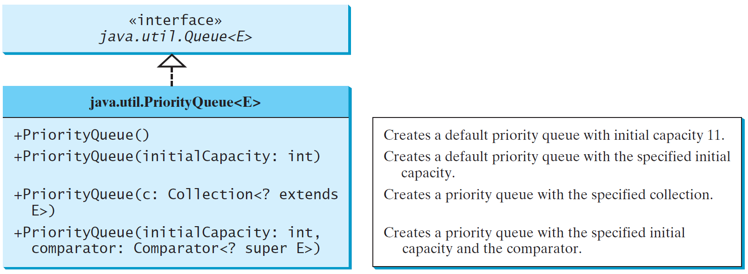
Priority Queue Constructors

Slide 94
Priority Queue methods
add / offer – Adds an element to the priority queue
remove / poll – Removes & returns
The smallest element if the queue is a min priority queue
The largest element if the queue is a max priority queue
peek / element – Returns but does not remove
The smallest element if the queue is a min priority queue
The largest element if the queue is a max priority queue

Slide 95
Java PriorityQueue<E> Class
See here for details of the Java PriorityQueue<E> class

Slide 96
Applications of Priority Queue
Sorting
Priority-based scheduling, e.g.
ER scheduling
CPU scheduling
Huffman code for data compression (e.g. for MP3 & JPEG)
Dijkstra’s algorithm for single-source shortest paths
Made digital navigation a reality

Slide 97
Application: Sorting
First build a priority queue from the input data
Then call remove() until the priority queue is empty
The elements come out in the sorted order
This algorithm is known as Heap Sort when a binary heap is used to implement the priority queue

Slide 98
Application: Sorting
See the code in PriorityQueueDemo.java

Slide 99
Demonstrations
See PQDemo.java for a demonstration of constructions and basic operations of priority queues
See HeapSort.java for an implementation of Heap Sort

Slide 100
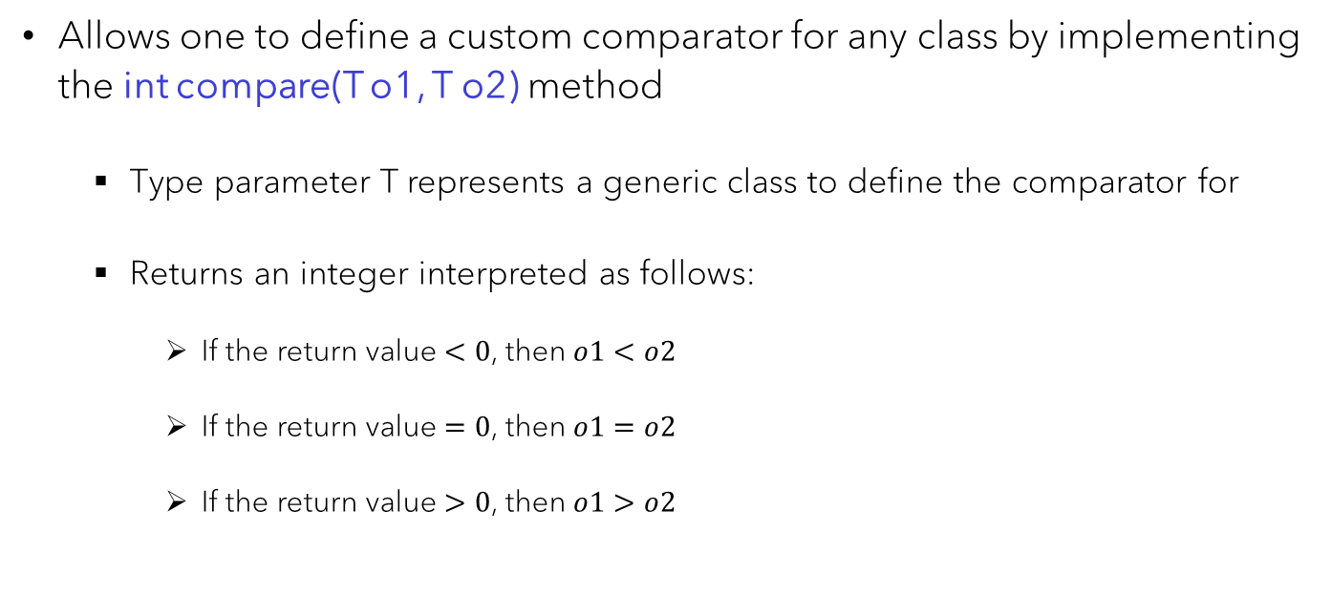
ComparatoR<T> Interface
Allows one to define a custom comparator for any class by implementing the int compare(T o1, T o2) method
Type parameter T represents a generic class to define the comparator for
Returns an integer interpreted as follows:
If the return value $<0$, then $o1<o2$
If the return value $=0$, then $o1=o2$
If the return value $>0$, then $o1>o2$

Slide 101
ComparatoR<T> Interface
See here for details of the Java Comparator<T> interface

Slide 102
Demonstration
See comparatorDemo1.java and comparatorDemo2.java for different ways to define and use comparators

Slide 103
Back to the ER example
See the code in ER.java

