Slide 1
Trees – A Primer

Slide 2
Rooted Trees
root
a
b
c
d
e
f
g
h
i
j
k
l
m
n
o

Slide 3
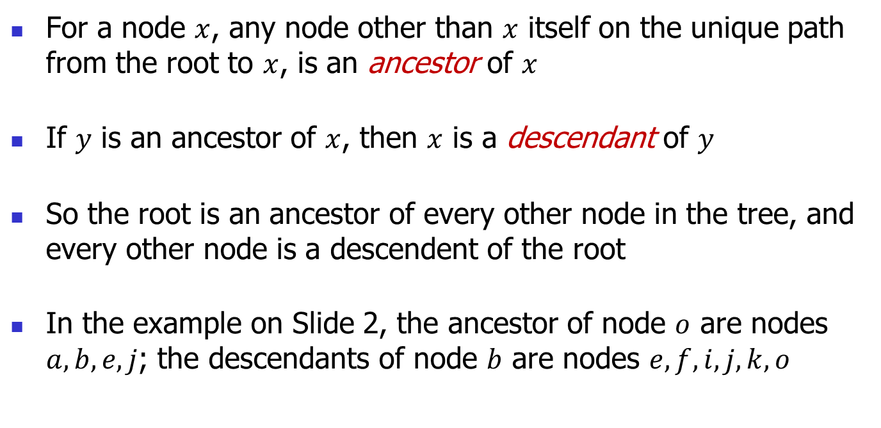
Rooted Tree Terminologies
For a node $x$, any node other than $x$ itself on the unique path from the root to $x$, is an ancestor of $x$
If $y$ is an ancestor of $x$, then $x$ is a descendant of $y$
So the root is an ancestor of every other node in the tree, and every other node is a descendent of the root
In the example on Slide 2, the ancestor of node $o$ are nodes $a,b,e, j$; the descendants of node $b$ are nodes $e,f,i,j,k,o$

Slide 4
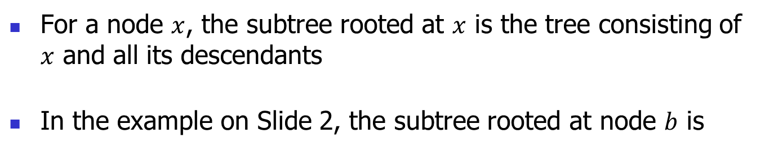
Rooted Tree Terminologies
For a node $x$, the subtree rooted at $x$ is the tree consisting of $x$ and all its descendants
In the example on Slide 2, the subtree rooted at node $b$ is
b
e
f
i
j
k
o

Slide 5
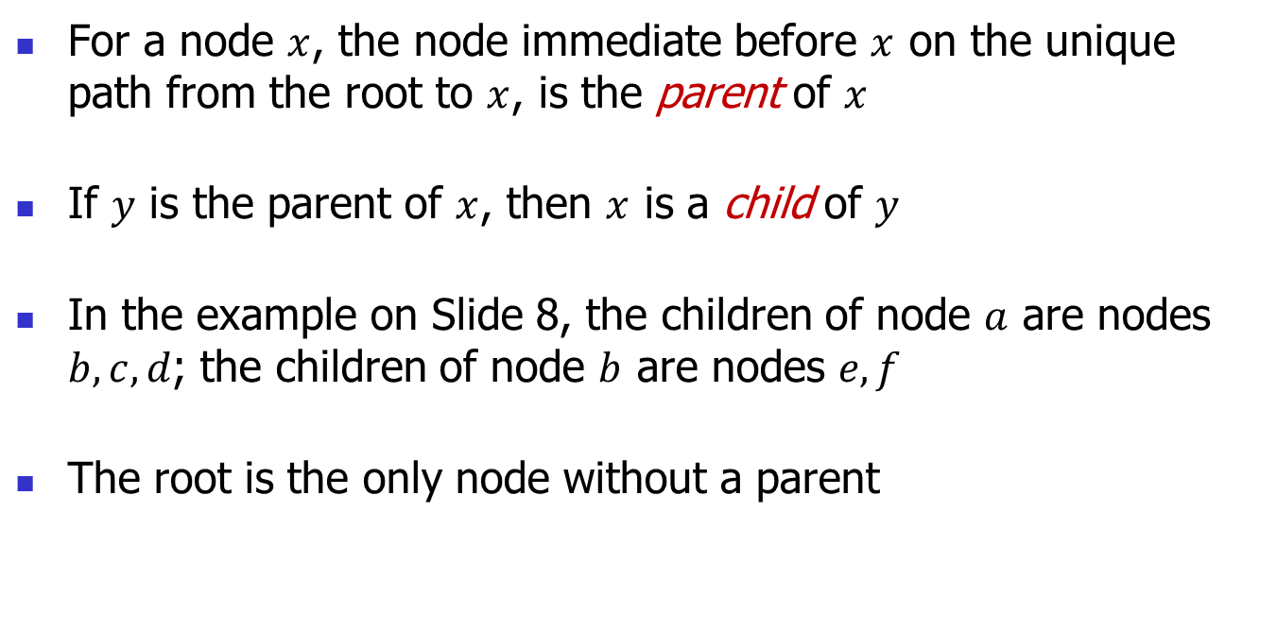
Rooted Tree Terminologies
For a node $x$, the node immediate before $x$ on the unique path from the root to $x$, is the parent of $x$
If $y$ is the parent of $x$, then $x$ is a child of $y$
In the example on Slide 8, the children of node $a$ are nodes $b,c, d$; the children of node $b$ are nodes $e,f$
The root is the only node without a parent

Slide 6
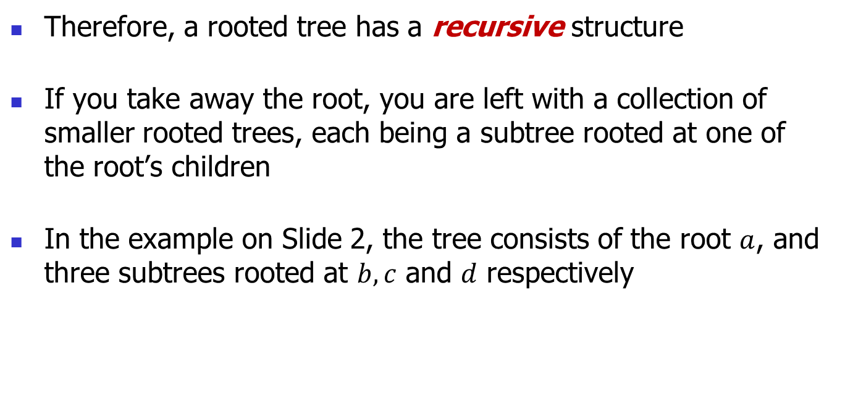
Rooted Tree Terminologies
Therefore, a rooted tree has a recursive structure
If you take away the root, you are left with a collection of smaller rooted trees, each being a subtree rooted at one of the root’s children
In the example on Slide 2, the tree consists of the root $a$, and three subtrees rooted at $b,c$ and $d$ respectively

Slide 7

Rooted Tree Terminologies
A node without a child is called a leaf
In the example on Slide 2, the leaves are nodes $c, i,k,l,m,n,o$
A non-leaf node is called an internal node

