Slide 1
BAIT
LIVE PRODUCT + PUBLIC SOLANA CONTEXT
Check
before you pay.
Bait turns suspicious payment requests into an explainable pause — with read-only blockchain evidence when a Solana address is involved.
Website · Chrome extension · FastAPI · optional AI · Solana RPC
THE PROMISE
Pause. Check.
Verify independently.
SOLANA HACKATHON · PRODUCT OVERVIEW
01
Notes:
Opening: Bait is a pre-payment decision aid. It flags warning signs, explains why they matter, and leaves the final payment decision with the user. Product claims are based on the project README, Master-Document.md, docs/feature-status.md, docs/api-contract.md, backend/README.md, frontend/README.md, and extension/README.md.

Slide 2
BAIT
THE PROBLEM
Payment scams borrow familiar details.
Trust is established first. The request changes second. The transfer happens third.
The dangerous moment is often a tiny change inside an otherwise normal workflow.
01
02
03
Invoice
Marketplace link
Wallet request
“Our payment details changed.”
“Use this checkout.”
“Send USDC here.”
A familiar vendor asks for a new bank account, a rush transfer, or no-call instructions.
A cloned site, odd URL, or pressure to bypass the normal buyer workflow.
A public address can be valid and still deserve context before funds move.
Bait exists for the pause between “this looks normal” and “the money is gone.”
SOLANA HACKATHON · PRODUCT OVERVIEW
02
Notes:
This framing follows the project brief: Bait is designed for invoice fraud, payment-link scams, QR and screenshot workflows, and suspicious wallet requests. The examples are fictional and are used to show the workflow, not to claim a live scam dataset.

Slide 3
BAIT
THE PRODUCT
One workflow across websites, links, and Solana.
The same decision loop powers the website and the user-initiated browser extension.
01
02
03
04
Submit
Check
Review
Verify
Paste a request, URL, screenshot, QR, or wallet address.
Run deterministic local checks, then optional AI assistance.
See exact evidence, not just a red / green label.
Take a safer next step through a trusted channel.
WEBSITE
CHROME EXTENSION
READ-ONLY RPC
No transaction signing. No seed phrases. No background page monitoring.
SOLANA HACKATHON · PRODUCT OVERVIEW
03
Notes:
Product workflow source: frontend/README.md, extension/README.md, docs/feature-status.md, and backend/README.md. The extension is user-initiated: users press Use selection or paste content before analysis. Bait does not sign transactions, move funds, or require wallet secrets.

Slide 4
BAIT
TECHNICAL ARCHITECTURE
How Bait builds a report.
A shared API keeps the website and extension aligned while keeping the sensitive steps explicit.
MESSAGE
URL / QR
SOLANA
SHARED API
REPORT
invoice · chat · email
link · screenshot
public address
FastAPI
/analyze
risk + evidence
+ next action
LOCAL CHECKS
OPTIONAL AI
SOLANA RPC
OCR / QR · URL signals
address-byte validation
local Ollama / OpenAI
quote-backed findings only
selected network
balance + signatures + links
The API is the contract. The interface is the explanation.
SOLANA HACKATHON · PRODUCT OVERVIEW
04
Notes:
Architecture sources: docs/api-contract.md, backend/README.md, frontend/README.md, extension/README.md, and docs/feature-status.md. The API exposes POST /api/analyze with risk levels suspicious, needs_verification, and no_major_warnings_detected. The Solana path is read-only and only uses public chain data.

Slide 5
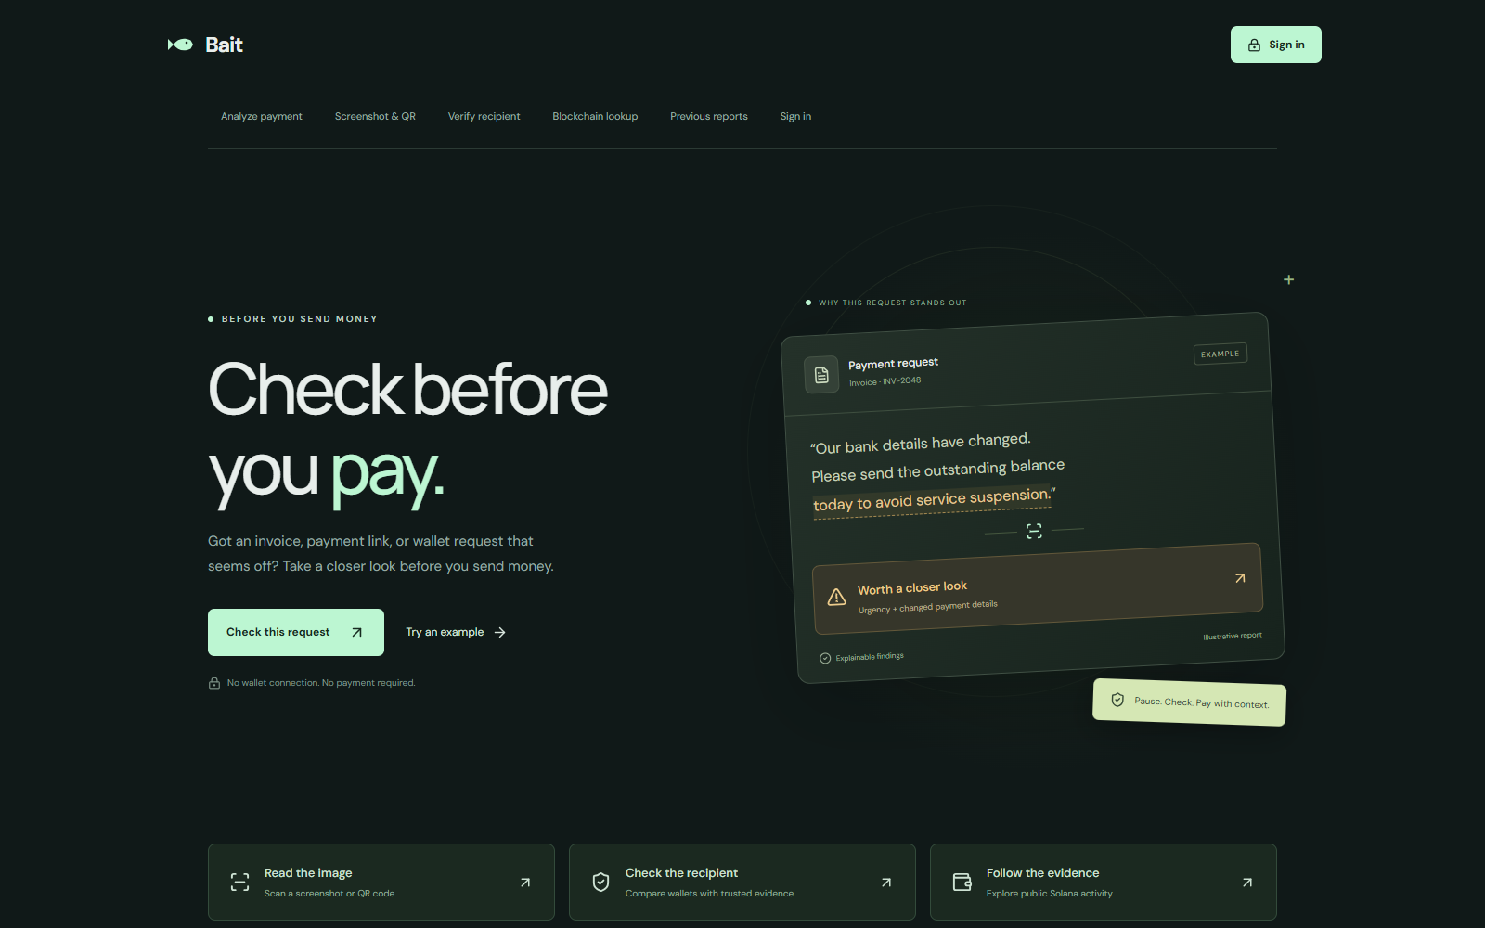
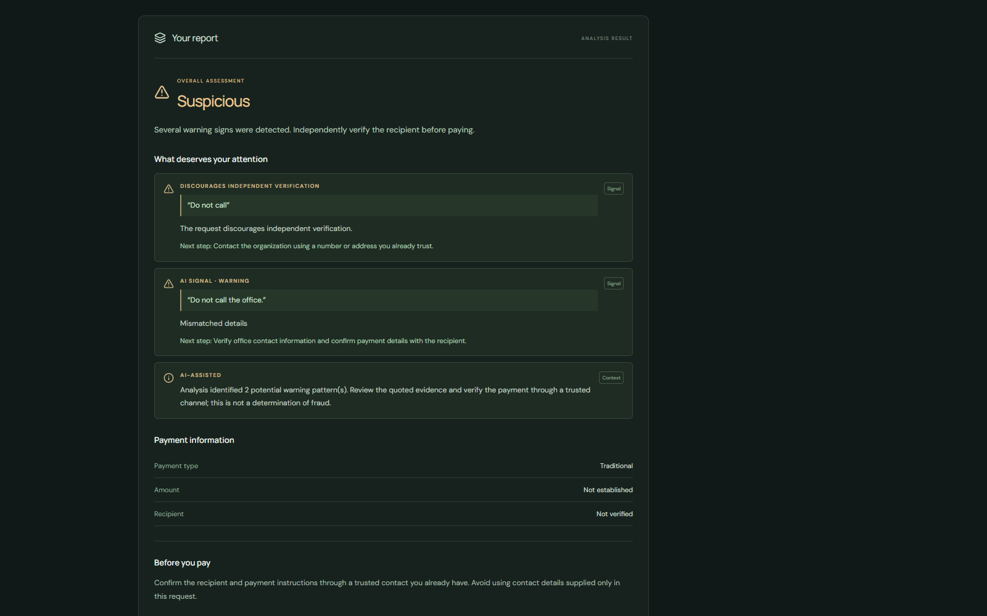
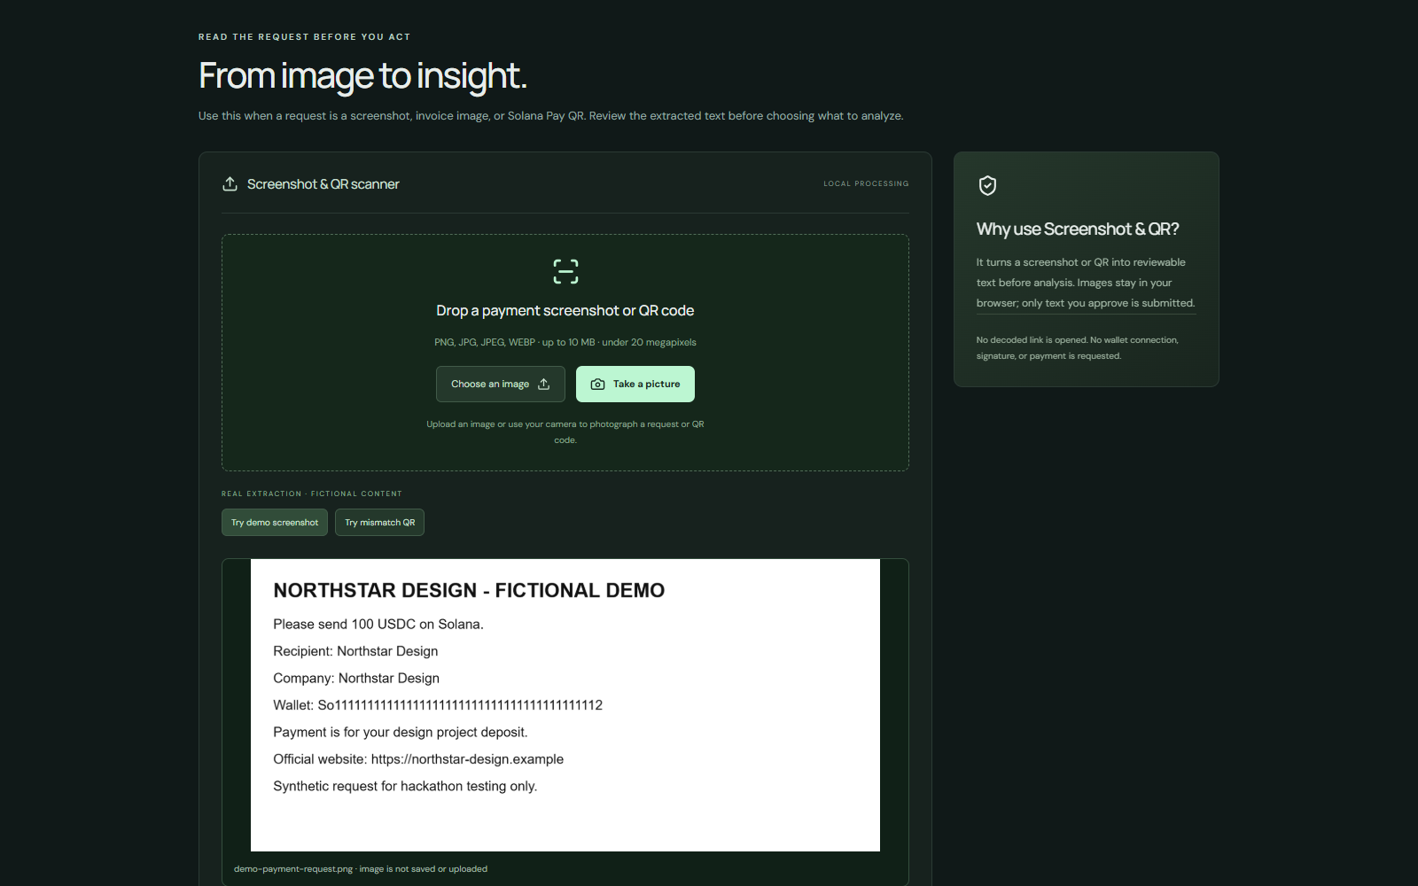
BAIT
LIVE PRODUCT PROOF
The live build is more than a pitch.
Three surfaces show the same idea from different angles: capture, explain, and review.
WEBSITE HOME
EXPLAINABLE REPORT
BROWSER-LOCAL SCANNER
One workflow for payment requests, screenshots, links, and wallet checks.
Quoted evidence + a next step make the result actionable.
OCR / QR review starts in the browser before submit.
Same product language across the website, the extension, and the read-only blockchain lookup.
SOLANA HACKATHON · PRODUCT OVERVIEW
05
Notes:
Screenshots captured from the local Bait build during this deck update: bait-home.png, bait-report.png, and bait-scanner.png. The report screenshot shows the explainable evidence format. The scanner screen reflects browser-local screenshot processing and a fictional demo request; it is not evidence of a real scam.

Slide 6
BAIT
EXAMPLE 01 · TRADITIONAL PAYMENT
A small change can hide a big consequence.
The user sees the original request, the warning signs, and the next best action in one screen.
INCOMING REQUEST
BAIT REPORT
“Our payment details changed.
Wire the $2,500 invoice today.
Do not call the office.”
Suspicious
Evidence
• payment details changed
• urgency + no-call instruction
• verify through a trusted contact
Fictional example · Northstar Design
Recommended action: call the known number or use a trusted vendor portal — not the number or link in the request.
SOLANA HACKATHON · PRODUCT OVERVIEW
06
Notes:
Fictional example adapted from the original deck. The recommended action reflects the project’s intended user experience: Bait flags warning signs and suggests independent verification. It does not claim to prove sender identity.

Slide 7
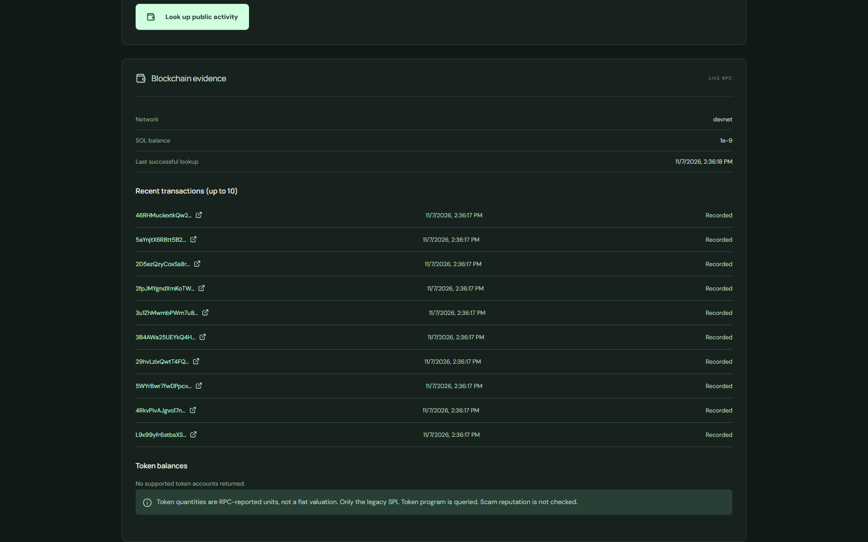
BAIT
EXAMPLE 02 · SOLANA
A Solana request adds public context.
Bait does not connect a wallet. It reads public chain data for the selected network and makes the evidence legible.
INCOMING REQUEST
READ-ONLY EVIDENCE
“Send 25 USDC to
this wallet before
the quote expires.”
What Bait can verify
• selected network: devnet / configured network
• address format + account existence
• balance + recent signatures
• explorer links for independent review
LIVE LOCAL EVIDENCE
Public address · fictional request
Solana RPC
lookup surface
A valid address is not the same as a trusted recipient.
No wallet secrets.
No transaction signing.
Important: chain history can add context, but it cannot identify an owner or guarantee safety.
SOLANA HACKATHON · PRODUCT OVERVIEW
07
Notes:
Solana example sources: docs/api-contract.md, docs/feature-status.md, backend/README.md, and the captured bait-wallet.png screen. The current local integrated stack showed Solana network devnet and read-only RPC evidence. The deck intentionally names the selected network because network context changes how the evidence should be interpreted. A wallet address does not identify its owner.

Slide 8
BAIT
DECISION MODEL
A result is a prompt to verify — not a verdict.
The wording is deliberately calibrated: Bait surfaces evidence without pretending certainty.
Suspicious
Needs verification
No major warnings detected
Multiple warning signs
need immediate pause.
Signals are incomplete
or context is missing.
No major signals found
in the submitted content.
“No major warnings detected” is not a safety guarantee.
The user still verifies the recipient, source, and final payment details through a trusted channel.
SOLANA HACKATHON · PRODUCT OVERVIEW
08
Notes:
Risk labels and the calibration statement are taken from docs/api-contract.md. The public API uses suspicious, needs_verification, and no_major_warnings_detected. This slide renders the same labels in human-readable language for judges.

Slide 9
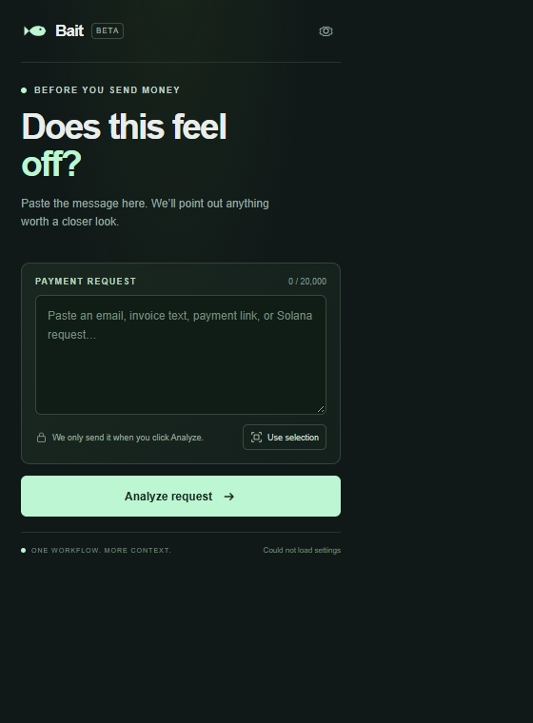
BAIT
GUARDRAILS
The fastest path is user-initiated.
The extension brings the same analysis flow closer to the moment a suspicious request appears.
USER-INITIATED
Press Use selection or paste content before analysis.
SAME CONTRACT
Website and extension share the FastAPI analysis path.
NO PRIVILEGED ACCESS
No background monitoring, private keys, or transaction signing.
Chrome extension surface
SOLANA HACKATHON · PRODUCT OVERVIEW
09
Notes:
Extension sources: extension/README.md and the captured bait-extension.png popup. The project explicitly avoids page monitoring, transaction signing, and private-key access. The extension asks the user to provide the content to analyze.

Slide 10
BAIT
THE BUILD
Small team. Full-stack proof.
The hard part was integrating the whole flow — not just naming the feature.
4 builders
PRODUCT
FRONTEND
3 first-time hackathon participants
Problem framing
& user flow
Website
& explainable UI
We shipped a website, a browser surface, an API contract, local checks, optional AI, and a public-chain evidence path into one product story.
BACKEND
SOLANA / EXT
FastAPI
& analysis contract
RPC evidence
& browser surface
SOLANA HACKATHON · PRODUCT OVERVIEW
10
Notes:
Team framing is based on the original deck’s “four people / three new to hackathons” content. Roles are expressed by the work shipped in the repository rather than inventing names or credentials not provided in the source materials.

Slide 11
BAIT
ROADMAP
Live now vs next.
The submission is strongest when judges can separate demonstrated capability from the work still ahead.
LIVE NOW
NEXT
✓
browser-local OCR / QR review
→
production hosting + stable origins
✓
deterministic text + URL checks
→
broader false-positive evaluation
✓
explainable risk + next action
→
maintainable recipient intelligence
✓
read-only Solana RPC lookup
→
more privacy / security review
✓
optional AI with local fallback
→
live demo + repository links in submission
Out of scope by design: browsing surveillance, payment sending, and any safety guarantee.
SOLANA HACKATHON · PRODUCT OVERVIEW
11
Notes:
Live-now items are drawn from docs/feature-status.md, frontend/README.md, extension/README.md, backend/README.md, and docs/api-contract.md. Next items are intentionally framed as forward work: stable deployment origins, evaluation, recipient intelligence, and deeper privacy/security review. The live demo and source code should be attached through the hackathon submission links.

Slide 12
BAIT
Pause. Check.
Verify.
Then decide.
Bait flags warning signs.
The final payment decision stays with you.
Thank you.
LIVE DEMO + SOURCE CODE · SUBMITTED ALONGSIDE THIS DECK
BAIT · THANK YOU
12
Notes:
Close by returning to the promise: Bait is a decision aid, not an oracle. The live demo and source code are intended to accompany the submission.

