Slide 1

How does motif-based genome mining work?
ICS

Slide 2

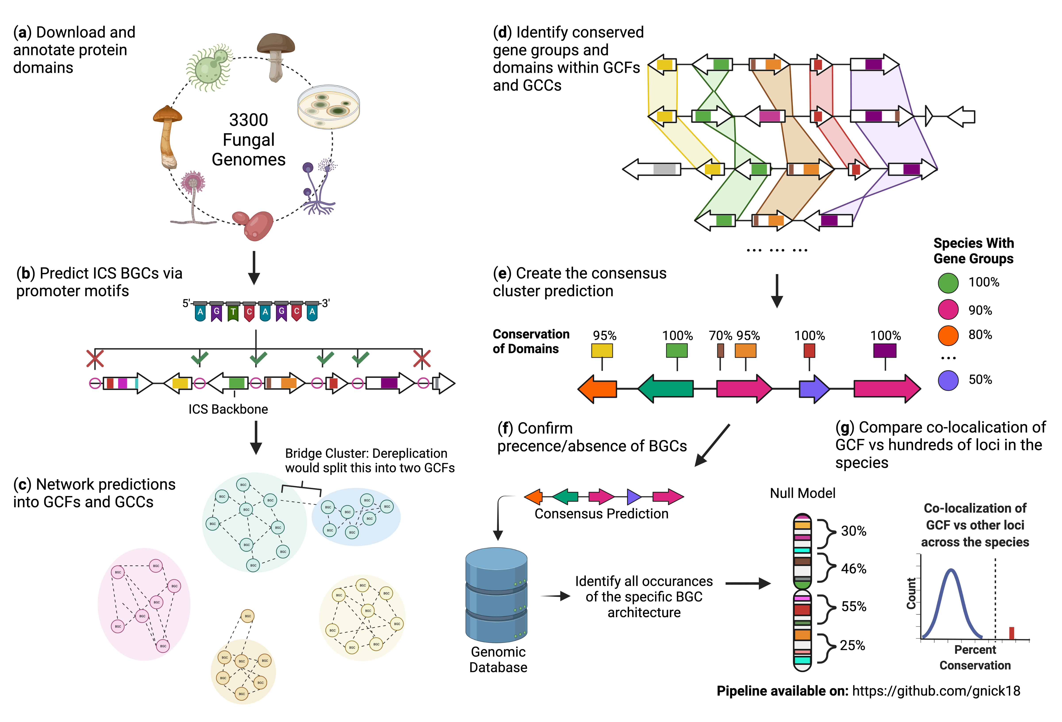
The CASSIS algorithm searches for promoter motifs shared between the backbone gene and pair-wise combinations of genes to the left and right of the backbone.
ICS

Slide 3


Genes that share the cluster motif determine the BGC window
ICS
Notes:
It then sees if the genes surrounding the ICS share the same cluster specific motif to determine what is apart of the BGC. This is at the core of how I generated my BGC predictions. There is more nuance to what is done than that, which I can explain if anyone has questions on it, but at a conceptual level this is broadly how the algorithm worked.

Slide 4
This results in a list of potential promoter motifs found in various combinations of genes adjacent to the ICS backbone.
Motif
Genes with motif
ICS
ICS
ICS

Slide 5


The occurrence of of each cluster defining motif is calculated in all promoters within the genome. If the motif is frequently found within the genome (i.e., it’s not cluster-specific), that prediction is rejected.
ICS
Resulting ICS BGC prediction

Slide 6
Why is this important to know?
The predictions carry information regarding the potential regulation of clusters
Clusters can evolve different regulatory pathways within different genomes
When looking at a BGC that was sorted into a GCF, compare its genomic architecture to others within the same GCF
Smaller than normal BGCs within a GCF could indicate differentially regulated variations
Important assumptions to remember:
Identifying a BGC with this methodology relies on the assumption of co-regulating genes
It is never guaranteed that the underlying algorithm will identify the correct regulatory motif
As such, this approach (as with all genome mining algorithms) will occasionally lead to false-positives (i.e., predicting a BGC that doesn’t exist) and false-negatives (i.e., failing to locate or to correctly locate the boundaries of a BGC).

Slide 7
Other tips!
Good questions to ask yourself when analyzing a GCF:
Which genes are shared across the BGCs within a GCF?
This may indicate the biosynthetic core of the GCF
Are there any extremely large predictions?
These can be signs of BGC border miss-calls, and likely will need to be double checked.
Are there any extremely small predictions relative to the normal size of BGCs within the GCF?
This may suggest that the ICS backbone is no longer linked to neighboring genes by a shared promoter motif. If you are interested in investigating this further, it is recommended that you manually verify whether the genes in the GCF are still co-localized with the ICS backbone.

Slide 8
Please refer to these two publications, and the CASSIS algorithm if interesting in learning more!
Wolf, T., Shelest, V., Nath, N. & Shelest, E. CASSIS and SMIPS: Promoter-based prediction of secondary metabolite gene clusters in eukaryotic genomes. Bioinformatics 32, 1138–1143 (2016).
Wolf, T., Shelest, V. & Shelest, E. Motif-based method for the genome-wide prediction of eukaryotic gene clusters. Lecture Notes in Computer Science (including subseries Lecture Notes in Artificial Intelligence and Lecture Notes in Bioinformatics) 8158 LNCS, 389–398 (2013).

Slide 9


Other key publications, algorithms, and repositories that aided in the pipeline development
(see publication for full details)
Navarro-Muñoz, J. C. et al. A computational framework to explore large-scale biosynthetic diversity. Nat Chem Biol 16, 60–68 (2020).
Medema, M. H. et al. AntiSMASH: Rapid identification, annotation and analysis of secondary metabolite biosynthesis gene clusters in bacterial and fungal genome sequences. Nucleic Acids Research 39, (2011).
Blin, K. et al. AntiSMASH 5.0: Updates to the secondary metabolite genome mining pipeline. Nucleic Acids Res 47, W81–W87 (2019).
Images in slides made with the help of BioRender.com

