Slide 1

How does motif-based genome mining work?
ICS

Slide 2

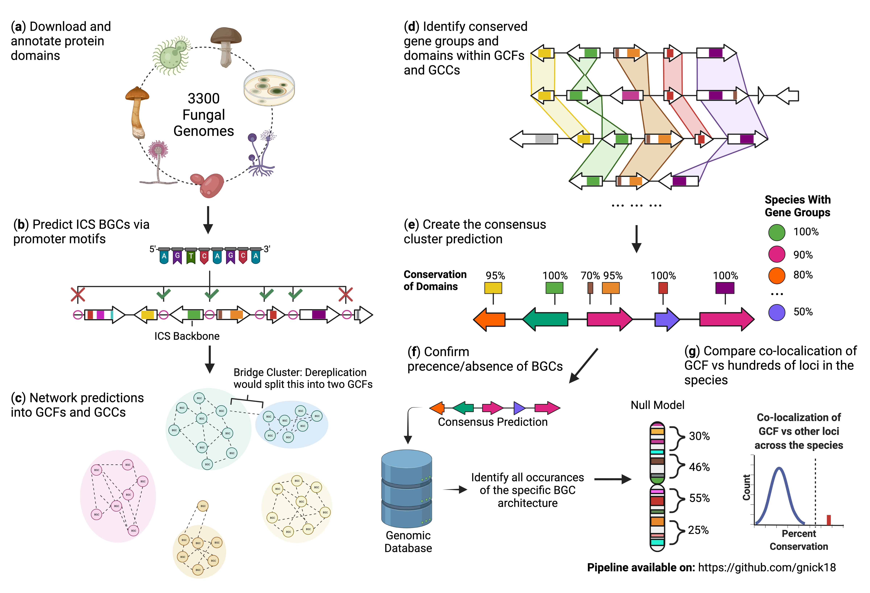
The CASSIS algorithm searches for promoter motifs shared between the backbone gene and pair-wise combinations of 15 gene windows to the left and right of the backbone.
ICS

Slide 3


Looking for this motif
Genes that share the cluster motif determine the BGC window
ICS
Notes:
It then sees if the genes surrounding the ICS share the same cluster specific motif to determine what is apart of the BGC. This is at the core of how I generated my BGC predictions. There is more nuance to what is done than that, which I can explain if anyone has questions on it, but at a conceptual level this is broadly how the algorithm worked.

Slide 4
This results in a list of potential promoter motifs found in various combinations of genes adjacent to the ICS backbone.
ICS
ICS
ICS

Slide 5


Every gene within the genome is scanned for each putative promoter motif. The goal is to find a motif that ISN’T widespread in the genome. This is referred to as a “cluster-specific motif”.
ICS
Resulting ICS BGC prediction

Slide 6
Please refer to these two publications, and the CASSIS algorithm if interesting in learning more!
Wolf, T., Shelest, V., Nath, N. & Shelest, E. CASSIS and SMIPS: Promoter-based prediction of secondary metabolite gene clusters in eukaryotic genomes. Bioinformatics 32, 1138–1143 (2016).
Wolf, T., Shelest, V. & Shelest, E. Motif-based method for the genome-wide prediction of eukaryotic gene clusters. Lecture Notes in Computer Science (including subseries Lecture Notes in Artificial Intelligence and Lecture Notes in Bioinformatics) 8158 LNCS, 389–398 (2013).

Slide 7


Key publications, algorithms, and repositories that aided in this work
Navarro-Muñoz, J. C. et al. A computational framework to explore large-scale biosynthetic diversity. Nat Chem Biol 16, 60–68 (2020).
Medema, M. H. et al. AntiSMASH: Rapid identification, annotation and analysis of secondary metabolite biosynthesis gene clusters in bacterial and fungal genome sequences. Nucleic Acids Research 39, (2011).
Blin, K. et al. AntiSMASH 5.0: Updates to the secondary metabolite genome mining pipeline. Nucleic Acids Res 47, W81–W87 (2019).
Images in slides made with the help of BioRender.com

