Slide 1

Mozix
Nagy Balázs Sándor Gubisi Péter Gazsi Erik Nikolász

Slide 2





Whatis Mozix?
• •
The bestHungarianmoviescanbe foundin one place
A modern, easy-to-usemoviesearchengine

Slide 3


How doesit work?
• • •
Searchbygenres, actors, directors Moviescanbe rated You can watch the movie trailers

Slide 4
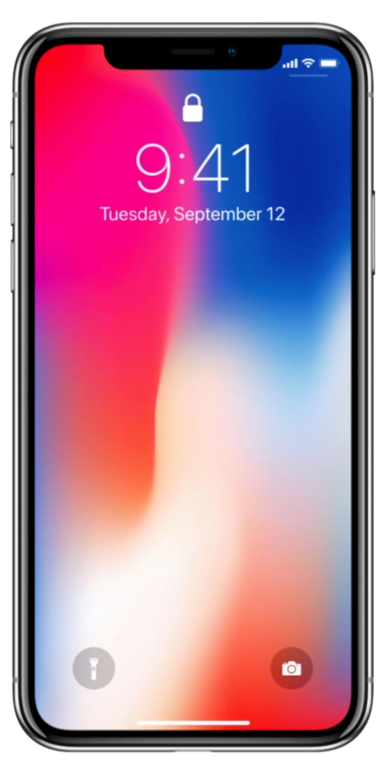


Whya website?
• • • •
Easily accessible on the internet Accessible from any device Easiermaintenanceand updates Itdoesn't require storagespace

Slide 5
Motivation behind the
creationof Mozix

Slide 6



Why did we choose this topic?
• • • •
Love forHungarianfilms ItsupportstheHungarianfilm industry It promotes Hungarian films It preserves cultural heritage

Slide 7


Whatgapdoesit fill?
• •
Therewasno searchapplicationfocusedonHungarian filmsbeforeMozix
Itis notpossibletoshareopinionsin anymoviesearch
application

Slide 8

• • •
Fansof Hungarianfilms Any age group Families
Targetaudience

Slide 9
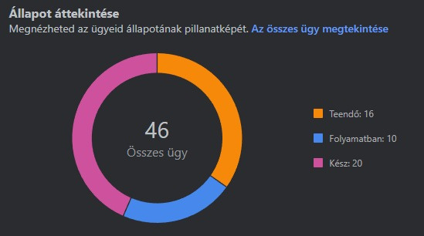
Jira

Slide 10

Competition: IMDb
• • •
Ithas a widerreach Larger database More options

Slide 11

SWOT
•
•Missing mobile
Transparency
•Modern look
a pp lica tion
•
Limited audience
• •
Promotion on social
media Expanding Hungarian
film selection
•
Foreign competition
•Market indifference

Slide 12
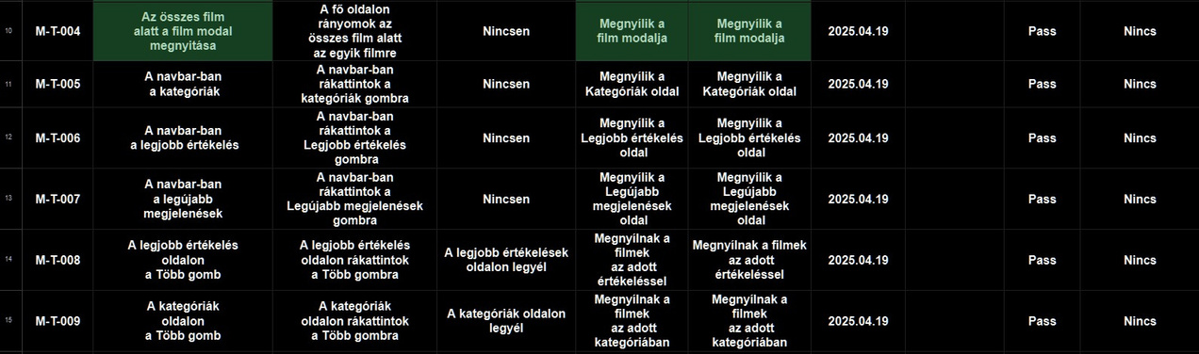
Manual Test

