Slide 1
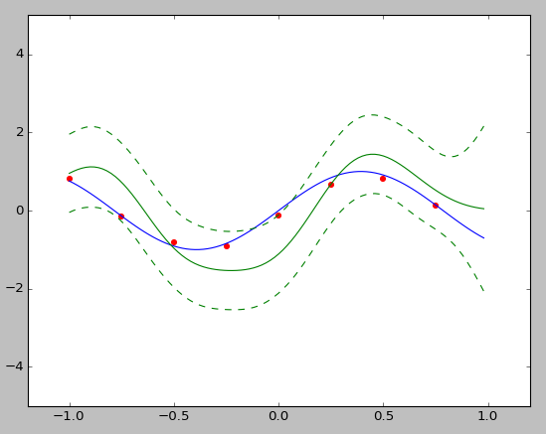








$$\left(x_{1},t_{1}\right)$$
$$\left(x_{6},t_{6}\right)$$
$$\left(x_{7},t_{7}\right)$$
$$\left(x_{2},t_{2}\right)$$
$$\left(x_{5},t_{5}\right)$$
$$\left(x_{8},t_{8}\right)$$
$$\left(x_{3},t_{3}\right)$$
$$\left(x_{4},t_{4}\right)$$

