Slide 1
Line Segment Intersection Detection
Gen Nishida

Slide 2
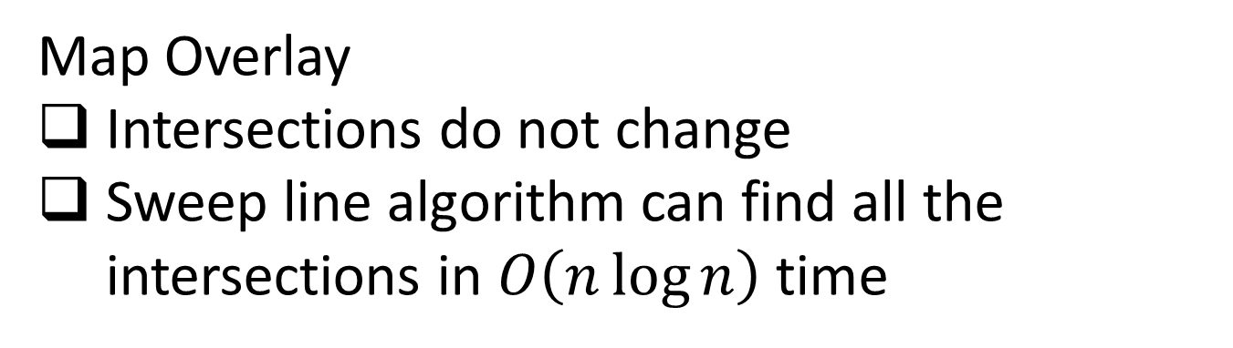
Static Set of Line Segments
Map Overlay
Intersections do not change
Sweep line algorithm can find all the intersections in $O\left(n\log{n}\right)$ time
Sweep line の絵を張っとく

Slide 3
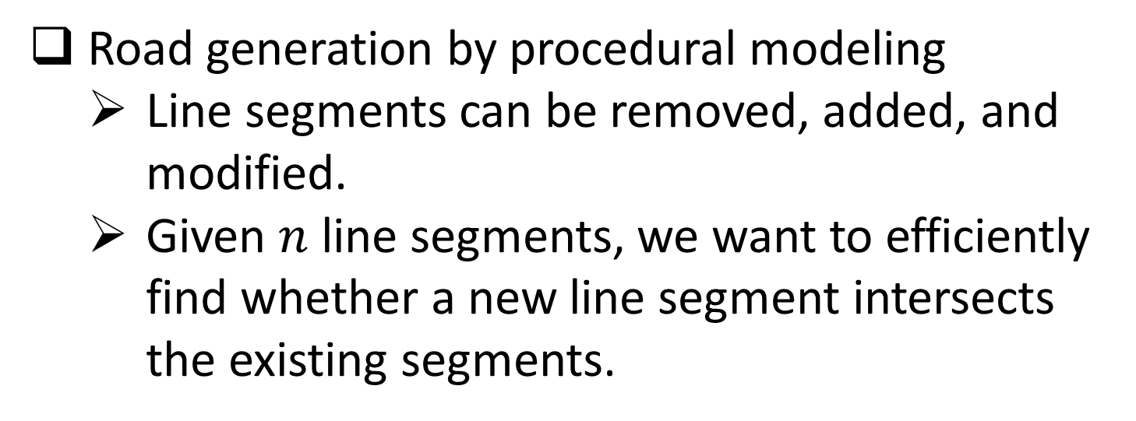
Dynamic Set of Line Segments
Road generation by procedural modeling
Line segments can be removed, added, and modified.
Given $n$ line segments, we want to efficiently find whether a new line segment intersects the existing segments.

Slide 4
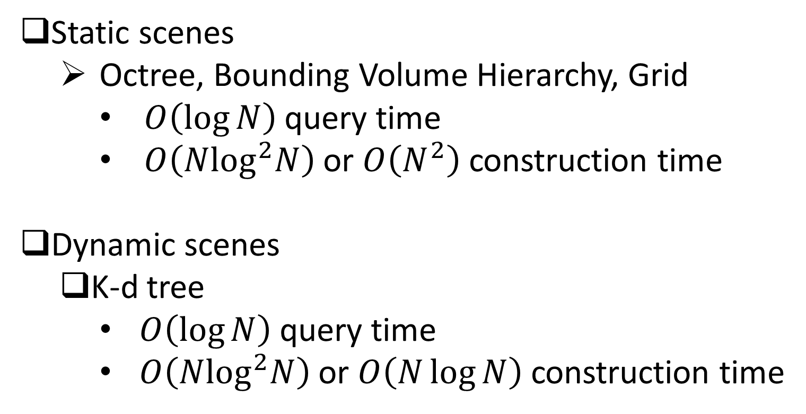
Ray Tracing
Static scenes
Octree, Bounding Volume Hierarchy, Grid
$O\left(\log{N}\right)$ query time
$O\left(N\log^{2}N\right)$ or $O\left(N^{2}\right)$ construction time
Dynamic scenes
K-d tree
$O\left(\log{N}\right)$ query time
$O\left(N\log^{2}N\right)$ or $O\left(N\log{N}\right)$ construction time

Slide 5
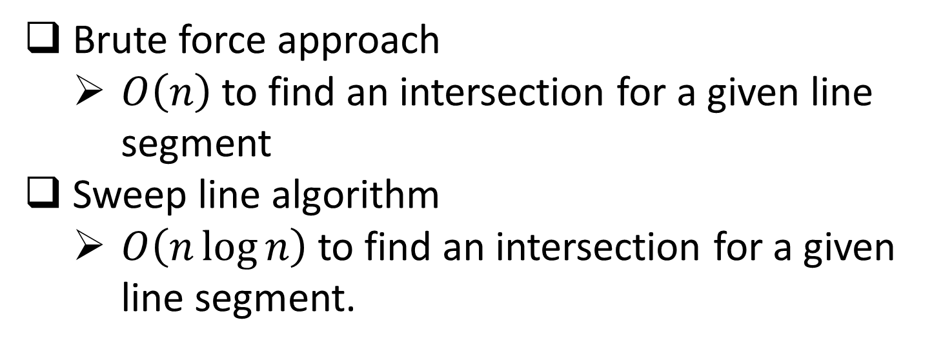
Dynamic Set of Line Segments
Brute force approach
$O\left(n\right)$to find an intersection for a given line segment
Sweep line algorithm
$O\left(n\log{n}\right)$ to find an intersection for a given line segment.

Slide 6
K-d tree^{[1]} for line segments
How to choose a splitting line?
Spatial median splitting evenly split the space
Randomized algorithm randomly choose a line segment as a splitting line
[1] Bentley, J. L. 1975. Multidimensional binary search trees used for associative searching. Communications of the ACM,
18(9), 1975.

Slide 7
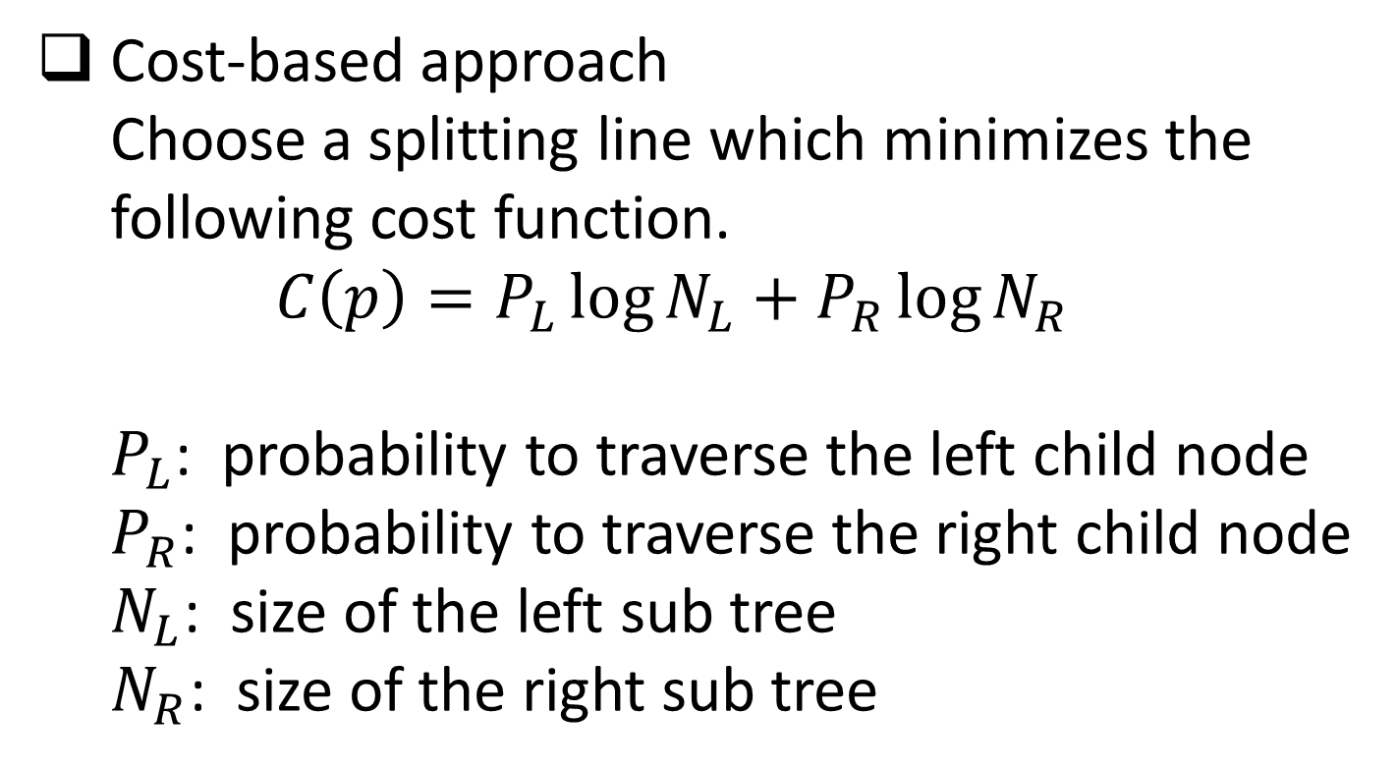
My Approach
Cost-based approach Choose a splitting line which minimizes the following cost function. $C\left(p\right)=P_{L}\log{N_{L}}+P_{R}\log{N_{R}}$ $P_{L}$: probability to traverse the left child node $P_{R}$: probability to traverse the right child node $N_{L}$: size of the left sub tree $N_{R}$: size of the right sub tree

Slide 8


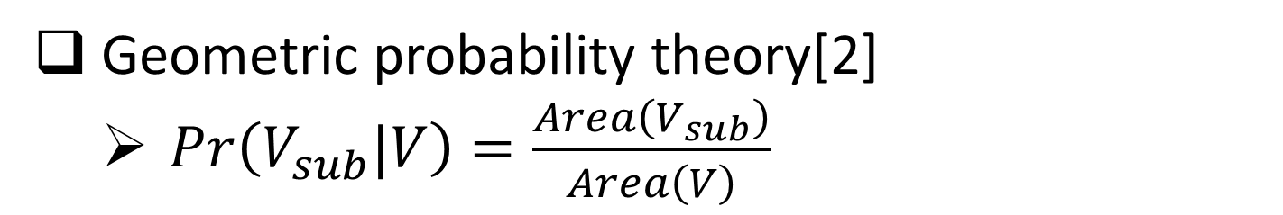

Probability Estimation
Geometric probability theory[2]
$Pr\left(V_{sub}|V\right)=\frac{Area\left(V_{sub}\right)}{Area\left(V\right)}$
$$N_{L}=3$$
$$N_{R}=4$$
Splitting line $\hat{l}$

Slide 9
Splitting Line Candidates
The splitting lines that pass one of two end points of each line segment are the only candidates that we have to consider.

Slide 10
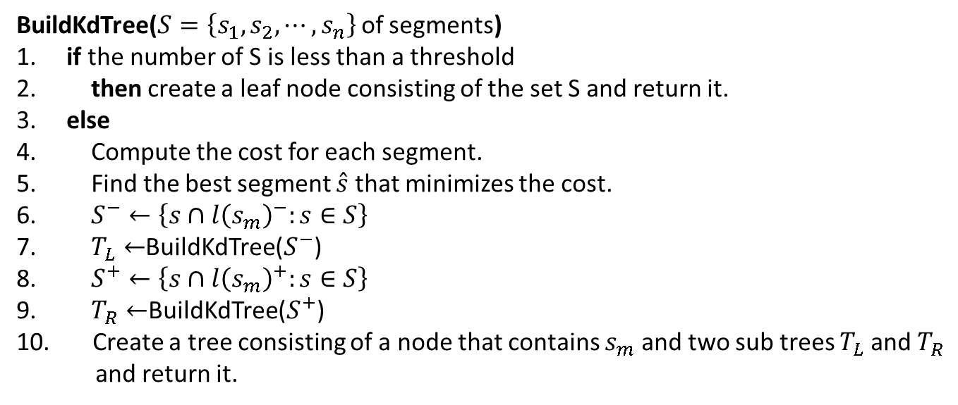
K-d Tree Construction
Recursive call of the following function.
BuildKdTree($S=\left\{s_{1},s_{2},⋯,s_{n}\right\}$ of segments)
1. if the number of S is less than a threshold
2. then create a leaf node consisting of the set S and return it.
3. else
4. Compute the cost for each segment.
5. Find the best segment $\hat{s}$ that minimizes the cost.
6. $S^{−}←\left\{s∩{l\left(s_{m}\right)}^{−}:s∈S\right\}$
7. $T_{L}←$BuildKdTree($S^{−}$)
8. $S^{+}←\left\{s∩{l\left(s_{m}\right)}^{+}:s∈S\right\}$
9. $T_{R}←$BuildKdTree($S^{+}$)
10. Create a tree consisting of a node that contains $s_{m}$ and two sub trees $T_{L}$ and $T_{R}$
and return it.

Slide 11
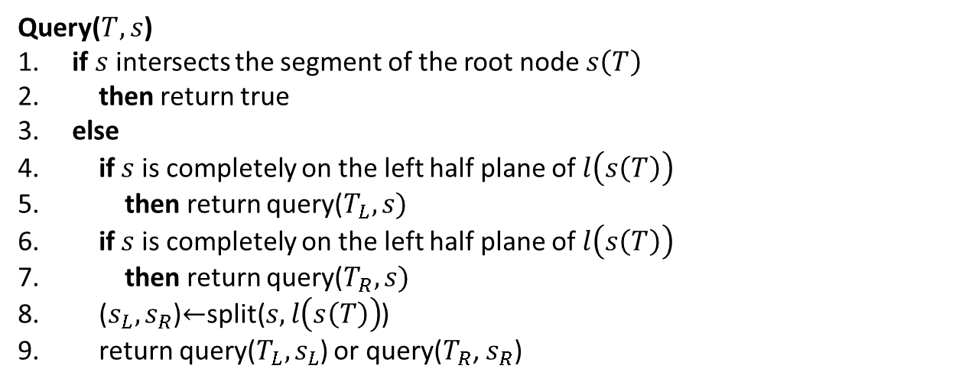
K-d Tree Query
Recursive call of the following function.
Query($T, s$)
1. if $s$ intersects the segment of the root node $s\left(T\right)$
2. then return true
3. else
4. if $s$ is completely on the left half plane of $l\left(s\left(T\right)\right)$
5. then return query($T_{L}, s)$
6. if $s$ is completely on the left half plane of $l\left(s\left(T\right)\right)$
7. then return query($T_{R}, s)$
8. ($s_{L}, s_{R}$)$←$split($s,l\left(s\left(T\right)\right)$)
9. return query($T_{L}, s_{L}$) or query($T_{R}$, $s_{R}$)

Slide 12
Analysis

Slide 13
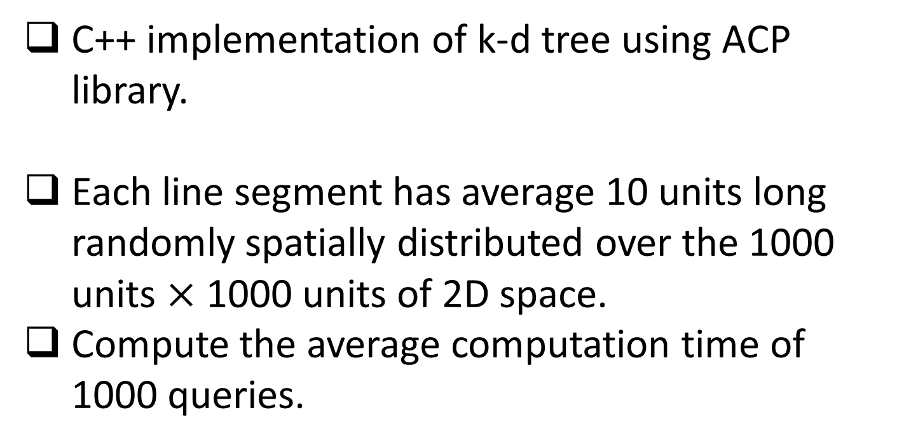
Experiments
C++ implementation of k-d tree using ACP library.
Each line segment has average 10 units long randomly spatially distributed over the 1000 units $×$ 1000 units of 2D space.
Compute the average computation time of 1000 queries.

Slide 14
Results
K-d tree versus brute force approach

Slide 15
Results
Cost-based splitting versus spatial median splitting

Slide 16
Conclusions
K-d tree for line segments using cost-based splitting
Faster than the spatial median splitting by average 20%.

Slide 17
Thank you

