Slide 1
Line Segment Intersection
Gen Nishida

Slide 2
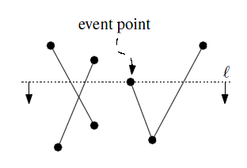
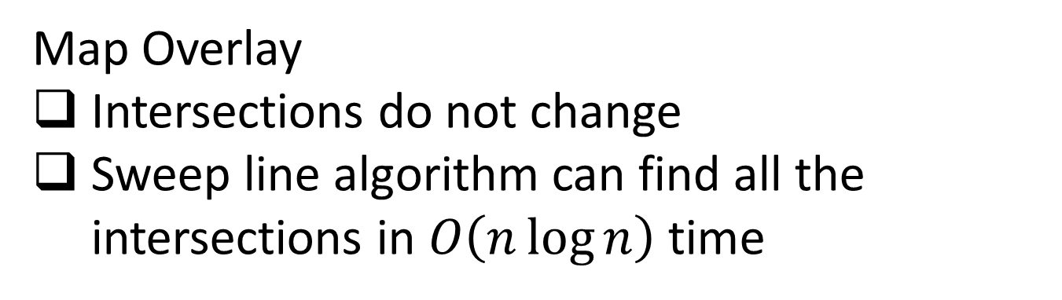
Static Set of Line Segments
Map Overlay
Intersections do not change
Sweep line algorithm can find all the intersections in $O\left(n\log{n}\right)$ time
[1] Berg, M. D., Cheong, O., Kreveld, M. V., and Overmars, M. Computational Geometry Algorithms and Applications Third
Edition. 2008. ISBN 3-54077-973-6

Slide 3
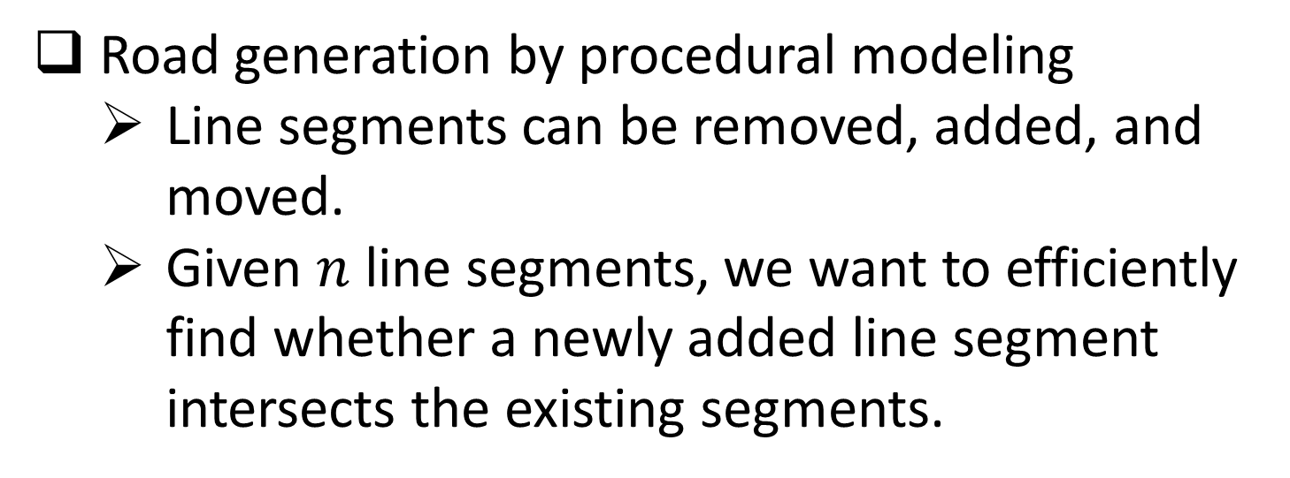
Dynamic Set of Line Segments
Road generation by procedural modeling
Line segments can be removed, added, and moved.
Given $n$ line segments, we want to efficiently find whether a newly added line segment intersects the existing segments.

Slide 4
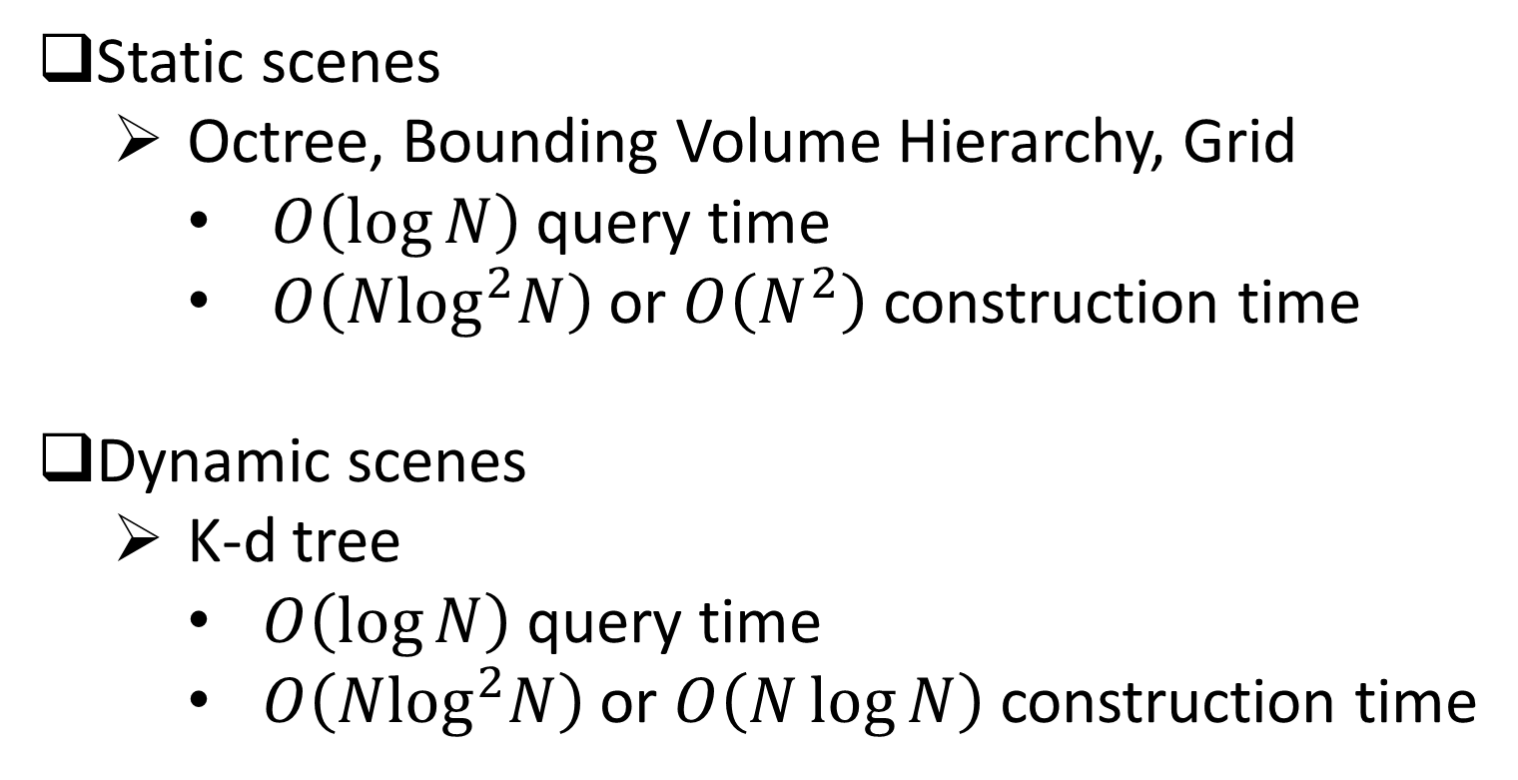
Ray Tracing
Static scenes
Octree, Bounding Volume Hierarchy, Grid
$O\left(\log{N}\right)$ query time
$O\left(N\log^{2}N\right)$ or $O\left(N^{2}\right)$ construction time
Dynamic scenes
K-d tree
$O\left(\log{N}\right)$ query time
$O\left(N\log^{2}N\right)$ or $O\left(N\log{N}\right)$ construction time

Slide 5
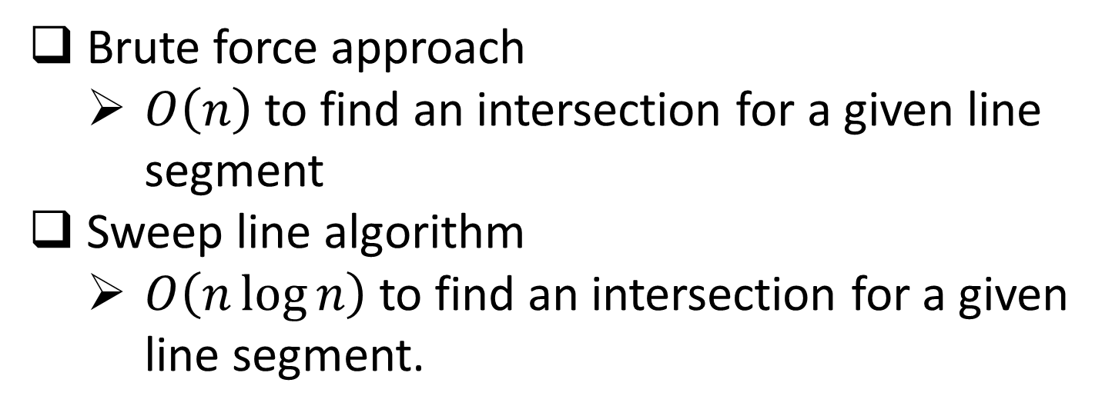
Dynamic Set of Line Segments
Brute force approach
$O\left(n\right)$to find an intersection for a given line segment
Sweep line algorithm
$O\left(n\log{n}\right)$ to find an intersection for a given line segment.

Slide 6
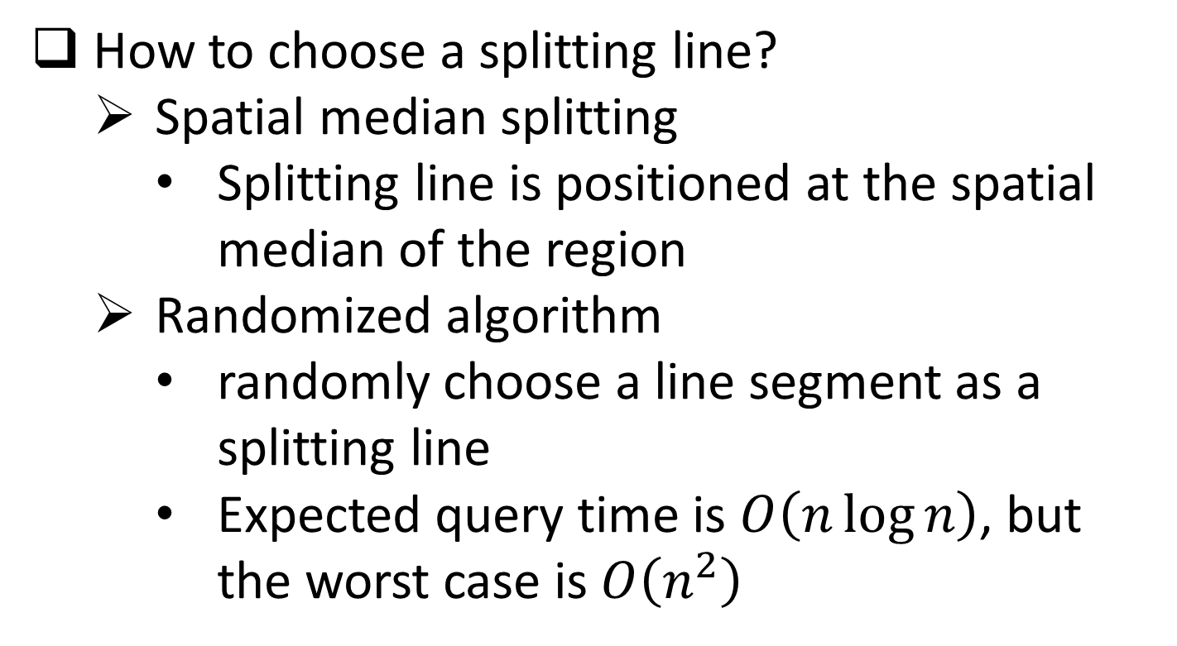
K-d tree^{[2]} for line segments
How to choose a splitting line?
Spatial median splitting
Splitting line is positioned at the spatial median of the region
Randomized algorithm
randomly choose a line segment as a splitting line
Expected query time is $O\left(n\log{n}\right)$, but the worst case is $O\left(n^{2}\right)$
[2] Bentley, J. L. 1975. Multidimensional binary search trees used for associative searching. Communications of the ACM,
18(9), 1975.

Slide 7
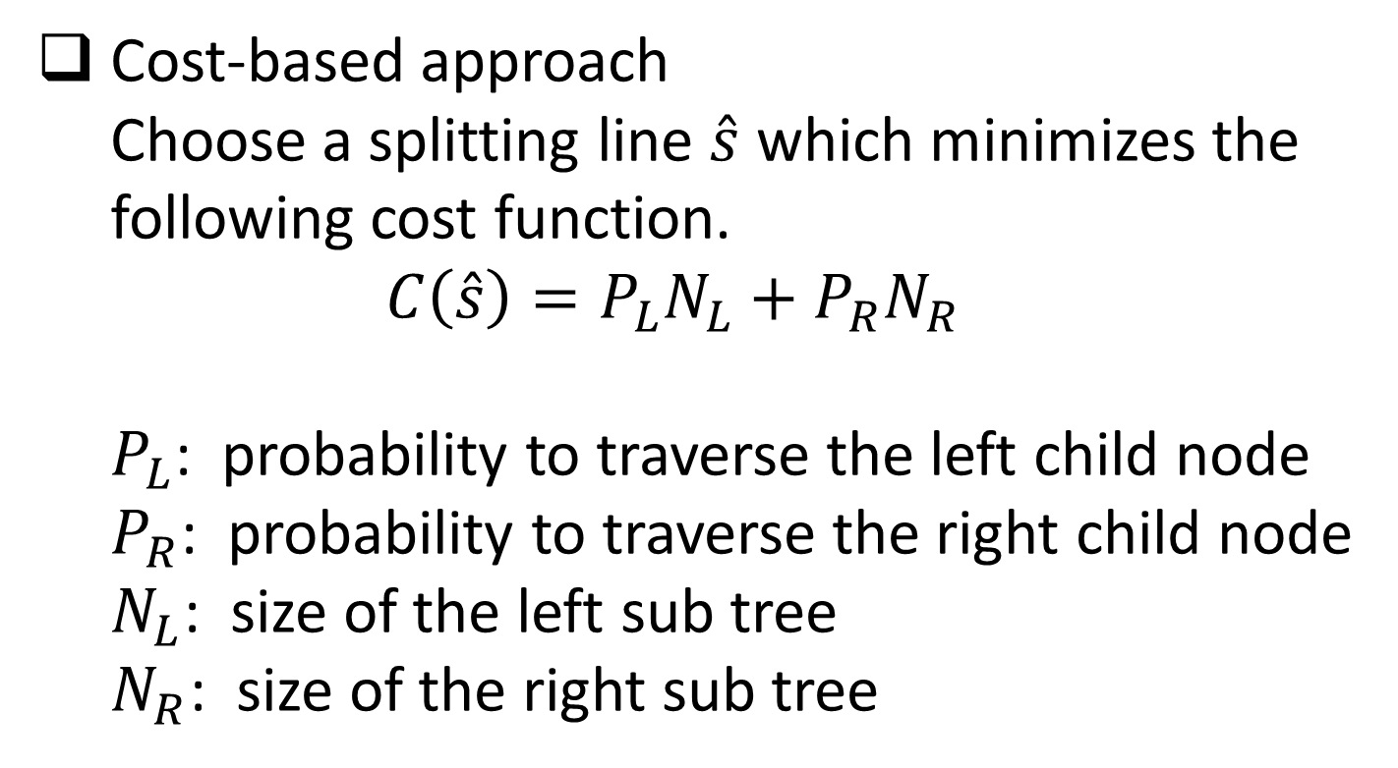
My Approach
Cost-based approach Choose a splitting line $\hat{s}$ which minimizes the following cost function. $C\left(\hat{s}\right)=P_{L}N_{L}+P_{R}N_{R}$ $P_{L}$: probability to traverse the left child node $P_{R}$: probability to traverse the right child node $N_{L}$: size of the left sub tree $N_{R}$: size of the right sub tree

Slide 8

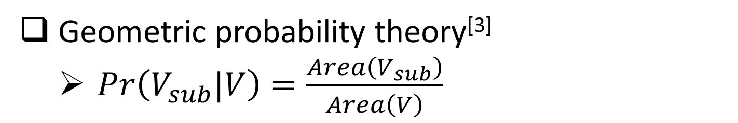


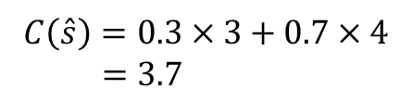
Probability Estimation
Geometric probability theory^{[3]}
$Pr\left(V_{sub}|V\right)=\frac{Area\left(V_{sub}\right)}{Area\left(V\right)}$
$$C\left(\hat{s}\right)=0.3×3+0.7×4$$ $=3.7$
$$V_{L}$$
$$V_{R}$$
0.3
0.7
Splitting line $\hat{s}$
[3] Glassner, A. 1989. An Introduction to Ray Tracing. Morgan Kaufmann, 1989. ISBN 0-12286-160-4.

Slide 9
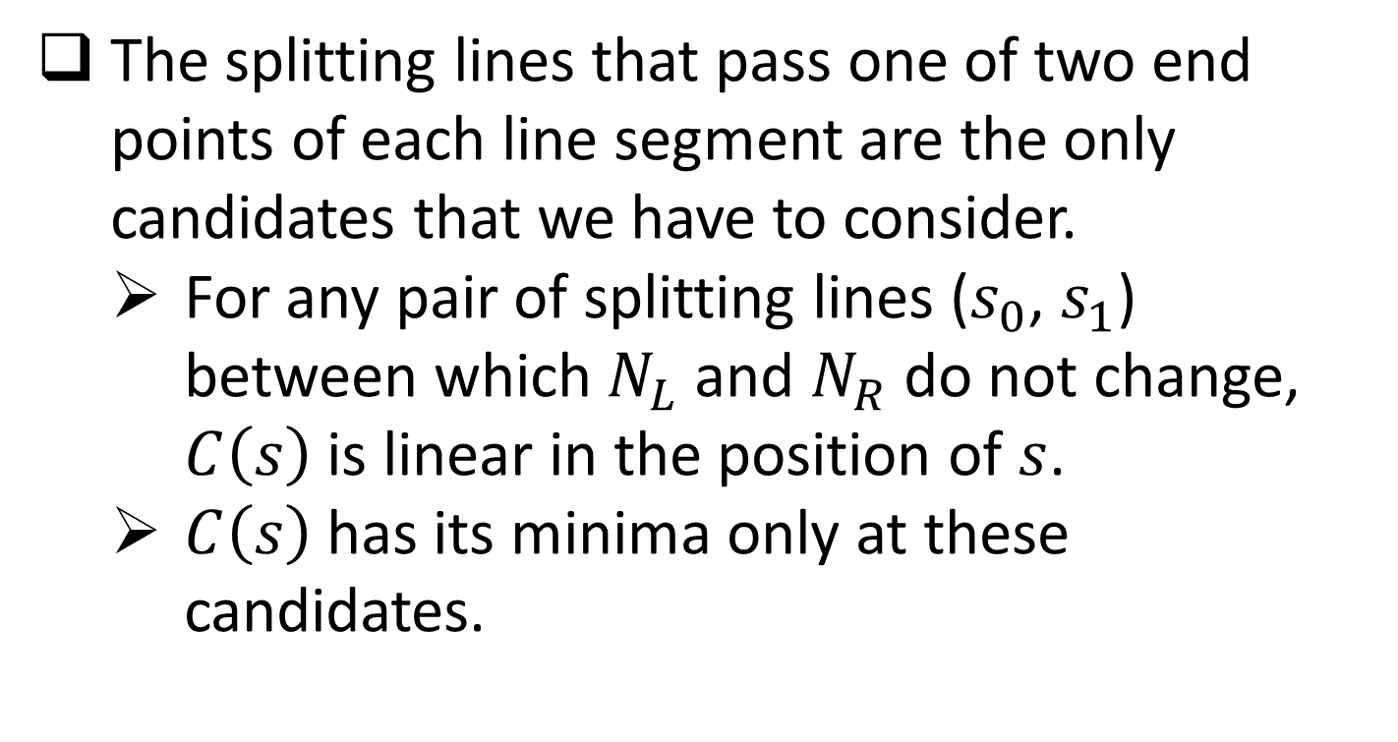
Splitting Line Candidates
The splitting lines that pass one of two end points of each line segment are the only candidates that we have to consider.
For any pair of splitting lines ($s_{0}$, $s_{1}$) between which $N_{L}$ and $N_{R}$ do not change, $C\left(s\right)$ is linear in the position of $s$.
$C\left(s\right)$ has its minima only at these candidates.

Slide 10
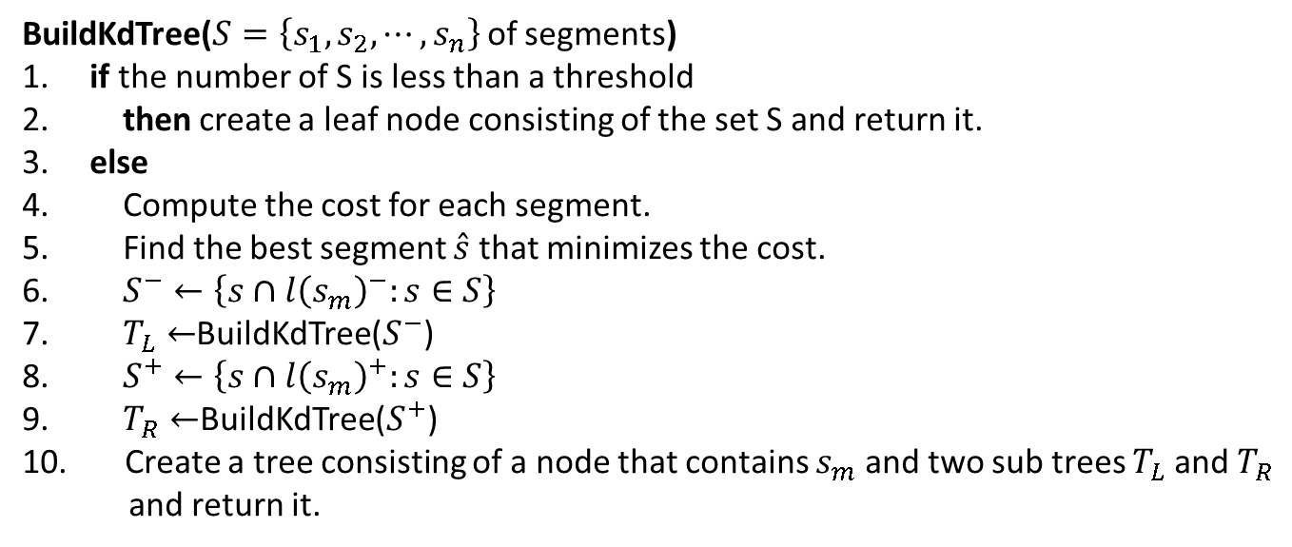
K-d Tree Construction
Recursive call of the following function.
BuildKdTree($S=\left\{s_{1},s_{2},⋯,s_{n}\right\}$ of segments)
1. if the number of S is less than a threshold
2. then create a leaf node consisting of the set S and return it.
3. else
4. Compute the cost for each segment.
5. Find the best segment $\hat{s}$ that minimizes the cost.
6. $S^{−}←\left\{s∩{l\left(s_{m}\right)}^{−}:s∈S\right\}$
7. $T_{L}←$BuildKdTree($S^{−}$)
8. $S^{+}←\left\{s∩{l\left(s_{m}\right)}^{+}:s∈S\right\}$
9. $T_{R}←$BuildKdTree($S^{+}$)
10. Create a tree consisting of a node that contains $s_{m}$ and two sub trees $T_{L}$ and $T_{R}$
and return it.

Slide 11
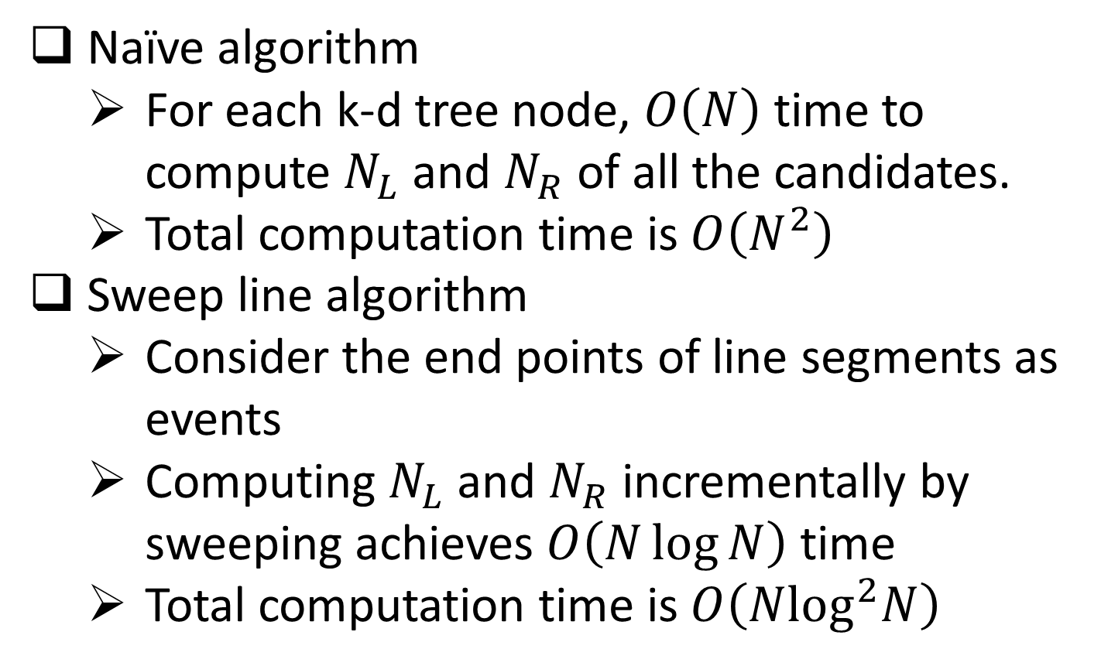
Cost Computation
Naïve algorithm
For each k-d tree node, $O\left(N\right)$ time to compute $N_{L}$ and $N_{R}$ of all the candidates.
Total computation time is $O\left(N^{2}\right)$
Sweep line algorithm
Consider the end points of line segments as events
Computing $N_{L}$ and $N_{R}$ incrementally by sweeping achieves $O\left(N\log{N}\right)$ time
Total computation time is $O\left(N\log^{2}N\right)$

Slide 12
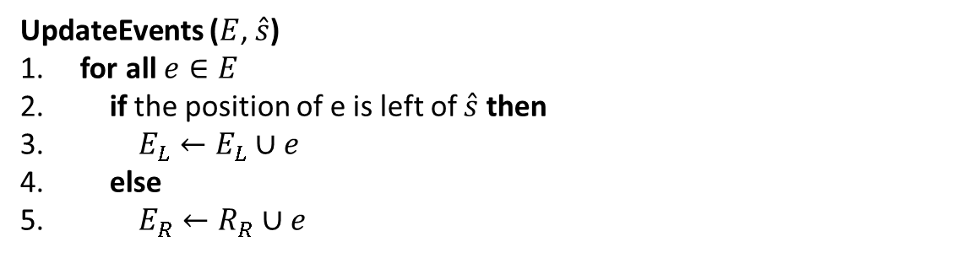
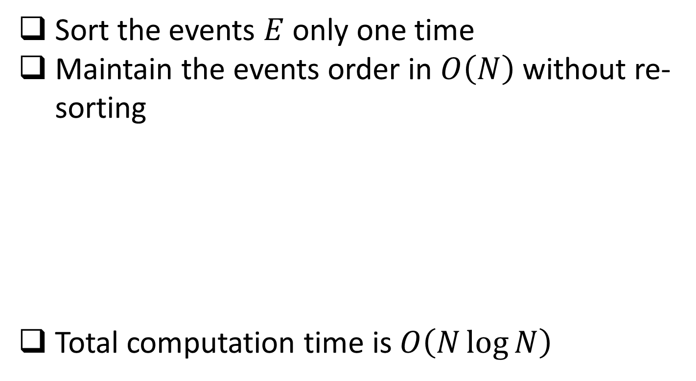
Improved Cost Computation
Sort the events $E$ only one time
Maintain the events order in $O\left(N\right)$ without re-sorting
Total computation time is $O\left(N\log{N}\right)$
UpdateEvents ($E$, $\hat{s}$)
1. for all $e∈E$
2. if the position of e is left of $\hat{s}$ then
3. $E_{L}←E_{L}∪e$
4. else
5. $E_{R}←R_{R}∪e$

Slide 13
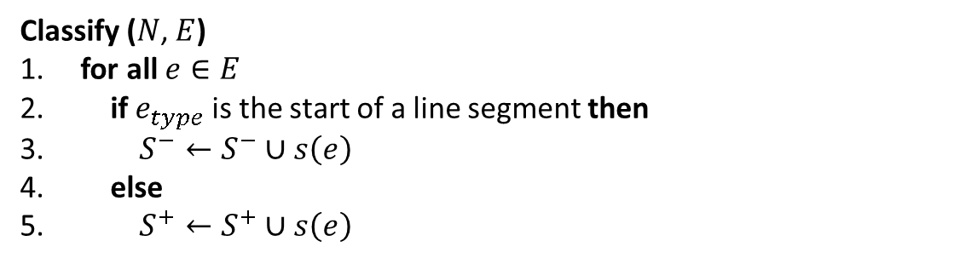
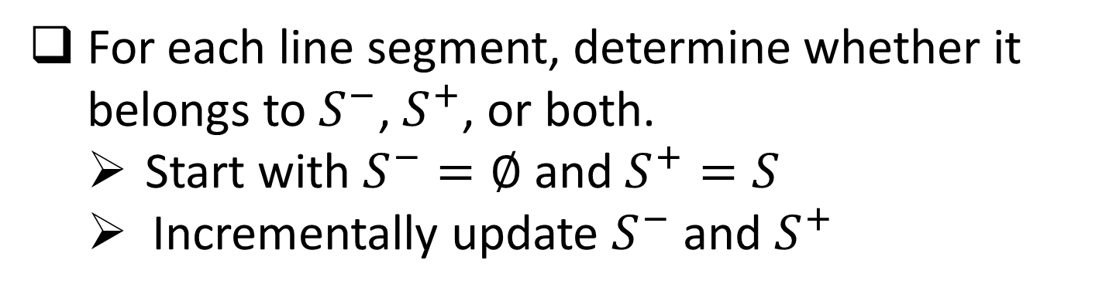
Classification
For each line segment, determine whether it belongs to $S^{−}$, $S^{+}$, or both.
Start with $S^{−}=∅$ and $S^{+}=S$
Incrementally update $S^{−}$ and $S^{+}$
Classify ($N$, $E$)
1. for all $e∈E$
2. if $e_{type}$ is the start of a line segment then
3. $S^{−}←S^{−}∪s\left(e\right)$
4. else
5. $S^{+}←S^{+}∪s\left(e\right)$

Slide 14






Classification
$$E^{x}=\left\{{e_{0}}^{s}<{e_{1}}^{s}<{e_{0}}^{e}<{e_{2}}^{s}<{e_{1}}^{e}<{e_{2}}^{e}\right\}$$
$$s_{1}$$
$$E^{y}=\left\{{e_{0}}^{s}<{e_{2}}^{s}<{e_{2}}^{e}<{e_{0}}^{e}<{e_{1}}^{e}<{e_{1}}^{s}\right\}$$
$$s_{0}$$
$$s_{2}$$
$S^{−}=\left\{s_{0},s_{1}\right\}$, $S^{+}=\left\{s_{0},s_{1},s_{2}\right\}$
${e_{0}}^{e}$ occurs
$S^{−}=\left\{s_{0},s_{1}\right\}$, $S^{+}=\left\{s_{1},s_{2}\right\}$

Slide 15
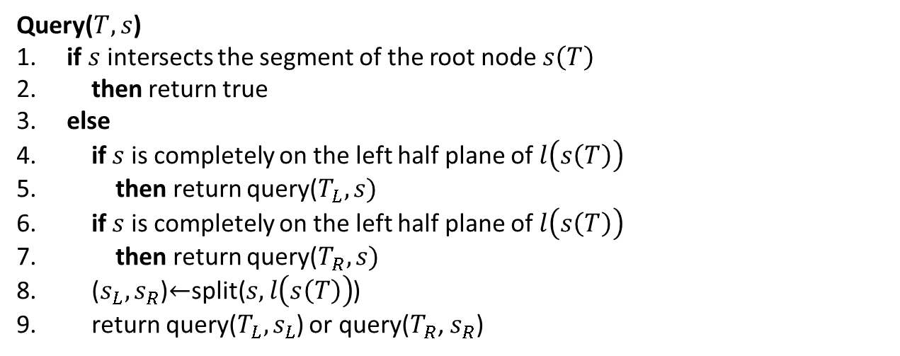
K-d Tree Query
Recursive call of the following function.
Query($T, s$)
1. if $s$ intersects the segment of the root node $s\left(T\right)$
2. then return true
3. else
4. if $s$ is completely on the left half plane of $l\left(s\left(T\right)\right)$
5. then return query($T_{L}, s)$
6. if $s$ is completely on the left half plane of $l\left(s\left(T\right)\right)$
7. then return query($T_{R}, s)$
8. ($s_{L}, s_{R}$)$←$split($s,l\left(s\left(T\right)\right)$)
9. return query($T_{L}, s_{L}$) or query($T_{R}$, $s_{R}$)
Computation time is $O\left(\log{N}\right)$

Slide 16
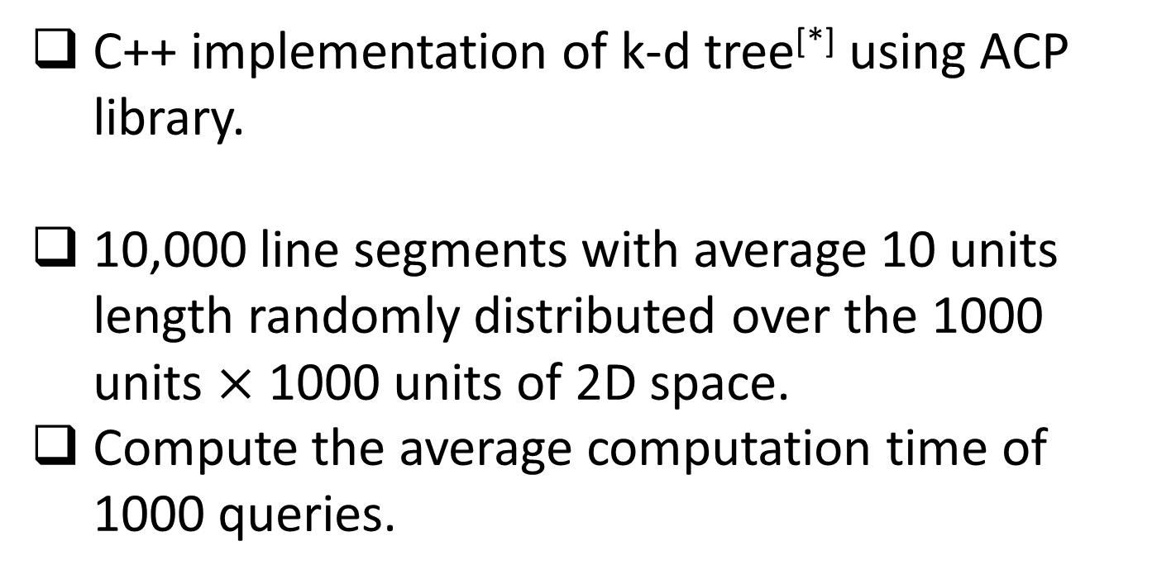
Experiments
C++ implementation of k-d tree[*] using ACP library.
10,000 line segments with average 10 units length randomly distributed over the 1000 units $×$ 1000 units of 2D space.
Compute the average computation time of 1000 queries.
* For the tree construction, only the naïve approach was implemented.

Slide 17
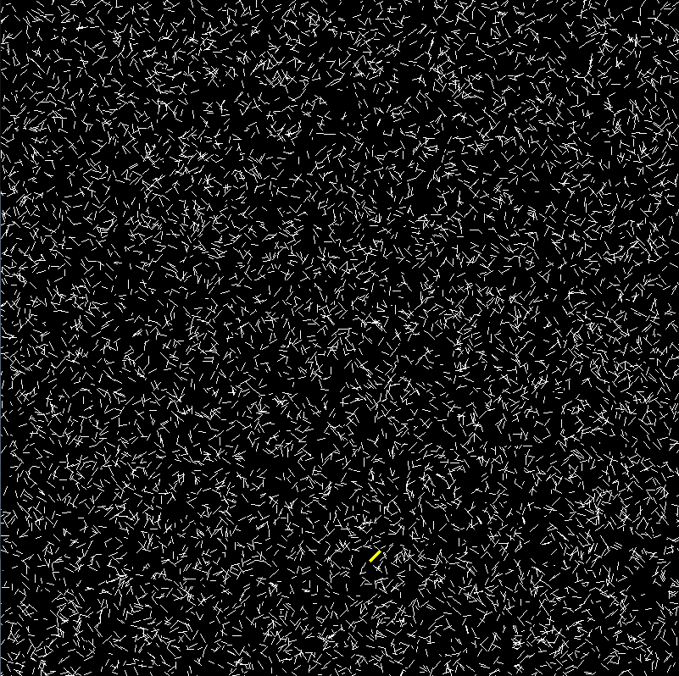
One Example of Test Data

Slide 18
Results
K-d tree versus brute force approach

Slide 19
Results
Cost-based splitting versus spatial median splitting

Slide 20
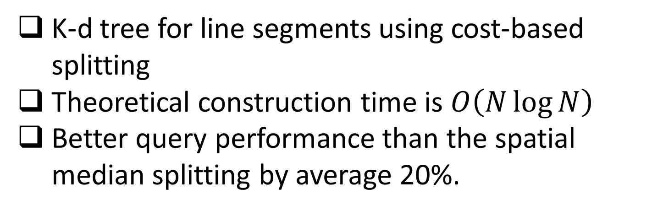
Conclusions
K-d tree for line segments using cost-based splitting
Theoretical construction time is $O\left(N\log{N}\right)$
Better query performance than the spatial median splitting by average 20%.

Slide 21
Thank you

Slide 22
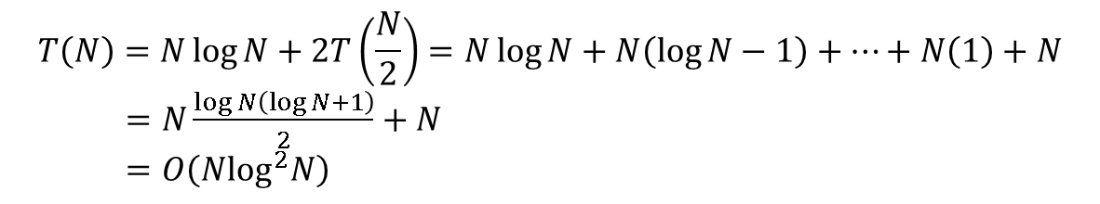
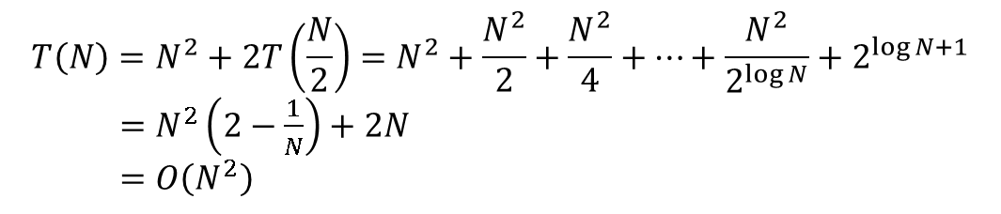
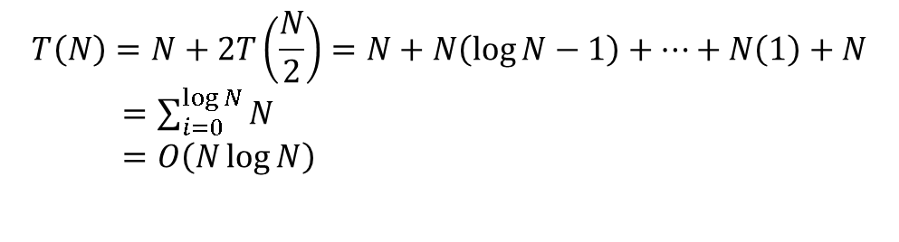
Appendix
Naïve algorithm for cost computation
$$T\left(N\right)=N^{2}+2T\left(\frac{N}{2}\right)=N^{2}+\frac{N^{2}}{2}+\frac{N^{2}}{4}+⋯+\frac{N^{2}}{2^{\log{N}}}+2^{\log{N+1}}$$
$=N^{2}\left(2−\frac{1}{N}\right)+2N$
$=O\left(N^{2}\right)$
Sweep line algorithm for cost computation
$$T\left(N\right)=N\log{N}+2T\left(\frac{N}{2}\right)=N\log{N}+N\left(\log{N}−1\right)+⋯+N\left(1\right)+N$$
$=N\frac{\log{N}\left(\log{N}+1\right)}{2}+N$
$=O\left(N\log^{2}N\right)$
Improved algorithm
$$T\left(N\right)=N+2T\left(\frac{N}{2}\right)=N+N\left(\log{N}−1\right)+⋯+N\left(1\right)+N$$
$=\sum_{i=0}^{\log{N}}{N}$
$=O\left(N\log{N}\right)$

