Slide 1
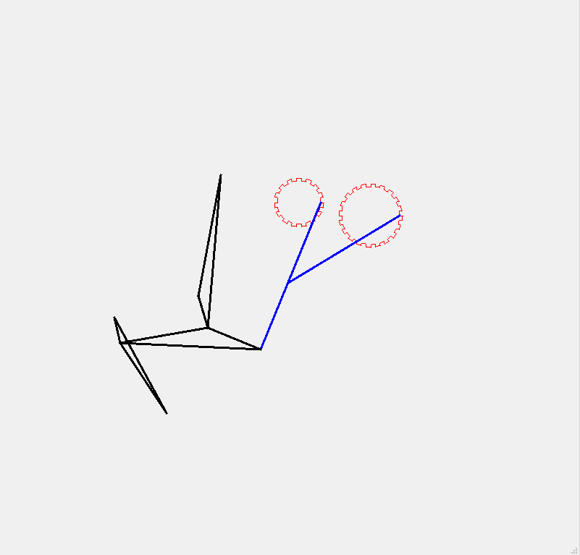


















Constraint
$$p_{0}$$
$$p_{1}$$
$$p_{3}$$
$$p_{3}$$
$$p_{0}$$
$$p_{2}$$
$$p_{1}$$
$$p_{4}$$
$$p_{6}$$
$$p_{5}$$
$$p_{4}$$
$$p_{7}$$
$$p_{5}$$
$$p_{7}$$
$$p_{2}$$
$$p_{6}$$
$$p_{8}$$
$$p_{8}$$

Slide 2
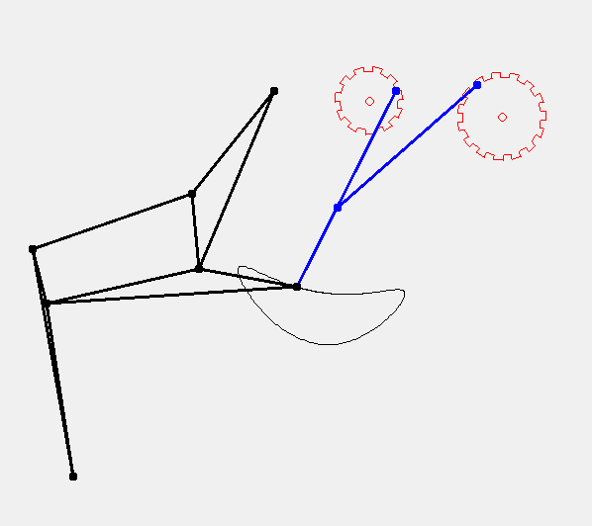




















$$v_{4}$$
$$v_{0}$$
$$v_{1}$$
$$v_{4}$$
$$v_{1}$$
$$v_{0}$$
$$v_{6}$$
$$v_{6}$$
$$v_{2}$$
$$v_{2}$$
$$v_{7}$$
$$v_{7}$$
$$v_{5}$$
$$v_{5}$$
$$v_{3}$$
$$v_{3}$$
$$v_{8}$$
$$v_{8}$$
$$v_{9}$$
$$v_{9}$$

