Slide 1





Image plane
$$v_{y}$$
$$p_{y}$$
$$z$$
$$f$$
$$−v_{z}$$

Slide 2






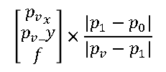

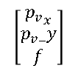
$${−v_{0}}_{z}$$
$$f$$
$$v_{0}$$
$$p_{0}$$
$$v_{1}$$
Camera
$$p_{1}$$
$$\left[\begin{aligned}\begin{matrix}{p_{v}}_{x} \\ p_{v}_y\end{matrix} \\ f\end{aligned}\right]×\frac{\left|p_{1}−p_{0}\right|}{\left|p_{v}−p_{1}\right|}$$
$$\left[\begin{aligned}\begin{matrix}{p_{v}}_{x} \\ p_{v}_y\end{matrix} \\ f\end{aligned}\right]$$
$$p_{v}$$

Slide 3









$$v_{0}$$
$$v_{1}$$
$$p_{0}$$
$$vp0$$
$$v_{2}$$
$$p_{1}$$
$$p_{2}$$
$$vp1$$
Camera
$$vp2$$

