Slide 1
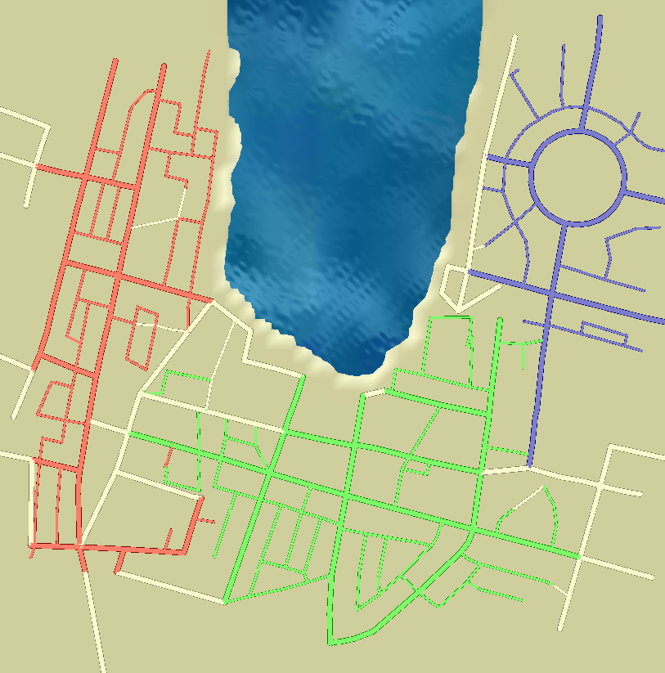
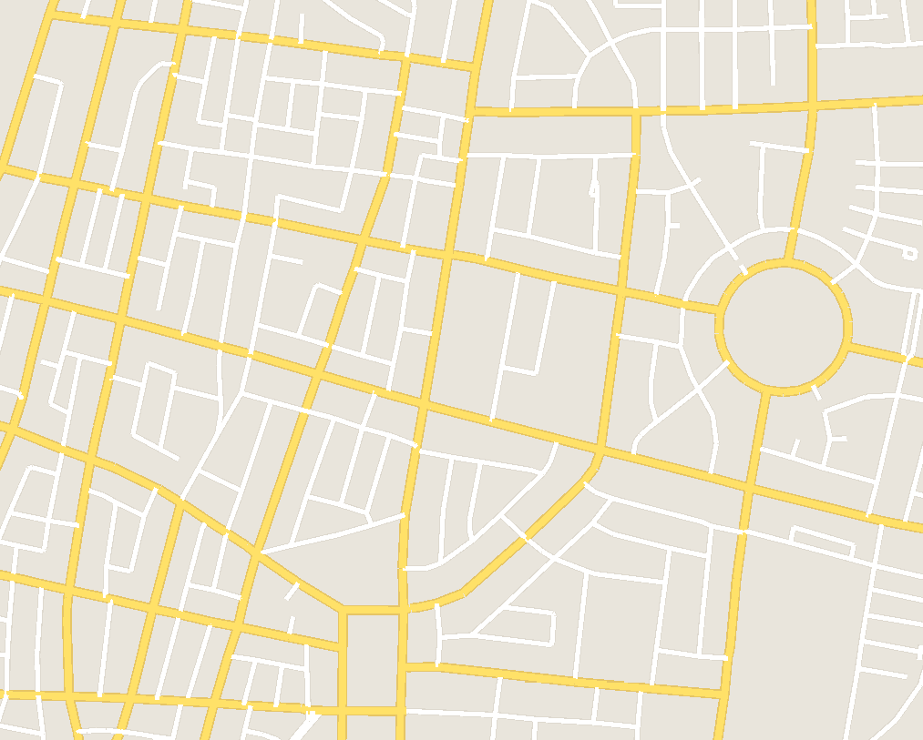

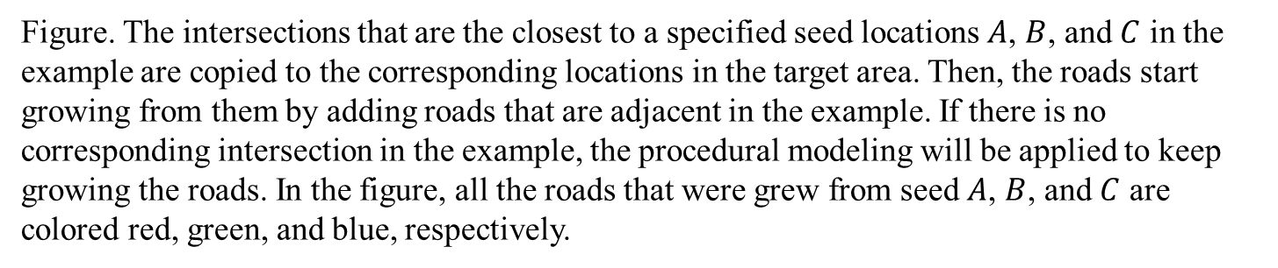





Seed $A$
Seed $C$
Seed $A$
Seed $C$
Seed $B$
Seed $B$
(a) The example roads in Tel-Aviv
(b) The result of adaptive fitting.
Figure. The intersections that are the closest to a specified seed locations $A$, $B$, and $C$ in the example are copied to the corresponding locations in the target area. Then, the roads start growing from them by adding roads that are adjacent in the example. If there is no corresponding intersection in the example, the procedural modeling will be applied to keep growing the roads. In the figure, all the roads that were grew from seed $A$, $B$, and $C$ are colored red, green, and blue, respectively.

