Slide 1
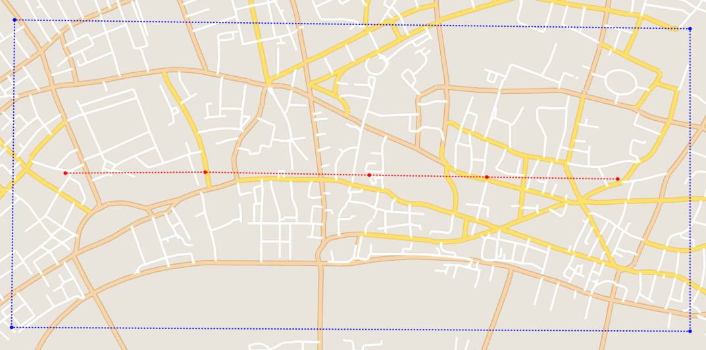
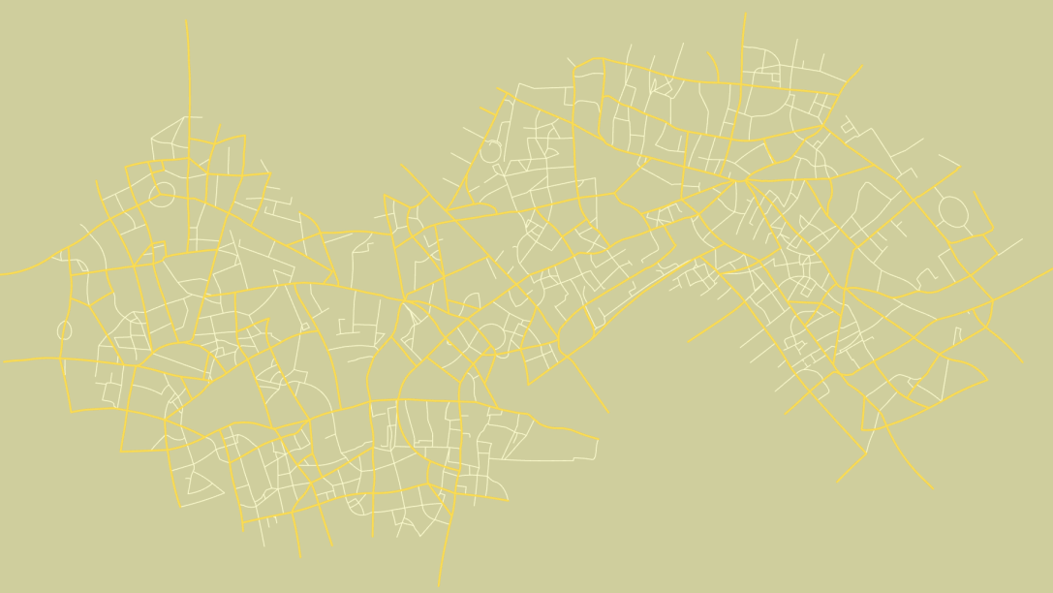




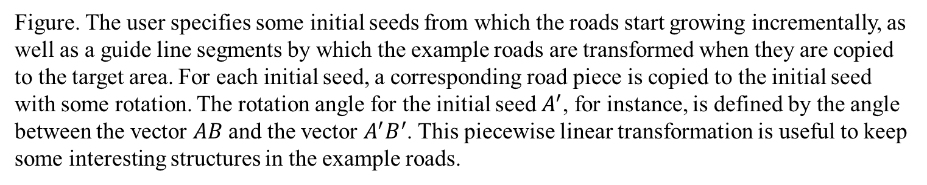






Warping
$$D^{′}$$
$$A$$
$$B$$
$$C$$
$$D$$
$$E$$
$$A^{′}$$
$$B^{′}$$
$$C^{′}$$
$$E^{′}$$
(a) The example roads in London
(b) The result of the roads warping
Figure. The user specifies some initial seeds from which the roads start growing incrementally, as well as a guide line segments by which the example roads are transformed when they are copied to the target area. For each initial seed, a corresponding road piece is copied to the initial seed with some rotation. The rotation angle for the initial seed $A^{′}$, for instance, is defined by the angle between the vector $AB$ and the vector $A^{′}B^{′}$. This piecewise linear transformation is useful to keep some interesting structures in the example roads.

Slide 2
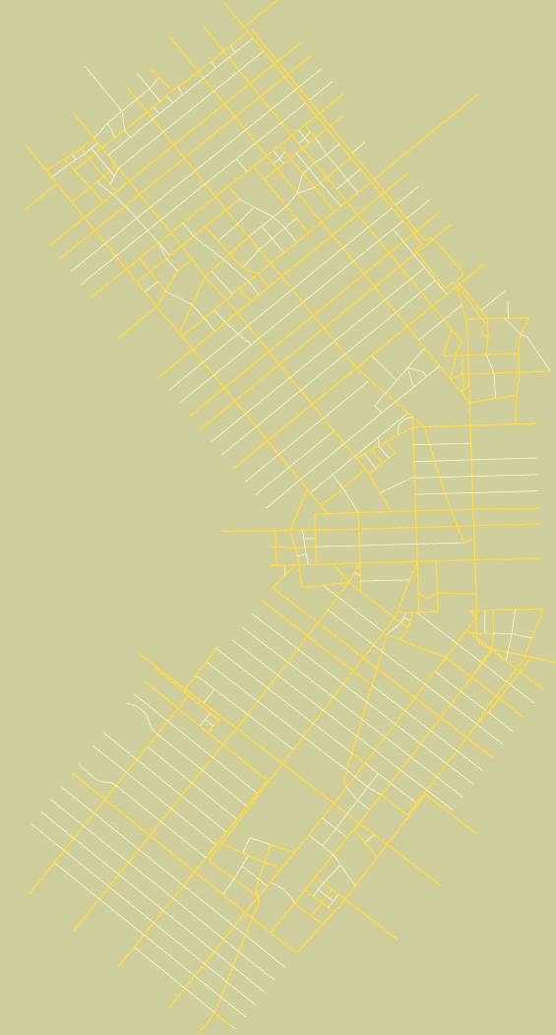
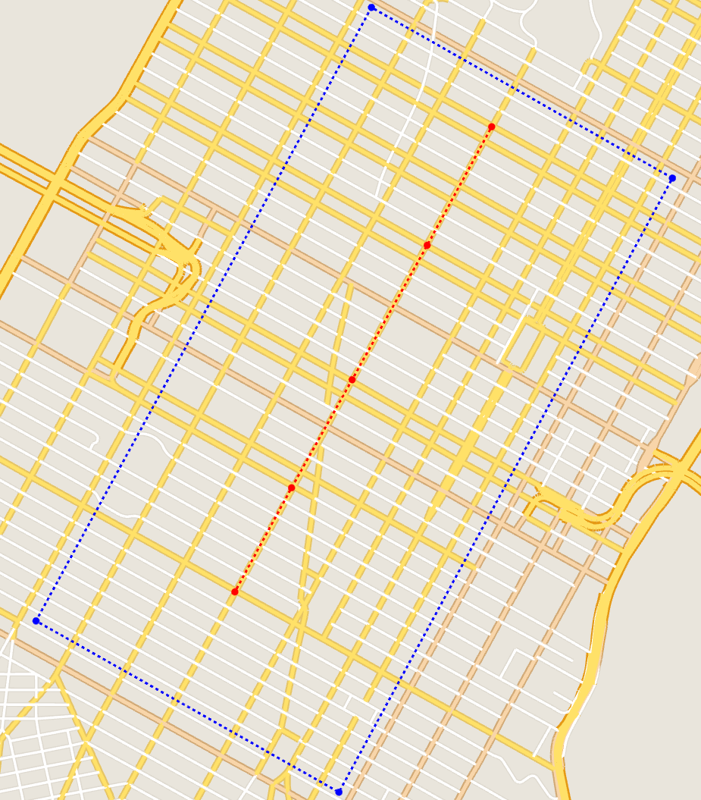










Another result
$$A$$
$$A^{′}$$
$$B$$
$$B^{′}$$
$$C$$
$$C^{′}$$
$$D$$
$$D^{′}$$
$$E$$
$$E^{′}$$
(b) The result of the roads warping
(a) The example roads in Manhattan
(b) The result of the roads warping
(a) The example roads in Manhattan

Slide 3
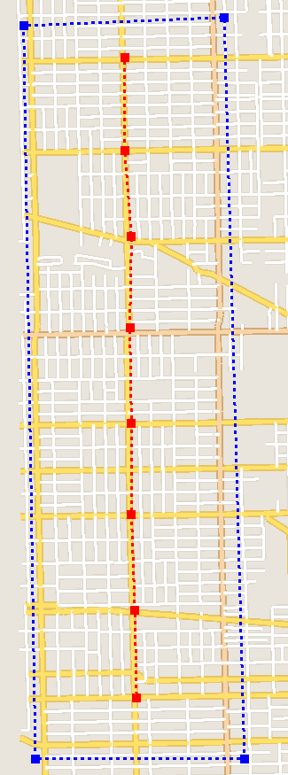
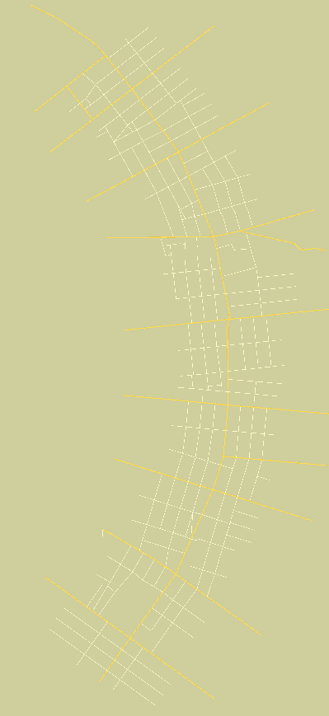
Another result
(a) The example roads in Chicago
(b) The result of the roads warping

