Slide 1
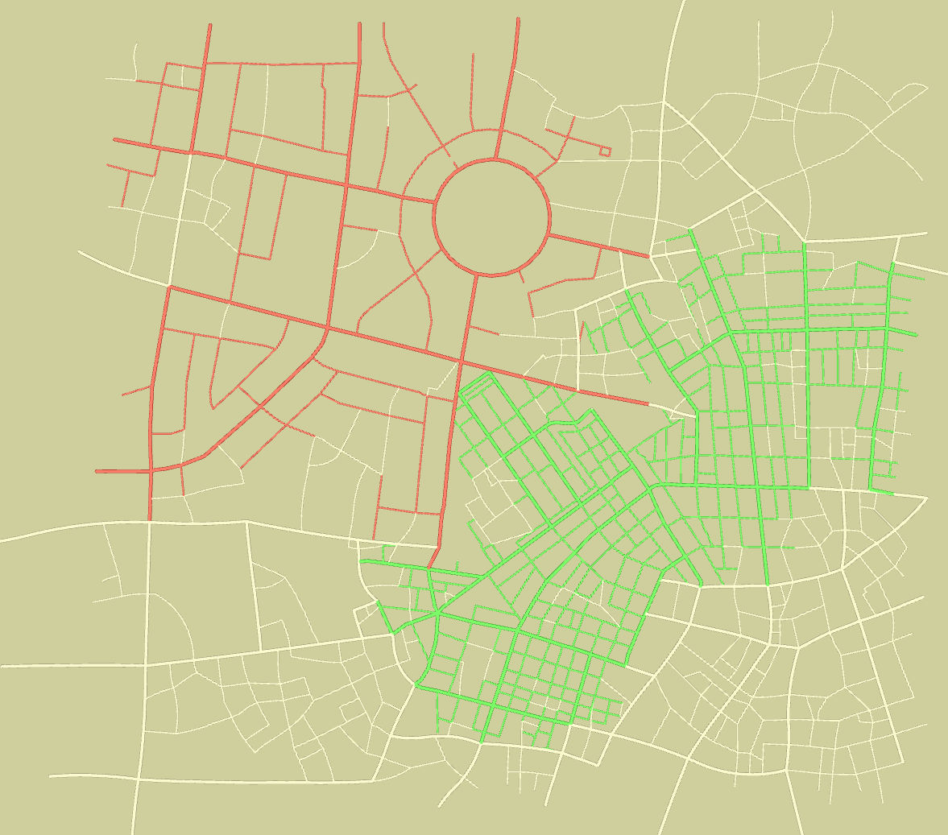
Interpolation between two examples, Tel-Aviv and Tokyo

Slide 2
