Slide 1
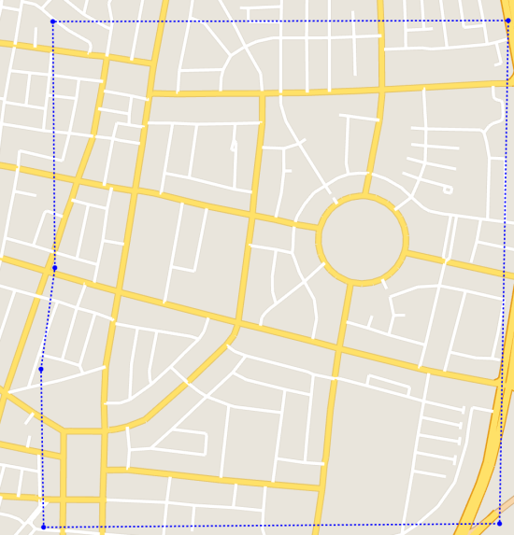
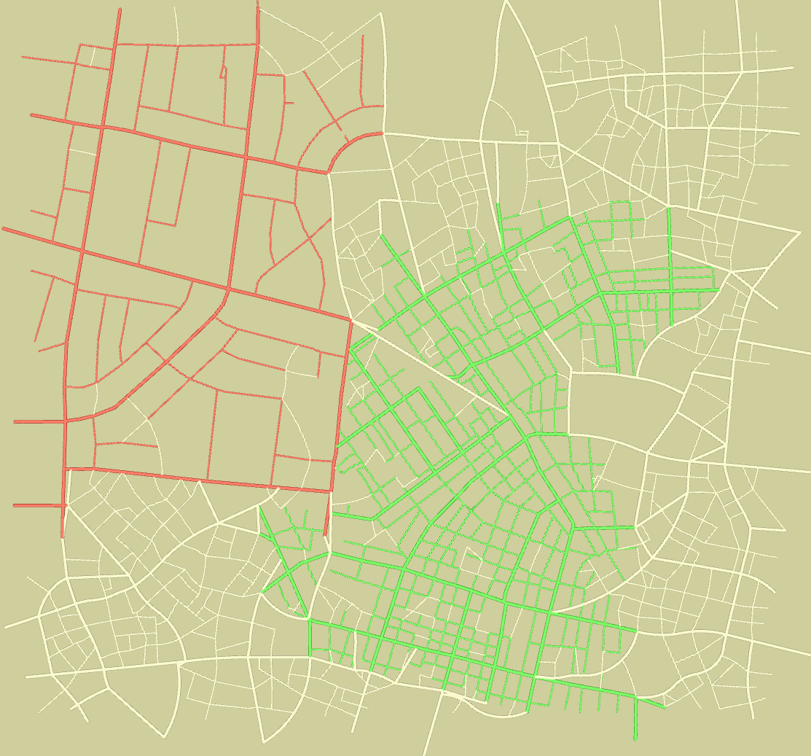
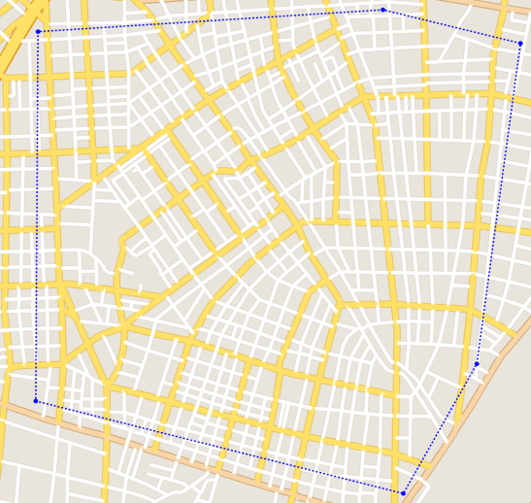




(a) The example $A$ (Tel-Aviv)
Seed $A$
Seed $B$
(b) The example $B$ (Tokyo)
(c) The result of the interpolation of two examples
Figure. The user specifies multiple examples and the corresponding initial seed location for each example. The example roads are copied to the target area starting from the initial seeds.

