Slide 1

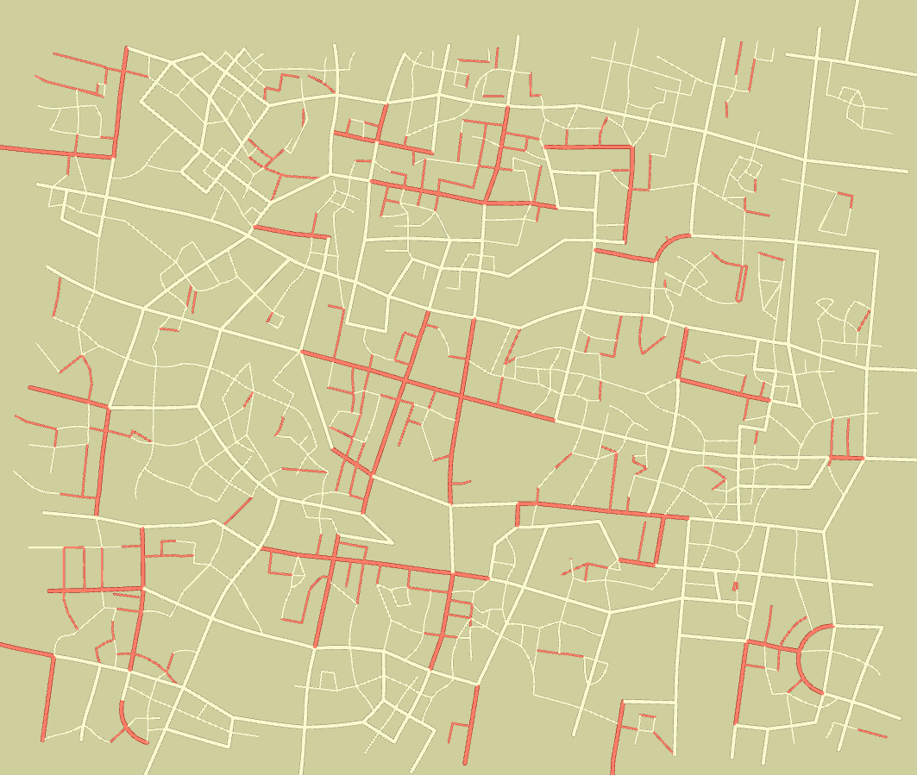
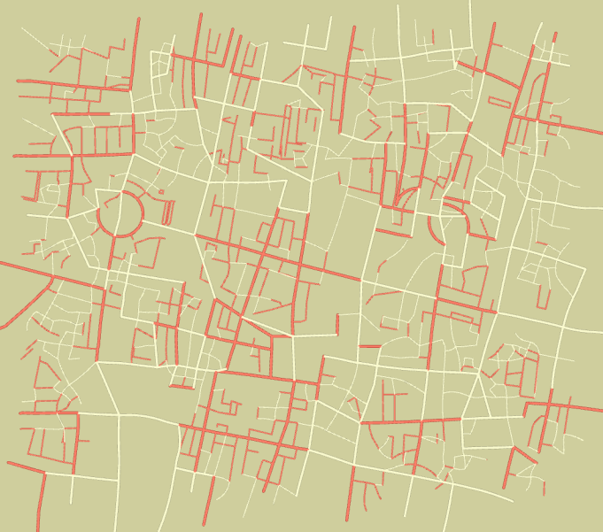
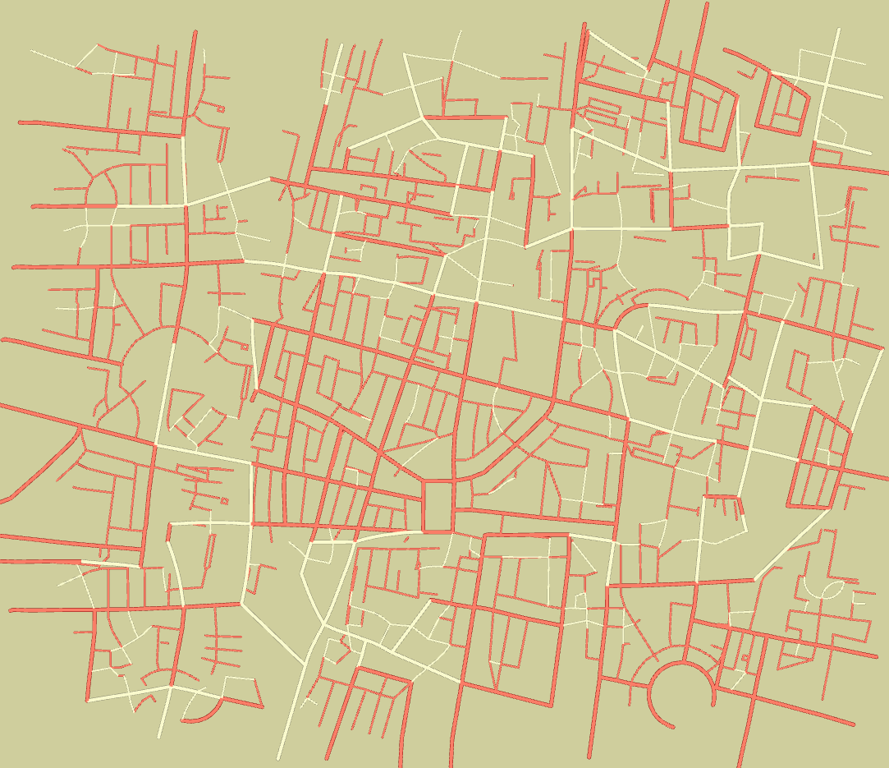
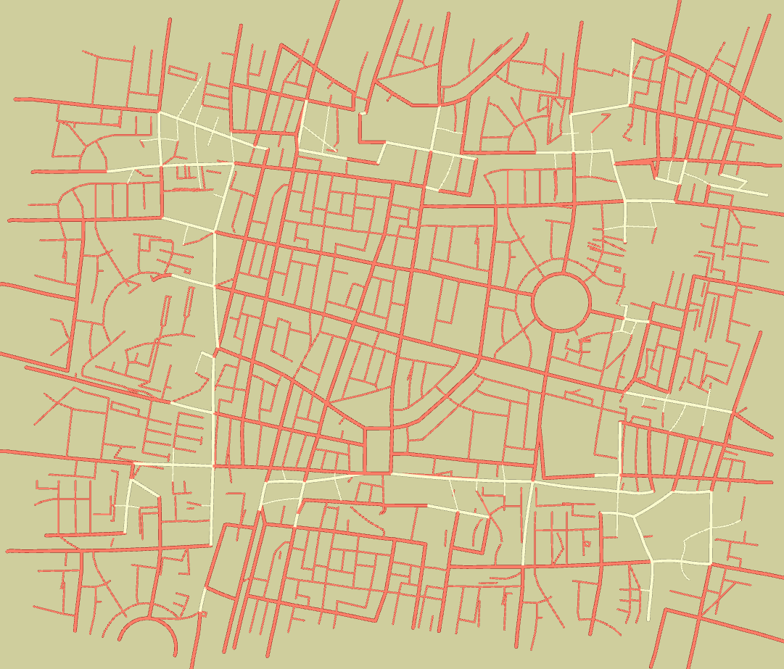
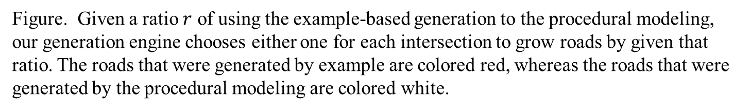





$$r=0.0$$
$$r=0.25$$
$$r=0.5$$
$$r=0.75$$
$$r=1.0$$
Figure. Given a ratio $r$ of using the example-based generation to the procedural modeling, our generation engine chooses either one for each intersection to grow roads by given that ratio. The roads that were generated by example are colored red, whereas the roads that were generated by the procedural modeling are colored white.

