Slide 1

DynamoDb

Slide 2

Who am I
AWS Website (aws.amazon.com) – 2 years
AWS Proton – 6 months
I work for AWS, my opinions are my own.

Slide 3
High volume databases
500 TPS?
1,000 TPS?
10,000 TPS?
What about 66,000 TPS?

Slide 4
What is Dynamo
 | SQL | No SQL | Dynamo
Generic Query Engine | ✔️ | ✔️ | ❌
Schema Validation | ✔️ | ✔️ | ❌
Transactions | ✔️ | ✔️ | (Limited)
Basic Read/Write | ✔️ | ✔️ | ✔️

Slide 5
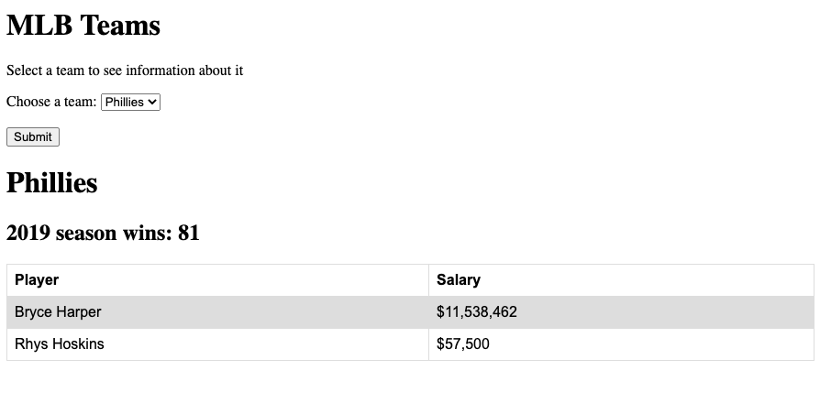
Sample App
1. Wins by team 2. What players played for which teams 3. Highest paid player on that team

Slide 6
MySQL
Player
Team
Player Name | Salary | Team
Bryce Harper | $11,538,462 | Phillies
Rhys Hoskins | $57,500 | Phillies
Homer Bailey | $23,000,000 | Dodgers
Team Name | Wins
Phillies | 81
Yankees | 103

Slide 7
Dynamo (Multi Table)
Player
Team
Team (PK) | Salary (SK) | Player Name
Phillies | $11,538,462 | Bryce Harper
Phillies | $57,500 | Rhys Hoskins
Dodgers | $23,000,000 | Homer Bailey
Team Name | Wins
Phillies | 81
Yankees | 103

Slide 8
Data Access Object Pattern
Separation of concerns
Encapsulates Data Source
Application
PlayerDAO (Player)
DynamoDB (Dynamo Object)

Slide 9
Partition Key
Player
Partition 1
Team (PK) | Salary (SK) | Player Name
Dodgers | $23,000,000 | Homer Bailey
Team (PK) | Salary (SK) | Player Name
Phillies | $11,538,462 | Bryce Harper
Phillies | $57,500 | Rhys Hoskins
Dodgers | $23,000,000 | Homer Bailey
Partition 2
Team (PK) | Salary (SK) | Player Name
Phillies | $11,538,462 | Bryce Harper
Phillies | $57,500 | Rhys Hoskins

Slide 10
Dynamo (Single Table)
Team (PK) | Sort Key | Player Name | Salary | Wins
Phillies | TEAM# |  |  | 81
Phillies | PLAYER#00575 | Rhys Hoskins | $57,500
Phillies | PLAYER#26483511 | Bryce Harper | $11,538,462
Dodgers | PLAYER#00000032 | Homer Bailey | $23,000,000
Dodgers | PLAYER#00000091 | Justin Turner | $19,000,000

Slide 11
Partitions
Team (PK) | Sort Key | Player Name | Salary | Wins
Phillies | TEAM# |  |  | 81
Phillies | PLAYER#00575 | Rhys Hoskins | $57,500
Phillies | PLAYER#26483511 | Bryce Harper | $11,538,462
Team (PK) | Sort Key | Player Name | Salary | Wins
Dodgers | PLAYER#00000032 | Homer Bailey | $23,000,000
Dodgers | PLAYER#00000091 | Justin Turner | $19,000,000

Slide 12
Operations

