Slide 1

Balancing Privacy, Accuracy, and Fairness: A Comparative Study of Privacy-Preserving Techniques in Pedestrian Detection Models for Public Surveillance
S.A.G.N. Jayasekara, sagnjayasekara@std.appsc.sab.ac.lk, 20APC4635
Supervisor: Mr. S. Nishankar
Lecturer (Prob.)
Department of Software Engineering,
Faculty of Computing,
Sabaragamuwa University of Sri Lanka.
DEPARTMENT OF COMPUTING AND INFORMATION SYSTEMS
IS 8101 - RESEARCH PROJECT IN IS

Slide 2
CONTENTS
Background
Literature Review
Research Gap
Significance of Research
Problem Statement & Research Questions
Research Objectives & Goals
Proposed Research Method/s
Expected Outcome/s
References
DEPARTMENT OF COMPUTING AND INFORMATION SYSTEMS
IS 8101 - RESEARCH PROJECT IN IS

Slide 3
background
The Role of AI Surveillance Systems
Public surveillance systems are integral to modern infrastructure for pedestrian monitoring, traffic management, and public safety.
Modern systems use computer vision (CV) for real-time monitoring.
Challenges:
Privacy breaches (personally identifiable information exposure)
Bias in detection across demographic groups
Trade-off between privacy, accuracy, and fairness
DEPARTMENT OF COMPUTING AND INFORMATION SYSTEMS
IS 8101 - RESEARCH PROJECT IN IS

Slide 4
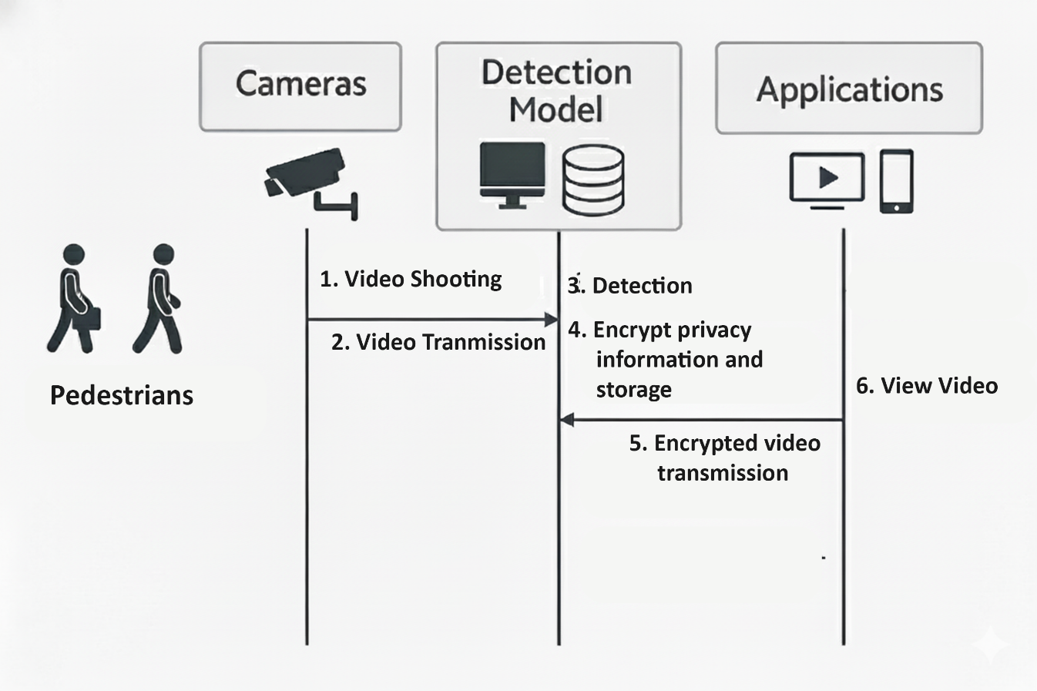
Background (Cont.)
The Role of AI Surveillance Systems
Need for responsible and transparent surveillance AI.
“Billions of video frames processed daily”
Figure 1:Surveillance System process (Source: [1])
DEPARTMENT OF COMPUTING AND INFORMATION SYSTEMS
IS 8101 - RESEARCH PROJECT IN IS

Slide 5
LITERATURE REVIEW
Title: Does Image Anonymization Impact Computer Vision Training? [2]
Objectives | Methodology | Results & Conclusion | Limitations
To study the impact of various anonymization techniques on the performance of computer vision models. Focus on privacy-preserving methods in face detection and recognition. | Evaluate image obfuscation and deep learning-based anonymization methods (DeepPrivacy, CIAGAN, DeepPrivacy2) on face datasets. Assess their impact on detection and recognition accuracy, using transfer learning to minimize performance loss. | Realistic anonymization enables privacy-preserving model training with minimal accuracy loss. Allows anonymized data to serve as a practical alternative to original datasets. | Utility drops of up to 28 AP points highlight the difficulty of balancing privacy and performance. Indicates trade-off challenges, though specific limitations are not explicitly detailed.
DEPARTMENT OF COMPUTING AND INFORMATION SYSTEMS
IS 8101 - RESEARCH PROJECT IN IS

Slide 6
LITERATURE REVIEW (Cont.)
Title: Fairly Private: Investigating The Fairness of Visual Privacy Preservation Algorithms [3]
Objectives | Methodology | Results & Conclusion | Limitations
To assess the fairness of privacy-preserving algorithms across demographic groups (race, gender) in facial recognition, and identify biases introduced by obfuscation techniques. | Use the PubFig dataset (80% unobfuscated, 20% obfuscated) to evaluate fairness impacts of obfuscation. Train classifiers (KNN, Naïve Bayes, SVC, MLP) on unobfuscated data and assess fairness metrics (accuracy, precision, recall, F1, PDR) on obfuscated samples. | Obfuscation provides unequal privacy protection across groups, with biases in recognition performance on the PubFig dataset, highlighting the need for fairness-aware privacy techniques. | Imbalanced dataset (PubFig, majority white) limits demographic analysis; iterative obfuscation unsuitable for real-time; restricted image distribution hinders reproducibility.
DEPARTMENT OF COMPUTING AND INFORMATION SYSTEMS
IS 8101 - RESEARCH PROJECT IN IS

Slide 7
LITERATURE REVIEW (Cont.)
Title: Accurate Image-Based Pedestrian Detection With Privacy Preservation [4]
Objectives | Methodology | Results & Conclusion | Limitations
To develop a privacy-preserving pedestrian detection scheme that maintains high accuracy with reduced computation and communication costs. | Propose the PPPD scheme using Vector Homomorphic Encryption (VHE) for privacy-preserving HOG feature extraction and SVM training on encrypted images. Enable encrypted kernel matrix construction (linear, polynomial, Gaussian) without decrypting features. | Achieves high accuracy with lower computational overhead than existing methods. Ensures end-to-end privacy, making it suitable for real-world surveillance applications. | Specific limitations not detailed; implied challenges in scalability or diverse condition robustness from dataset constraints.
DEPARTMENT OF COMPUTING AND INFORMATION SYSTEMS
IS 8101 - RESEARCH PROJECT IN IS

Slide 8
Research Gap
Research Gaps
Current studies analyze only one of privacy or fairness separately [3].
Analyze fairness in facial recognition separately from privacy preservation techniques (e.g., obfuscation), without integrating the two.
No systematic evaluation of hybrid privacy configurations [4].
Existing privacy schemes (e.g., SecHOG) are evaluated separately, with no systematic assessment of hybrid configurations.
Absence of a quantitative model linking privacy, accuracy, and fairness [5].
Prior methods lack quantitative models to link privacy with accuracy/utility.
DEPARTMENT OF COMPUTING AND INFORMATION SYSTEMS
IS 8101 - RESEARCH PROJECT IN IS

Slide 9
Significance of Research
Novelty
Introduces hybrid / optimized privacy-preserving techniques (e.g., light blurring + masking) that go beyond the single-method evaluation done in most prior studies and use a multi-method evaluation.
Importance
Addresses the real-world trade-off between privacy and accuracy in surveillance AI.
Supports compliance with data protection laws.
DEPARTMENT OF COMPUTING AND INFORMATION SYSTEMS
IS 8101 - RESEARCH PROJECT IN IS

Slide 10
Significance of Research (Cont.)
Message to the Community
Privacy and accuracy can coexist through smart hybrid design.
Encourages building privacy-aware computer vision systems that remain effective and fair.
Contributes guidelines and benchmarks for future privacy-preserving AI research.
Who Benefits:
AI researchers & developers
Public safety & surveillance agencies
Policymakers & data protection officers
General public
DEPARTMENT OF COMPUTING AND INFORMATION SYSTEMS
IS 8101 - RESEARCH PROJECT IN IS

Slide 11

Problem Statement
Main Problem
Computer vision models for public surveillance systems are used for pedestrian monitoring and safety management, but while privacy-preserving methods such as face blurring, encryption, and masking protect identities, they often reduce model accuracy.
Existing studies evaluate these techniques separately, without testing combined or optimized approaches.
Privacy
Utility
DEPARTMENT OF COMPUTING AND INFORMATION SYSTEMS
IS 8101 - RESEARCH PROJECT IN IS

Slide 12
Research Questions
Research Questions
RQ1: How do different privacy-preserving techniques (blurring, swapping, anonymization) affect model accuracy?
RQ2: How does varying the intensity or level of privacy preservation impact the balance between data privacy and model utility?
RQ3: Can an optimized or hybrid combination of privacy-preserving techniques provide a better balance between privacy protection and model performance compared to individual methods?
DEPARTMENT OF COMPUTING AND INFORMATION SYSTEMS
IS 8101 - RESEARCH PROJECT IN IS

Slide 13
Research Objectives
Main Objective
To evaluate and improve privacy-preserving techniques for pedestrian detection in public surveillance by identifying the optimal balance between privacy protection and model performance, including the development and testing of hybrid or optimized combinations of privacy-preserving methods.
DEPARTMENT OF COMPUTING AND INFORMATION SYSTEMS
IS 8101 - RESEARCH PROJECT IN IS

Slide 14
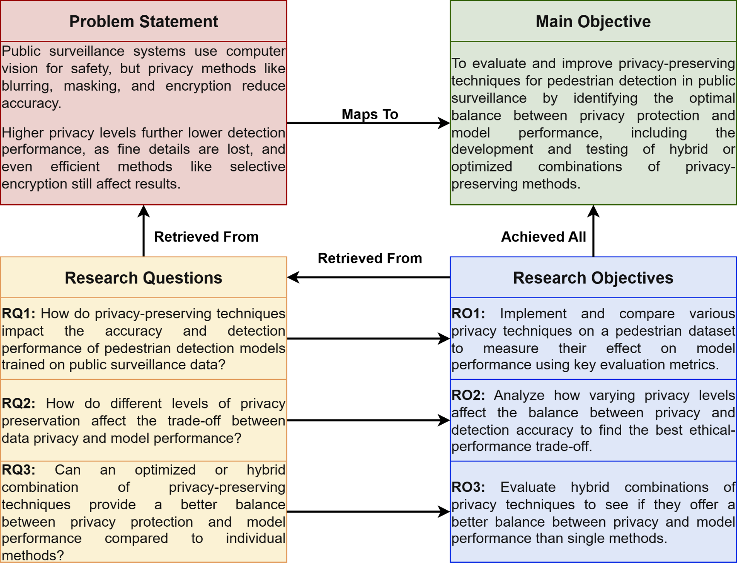
Research Objectives (Cont.)
DEPARTMENT OF COMPUTING AND INFORMATION SYSTEMS
IS 8101 - RESEARCH PROJECT IN IS

Slide 15
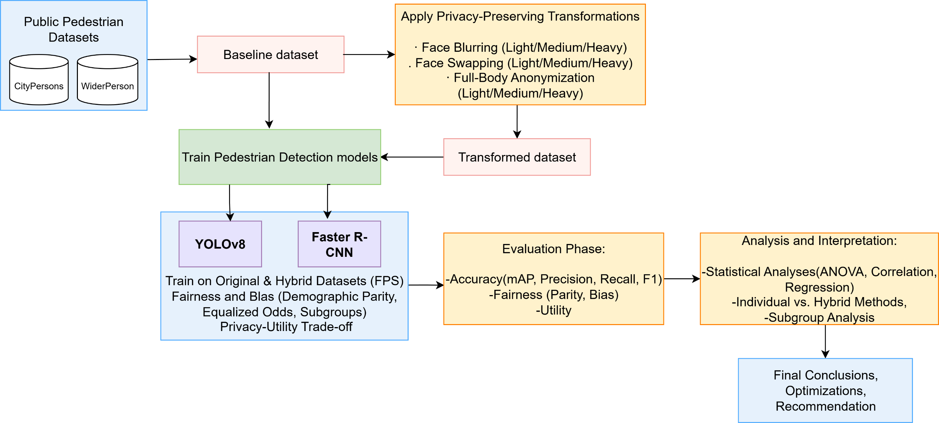
Proposed Research Method/s
DEPARTMENT OF COMPUTING AND INFORMATION SYSTEMS
IS 8101 - RESEARCH PROJECT IN IS

Slide 16
Proposed Research Method/s (Cont.)
Experimental Framework
Datasets: CityPersons, WiderPerson
Privacy Techniques:
Face blurring (Gaussian/mosaic)
Face swapping (DeepPrivacy 2)
Full-body anonymization (semantic segmentation)
Hybrid setups
Models: YOLOv8, Faster R-CNN
DEPARTMENT OF COMPUTING AND INFORMATION SYSTEMS
IS 8101 - RESEARCH PROJECT IN IS

Slide 17
Proposed Research Method/s (Cont.)
Evaluation Metrics
Accuracy & Utility: mAP, Precision, Recall, F1, FPS
Fairness: Demographic Parity, Equalized Odds, Subgroup Accuracy
Privacy–Utility Trade-off: Quantitative relationship between privacy intensity and accuracy drop
DEPARTMENT OF COMPUTING AND INFORMATION SYSTEMS
IS 8101 - RESEARCH PROJECT IN IS

Slide 18
Expected Outcome/s
Expected Outcomes
Comprehensive Evaluation:
Quantitative comparison of individual and hybrid privacy-preserving techniques (face blurring, swapping) across multiple privacy intensity levels.
Privacy–Utility–Fairness Insights:
Development of privacy–utility curves and fairness analysis to identify the optimal balance point between privacy, model accuracy, and fairness.
Optimized Hybrid Configuration:
Proposal of a hybrid privacy method that minimizes accuracy loss while maintaining strong privacy and ethical compliance.
DEPARTMENT OF COMPUTING AND INFORMATION SYSTEMS
IS 8101 - RESEARCH PROJECT IN IS

Slide 19
REFERENCES
[1] W. Jang and S.-Y. Lee, “Partial image encryption using format-preserving encryption in image processing systems for Internet of things environment,” International Journal of Distributed Sensor Networks, vol. 16, no. 3, p. 155014772091477, Mar. 2020, doi: 10.1177/1550147720914779.
[2] H. Hukkelås and F. Lindseth, “Does image anonymization impact computer vision training?,” 2022 IEEE/CVF Conference on Computer Vision and Pattern Recognition Workshops (CVPRW), pp. 140–150, Jun. 2023, doi: 10.1109/cvprw59228.2023.00019.
[3] S. Noiret, S. Ravi, M. Kampel, and F. Florez-Revuelta, “Fairly private: Investigating the fairness of visual privacy preservation algorithms,” arXiv.org, Jan. 12, 2023. http://arxiv.org/abs/2301.05012
[4] H. Yang, Q. Zhou, J. Ni, H. Li, and X. Shen, “Accurate Image-Based pedestrian detection with privacy preservation,” IEEE Transactions on Vehicular Technology, vol. 69, no. 12, pp. 14494–14509, Dec. 2020, doi: 10.1109/tvt.2020.3043203.
[5] A. Kunchala, M. Bouroche, and B. Schoen-Phelan, “Towards a framework for Privacy-Preserving pedestrian analysis,” 2022 IEEE/CVF Winter Conference on Applications of Computer Vision (WACV), pp. 4359–4369, Jan. 2023, doi: 10.1109/wacv56688.2023.00435.
DEPARTMENT OF COMPUTING AND INFORMATION SYSTEMS
IS 8101 - RESEARCH PROJECT IN IS

Slide 20

Q & A
DEPARTMENT OF COMPUTING AND INFORMATION SYSTEMS
IS 8101 - RESEARCH PROJECT IN IS

Slide 21
Thank You

