Slide 1


Bidirectional Many-to-One Associations
Good practices

Slide 2

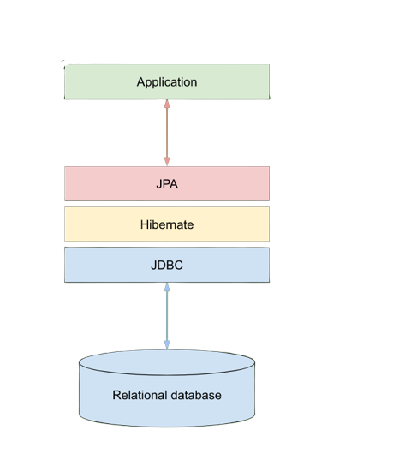
Contents
Bidirectional Association
@OneToMany
@ManyToOne

Slide 3
Bidirectional Association
unidirectional
Post
Comment
bidirectional
Post
Comment

Slide 4
@OneToMany
@OneToMany(
mappedBy = “post",
cascade = CascadeType.ALL,
orphanRemoval = true
)
private Set<Comment> comments;
Owner of the relationship
Cascade type
Entity child remove operation

Slide 5
@ManyToOne
@ManyToOne(
fetch = FetchType.LAZY
)
@JoinColumn(name = "fk_post")
private Post post;
Reference to another object
Expressing the relationship
Fetch type

Slide 6
Questions?
Resource:
https://aws.amazon.com/; https://docs.oracle.com/; https://vladmihalcea.com/; https://en.wikibooks.org/

