Slide 1
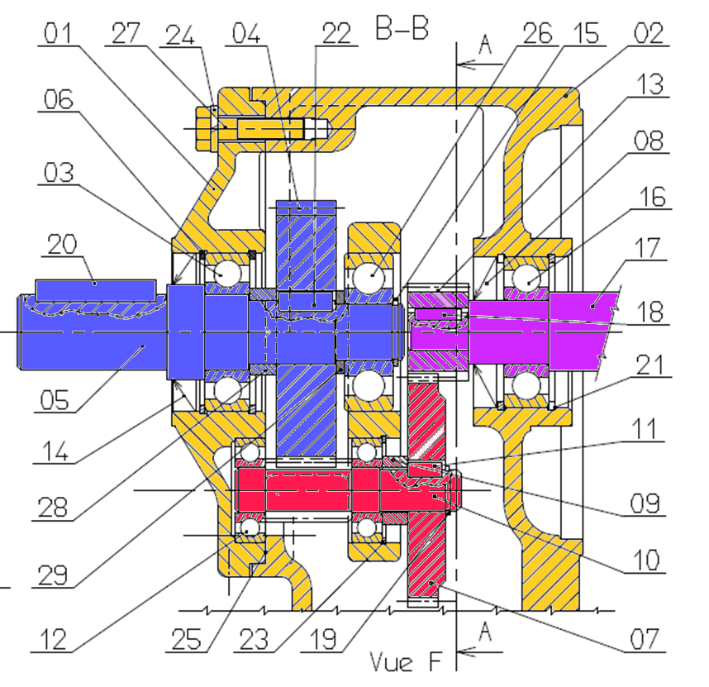




$$Z_{13}=19$$
$$Z_{7}=52$$
$$Z_{4}=67$$
$$Z_{10}=12$$

