Slide 1
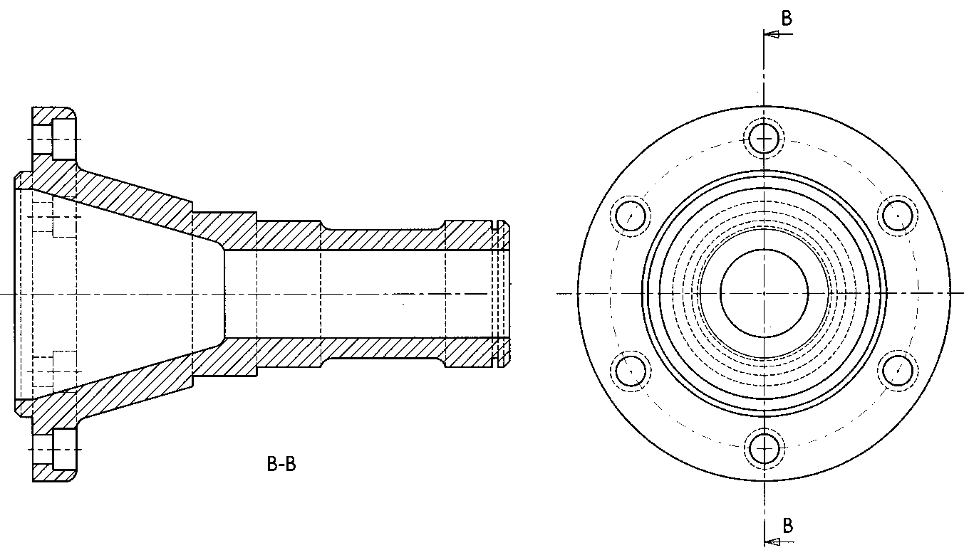

Slide 2
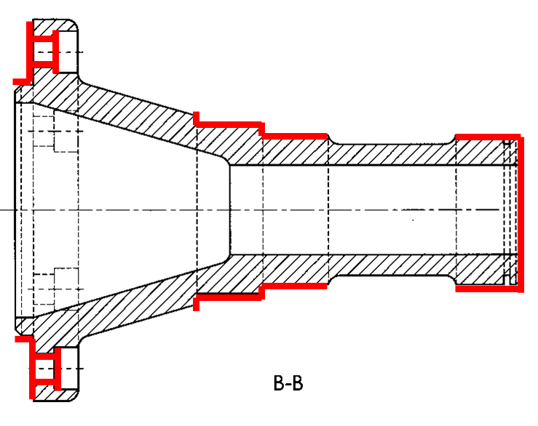

Slide 3
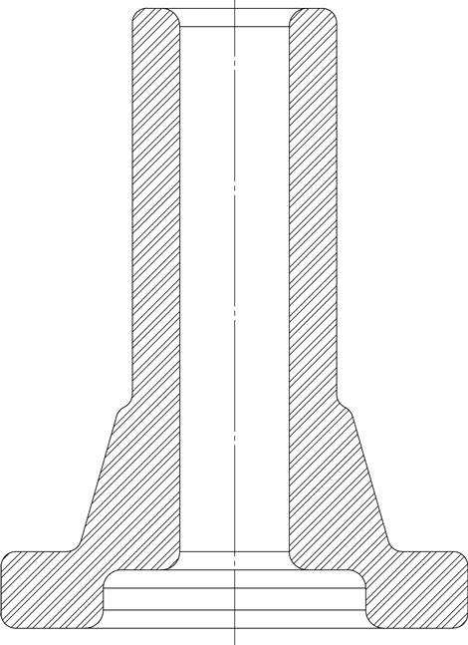

Slide 4
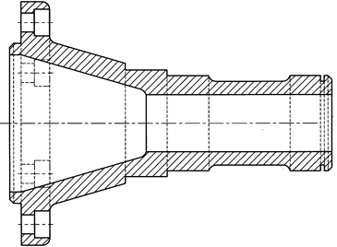
1
2
3
4
5

Slide 5
1
4
2
5
3

Slide 8
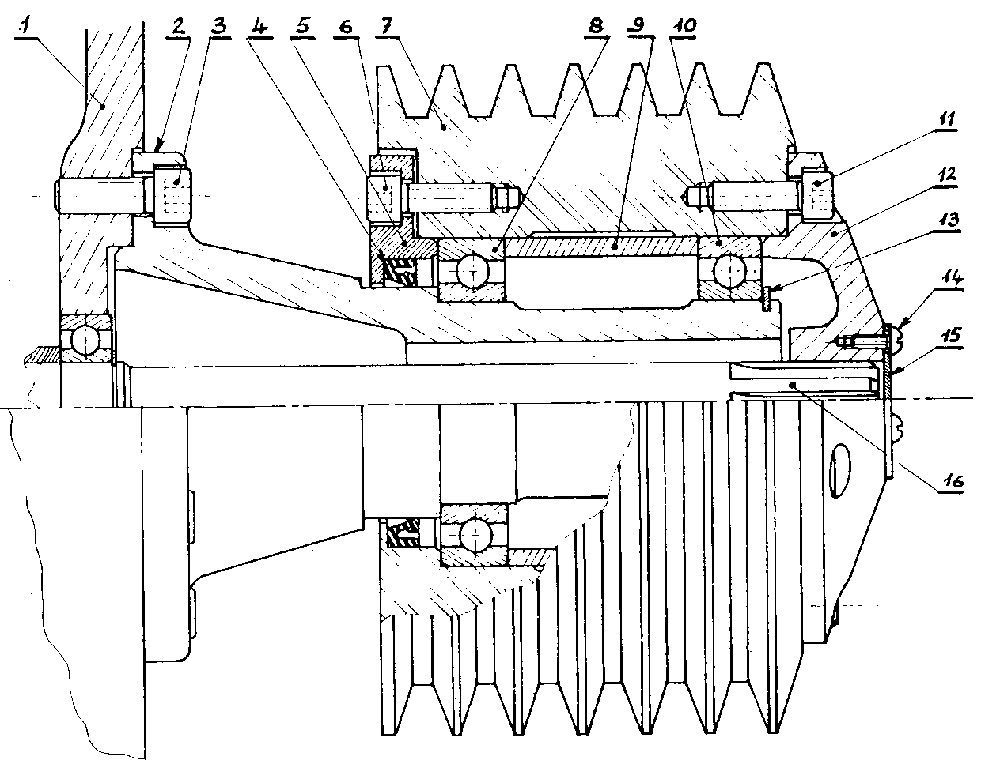
C₁
C₁₂
C₂
C₂
J1
J2

