Slide 1
MoSTO 101

Slide 2

Expectations
This presentation is to give you a general idea of what MoSTO is, plus some basic first-hand experience with its most important elements. It is not intended as a replacement for user manual document.
Action plan:
Learn how MoSTO operates
Get to know key MoSTO macros
Have some hands-on practice

Slide 3
What is MoSTO?
MoSTO is a SAS Macro package developed internally at Bayer by a group of very skilled German developers led by Katja Glass to replace traditional output methods such as PROC REPORT.
Goals:
Standardize the look of all printable outputs
Simplify creation of standard tables and listings
Provide ready-made implementation for some uncommon tables
Support shared features, such as output redirection into RTF
Just like PROC REPORT, a MoSTO call takes a dataset and creates a table (or a series of tables) from its data.

Slide 4
Initializing MoSTO
MoSTO is initialized using globally available macro %initsystems.
%initsystems(… mosto=6, …);
Currently, the latest version is v7. There are a few differences that you will be expected to learn in the course of your work.

Slide 5


How does MoSTO work?
MoSTO features over a dozen different macros, each producing a different table structure, but this presentation will only introduce a few of the most important ones.
ADS
Preprocessing
%DESC_TAB
%FREQ_TAB
%INCIDENCE_PRINT
%DESC_FREQ_TAB
%OVERVIEW_TAB
%DATALIST
Post-processing
RTF

Slide 6
%DATALIST: Simple Stuff
Macro %DATALIST is performs the same function as PROC REPORT. It takes a dataset and prints it as a table, column by column.
Parameter | Equivalent in PROC REPORT | Functionality
DATA | DATA= | Specifies data source; allows dataset options
PAGE | COMPUTE BEFORE _PAGE_ | Displays group variable(s) in the top-left corner of each page
BY | DEFINE / ORDER | Displays group variable(s) as leftmost columns
ORDER | DEFINE / NOPRINT | Hides PAGE and BY variables that were used for sorting only
VAR | DEFINE / DISPLAY | Displays variable(s) in left-to-right order
TOGETHER |  | Guarantees all values of the variable to be on same page if possible
FREELINE | BREAK AFTER <var> / SKIP | Inserts a blank line after each distinct value of the variable (can accept syntax FIRST.<var>)

Slide 7


%DATALIST: Spanning Headers
Parameter VAR may include spanning headers. They work exactly as spanning headers in COLUMN statement of PROC REPORT, except nested spanning headers are not allowed.
Example:
VAR = make model (“Price” msrp invoice) horsepower
VAR = make (“Model data” model (“Price” msrp invoice) horsepower)
Spanned headers should be used if the table specification document clearly requires so, but as a general rule they are not recommended due to their poor implementation in RTF format.

Slide 8
%DATALIST: Magic of TABLESBY
Parameter TABLESBY allows to create distinct titles for each separate report page. The following needs to be done:
The title must include the name of the variable encased in dollar signs, e.g. “Descriptive statistics of $PARAM$”. If the variable has a format attached to it, the formatted value will be printed.
Variables to be displayed in the title must be defined as both PAGE and ORDER variables.
A dataset must be created (commonly, by using PROC SORT NODUPKEY) that contains these variables only.
The above-mentioned dataset must be defined as TABLESBY=.

Slide 9
%DATALIST: Some Visual Tricks
Parameter HSPLIT specifies the character that splits custom headers in places explicitly set by the programmer. It is commonly used to make the column as narrow as possible while keeping its label readable. The default value is ‘@’. Note that the character itself will print as blank.
It’s uncommon but possible to have display variables with empty label. Setting parameter LABEL to NO will cause such variables to be displayed with blank headers, instead of printing variable name there.
To control the empty output look, parameter EMPTYTXT_NEW can be set to YES or NO; the exact effect can be seen in the manual. Please note that printing a custom message is currently disallowed.
IMPORTANT: There are many %DATALIST parameters involved with ASCII output layout. These parameters are outside the scope of this presentation because almost all outputs have RTF or PDF format.

Slide 10
RTF Output
Enabling RTF redirection is extremely easy with MoSTO. Add
%startMostoRTF(file=<filename>, onlyrtf=Y, toc=N);
before calling a MoSTO macro, and
%endMostoRTF;
afterwards, where <filename> is the full pathname of the output RTF file (without the “.rtf” extension).
Note: ComBO training will explain what to do with these RTF files.

Slide 11
RTF Output (cont.)
The RTF output can be further controlled by specifying physical width (in millimeters) and alignment of each specific column.
%insertoption(namevar=<var>, ← variable name
width=20mm, ← fixed width of the column
align=c, ← alignment override (usually blank)
keep=n, ← preserve value for the next call?
overwrite=y) ← overwrite the value if specified earlier?
Manual overrides are enabled by defining the global macro variable
MostoCalcPercWidth and setting it to NO. If this variable is undefined or set to YES, the responsibility for column width allocation belongs to MoSTO. It works for many simple tables but is very unreliable due to quirky auto-setting rules and dependence on actual data values.
The maximal page width with the current RTF template is 210 mm.

Slide 12
Other MoSTO Macros
The most common MoSTO macros other than %DATALIST are:
%FREQ_TAB
%DESC_TAB
%DESC_FREQ_TAB
%INCIDENCE_PRINT
%OVERVIEW_TAB
These MoSTO macros operate in the same way:
Create dataset with display data for %DATALIST
Create dataset with macro parameters for %DATALIST
Call %DATALIST
Parameters such as DATA, PAGE and BY are passed to %DATALIST call directly. In addition, a number of other important parameters have similar functionality in multiple MoSTO macros.

Slide 13
Parameter SUBJECT
Parameter SUBJECT defines a variable, or a combination of variables, that serves as a unique subject identifier. This parameter is a must for every macro that involves counting subjects rather than observations. It is required when presenting subject counts in the header is necessary.
The parameter is defaulted to USUBJID. In Bayer work environment, there is rarely a reason to override this default.

Slide 14
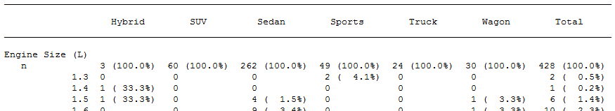
Parameters CLASS and TOTAL
Parameter CLASS specifies a single variable that is an approximate equivalent of ACROSS variable in PROC REPORT. Each of its values is presented as a separate column. The default order of columns is that of unformatted values, but it can be altered (very seldom) using parameter CLASS_ORDER.
Parameter TOTAL defines whether the “Total” column will be automatically added to the output table; the default value is YES.

Slide 15
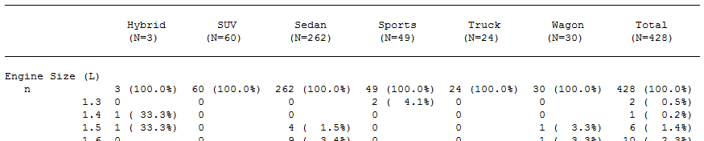
Parameter DATA_N
Optional parameter DATA_N identifies a dataset – not necessarily different from DATA – that serves two purposes:
First, it is used to subset the main dataset; only subjects present in DATA_N will be considered for reporting.
Second, distinct subjects present in DATA_N are counted to produce per-class header counts, otherwise known as “Big N”.

Slide 16
Parameter DATA_N (cont.)
If PAGE variables are defined, usage of DATA_N depends on whether the dataset it specifies contains them.
If DATA_N contains at least some PAGE variables, the subject counts will be different for each PAGE-defined population. This feature allows to avoid creating separate tables for each PAGE value.
If DATA_N does not contain any PAGE variables, the subject counts will be same on every page.
Every variable listed in PAGE but not present in DATA_N has to be listed in DATA_N_IGNORE.
Important: Variables CLASS and SUBJECT, if defined, must exist in both DATA and DATA_N.

Slide 17
Post-Processing
Every MoSTO macro other than %DATALIST has a parameter OUTDAT=<name>. It is blank by default; specifying it creates two datasets, <name> (with values) and <name>inp (with macro parameters), instead of calling %DATALIST.
It is possible to alter either dataset, or both, before calling %DATALIST manually. Doing so is called post-processing, and it is strongly discouraged unless you possess robust knowledge of MoSTO internals and the requested table shell cannot be implemented by any other means. Validating programs with post-processing is very challenging.
Important: If OUTDAT value is set, the macro does not print any table. The analyst is responsible to do that using a direct call to %DATALIST.

Slide 18
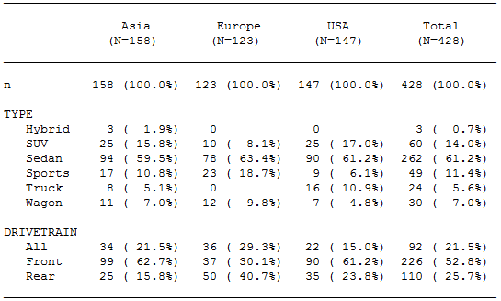
Macro %FREQ_TAB
The macro is designed to display frequency analysis for one or more variables. The closest analog of the macro is PROC FREQ.

Slide 19
Macro %FREQ_TAB (cont.)
Parameter VAR defines a list of variables to be analyzed. Each variable must exist and be either character or enumerated (coded).
VAR may include pairs of variables separated by asterisk, to produce cross-frequency analysis; the first variable in such pair is referred to as “main”, the other as “explanatory”. Displaying such variables is outside the scope of this presentation.
Other %FREQ_TAB functionality outside the scope of the presentation:
Control over methodology of percentage calculation
Manipulation of labels, sorting options and layout details
Basic inferential analysis of homogeneity between classes

Slide 20
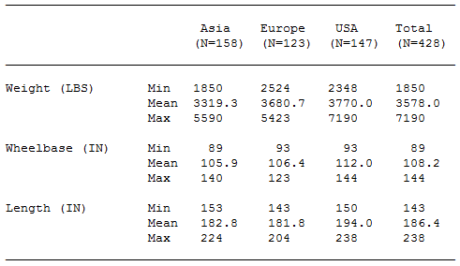
Macro %DESC_TAB
The macro is designed to display descriptive statistics for one or more variables. The closest analog of the macro is PROC MEANS.

Slide 21
Macro %DESC_TAB (cont.)
Parameter VAR defines a list of variables to be analyzed. Each variable must exist, be numeric, and have floating format attached to it.
Parameter STAT is a list of predefined keywords that represent statistical functions (MIN, STD, Q3, etc.). The full list of available functions is available in the manual.
Other %DESC_TAB functionality outside the scope of the presentation:
Definition of time variable, baseline and change from baseline
Manipulation of rounding options, labels and layout details
Basic inferential analysis of value distribution between classes

Slide 22
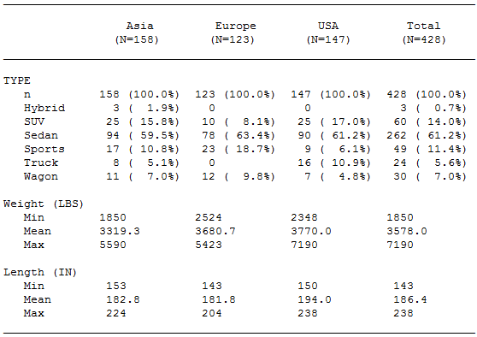
Macro %DESC_FREQ_TAB
The macro is a blend of %FREQ_TAB and %DESC_TAB, and combines the functionality of both, with some minor limitations.

Slide 23
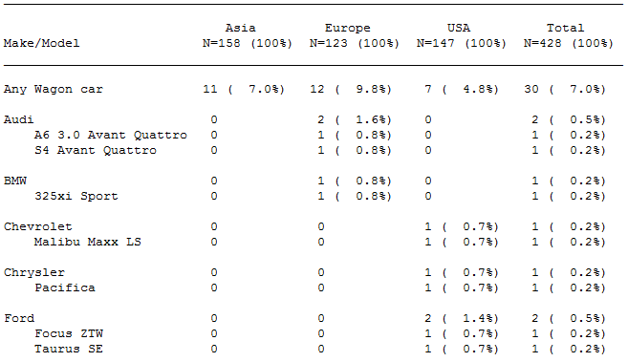
Macro %INCIDENCE_PRINT
The macro is designed to display frequency of occurrence of specified observation type, usually referred to as “event”.

Slide 24
Macro %INCIDENCE_PRINT (cont.)
Parameter VAR defines a list of variables (up to 3), otherwise known as “terms”, that are displayed as an hierarchy in the leftmost column.
Parameter TRIGGERCOND defines the SAS condition used to filter observations in; the default value is ‘1’, which is equivalent to TRUE.
Other %INCIDENCE_PRINT functionality outside the scope of the presentation:
Manipulation of text labels, sorting options and threshold value
Definition of additional analysis subcategory for events
Basic inferential analysis of homogeneity between classes

Slide 25
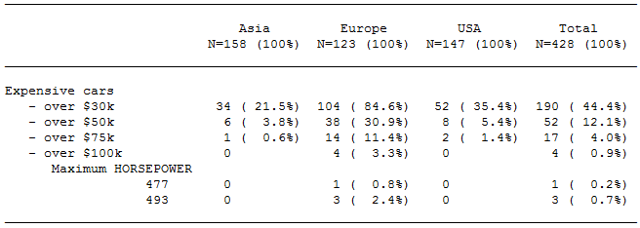
Macro %OVERVIEW_TAB
The macro is designed to display frequency distribution for a specified list of conditions, which may be independent from each other.
The macro is widely used for ad-hoc analysis because of its ability to handle custom conditions that are possibly unrelated to main analysis.

Slide 26
Macro %OVERVIEW_TAB (cont.)
The macro does not have the usual parameter VAR. Instead, it offers parameter GROUPS, which consists of paired quoted expressions:
groups = “<DEL>”*”Expensive cars”
”msrp>30000”*“- over $30k”
”msrp>50000”*“- over $50k”
“msrp>75000”*“- over $75k”
”msrp>100000”*“- over $100k”*”MAX(horsepower)”
The details of this syntax are outside the scope of the presentation. Other %OVERVIEW_TAB functionality outside the scope of the presentation:
Control over methodology of percentage calculation
Manipulation of text labels and layout details

Slide 27

Conclusion
Reminder: The presentation is MoSTO 101 and thus very superficial, leaving numerous details, options and useful tricks undiscovered. That’s what you have detailed user manuals for:
/by-sasp/patdb/std_sg/stat/systems/mosto/doc/manuals_v6
You should also expect a lot of hands-on practice in the next months.

Slide 28
Question #1
In Pharmaceutical Research tables, what would you expect the CLASS variable to be?

Slide 29
Question #2
Which MoSTO macro would you recommend to use for demographic data?

Slide 30
Question #3
Name at least two domains where %DESC_TAB is expected to be used for reporting.

Slide 31
Question #4
Both %FREQ_TAB and %INCIDENCE_PRINT present frequencies – what is the important difference between them?

Slide 32
Question #5
When using %NSERTOPTION macro, what kind of variable would you prefer to center-align?

Slide 33
Question #6
From purely visual point of view, what are advantages and disadvantages of defining variable as PAGE, as opposed to BY?

Slide 34
Question #7
Parameters FREELINE and TOGETHER usually have the same value. Why is it so?

Slide 35
Question #8
What kind of situations makes adding HSPLIT symbol to labels necessary?

Slide 36
Question #9
Parameter TOTAL is defaulted to YES. What would necessarily make you change it to NO?

Slide 37
Question #10
While working on a contraception drug, you are asked to produce a pregnancy report. Which MoSTO macro will you recommend?

Slide 38
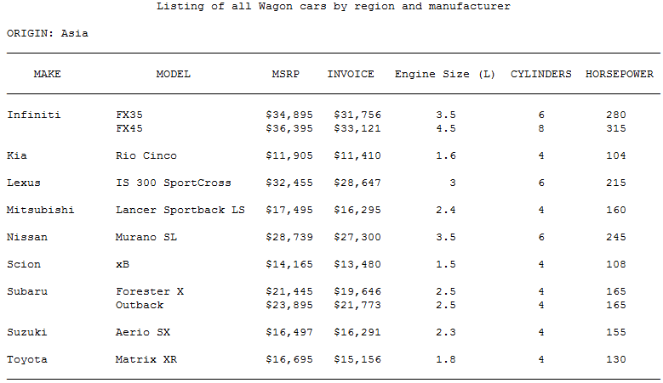
Exercise 1: Simple Listing
Please produce the following table from SASHELP.CARS using both PROC REPORT and %DATALIST:

Slide 39
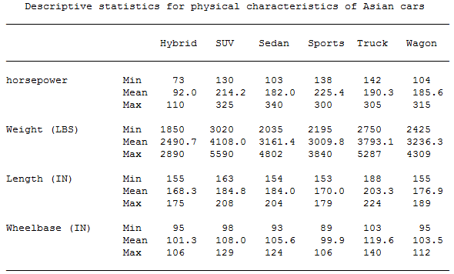
Exercise 2: Descriptive Statistics
Please produce the following table from SASHELP.CARS using an appropriate MoSTO macro:

Slide 40
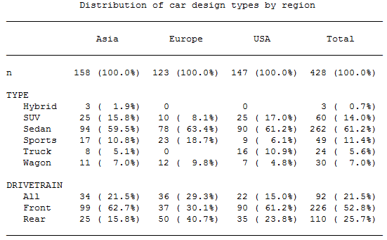
Exercise 3: Frequency Analysis
Please produce the following table from SASHELP.CARS using an appropriate MoSTO macro:

Slide 41
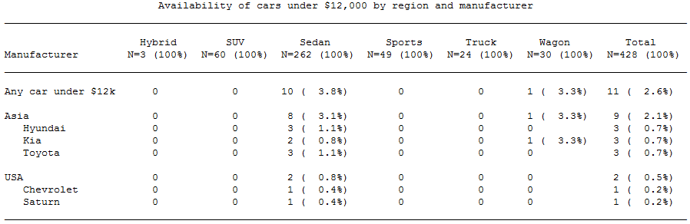
Exercise 4: Incidence Report
Please produce the following table from SASHELP.CARS using an appropriate MoSTO macro:
WARNING: For this table, rename variable TYPE to any other name. It is a known bug; the macro uses this specific variable name internally.
WARNING: Choose your SUBJECT= variable(s) carefully, it must be unique.

Slide 42
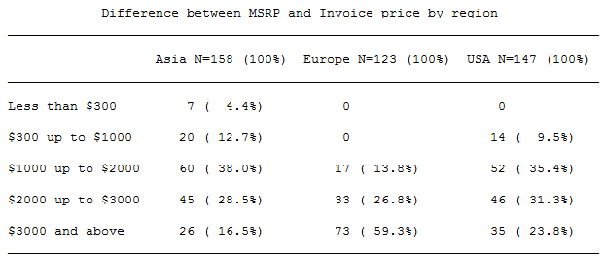
Exercise 5: Special Inquiries
Please produce the following table from SASHELP.CARS using an appropriate MoSTO macro:
WARNING: Choose your SUBJECT= variable(s) carefully, it must be unique.

Slide 43
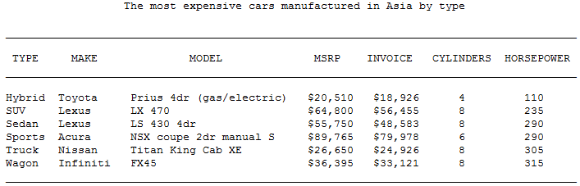
Exercise 6: %DATALIST Magic
Please produce the following table from SASHELP.CARS using an appropriate MoSTO macro:
WARNING: A page for each region must have a different title. No macro code!

Slide 44
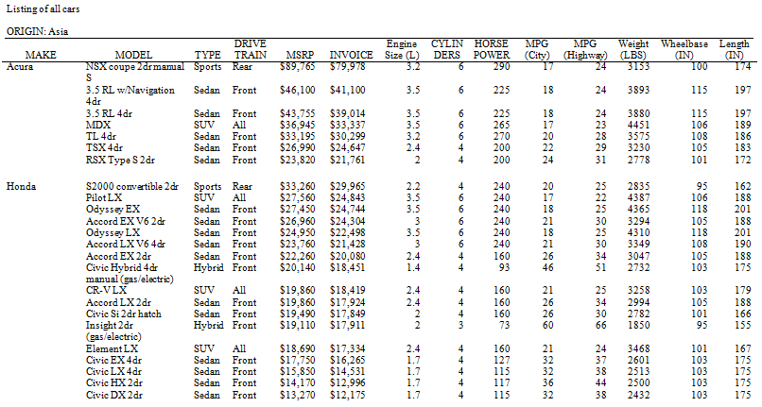
Exercise 7: Heavy Lifting
Please produce the following RTF table from SASHELP.CARS using an appropriate MoSTO macro:
WARNING: Every variable must be included – with as few line breaks as possible!

Slide 45

That’s All, Folks!

