Slide 1

Implementation of PCAP Reader
Presented by
Gaurav Kumar (19911014) Kanhu Charan Gouda(19911006)
Asmita Mahajan(20911002) Hem Chandra Joshi(20911005)
Srishti Sharma(20911009)

Slide 2
Contribution
Gaurav Kumar
Collection of PCAP files
Implementation of ARP and ICMP packet reader
Asmita Mahajan
Analysed & Captured the packets from wireshark
Implemented the IP & TCP/UDP packet reader
Srishti Sharma
Prepared the literature part regarding project
Analyzed various filed of TCP/UDP packets using wireshark
Kanhu Charan Gouda
Prepared the part of project report
Analyzed various filed of ARP packets using wireshark
Hem Chandra Joshi
Processed the excel file to summarize the data
Visualize the few important values of various packets

Slide 3
Contents
Introduction
Implementation
Reading of PCAP File
Extracting Layer Specific Fields
Display Header Fields as per User Request
Fetching IP, TCP & UDP Fields
Fetching ARP and ICMP Packet Fields
Result Analysis
Visualization and Summarization of Data
Conclusion
References

Slide 4
Introduction
Packet capture:
Packet capture is a networking term for intercepting a data packet that is crossing a specific data network.
Once a data packet is capturing in real-time, it is stored for a period of time so that it can be analyzed, and then either be downloaded, achieved or discarded.
Full packet capture:
Entire packets or specific portions of a packet can be captured.
A full packet includes two things i.e. a payload and a header.
The payload is the actual contents of the packet, while the header contains metadata, including the packet’s source and destination address.

Slide 5
Introduction
Packet capture analysis:
Analysis of packet capture data typically requires significant technical skills, and often is performed with tools such as Wireshark.
Wireshark:
Wireshark is a free and open source packet analyzer. It is used for network troubleshooting, analysis, software and communication protocol development, and education.
In other words, Wireshark is a packet sniffer and analysis tool. It captures network traffic on the local network and stores that data for offline analysis.

Slide 6
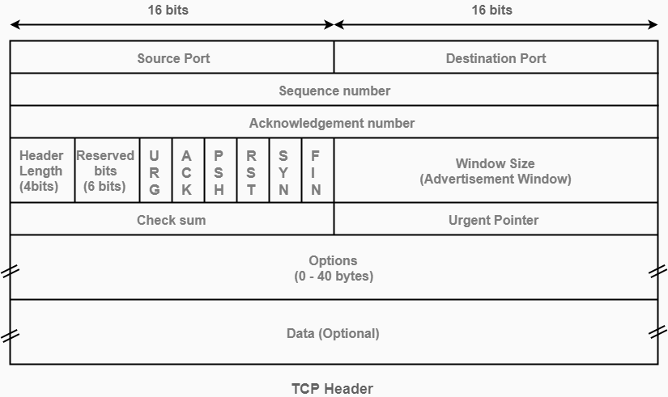
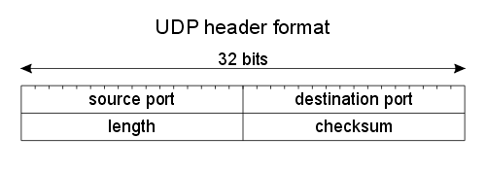
TCP and UDP
TCP Header Format:
UDP Header Format:

Slide 7
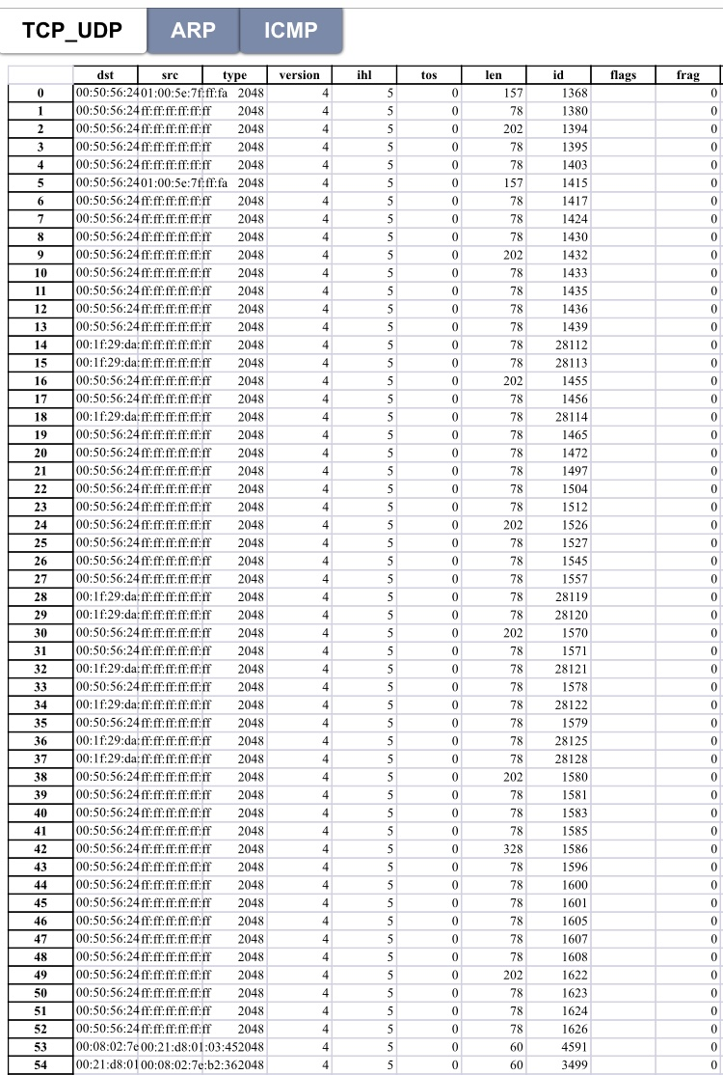

Slide 8
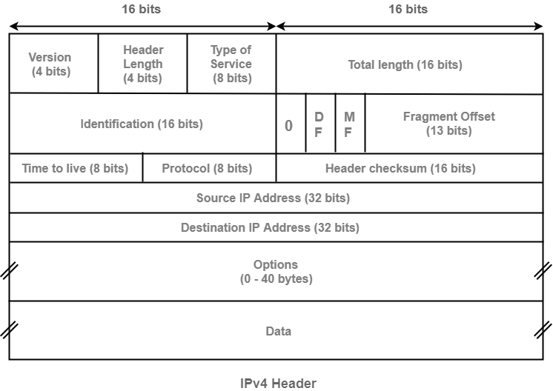
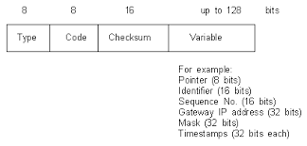
IP and ICMP
IP Packet Header:
ICMP Packet Header:

Slide 9
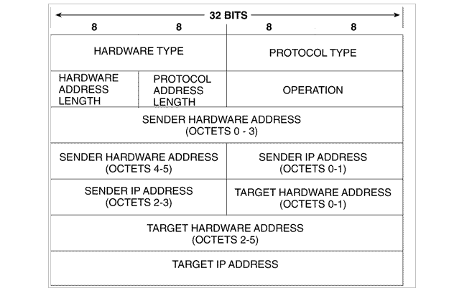
ARP
ARP Header Format:

Slide 10
Python Implementation
Packet Header Extraction & Analysis

Slide 11
Reading the PCAP File

Slide 12
Extracting Layer Specific Fields
ethernet_frame = file2[66]
#Extracting Data Encapsulated in Ethernet Frame
ip_packet = ethernet_frame.payload
#Extracting Data Encapsulated in IP Packet
segment = ip_packet.payload
#Extracting payload Encapsulated in the Packet
data = segment.payload

Slide 13
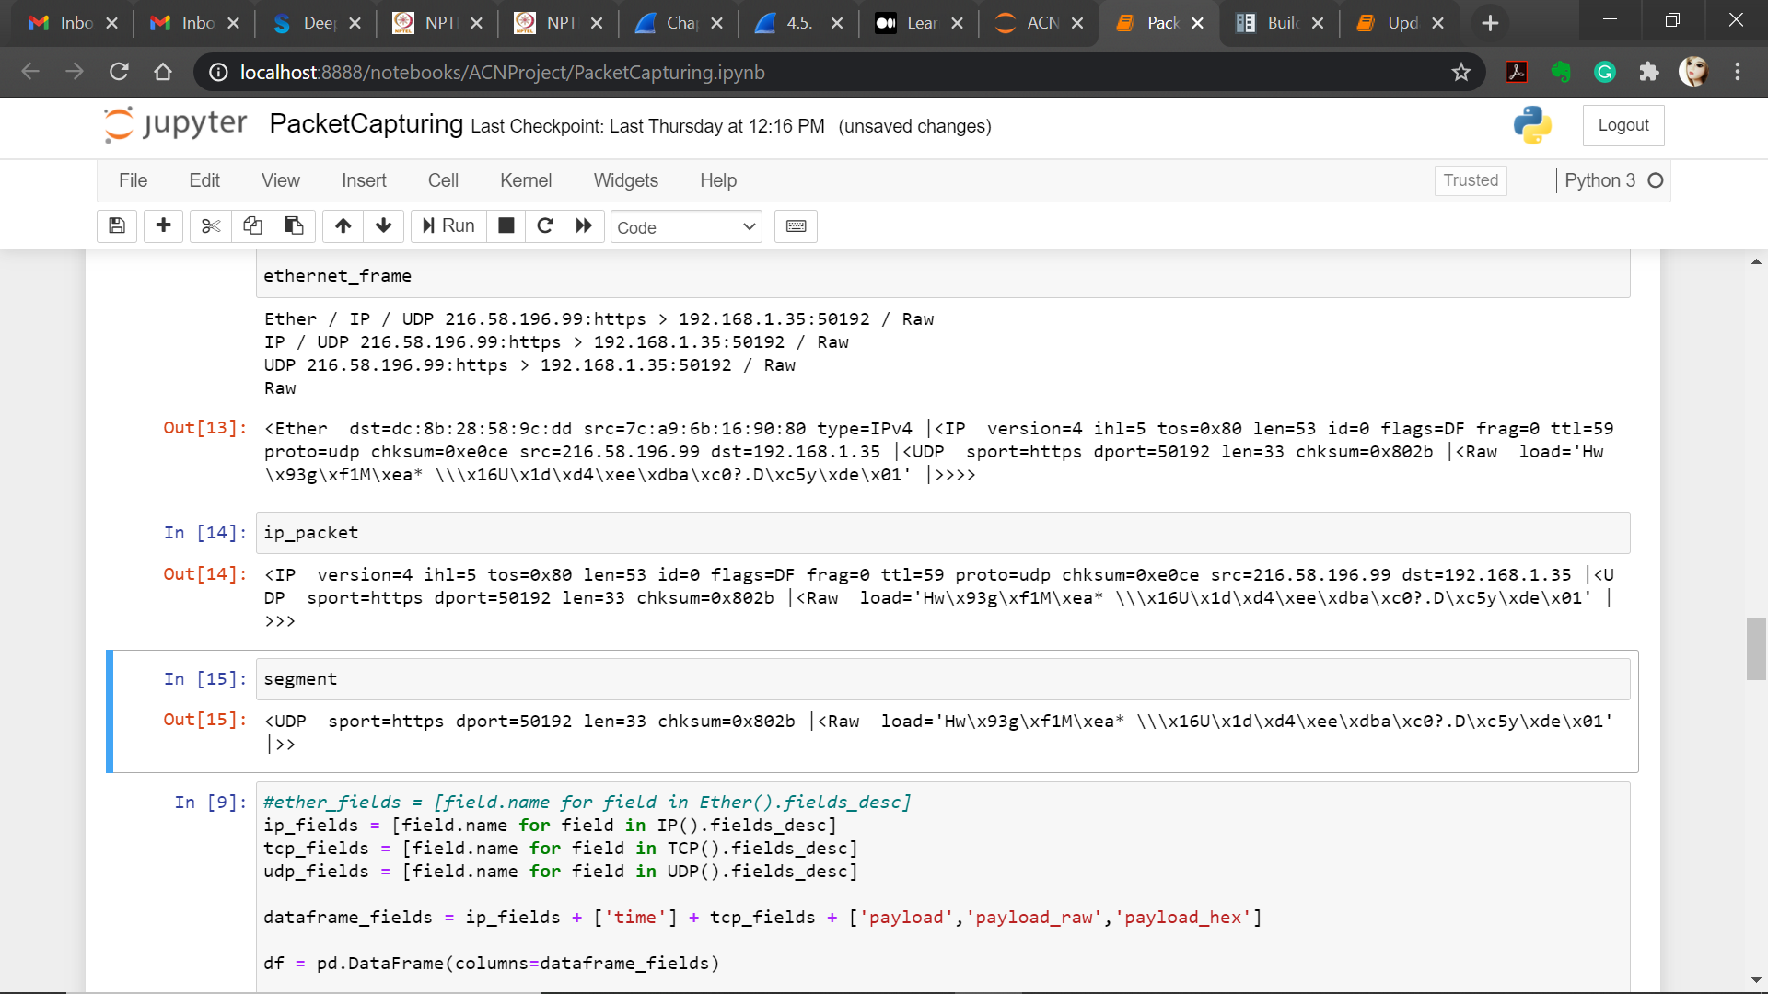
UDP Packet

Slide 14
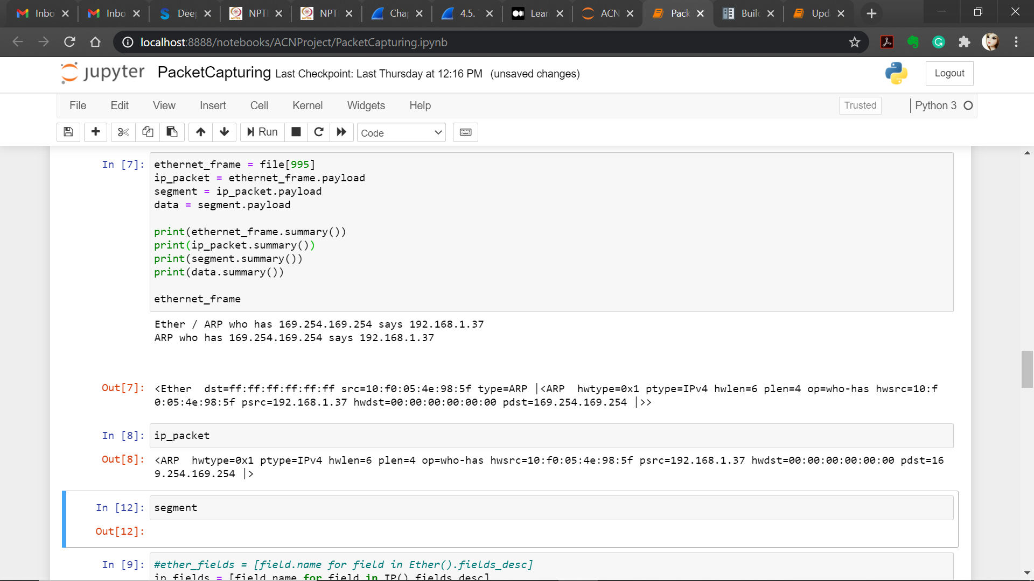
ARP Packet

Slide 15
Display Header Fields as per User Request
def display(n): #Function to display the Header Fields
file[n].display()
return 0
print('Total Number of Packets is', len(file)) #Display No. of Total Packets
while(1):
print('\nDo you want to continue?\n')
c = input('Press c to continue or q to quit:')
if(c == 'c'):
p = int(input('\nEnter the packet whose details you want to display:'))
display(p)
if(c == 'q'):
break

Slide 16
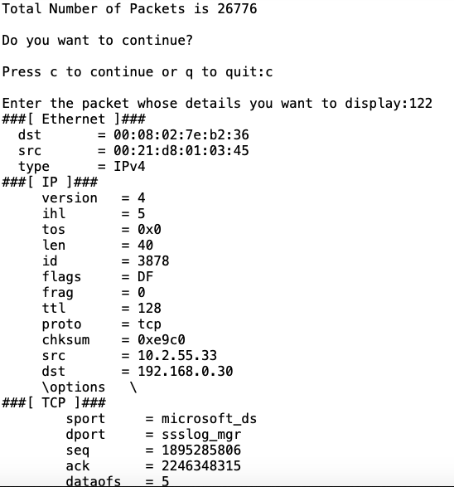
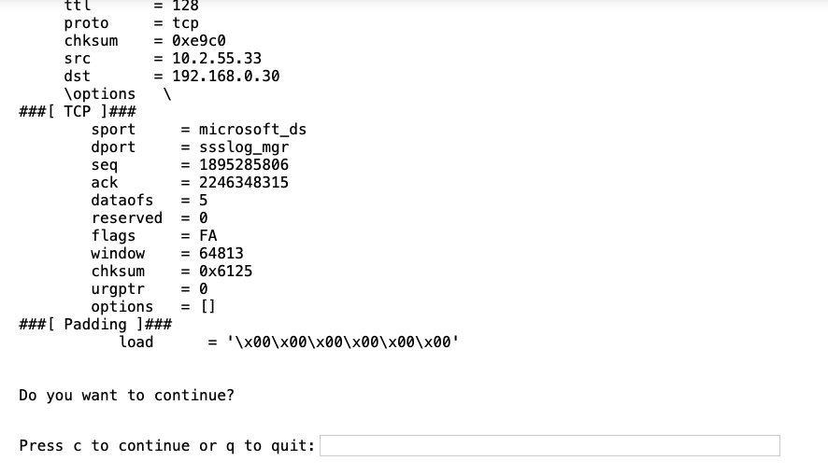
Output

Slide 17
Fetching IP, TCP & UDP Fields
ip_fields = [field.name for field in IP().fields_desc]
tcp_fields = [field.name for field in TCP().fields_desc]
udp_fields = [field.name for field in UDP().fields_desc]

Slide 18
Fetching IP Header Values
for packet in file[IP]:
field_values = []
for field in ip_fields:
if field == 'options': #Adding only the size of
Options field
field_values.append(len(packet[IP].fields[field]))
else:
field_values.append(packet[IP].fields[field])

Slide 19
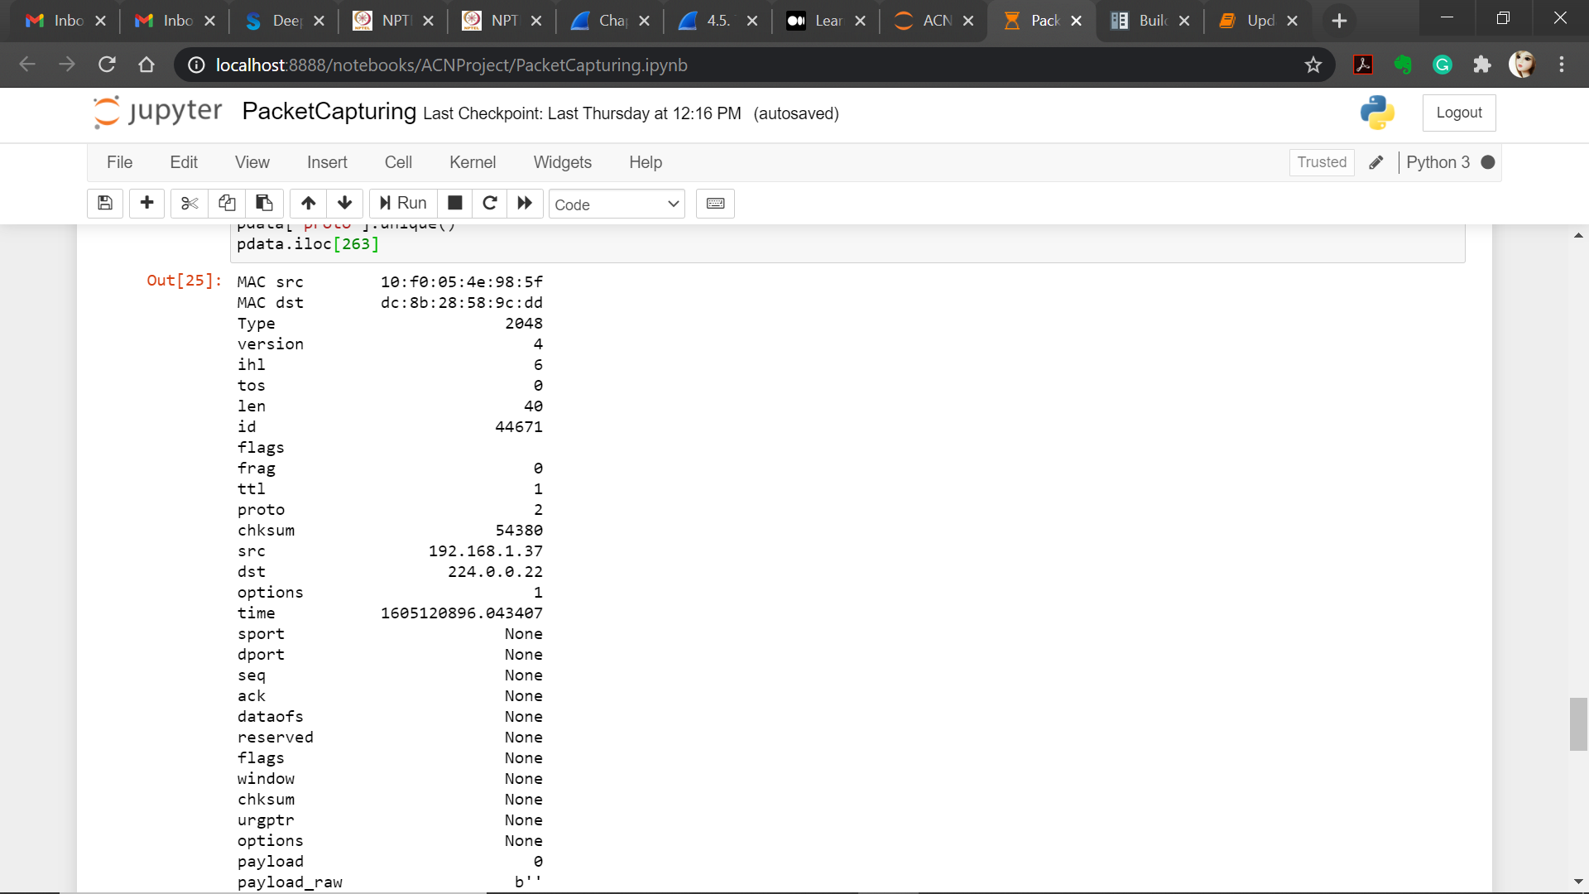
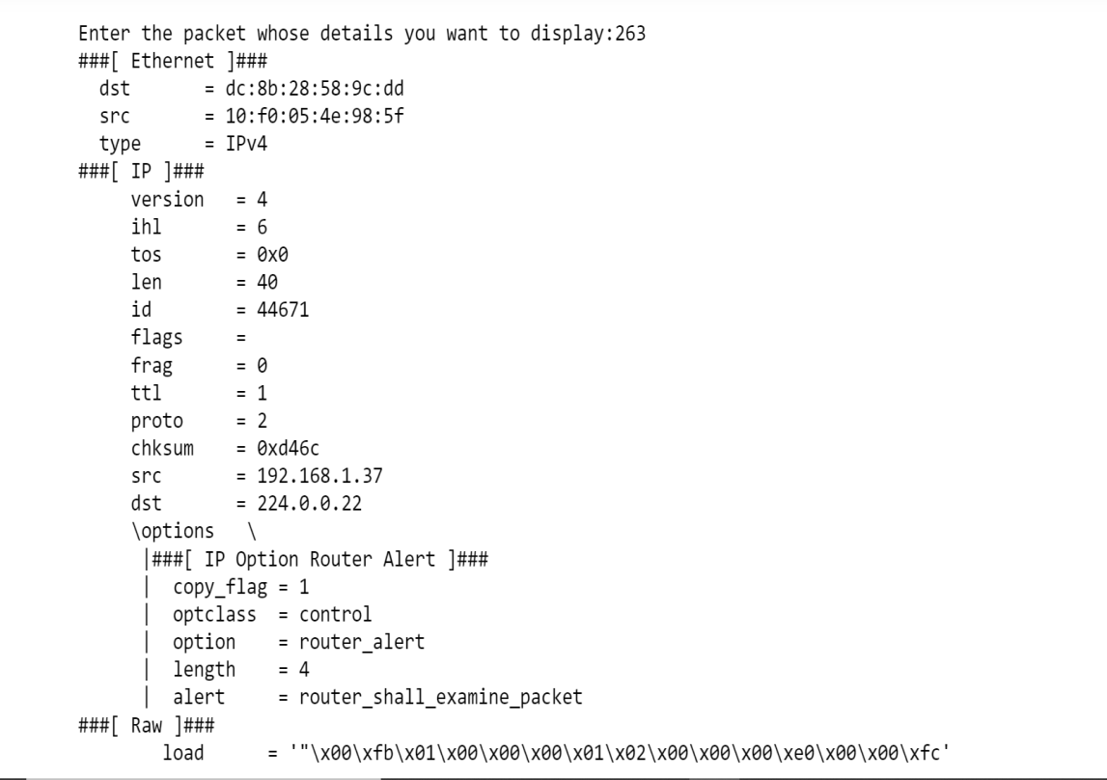
IP Header Output

Slide 20
Fetching TCP/UDP Header Values
From each TCP/UDP segment, the values of all header parameters are fetched and stored in data frame for further analysis.
for field in tcp_fields:
field_values.append(packet[layer_type].fields[field])

Slide 21
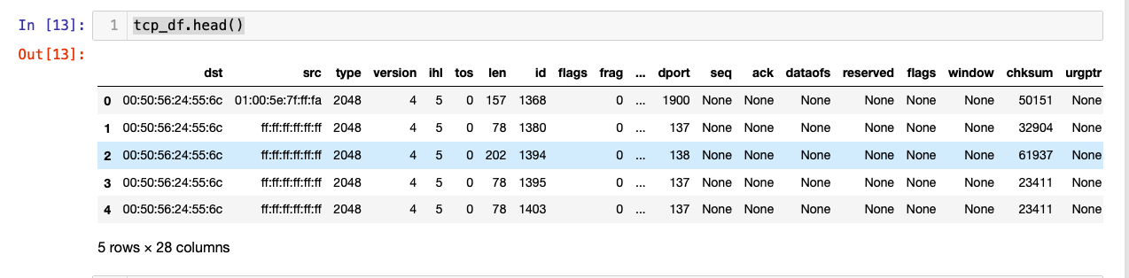
TCP/UDP Header Output

Slide 22
Fetching ARP and ICMP Packet Fields
arp_fields = [field.name for field in ARP().fields_desc]
icmp_fields = [field.name for field in ICMP().fields_desc]

Slide 23
Fetching ARP Header Values
From each ARP packets, the values of all parameters is fetched and store in data frame for further analysis.
for packet in file_name[ARP]:
field_values = []
for field in arp_fields:
field_values.append(packet[ARP].fields[field])

Slide 24
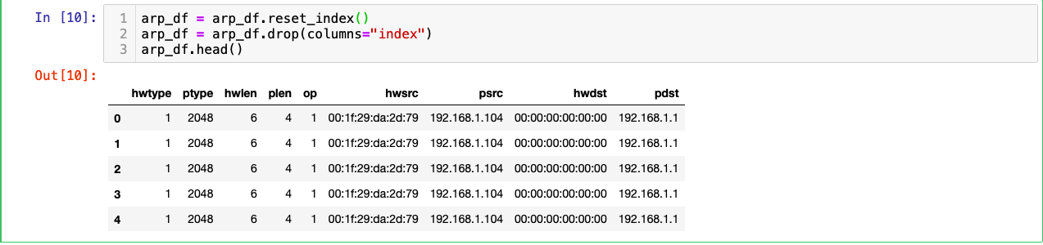
Display the ARP Data

Slide 25
Fetching ICMP Header Values
From each ICMP packets, the values of all parameters is fetched and store in data frame for further analysis.
for packet in file_name[ICMP]:
field_values = []
field_values.append(packet.type)
field_values.append(packet.code)
field_values.append(packet.chksum)

Slide 26
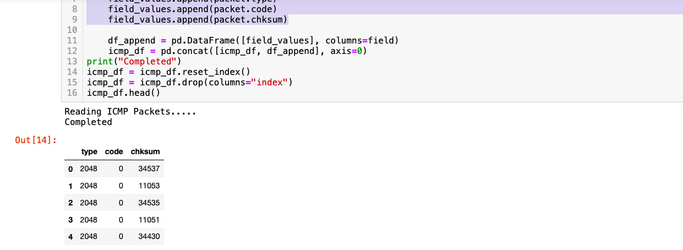
Display the ARP Data

Slide 27
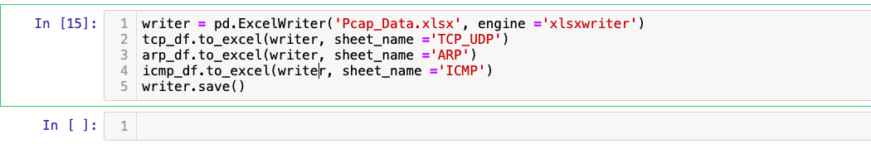
Write the data in Excel

Slide 28
Result Analysis
Visualization and Summarization of Data

Slide 29
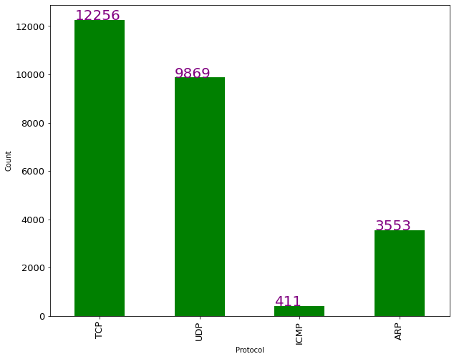
Number Of Protocols
The graph shows the number of packets each protocol has in the network.

Slide 30
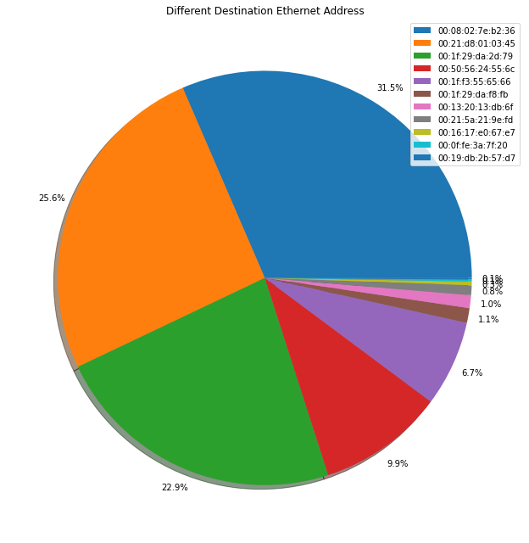
Unique Ethernet Destination Addresses
The pie chart shows the percentage of packets reaching the same destination Ethernet address. For example, 31.5% of packets (shown in blue) are having same destination Ethernet address.

Slide 31
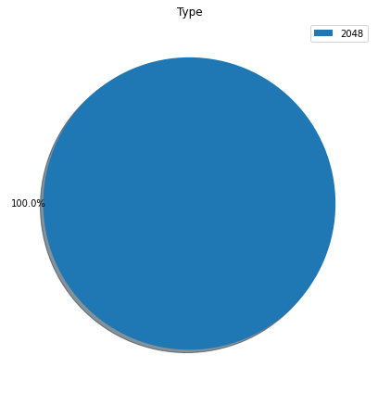
Ethernet type (decimal)
This graph shows that all our packets are generated Ethernet network.

Slide 32
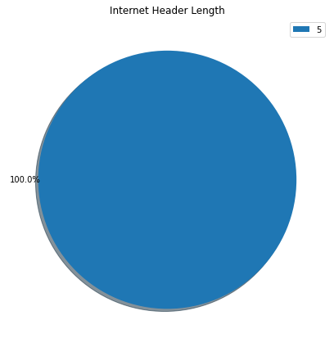
Internet Header Length
The pier char shows that all our packets are using IP protocol with header length 5.

Slide 33
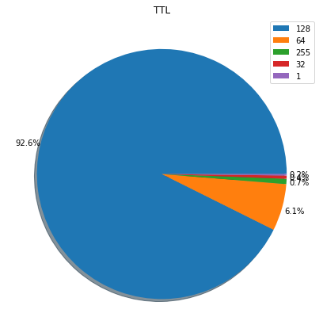
Time To Live
This graph shows the Time to live value for packets. e.g. 92.6% of the packets have TTL value 128.

Slide 34
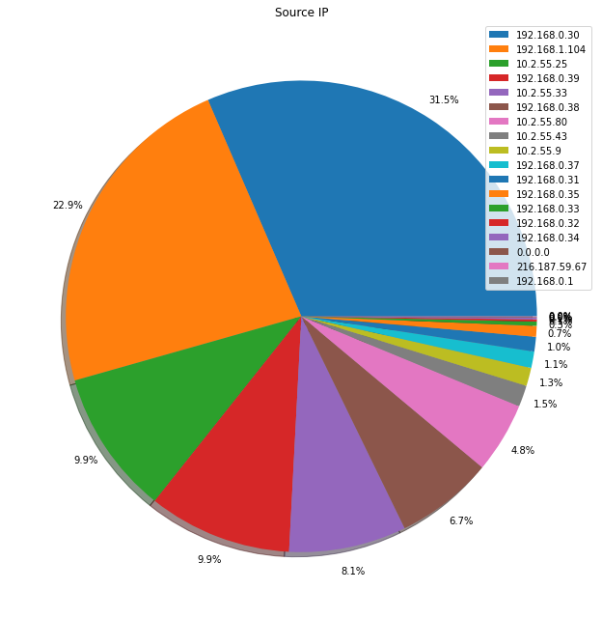
Source IP’s
The graph represent the packets coming from a particular source IP address.
31.5% of the packets are coming from IP address 192.168.0.30.

Slide 35
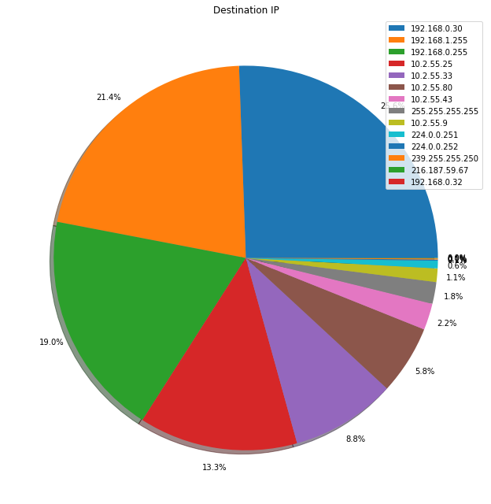
Destination IP’s
This graph shows the packets going to a particular destination IP address.
21.4% of packets are going to IP address 192.168.1.255.

Slide 36
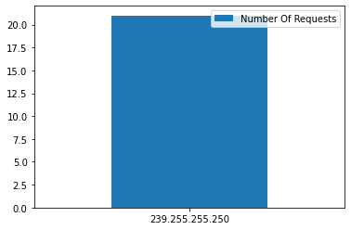
Ethernet Address Requests
This graph depicts the number of requests coming from a particular IP address.

Slide 37
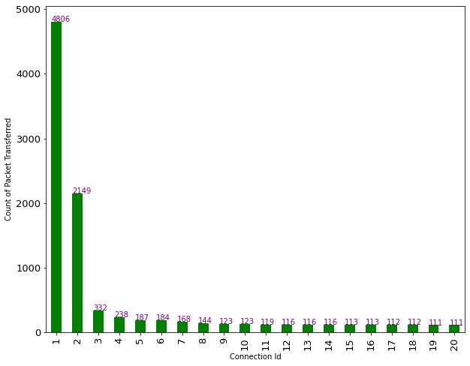
Socket Connections Of Network
Total Connection 1549 as analyzed.
Each connection has a number of packets transfer ranging from 1 to 4806.

Slide 38
Conclusion
We have analyzed a given PCAP file having different network packets captured in C array format.
To read the content of these packets, we have used the scpay package in python language.
The packets are analyzed to determine all the fields like source address, destination address, source port number, destination port number, and protocols used in a different layer (such as IPv4 protocol, TCP protocol).
Finally, all this information is displayed using various graphs and pie charts to summarize the network packets.

Slide 39
References
https://www.thousandeyes.com/learning/glossary/packet-capture
http://www.exa.unicen.edu.ar/catedras/comdat1/material/TP1-Ejercicio5-ingles.
Veteikis, M. and Moriarty, M., BreakingPoint Systems Inc, 2013. Packet capture for error tracking. U.S. Patent Application 13/529,970.
McCanne, S. and Jacobson, V., 1993, January. The BSD Packet Filter: A New Architecture for User-level Packet Capture. In USENIX winter (Vol. 46).
Deri, L., 2004, September. Improving passive packet capture: Beyond device polling. In Proceedings of SANE (Vol. 2004, pp. 85-93).

