Slide 1

Implementation of PCAP Reader
Presented by
Gaurav Kumar (19911014) Kanhu Charan Gouda(19911006)
Asmita Mahajan(20911002) Hem Chandra Joshi(20911005)
Srishti Sharma(20911009)

Slide 2
Contribution
Gaurav Kumar
Collection of PCAP files
Implementation of ARP and ICMP packet reader
Asmita Mahajan
Analysed & Captured the packets from wireshark
Implemented the IP & TCP/UDP packet reader
Srishti Sharma
Prepared the literature part regarding project
Analyzed various filed of TCP/UDP packets using wireshark
Kanhu Charan Gouda
Prepared the part of project report
Analyzed various filed of ARP packets using wireshark
Hem Chandra Joshi
Processed the excel file to summarize the data
Visualize the few important values of various packets

Slide 3
Contents
Introduction
Implementation
Reading of PCAP File
Extracting Layer Specific Fields
Display Header Fields as per User Request
Fetching IP, TCP & UDP Fields
Fetching ARP and ICMP Packet Fields
Result Analysis
Visualization and Summarization of Data
Conclusion
References

Slide 4
Overview
We have been given a file containing some packets captured (in C array format)
Need to analyze the captured packets to determine all the fields in the packet header like source/destination MAC and IP address, port numbers, different protocols used in different layers etc.
Based on the output a summary and visualization of few important header parameters is implemented to understand the network.

Slide 5
Introduction
Packet capture:
Packet capture is a networking term for intercepting a data packet that is crossing a specific data network.
Once a data packet is capturing in real-time, it is stored for a period of time so that it can be analyzed, and then either be downloaded, achieved or discarded.
Full packet capture:
Entire packets or specific portions of a packet can be captured.
A full packet includes two things i.e. a payload and a header.
The payload is the actual contents of the packet, while the header contains metadata, including the packet’s source and destination address.

Slide 6
Introduction
Packet capture analysis:
Analysis of packet capture data typically requires significant technical skills, and often is performed with tools such as Wireshark.
Wireshark:
Wireshark is a free and open-source packet analyzer. It is used for network troubleshooting, analysis, software and communication protocol development, and education.
In other words, Wireshark is a packet sniffer and analysis tool. It captures network traffic on the local network and stores that data for offline analysis.

Slide 7
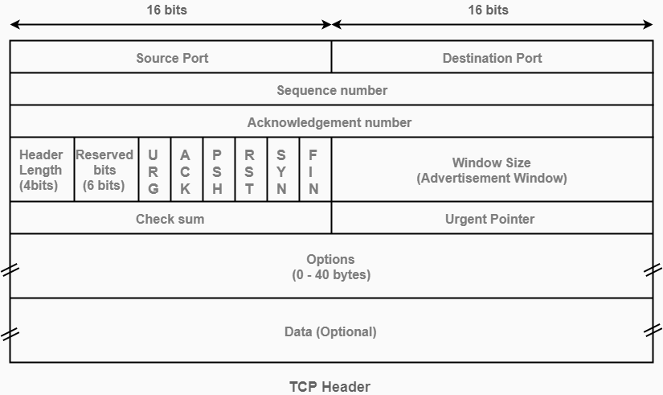
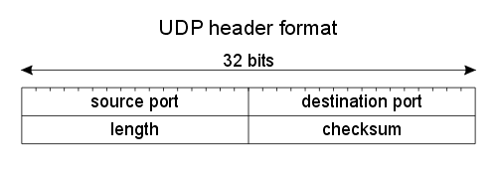
TCP and UDP
TCP Header Format:
UDP Header Format:

Slide 8
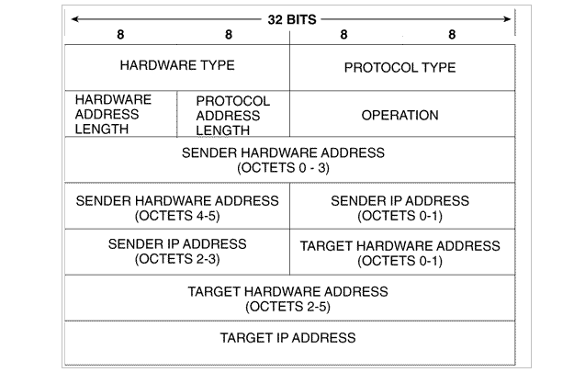
ARP
ARP Header Format:

Slide 9
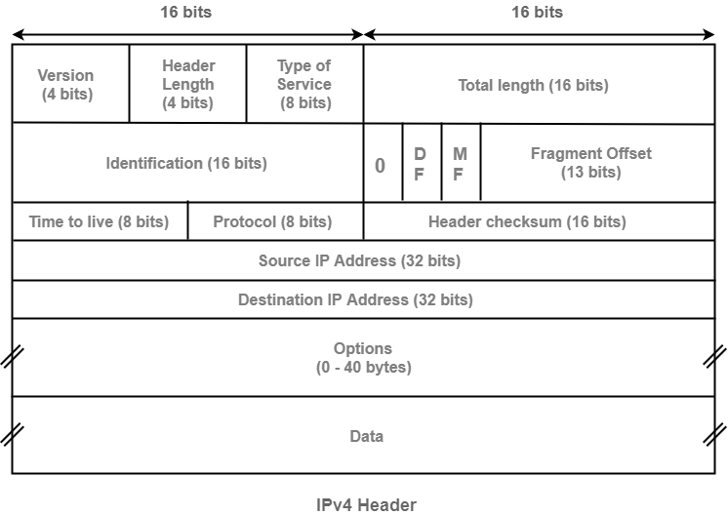
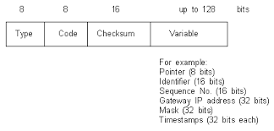
ICMP
IP Packet Header:
ICMP Packet Header:

Slide 10
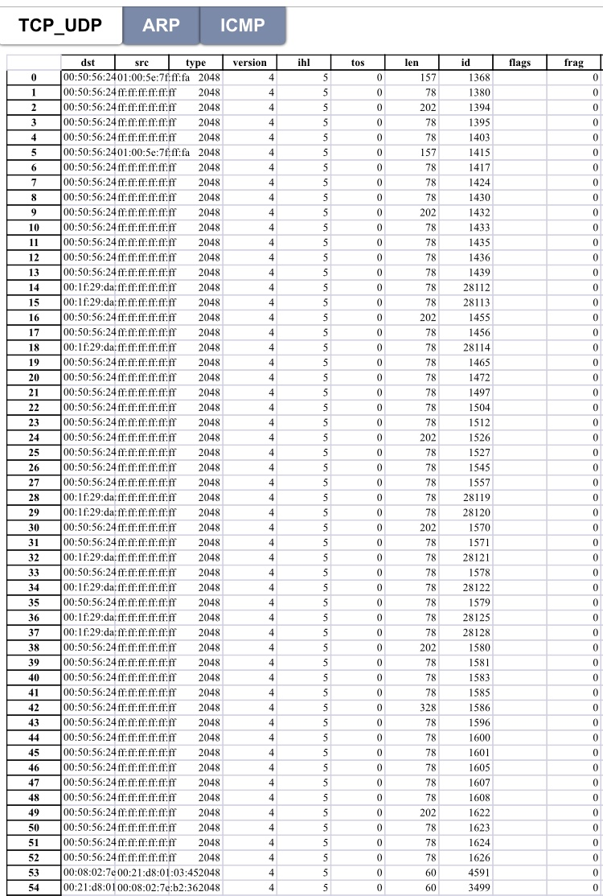
Sample values

Slide 11
Implementation
Packet Header Extraction & Analysis

Slide 12
Reading the PCAP File
Reading of PCAP file is done in python language using scapy package
Use rdpcap() method of scapy package to read the content of pcap file
Test file is having total 26776 packets

Slide 13
Extracting Layer Specific Fields
Extracting packet number 66 at various levels
ethernet_frame = file2[66]
Extracting Data Encapsulated in Ethernet Frame
ip_packet = ethernet_frame.payload
Extracting Data Encapsulated in IP Packet
segment = ip_packet.payload
Extracting payload Encapsulated in the Packet
data = segment.payload

Slide 14
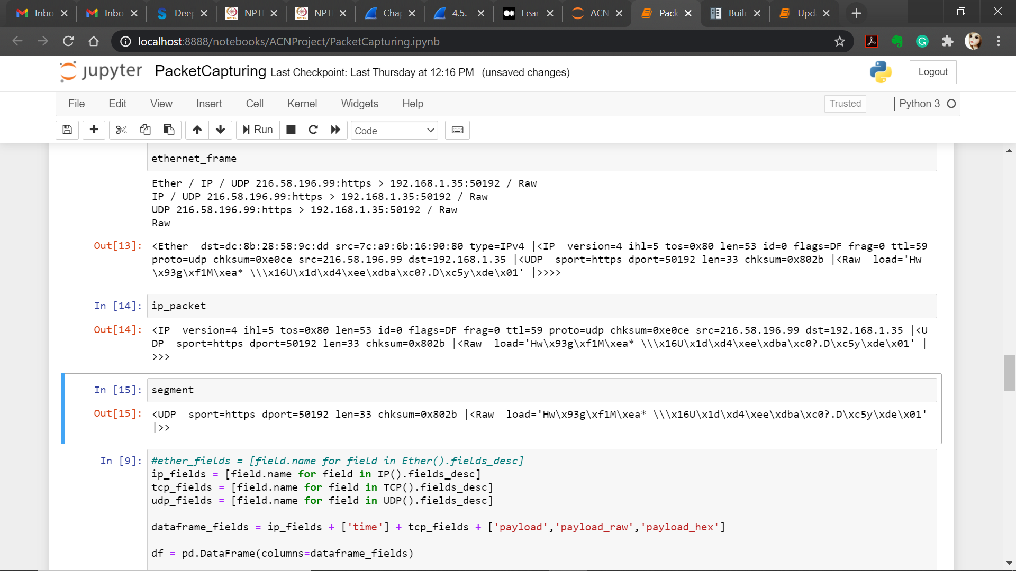
Display specific Packet headers

Slide 15
Display Header Fields as per User Request
Function to display the Header Fields
def display(n):
file[n].display()
return 0
Display No. of Total Packets
print('Total Number of Packets is', len(file)) while(1):
print('\nDo you want to continue?\n')
c = input('Press c to continue or q to quit:')
if(c == 'c'):
p = int(input('\nEnter the packet whose details you want to display:'))
display(p)
if(c == 'q'):
break

Slide 16
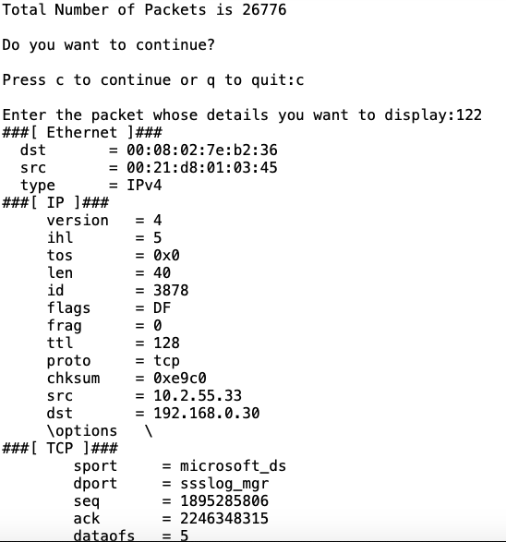
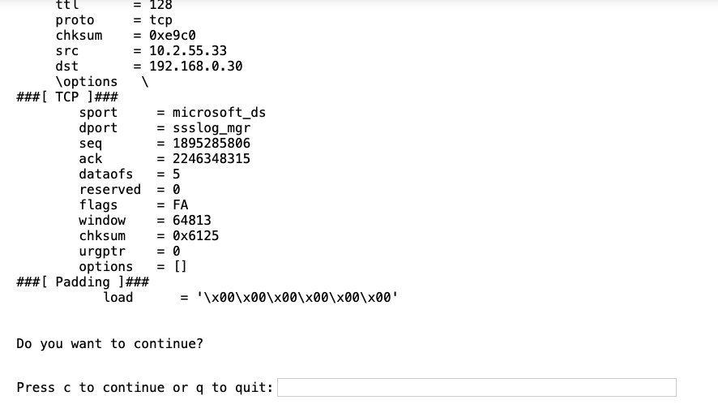
Output

Slide 17
Fetching IP, TCP & UDP Fields
All IP header fileds are extracted
ip_fields = [field.name for field in IP().fields_desc]
All TCP header fileds are extracted
tcp_fields = [field.name for field in TCP().fields_desc]
All UDP header fileds are extracted
udp_fields = [field.name for field in UDP().fields_desc]

Slide 18
Fetching IP Header Values
The size of Options field is added as the last parameter
for packet in file[IP]:
field_values = []
for field in ip_fields:
if field == 'options':
field_values.append (len(packet[IP].fields[field]))
else:
field_values.append(packet[IP].fields[field])

Slide 19
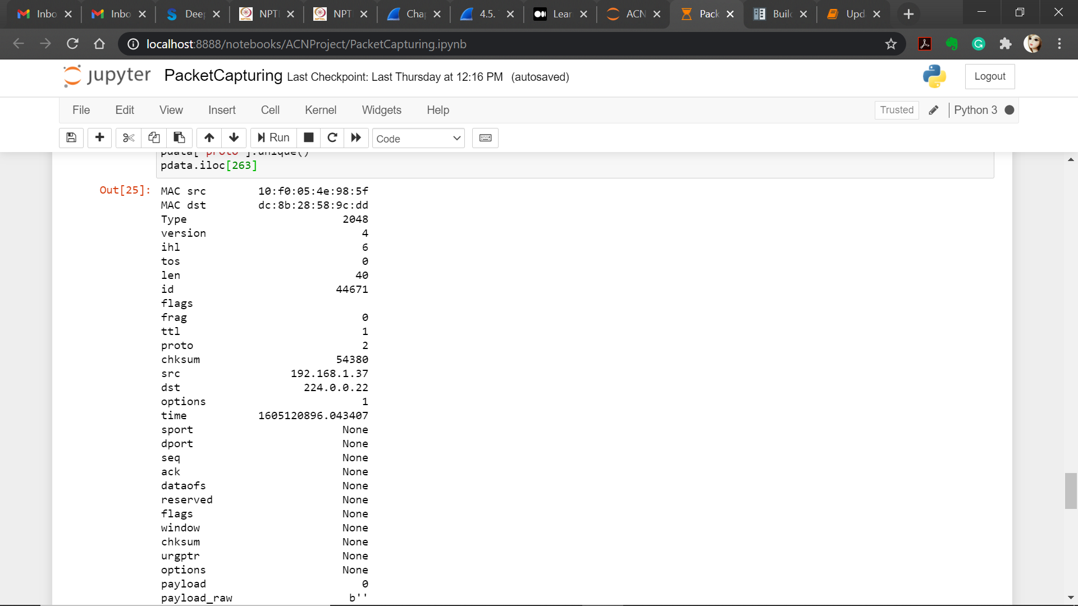
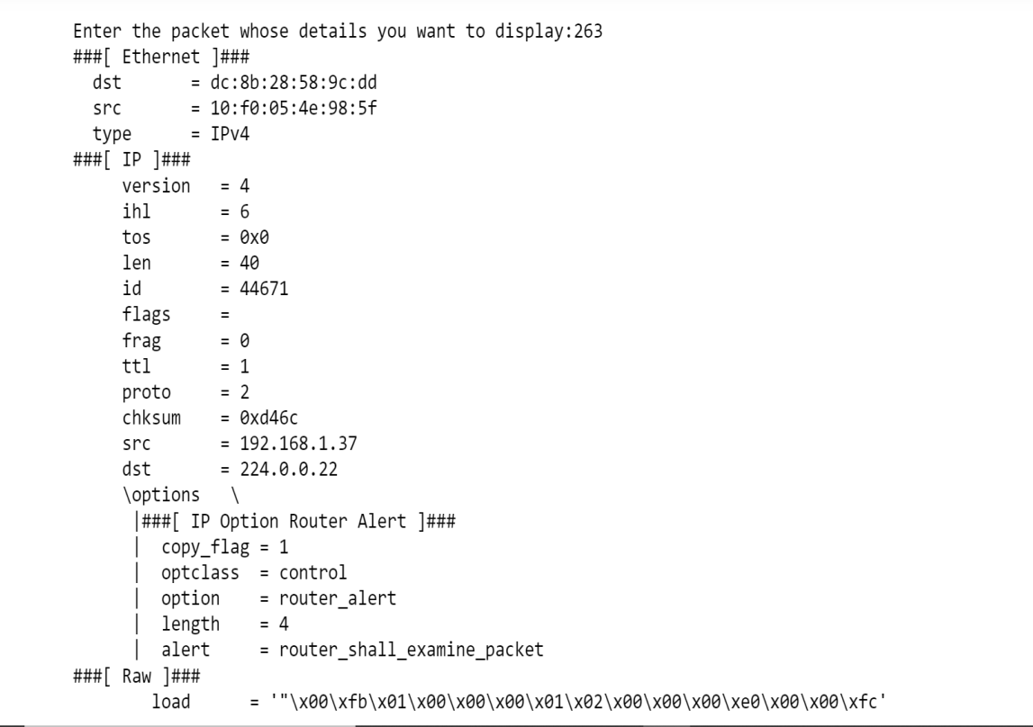
IP Header Output

Slide 20
Fetching TCP/UDP Header Values
From each TCP/UDP segment, the values of all header parameters are fetched and stored in data frame for further analysis.
for field in tcp_fields:
field_values.append(packet[layer_type].fields[field])

Slide 21
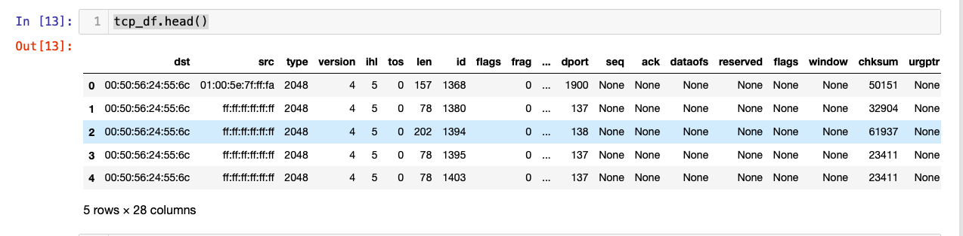
TCP/UDP Header Output

Slide 22
Fetching ARP and ICMP Packet Fields
Store all ARP header parameters
arp_fields = [field.name for field in ARP().fields_desc]
Store all ICMP header parameters
icmp_fields = [field.name for field in ICMP().fields_desc]

Slide 23
Fetching ARP Header Values
From each ARP packets, the values of all parameters is fetched and store in data frame for further analysis.
for packet in file_name[ARP]:
field_values = []
for field in arp_fields:
field_values.append(packet[ARP].fields[field])

Slide 24
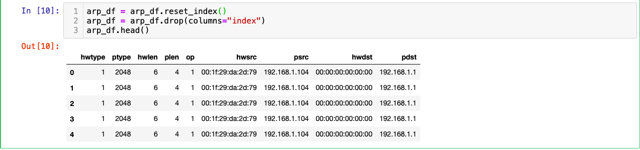
Output of ARP Header Values
ARP header values for first 5 packets is displayed

Slide 25
Fetching ICMP Header Values
From each ICMP packets, the values of all parameters is fetched and store in data frame for further analysis.
for packet in file_name[ICMP]:
field_values = []
field_values.append(packet.type)
field_values.append(packet.code)
field_values.append(packet.chksum)

Slide 26
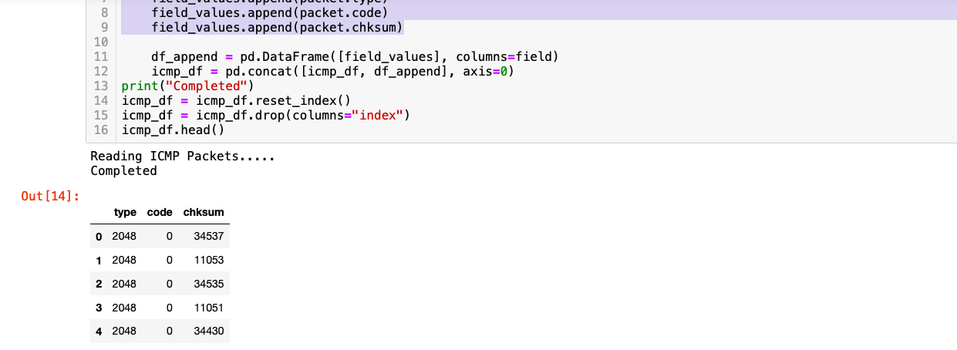
Display the ICMP Data
ICMP header values for first 5 packets is displayed

Slide 27
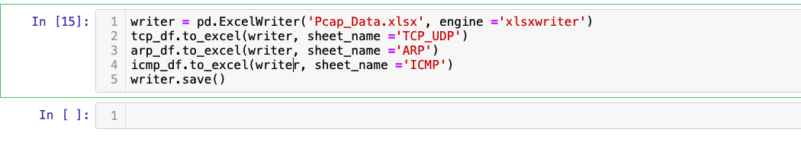
Write all the data in Excel Format
All parameters values are stored in a excel file in three different sheets

Slide 28
Result Analysis
Visualization and Summarization of Data

Slide 29
Visualization and Summarization of Data
Only few important parameters values are summarized here.
Visualization of data is done to understand the packets and their parameter values.

Slide 30
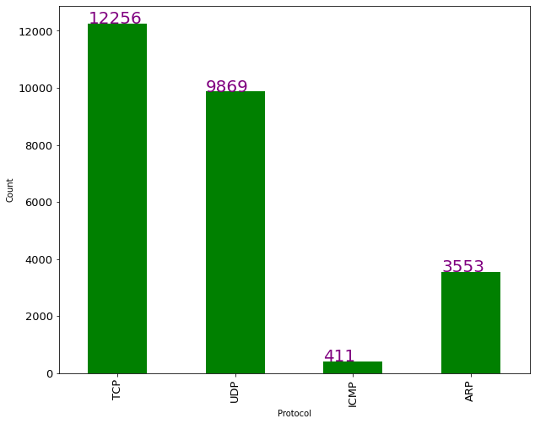
Number Of Protocols
The graph shows the number of packets each protocol has in the network.

Slide 31
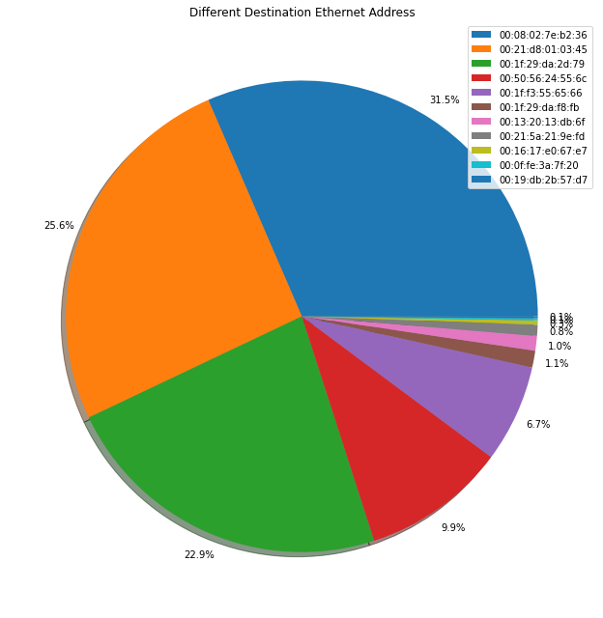
Unique Ethernet Destination Addresses
The pie chart shows the percentage of packets reaching the same destination Ethernet address. For example, 31.5% of packets (shown in blue) are having same destination Ethernet address.

Slide 32
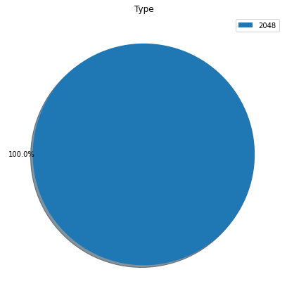
Ethernet type (decimal)
This graph shows that all our packets are generated Ethernet network.

Slide 33
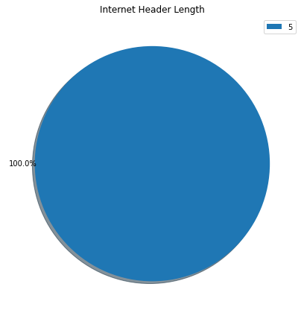
Internet Header Length
The pie chat shows that all our packets are using IP protocol with header length 5.

Slide 34
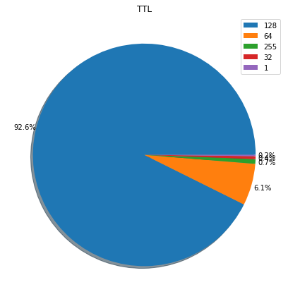
Time To Live
This graph shows the Time to live value for packets. e.g. 92.6% of the packets have TTL value 128.

Slide 35
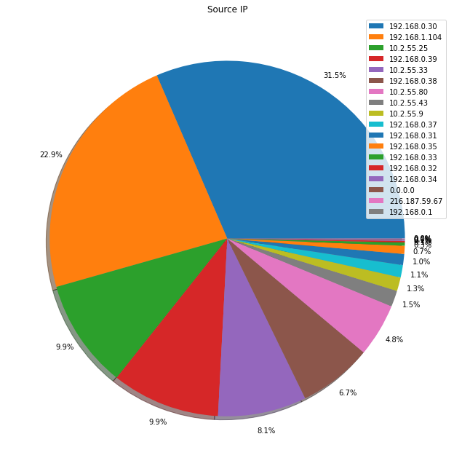
Source IP’s
The graph represent the packets coming from a particular source IP address.
31.5% of the packets are coming from IP address 192.168.0.30.

Slide 36
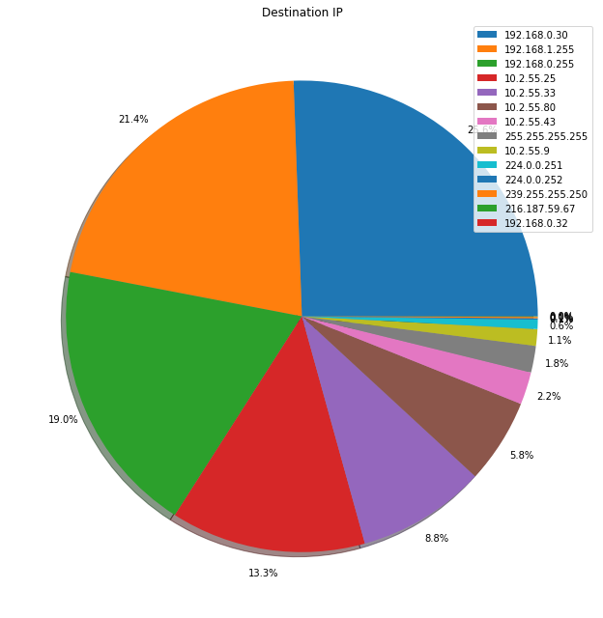
Destination IP’s
This graph shows the packets going to a particular destination IP address.
21.4% of packets are going to IP address 192.168.1.255.

Slide 37
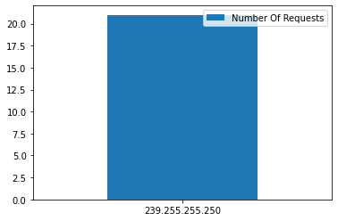
Ethernet Address Requests
This graph depicts the number of requests coming from a ethernet address (01:00:5e:7f:ff:fa)

Slide 38
Socket Connections Of Network
Total number of connection is 1549.
Each connection has several packets transfer ranging from 1 to 4806.
First 20 connection are displayed using bar chart.
Only first connection has 4806 packets transferred for first connection
Actual socket values is not displayed here. It represented using and Connection ID

Slide 39
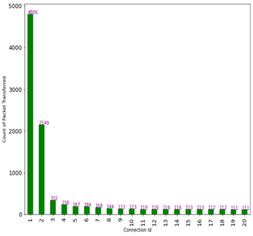
Socket Connections Of Network

Slide 40
Conclusion
We have analyzed a given PCAP file having different network packets captured in C array format.
To read the content of these packets, we have used the scpay package in python language.
The packets are analyzed to determine all the fields like source address, destination address, source port number, destination port number, and protocols used in a different layer (such as IPv4 protocol, TCP protocol).
Finally, all this information is displayed using various graphs and pie charts to summarize the network packets.

Slide 41
References
https://www.thousandeyes.com/learning/glossary/packet-capture
http://www.exa.unicen.edu.ar/catedras/comdat1/material/TP1-Ejercicio5-ingles.
Veteikis, M. and Moriarty, M., BreakingPoint Systems Inc, 2013. Packet capture for error tracking. U.S. Patent Application 13/529,970.
McCanne, S. and Jacobson, V., 1993, January. The BSD Packet Filter: A New Architecture for User-level Packet Capture. In USENIX winter (Vol. 46).
Deri, L., 2004, September. Improving passive packet capture: Beyond device polling. In Proceedings of SANE (Vol. 2004, pp. 85-93).

