Slide 1

Final Project Fraud Detection using Autoencoders and MLPs
Gogoberidze, Nodari
CSCI E-89 Deep Learning, Spring 2019
Harvard University Extension School
Prof. Zoran B. Djordjević

Slide 2
Problem
Credit Card Fraud is a huge problem
Detecting Fraud is a form of anomaly detection
Anomaly detection is a hard problem because of imbalanced nature of positive events
There are many more credit card Normal transactions than Fraudulent ones
Can we use Deep Learning to detect Fraudulent Transactions?
What architecture works best?
Overall accuracy of the model is useless. How do we know how well the models perform?

Slide 3
Description of Technology
For training Models: Keras with Tensorflow backend
Architectures:
Supervised Learning: Feed-Forward Multilayer Perceptron
MLP with weighted classes
Self-supervised Learning: Autoencoder

Slide 4
Dataset
Credit Card Fraud Detection - Anonymized credit card transactions labeled as fraudulent or genuine
Credit card transactions over two day period (but no time series analysis is done)
284,807 transactions
492 Fraud events (0.172% of all transactions)
This is what is meant by “highly imbalanced”
Class column (Fraud or Normal)
Time column
Amount column
28 columns of anonymized data
Undergone PCA transformation
Link to data: https://www.kaggle.com/mlg-ulb/creditcardfraud

Slide 5
Setup
Get the data: download csv from Kaggle or use API client
pip install kaggle
kaggle datasets download -d mlg-ulb/creditcardfraud
Read the data in
df = pd.read_csv("creditcard.csv")

Slide 6
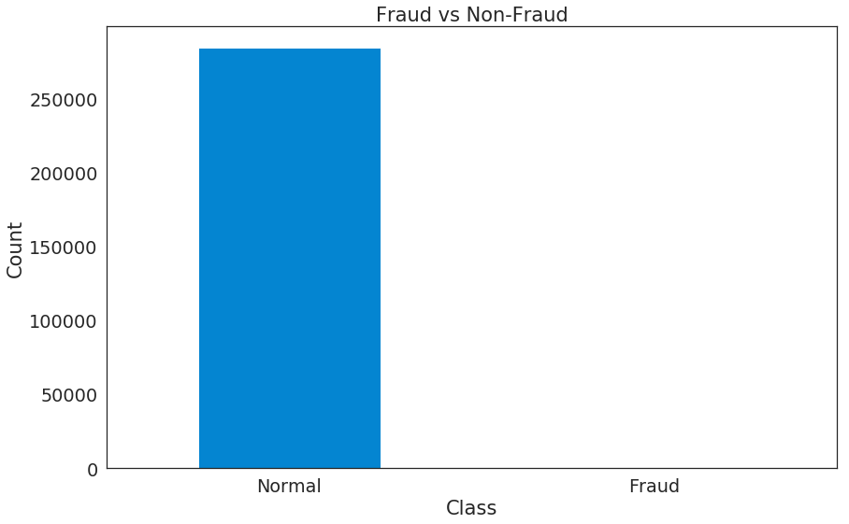
Exploring the data
284,315 labeled 0 (Normal)
492 labeled 1 (Fraud)

Slide 7
Normalizing data
Class acts as labeled, doesn’t need normalization
V1 - V28 already normalized
Time and Amount need normalization
df_norm = df
df_norm['Time'] = StandardScaler().fit_transform(df_norm['Time'].values.reshape(-1, 1))
df_norm['Amount'] = StandardScaler().fit_transform(df_norm['Amount'].values.reshape(-1, 1))

Slide 8
Supervised Learning - Binary Classification
Standard Feed-Forward MLP Model for Binary Classification (Logistic Regression)
Split data 80/20, Training to Testing
train_x, test_x = train_test_split(df_norm, test_size=0.2, random_state=RANDOM_SEED)
Setup Labels
train_y = train_x['Class']
train_x = train_x.drop(['Class'], axis=1)
test_y = test_x['Class']
test_x = test_x.drop(['Class'], axis=1)

Slide 9
Binary Classification - Model Setup
50 epochs, 128 batch size
Use Keras to define sequential, fully connected model, with 20% dropout at each step
model = Sequential()
model.add(Dense(120, input_shape=(input_dim,), activation='tanh'))
model.add(Dropout(0.2))
model.add(Dense(60, activation='tanh'))
model.add(Dropout(0.2))
model.add(Dense(30, activation='tanh'))
model.add(Dropout(0.2))
model.add(Dense(1, activation='sigmoid'))
Final layer is single neuron with sigmoid activation
Binary crossentropy for loss, Adam for optimizer
model.compile(metrics=['accuracy'],
loss='binary_crossentropy',
optimizer='adam')

Slide 10
Binary Classification - Running the Model
history = model.fit(train_x, train_y,
epochs=nb_epoch,
batch_size=batch_size,
shuffle=True,
validation_data=(test_x, test_y),
verbose=1,
callbacks=[cp]).history
Epoch 50/50
227845/227845 [==============================] - 8s 35us/step - loss: 0.0014 - acc: 0.9997 - val_loss: 0.0042 - val_acc: 0.9992
99.9% Validation Accuracy looks great.
But we have 99.8% Accuracy just claiming that all transactions are Normal
Overall Accuracy is not a good metric for Imbalanced data

Slide 11
Metrics for Model Performance
True Positive (TP) - correctly identifying a transaction as fraud
False Positive (FP) - incorrectly identifying a transaction as fraud (Type 1 Error)
True Negative (TN) - correctly identifying a transaction as normal
False Negative (FN) - incorrectly identifying a transaction as normal (Type 2 Error)
Two common curves
Receiver Operating Characteristic (ROC)
True Positive Rate = (TP) / (TP + FN)
False Positive Rate = (FP) / (FP + TN)
Precision-Recall
Precision = (TP) / (TP + FP)
Recall = True Positive Rate
Run predictions
preds_y = model.predict(test_x).flatten()
Put in dataframe with labels
error_df = pd.DataFrame({'Predictions': preds_y,
'Actual': test_y})

Slide 12
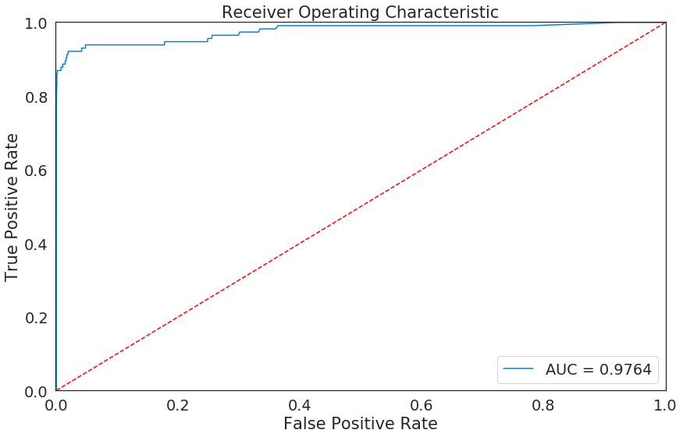
ROC Curve
Scikit-learn to get FPR, TPR, Thresholds
fpr, tpr, thresholds = roc_curve(error_df.Actual, error_df.Predictions)
Get Area Under Curve (AUC)
roc_auc = auc(fpr, tpr)
Only looks good because of huge data imbalance
Misleading because of huge number of TN in False Positive Rate

Slide 13
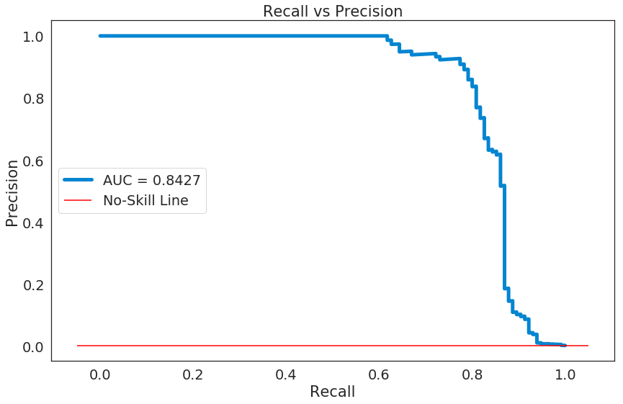
Precision - Recall
Neither Precision nor Recall use TN -> much more informative
precision_rt, recall_rt, threshold_rt = precision_recall_curve(error_df.Actual, error_df.Predictions)
pr_auc = auc(recall_rt, precision_rt)

Slide 14
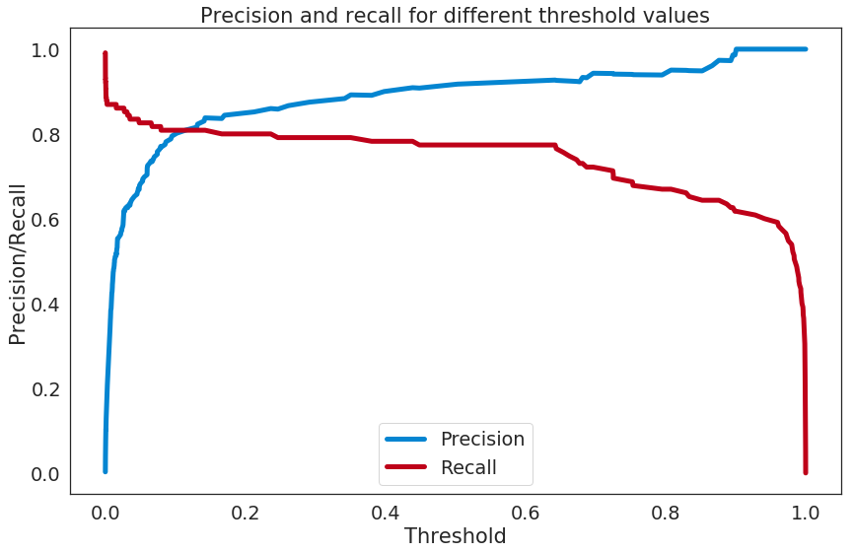
Threshold
For what probabilities do we assign transaction as Fraud
For perfectly balanced, 0.5
For imbalanced, may be higher, may be lower

Slide 15
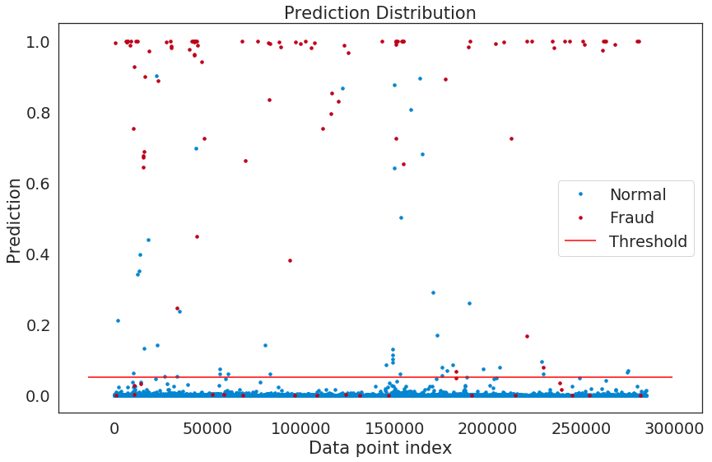
Data points vs predictions
threshold_fixed = 0.05

Slide 16
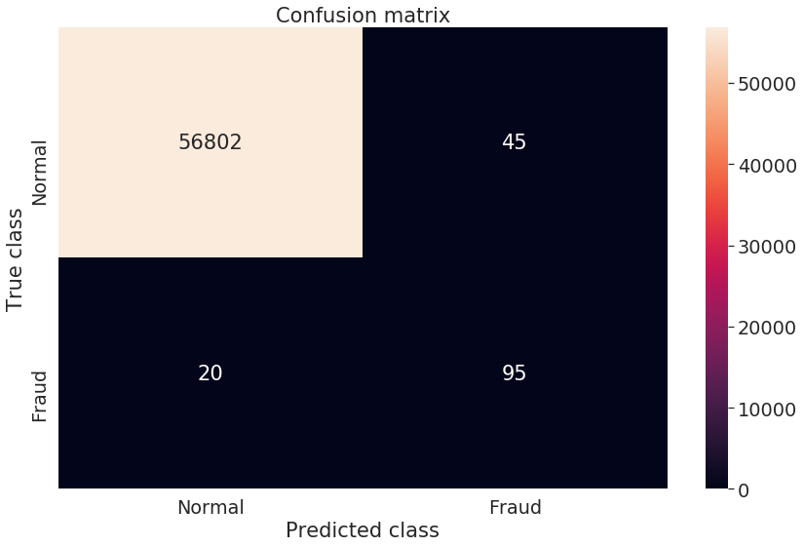
Final Tally
preds_y_binary = [1 if e > threshold_fixed else 0 for e in error_df.Predictions]
conf_matrix = confusion_matrix(test_y, preds_y_binary)
sns.heatmap(conf_matrix, xticklabels=LABELS, yticklabels=LABELS, annot=True, fmt="d");
TN = 56,802
TP = 95
FP = 45
FN = 20
Recall = 83%
Precision = 68%

Slide 17
Autoencoder Model - Setup
80/20 training-testing split, same as before
This time remove fraud data from training
train_x = train_x.drop(['Class'], axis=1)
remaining_fraud = train_x[train_x.Class == 1]
100 epochs, 128 batch size, L1 regularization
Encoder: 30 -> 14 -> 7
Decoder: 7 -> 14 -> 30
input_layer = Input(shape=(input_dim, ))
encoder = Dense(encoding_dim, activation="tanh", activity_regularizer=regularizers.l1(learning_rate))(input_layer)
encoder = Dense(hidden_dim, activation="relu")(encoder)
decoder = Dense(hidden_dim, activation='tanh')(encoder)
decoder = Dense(input_dim, activation='relu')(decoder)
autoencoder = Model(inputs=input_layer, outputs=decoder)
Mean-Squared Error, Adam optimizer
autoencoder.compile(metrics=['accuracy'],
loss='mean_squared_error',
optimizer='adam')

Slide 18
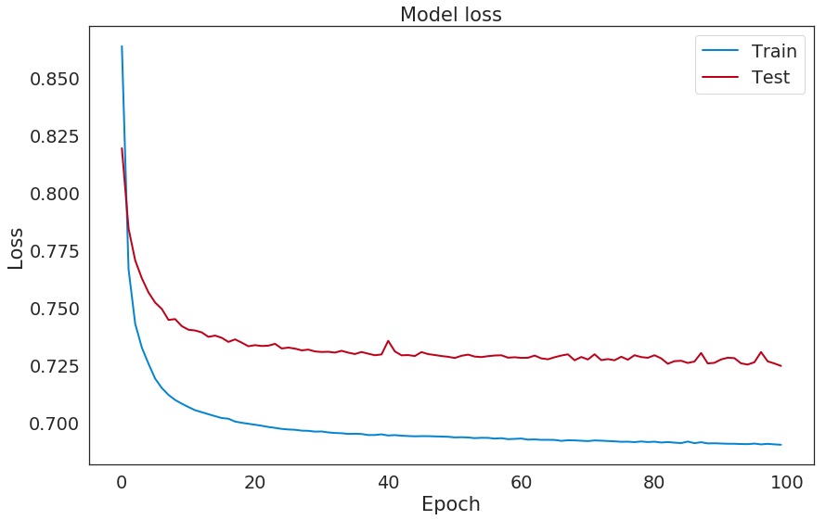
Autoencoder - Run the model
Train data on itself
history = autoencoder.fit(train_x, train_x,
epochs=nb_epoch,
batch_size=batch_size,
shuffle=True,
validation_data=(test_x, test_x),
verbose=1,
callbacks=[cp]).history
Validation Loss = 0.72

Slide 19
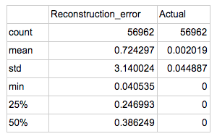
Reconstruction Error
Fraud data not used in training, can use it for predicting
test_x_extended = np.concatenate((remaining_fraud_x, test_x), axis=0)
test_y_extended = pd.concat([remaining_fraud_y, test_y])
Now we have all 492 Fraud data points
preds = autoencoder.predict(test_x_extended)
mse = np.mean(np.power(test_x_extended - preds, 2), axis=1)
error_df = pd.DataFrame({'Reconstruction_error': mse,
'Actual': test_y})
error_df.describe()
Reconstruction error is
high for data that does not
fit encoder well (fraud data)

Slide 20
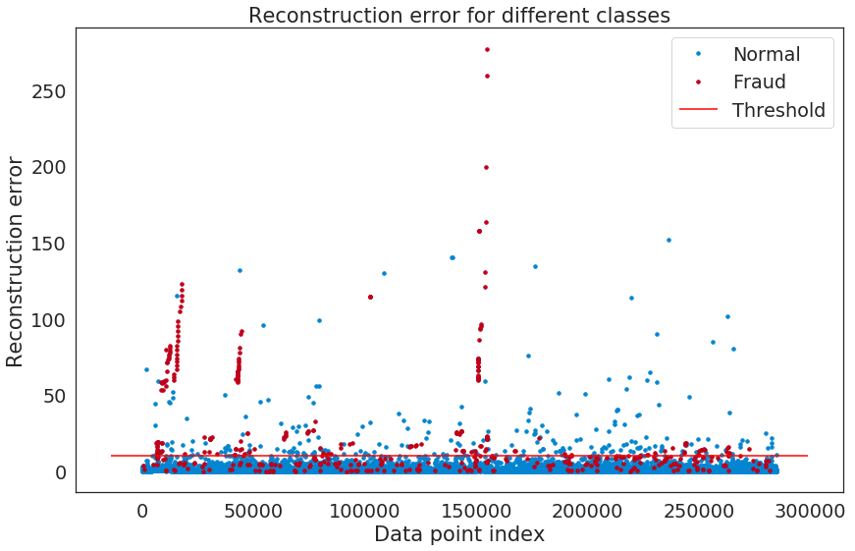
Reconstruction Error for different classes
Threshold lower than 10 introduces too many false positives
Raising threshold loses true positives

Slide 21
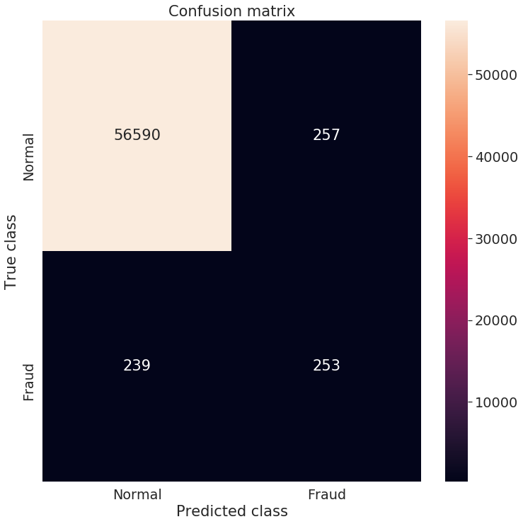
Final Tally
pred_y = [1 if e > threshold_fixed else 0 for e in error_df.Reconstruction_error.values]
conf_matrix = confusion_matrix(error_df.Actual, pred_y)
TN - 56,590
TP - 253
FP - 257
FN - 239
Recall = 51%
Precision = 50%
Okay results, but MLP
is better

Slide 22
MLP with weighted Classes
Oversampling - replicate minority class (fraud) to balance dataset
Issue: Overfitting
Undersampling - Remove majority class samples (normal) to balance dataset
Issue: Loss of information -> Bad generalization
Weighted Classes - Assign weights to classes, take bigger steps during optimizations for higher weights
Similar results to Oversampling
Keras model.fit() has class_weights parameter that takes dictionary of labels to weights
class_weight = {0 : 1., 1: 50.}
history = model.fit(class_weight=class_weight, …)

Slide 23
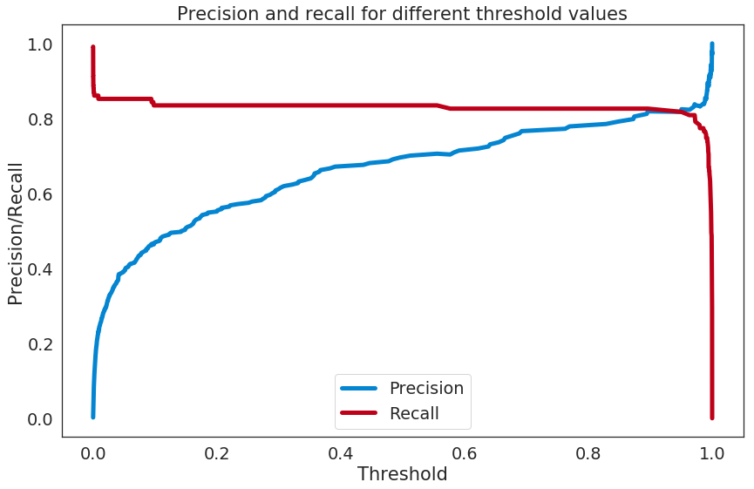
Weighted Class - Precision Recall Threshold
Higher Precision, without much of a drop in Recall

Slide 24
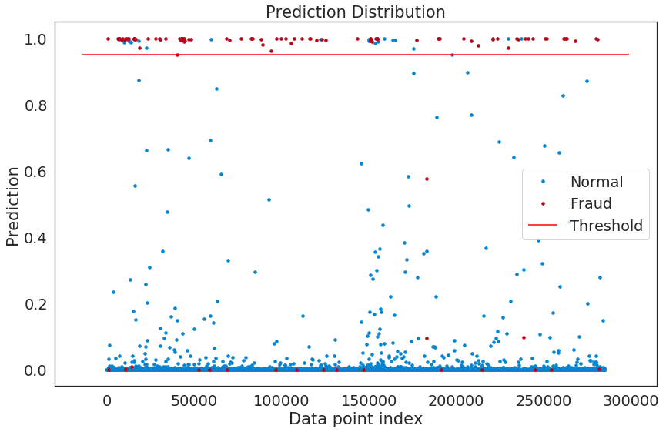
Prediction threshold
High probabilities for fraud events
Very high threshold

Slide 25

Weighted Class - Final Tally
Previously:
TP - 95
FN - 20
FP - 45
TN - 56,802
Precision - 68%
Recall - 83%
Now:
TP - 94
FN - 21
FP - 21
TN - 56,826
Precision - 82%
Recall - 82%
Similar Recall, but better Precision (less False Positives)

Slide 26
Summary and Lessons Learned
Imbalanced data common for anomaly detection (e.g. detecting fraud)
Model accuracy not a good predictor for model performance for highly imbalanced datasets
Tradeoff must be made between Recall and Precision
Optimal threshold can be found, but bounded by real-life constraints
Too low precision = Too many false positives -> nagging customers about potential fraud where there isn’t any
Too low recall = Too many false negatives -> customers complain about stolen credit cards
Autoencoders useful for anomaly detection, but a good encoding must be found in order to flag data that has higher than normal reconstruction error
Binary Classification also a good approach, and is improved with use of weighted classes

Slide 27
YouTube URLs, Last Page
Two minute (short): https://youtu.be/Ukyud5gpa2o
15 minutes (long): https://youtu.be/h-5t6h384K8

