Slide 1

Sprint 1 Playback
COSC2408 – Programming project 1
Team: 17
PM: Salman Maarouf
BA: Aryan Gholami
UX: Turin Sayed
Dev: Aiza Fontanilla
Dev: Luka Grganovic
Project: Telstra-Robotics and NLI
Notes:
Hi everyone, I'm Salman, PM for Team 17. My teammates are Ary, Aiza, Luka and Turin

Slide 2
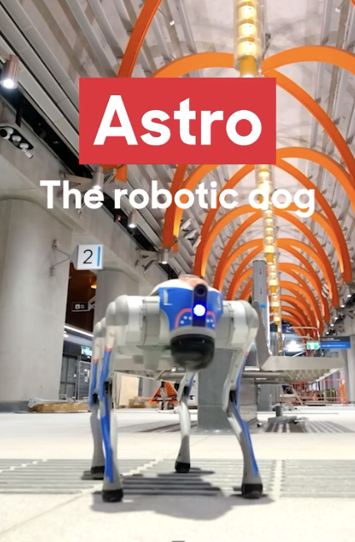
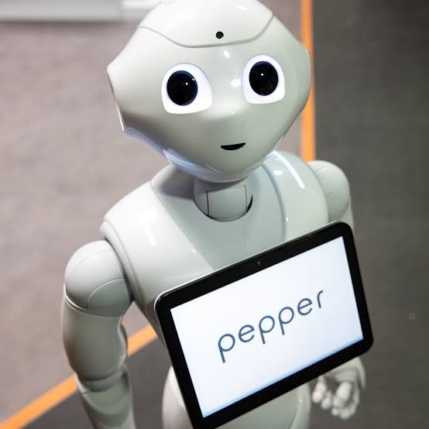
Project Overview
Robotics and Natural Language Intelligence
Answer natural-language questions about their surroundings
Resolve ambiguous instructions
Describe what it sees
Notes:
We're working with Telstra on Robotics and Natural Language Intelligence (iii)
Telstra has proven robots like Astro (!!!) can safely sense and report from hazardous sites, but there's no evidence they can interpret vague, unstructured human instructions or (iii) answer natural-language questions about their surroundings
Our project gives the robot enough language reasoning to resolve ambiguous instructions(iii) and describe what it sees in plain conversation.(iii)
We're researching and implementing this using Haku (!!!), the Pepper robot at RMIT's VX Lab, since we don't have physical access to Astro itself, but the target users are still Astro the Robot Dog operators.

Slide 3
Original Plan
Research
Design
Bootstrap
Notes:
The Scope for Sprint 1 was Research(iii), Design(iii) and Bootstrap(iii)
The three commitments entailed that we:
Research LLM options in the VX lab so we can make an informed choice for speech-to-text and reasoning.
Bootstrap the codebase by cloning and getting familiar with the haku_control_system repository that was given to us by Sam from the VX Lab
And design a basic user board that displays an interaction scenario between the human and robot in our simulated environment which is the XVLab

Slide 4
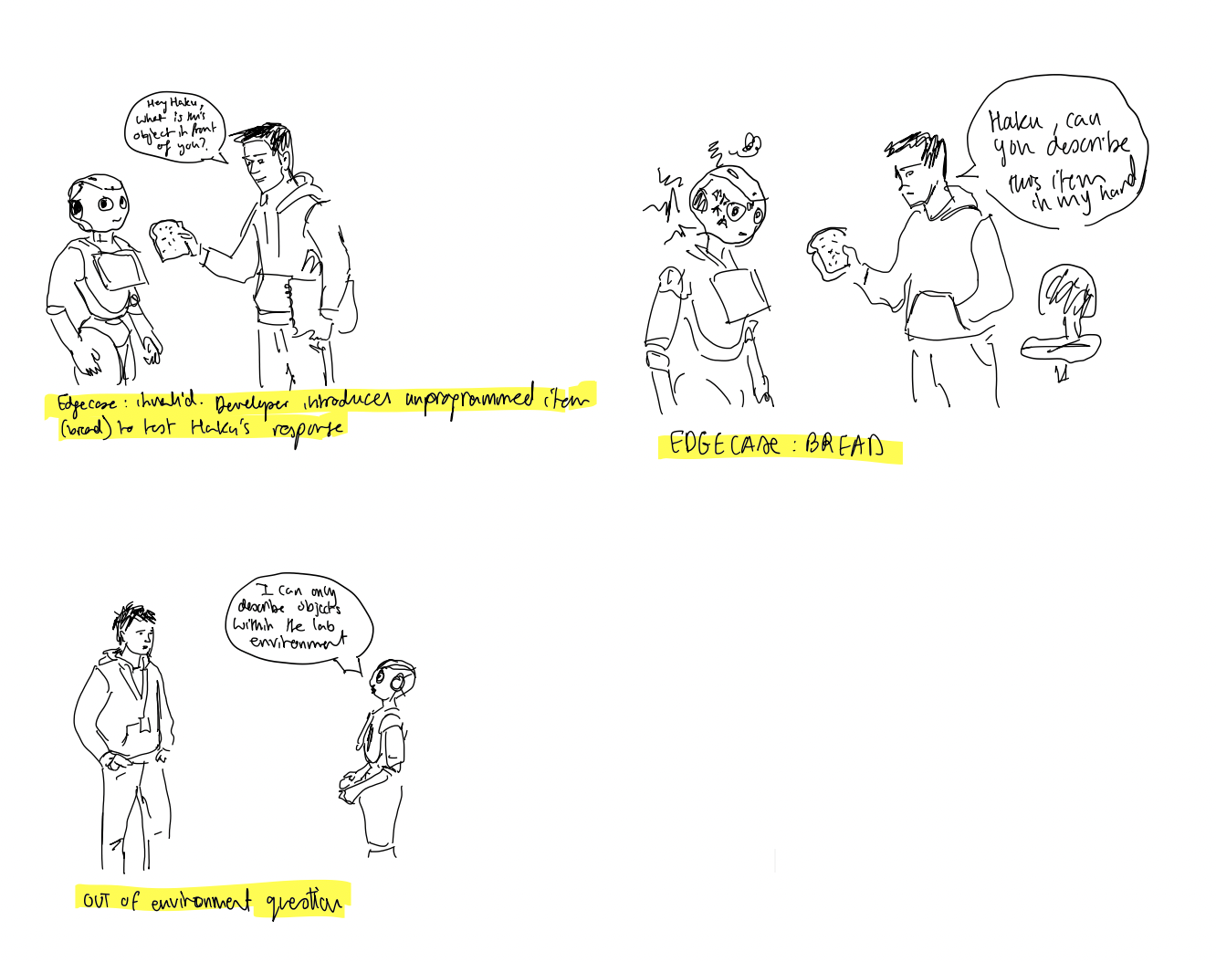
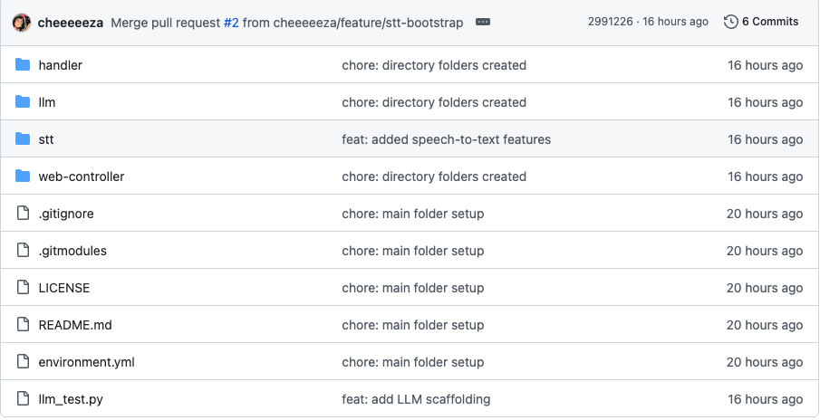
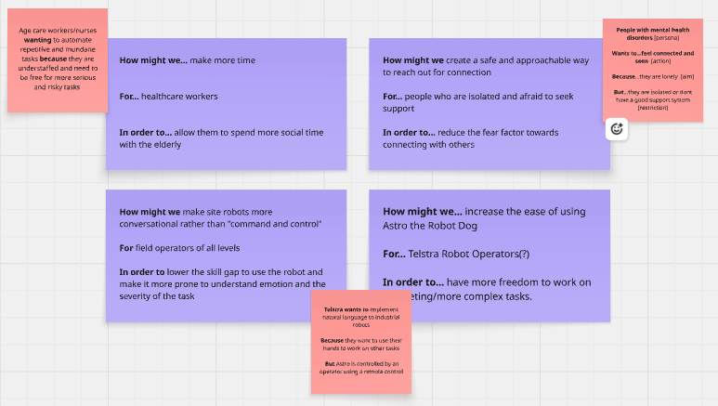
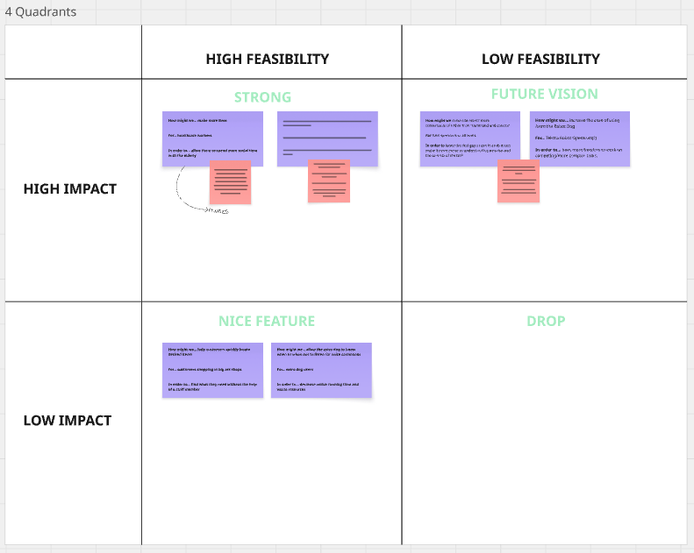
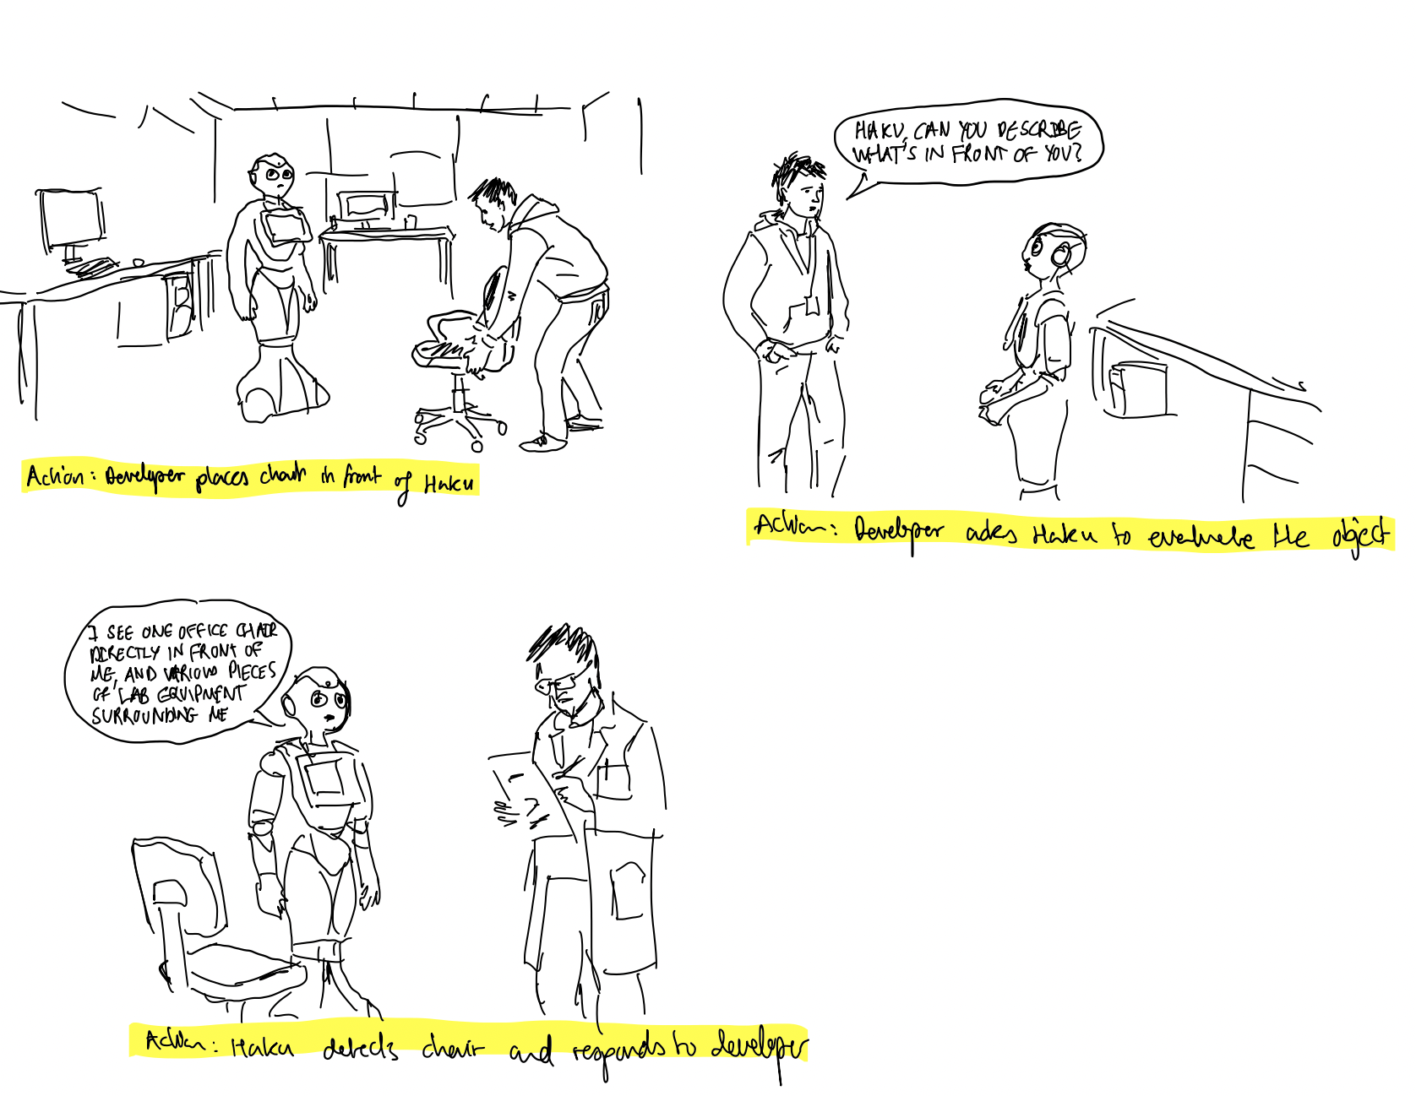
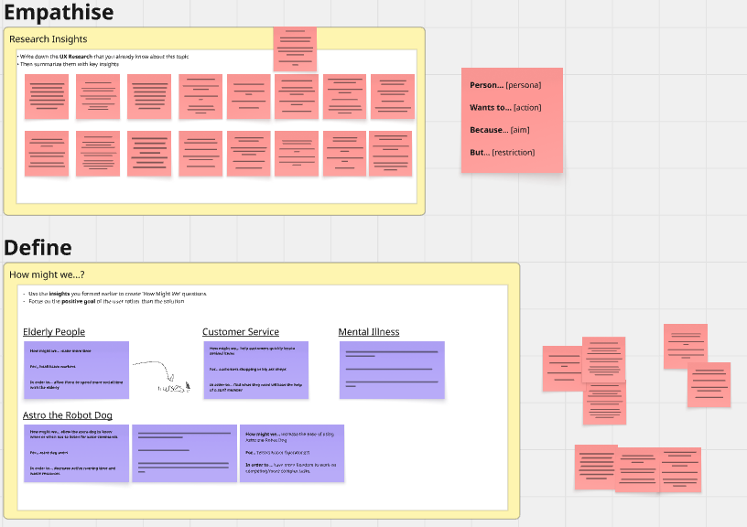
Actual Achievement
Notes:
Here are our actual achievements for the Sprint:
(iii) On the left there are 2 user board scenarios for a human interacting with the pepper robot, one with a programmed item which is the chair and it’s able to identify it and communicate it, and one with an unprogrammed item which is a piece of bread and it isn’t able to identify it or give a description.
This is to outline the vision we have for how the pepper robot and eventually Astro will be able to interpret and describe it’s surroundings while also handling edge cases and unfamiliar objects
(iii) In the middle we have the Github repo that was set up and will use for the rest of our project, so far we’ve bootstaped the repository and implemented the LLM scaffold using Ollama.
(iii) And to take it back to last week, we had a long design workshop to decide and nail down our idea and the problem we’re trying to solve, we used techniqcs from Jolly’s lecture a couple of weeks back.

Slide 5
Why It Matters
Sprint 1: speech to text, repo is bootstrapped, interaction scenario
Coming up: interact with surroundings more freely, implementing emotional awareness while speaking to the user
Notes:
Why it Matters?
(iii)For sprint 1 we focused on implementing the basic features right, like making sure speech-to-text is working and making sure the repository is bootstrapped and that we have a clear idea of what n interaction scenario is like between the operator and the robot.
(iii)This will give us a good foundation to be more challenging features in the coming sprints, for example being able to interact with it’s surroundings more freely and working to implementing emotional awareness while speaking to the user/operator.
This is to show that we got the setup done and we have everything ready for the next sprint

Slide 6
Blockers and Open Questions
Beginning of the week meetings rather than end of the week
Another important thing is that technically our client project proposal is still not signed off
Notes:
(iii)Ary our BA suggested that we have a meeting earlier in the week to discuss expectations for the tasks, this will help us a lot as we would normally have the catch up meeting towards the end of the week as an end of the week discussion and we would be misaligned at the start of the week, which delays task completion till Thursday and Friday.
(iii)Another important thing is that technically our client project proposal is still not signed off after last Monday’s meeting, hopfully we hear back from Alessio and Nikhita about it soon

Slide 7
Task Allocation and Time Spent
Team Member | Key Task(s) | Hours Logged
Salman Maarouf (PM) | S1W1 Update Tasks on Planner week: 60 S1W1 VXLab Introduction: 90 S1W1 Integrate new tasks by BA for S1W1: 60 S1W1 Signed up to get access to VXLab: 30 S1W1 Update Master Doc and submit W1: 120 S1W2 VXLab and Haku (pepper robot) Induction: 180 Writing Friday meeting agenda: 30 S1W2 Finalise client project proposal: 180 S1W2 Final Review and submission: 90 S1W2 Update Tasks on Planner Board: 45 S1W3 Design Human-Robot Interaction Wireframes: 90 | 16 Hours
Aiza Fontanilla (DEV 1) | S1W1 Research Haku Pepper Robot: 60 S1W1 Signed up to get access to VXLab: 30 S1W1 VXLab Introduction: 60 S1W2 VXLab and Haku (pepper robot) Induction: 180 S1W2 Finalise client project proposal: 180 S1W3 Playback Presentation Preparation: 30 S1W3 Bootstrap Development Environment in VXLab: 180 S1W3 Bootstrap Speech-to-text + LLM Pipeline Scaffolding: 180 | 15 Hours

Slide 8
Task Allocation and Time Spent
Luka Grganovic (DEV 2) | S1W1 Research Haku Pepper Robot: 60 S1W1 Signed up to get access to VXLab: 30 S1W2 VXLab and Haku (pepper robot) Induction: 180 S1W3 Playback Presentation Preparation: 30 S1W3 Bootstrap Development Environment in VXLab: 180 S1W3 Bootstrap Speech-to-text + LLM Pipeline Scaffolding: 180 | 11 hours
Turin Sayed (UX) | S1W1 Signed up to get access to VXLab: 30 S1W1 VXLab Introduction: 90 S1W2 Finalise client project proposal: 180 | 5 hours
Aryan Gholami (BA) | S1W1 Redefining Tasks for the rest of S1: 60 S1W1 VXLab Introduction: 90 S1W1 Plan out Friday meeting agenda: 30 S1W1 Signed up to get access to VXLab: 30 S1W2 VXLab and Haku (pepper robot) Induction: 180 S1W2 Finalise client project proposal: 180 S1W2 Reassigning and allocating tasks for S1W3: 90 S1W3 Create requirements document for user story boards: 90 S1W3 Playback Presentation Preparation: 30 S1W3 Review/Validate Development Environment: 60 | 15 hours
Notes:
These are all of our tasks for Sprint1 Weeks 1 to 3, if there is a disparity between this and our planner it’s because it weeks 1 and 2 we recorded meetings between us and with our supervisors and clients as hours, but Alessio made an announcement this week that meeting are not tasks, that’s why I left the meeting tasks in our planner out of this table.

Slide 9
Timeline and Next Steps
Major events this sprint
Supervisor meeting with Alessio
Introductory meeting with Milindi
XVLab Introduction
VXLab Induction
Client Propsal Meeting
Bootstrap Repository
Design User Stories
Research and Implement LLMs
What’s next
MVP
Notes:
Major events this Sprint include
(iii)Supervisor meeting with Alessio for feedback on client project proposal
(iii) We had and Introductory meeting with Milindi, our technical supervisor, she gave us some things to expect before we had our XVLab induction
(iii) We had a XVLab introduction where we dropped in to have a look at the lab and an overview of the 2 robots and talked expectations while using the lab
(iii) Then we had a VXLab induction where we picked Haku the pepper robot as opposed to Bandit the other robot, and Sam gave us a detailed overview on how to use the robot’s hardware and software
(iii) We then had our client proposal meeting last Monday where we implemented Alessio’s feedback from our first supervisor meeting
(iii) The three main tasks: research, design and bootstrap which I talked about earlier were all done this week
(iii) In sprint 2 we hope to explore and implement the emotional aware aspect of the interaction between the human and the robot and also train it more on it’s environement and how it interacts with it’s surrounding, and ultimate provide an MVP before refining it in Sprint 3

Slide 10
Aryan Gholami (BA)
Task Allocation
Ideation Workshop
Documentation
QA & Review
Project Management
Blockers & Resolutions
Blocker
Resolution
Notes:
Ary speaks
Tasks I’ve done:
Re-defining Tasks for Week 1: Because our Sprint 1 plan we’ve created during the demo sprint needed to be overhauled, I’ve worked with Salman to re-define these tasks.
Ideation Workshop in Week 2: Used Jolly’s template as guidance on setting up and facilitating the team ideation workshop, focused on implementing the design thinking framework to identify a feasible problem to focus on, which was used in the renewed client project proposal.
Re-defined and allocating tasks for Week 3: Worked with PM to redefine tasks for Week 3 based off renewed client project proposal.
User Story Board Requirements Document: Created two user story board requirement documents for (1) Robot Simulation Environment & Speech-to-text + LLM Pipeline Scaffolding Stand Up (2) Natural Language Object Query feature.
Reviewing Dev & UX Work: Reviewed UX and Dev work to ensure that it meets the acceptance criteria defined in the task, and ensure that there is no potential for scope creep (e.g. using a different language with Haku).
Collaborative Planning & Organization with PM: Collaboration with PM ensures redundancy; ensured that there are minimal gaps in planning, keeping the team on track and accountable, consistent communication with team members and keeping team members aligned with the project goals.
Blockers:
After creating the first client project proposal and receiving feedback from Alessio towards the end of the demo, we’ve learnt that we’ve gone in the wrong direction in our project planning, and it was a major bump in the road for the first week and a half of our sprint 1- causing delays. Through this, I’ve learnt the significance of having a structured ideation session, which I’ve implemented after attending Jolly’s UX design workshop, to effectively and efficiently identify a feasible problem to tackle.

Slide 11
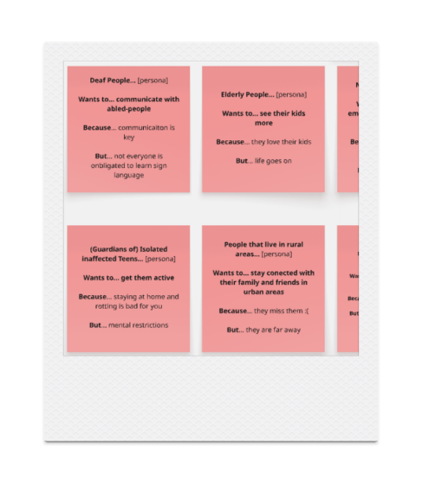
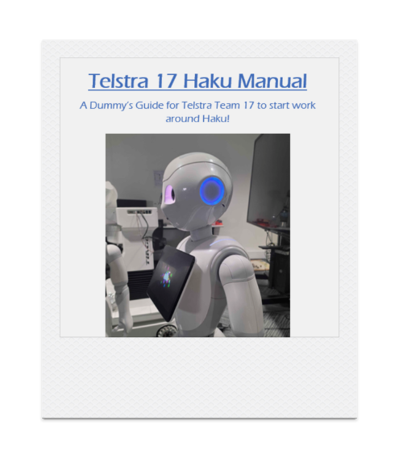
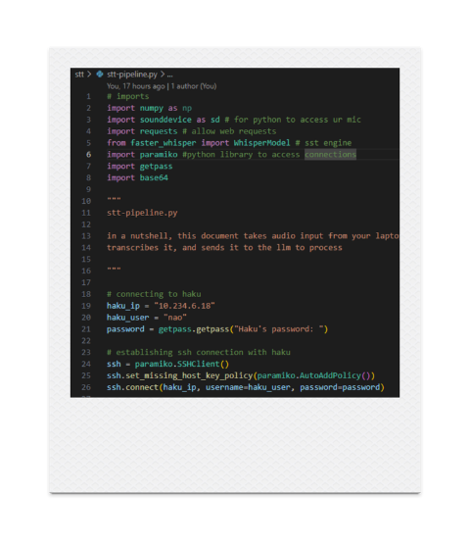
AIZA’S CONTRIBUTION (DEV 1)
01 WORKSHOP IDEATION
02 SETTING UP HAKU
03 HAKU MANUAL
BLOCKERS:
→ DISAGREEMENTS
→ HAKU

Slide 12
Luka Grganovic (DEV 2)
Research & Access: Researched the Haku Pepper Robot and secured VXLab access.
Induction: Completed the technical induction for the VXLab and Haku.
Environment Setup: Bootstrapped the core development environment within the VXLab.
Pipeline Scaffolding: Built the initial Speech-to-Text and LLM pipeline scaffolding.
Playback Prep: Prepared materials for the Sprint 1 Playback presentation.
Notes:
Luka Grganovic

Slide 13
Turin Sayed (UX)
Ideation Workshops: Explored problem areas, defined user personas, and mapped potential solutions.
Lab Induction: Assessed Haku's practical capabilities, limitations, and the physical environment.
Learning: Validated the necessity of thoroughly defining user needs before designing technical solutions.
Notes:
Turin Speaks: For Sprint 1, my main contribution as the UX designer was participating in the ideation workshops and helping the team explore different problem areas and potential use cases for the robot. I contributed to discussions around user needs, possible personas and how we could turn those problems into potential solutions. I also attended the Robot Lab induction, which helped me understand the environment we're designing for and some of the practical capabilities and limitations of Haku the robot.
One blocker I found was that because we're still in the early ideation stage the final use case and user requirements weren't completely defined.
That made it difficult to start producing detailed UX designs or wireframes. A key learning for me was that understanding the problem and the user's needs first is important before jumping straight into designing a solution.

