Slide 1
✋
✌️
✊
RENESAS RA8P1 · µT-KERNEL 3.0
👍
👎
Conversational Hand Gestures
An inclusive, on-device AI interface for children — built for the TRON Programming Contest 2026
2026-09-22
Tu Thai* · Duy Phan · Khoa Do
*Corresponding author · Gnomons
1
© 2026 Gnomons

Slide 2
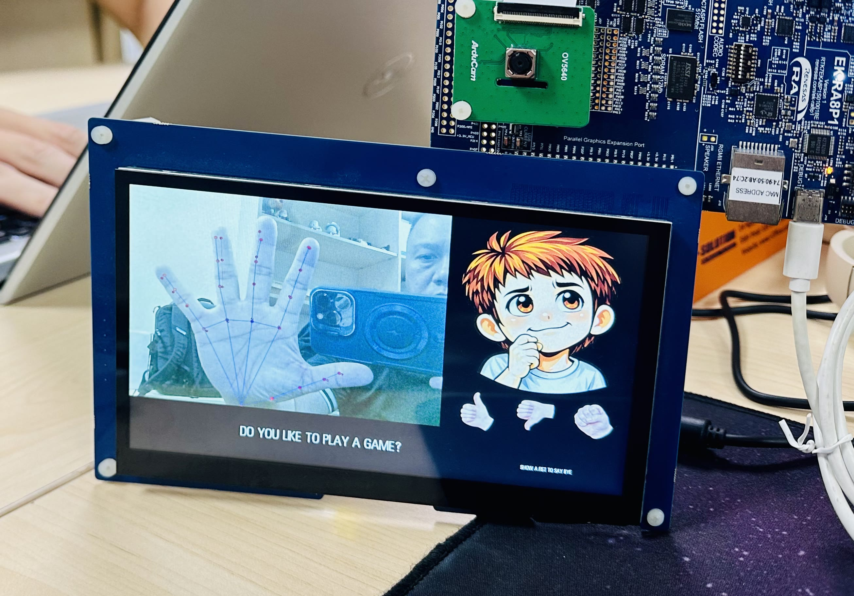
OVERVIEW
A gesture-only conversation, entirely on-device
A child raises an open palm. A cartoon face on screen greets them back. From there the two hold a short conversation, play a game, and watch a story generated live on screen — using only hand shapes. No network stack, no camera data ever leaves the device, so the exchange stays private to the child using it.
The exchange mimics conversational reciprocity — turn-taking, not a single command triggering a single response — with the animated face appearing to understand and talk back through its reactions.
a gesture in · a reaction back · live on the EK-RA8P1 board
▶ Watch the demo on YouTube
2
© 2026 Gnomons

Slide 3
THE CHALLENGE
Competing for CPU time and limited memory
On a single microcontroller, combining two AI workloads is not automatic.
VISION PIPELINE
Must keep up with a live camera feed — every frame, on time.
AI workloads are large relative to an MCU's compute and memory budget. Running more than one at once — for example a vision pipeline that must keep up with a live camera while a language model computes in the background — puts them in direct competition for CPU time and for the limited fast memory an AI accelerator needs. Without guaranteed task order, a slower AI workload can stall a time-critical one.
vs.
LANGUAGE MODEL
Computes in the background, hungry for the same CPU cycles and fast memory.
3
© 2026 Gnomons

Slide 4
SYSTEM ARCHITECTURE
Two AI workloads, one chip
The vision half feeds an MIPI camera into palm-detection and hand-landmark models on the on-chip Ethos-U55 NPU; 21 joint positions become one of five named gestures through geometry ratio tests on the Cortex-M85. The language half runs a “Tiny” Llama2 model at 8-bit quantization, reading weights directly out of external Octo-SPI flash and calling the Cortex-M85's Helium vector instructions for int8 matrix multiply — 16 lanes per instruction instead of one.
VISION · T_CAM / T_AI
LANGUAGE · T_STORY
MIPI Camera → Palm Detection → Hand Landmark (21 joints) → Gesture Geometry
Tiny Llama2 → int8 Matrix Multiply (Helium) → Weights read from flash → Token stream
SINGLE µT-KERNEL EVENT FLAG — ready / done bits only · interrupts set bits directly · nothing to overflow
RENESAS RA8P1
ETHOS-U55 NPU
CORTEX-M85 + HELIUM
OCTO-SPI FLASH
SDRAM
4
© 2026 Gnomons

Slide 5
SCHEDULING
Fixed priorities keep vision responsive
µT-Kernel's fixed task priorities let these two workloads share one chip safely, as four application tasks. Story generation only uses CPU time left over after the other three, so it cannot delay the camera or the display: the camera picture keeps updating and story text keeps appearing together, with no dropped frames on the panel.
T_CAM
Captures each camera frame and hands it to the vision pipeline. Highest priority so the live picture never stalls.
HIGHEST
camera capture
T_AI
Runs palm detection and hand-landmark inference on the NPU, then the gesture geometry on the Cortex-M85.
HIGH
AI inference
T_UI
Owns the conversation state machine and draws the whole screen — camera picture, face, game, and story text.
MEDIUM
UI & conversation
T_STORY
Generates story text one token at a time, using only whatever CPU time the other three tasks leave behind.
LOWEST
story generation
5
© 2026 Gnomons

Slide 6
REAL-TIME BEHAVIOR
Competitive speed, without freezing the screen
The same benchmark other microcontrollers run alone — llama2.c's stories15M, 8-bit quantized — runs here at a comparable rate while also driving a live camera and two NPU vision models at once.
2.61 tok/s
111 ms
Never freezes
story rate, camera and screen running too — on par with single-purpose boards running the same model alone
CPU time per token spent on the camera and screen, so the display stays live
the panel keeps drawing live camera and story text throughout generation
For comparison: published microcontroller runs of the same stories15M model alone — with no camera or vision workload alongside it — report about 2.5 tokens/s on a Cortex-M7 and about 2.96 tokens/s on an ESP32-S3.
6
© 2026 Gnomons

Slide 7
SIGNALING
One event flag, single-writer memory
The same four tasks coordinate through a single µT-Kernel event flag plus shared, single-writer memory — a signaling path small enough that its worst-case timing is easy to reason about.
The event flag carries signals, not data
Data travels in single-writer structures
Only ready and done bits pass through it. An interrupt sets its bits directly, with nothing in between that could overflow.
Processed images, joint positions, gesture results, and story text each live in a structure written by exactly one task, so no two tasks race over the same memory.
tk_set_flg / tk_wai_flg · interrupt-safe
shared memory · one writer per structure
7
© 2026 Gnomons

Slide 8
INTERACTION
Five gestures, one shared vocabulary
21 joint positions become one of five named gestures through geometry ratio tests on the Cortex-M85 — no embedding model, no network call, just distances and ratios computed on-device.
✋
✊
✌️
👍
👎
Open Palm
Fist
Victory
Thumbs Up
Thumbs Down
start / yes
goodbye / no
game play
yes
no
8
© 2026 Gnomons

Slide 9
MEMORY FOOTPRINT
Two AI workloads fit with room to spare
The story model's weights are read straight from flash, so the constrained on-chip SRAM stays free for the vision pipeline both models share.
17.1 MB
1.2 MB
71%
story weights read straight from Octo-SPI flash, never copied to RAM
on-chip SRAM used, of 1.9 MB fitted — shared by both NPU models
of external SDRAM still free after both AI workloads are loaded
9
© 2026 Gnomons

Slide 10
CLOSING THOUGHT
A small proof of a larger idea
This demo is deliberately small — one board, one camera, one child-sized conversation. But the same properties that make it work reach well beyond this one demo. A gesture-only interface reaches people voice and touch assistants don't: non-verbal children, hospital patients, anyone across a language barrier — the back-and-forth reciprocity here is what makes an interface feel like it's listening, which matters most for the users existing assistants serve worst.
Keeping every byte on-device means that reach doesn't cost privacy: nothing about a child's face or voice has anywhere to leak, by construction, not by policy.
And underneath both is the same discipline TRON was built on since 1984: computers embedded everywhere, working reliably, disappearing into their environment. This demo puts that discipline under a new kind of pressure, without giving it up — two AI workloads sharing one RA8P1 chip, under µT-Kernel's fixed priorities, without ever missing a frame.
AI doesn't have to mean flaky, cloud-dependent, unpredictable. Not when it inherits an RTOS's decades of determinism, instead of replacing it.
10
© 2026 Gnomons

