Slide 1
Scale Invariant Feature Transform
Tom Duerig

Slide 2
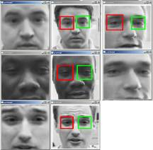
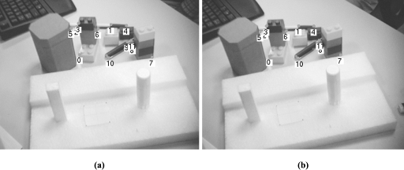
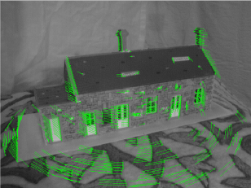
Why do we care about matching features?
Object Recognition
Wide baseline matching
Tracking/SFM

Slide 3
We want invariance!!!
Good features should be robust to all sorts of nastiness that can occur between images.

Slide 4
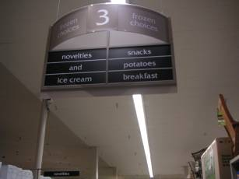
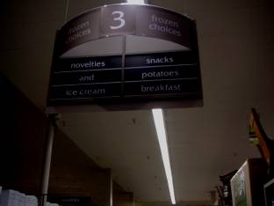
Types of invariance
Illumination

Slide 5

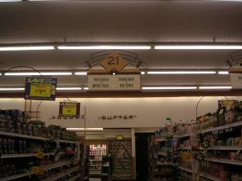
Types of invariance
Illumination
Scale

Slide 6
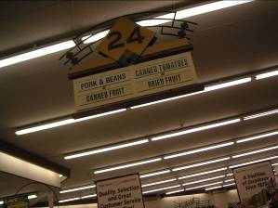
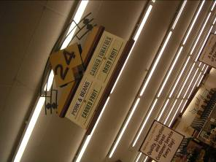
Types of invariance
Illumination
Scale
Rotation

Slide 7


Types of invariance
Illumination
Scale
Rotation
Affine

Slide 8
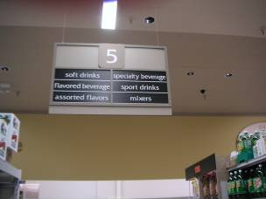
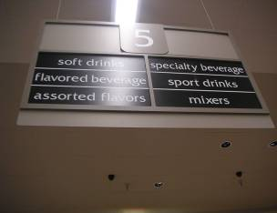
Types of invariance
Illumination
Scale
Rotation
Affine
Full Perspective

Slide 9
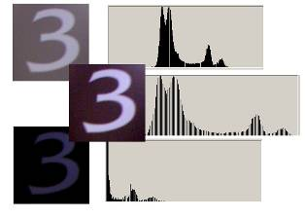
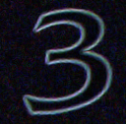
How to achieve illumination invariance
The easy way (normalized)
Difference based metrics (random tree, Haar, and sift)

Slide 10
How to achieve scale invariance
Pyramids
  Divide width and height by 2
  Take average of 4 pixels for each pixel (or Gaussian blur)
  Repeat until image is tiny
  Run filter over each size image and hope its robust
Scale Space (DOG method)

Slide 11
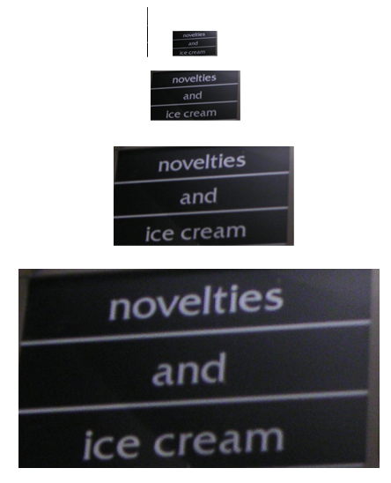
Pyramids

Slide 12
How to achieve scale invariance
Pyramids
Scale Space (DOG method)
  Pyramid but fill gaps with blurred images
  Like having a nice linear scaling without the expense
  Take features from differences of these images
  If the feature is repeatably present in between Difference of Gaussians it is Scale Invariant and we should keep it.

Slide 13
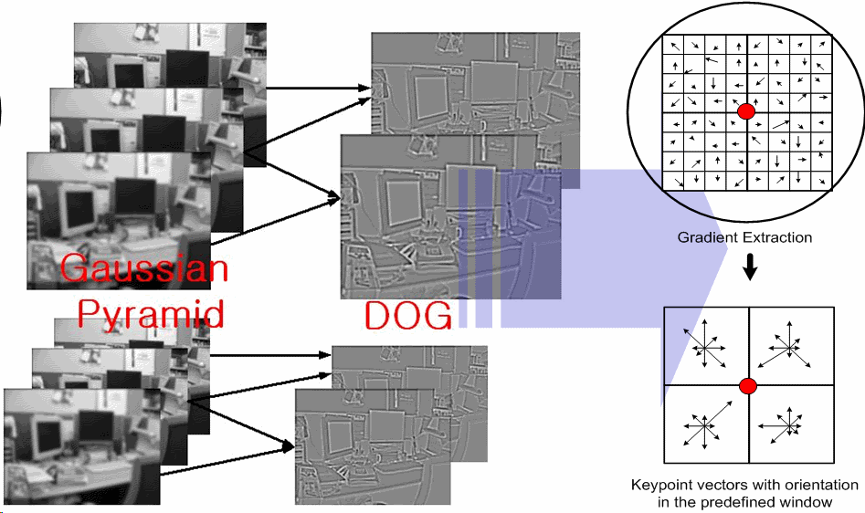
Differences Of Gaussians

Slide 14
Rotation Invariance
Rotate all features to go the same way in a determined manner
Take histogram of Gradient directions (36 in paper for 1 every 10 degrees)
Rotate to most dominant (maybe second if its good enough, sub-Bin accuracy)

Slide 15
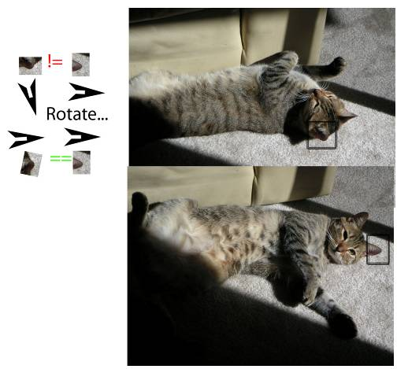
Rotation Invariance

Slide 16
Affine Invariance
Easy way: Warp your training and hope
Fancy way: design your feature itself to be robust against affine transformations (SIFT method)

Slide 17
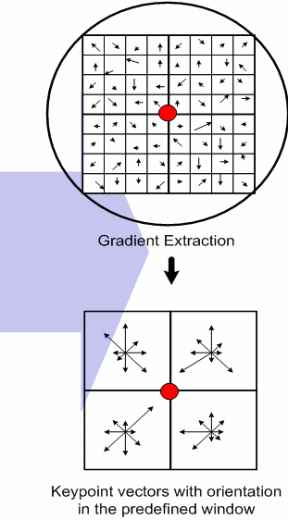
Actual SIFT features
Remember the gradient histograms we used for rotation invariance?
Same theory, except keep N² histograms (4 shown, 16 used)
Note, use weighted contributions to avoid edge nastiness

Slide 18
SIFT algorithm overview
Get tons of points from maxima+minima of DOGS
Threshold on simple contrast (low contrast is generally less reliable than high for feature points)
Threshold based on principal curvatures (technical term is linyness)

Slide 19
SIFT algorithm overview
Gradient, histogram, Rotate
Take old gradient, histogram regions using Gaussian weighting
Hand off beautiful robust feature to someone who cares (i.e. object recognizer, navigation software (SFM), or stereo matching algorithm)

Slide 20
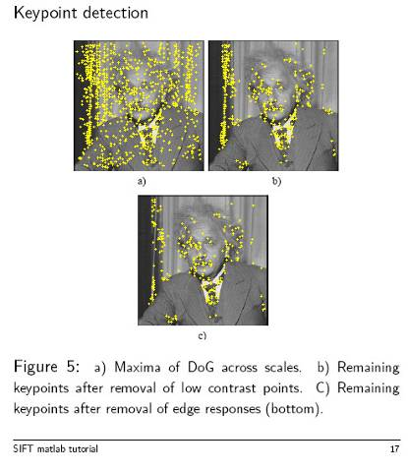
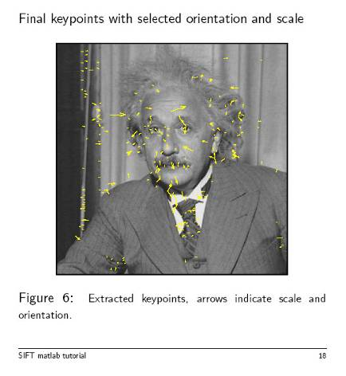
Actual SIFT stage output

Slide 21
MSER (a one minute survey)
Maximally Stable Extremal Regions
Go through thresholds, grab regions which stay nearly the same through a wide range of thresholds (connected components then bounding ellipses)
Keep those regions descriptors as features
As regions are illumination based warp ellipse to circle for affine invariance

Slide 22
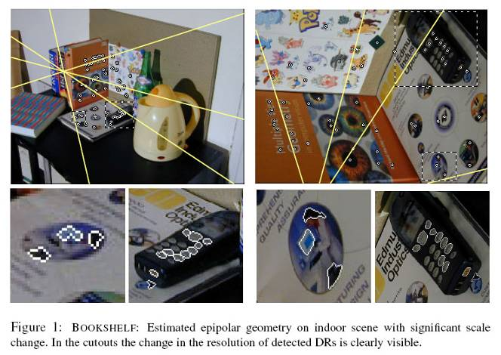
Actual MSER output

Slide 23
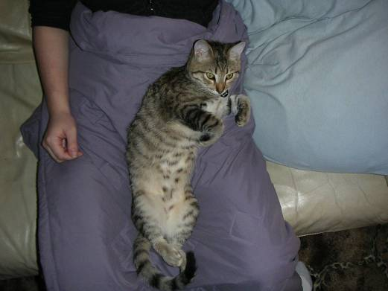
Initial image

Slide 24
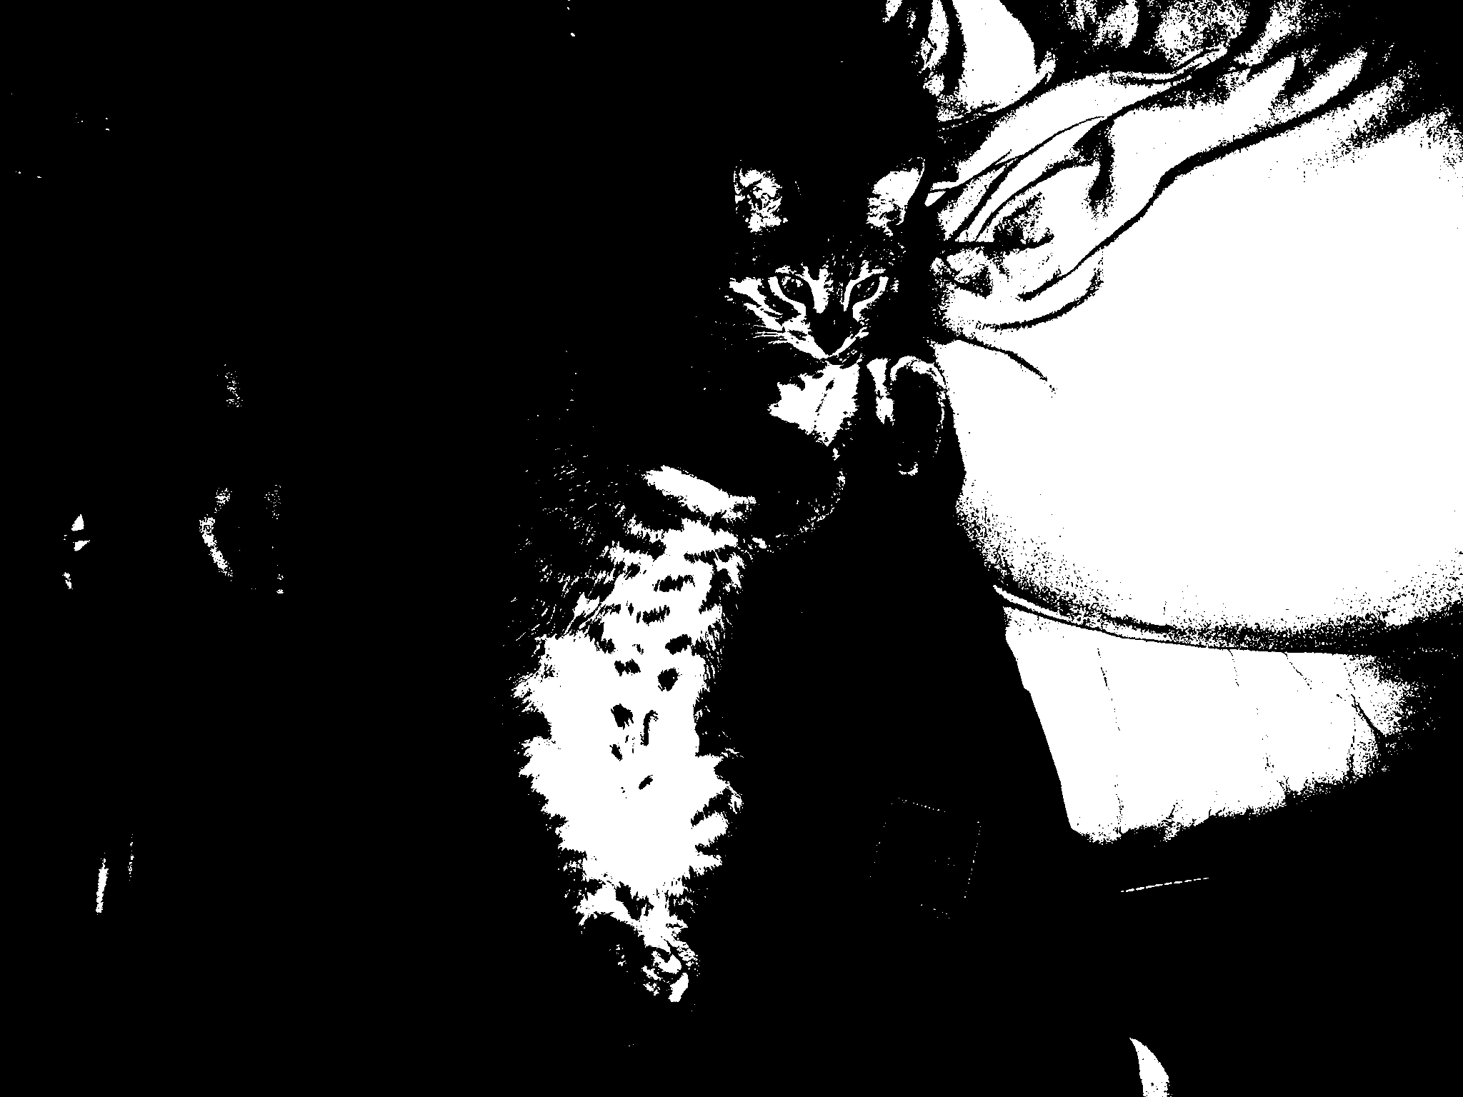
Threshold

Slide 25
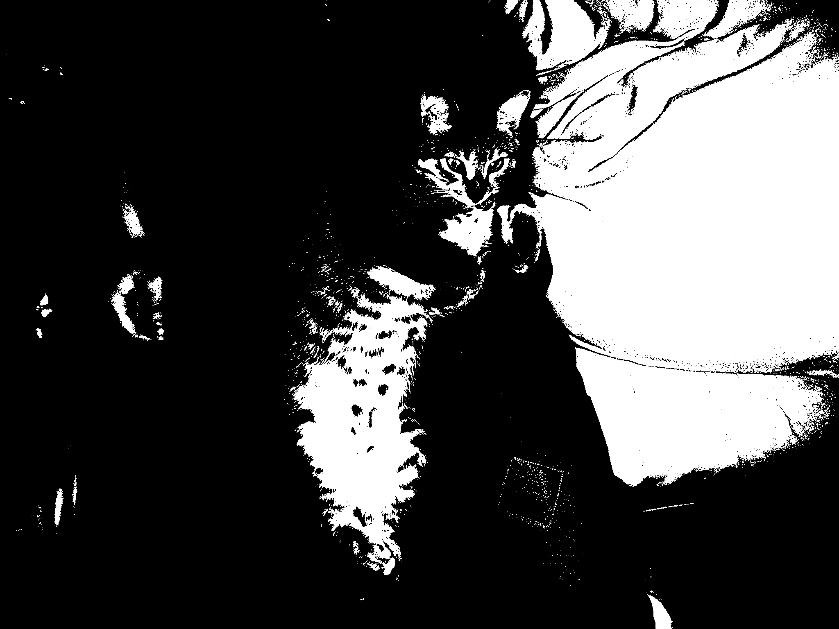
Threshold

Slide 26
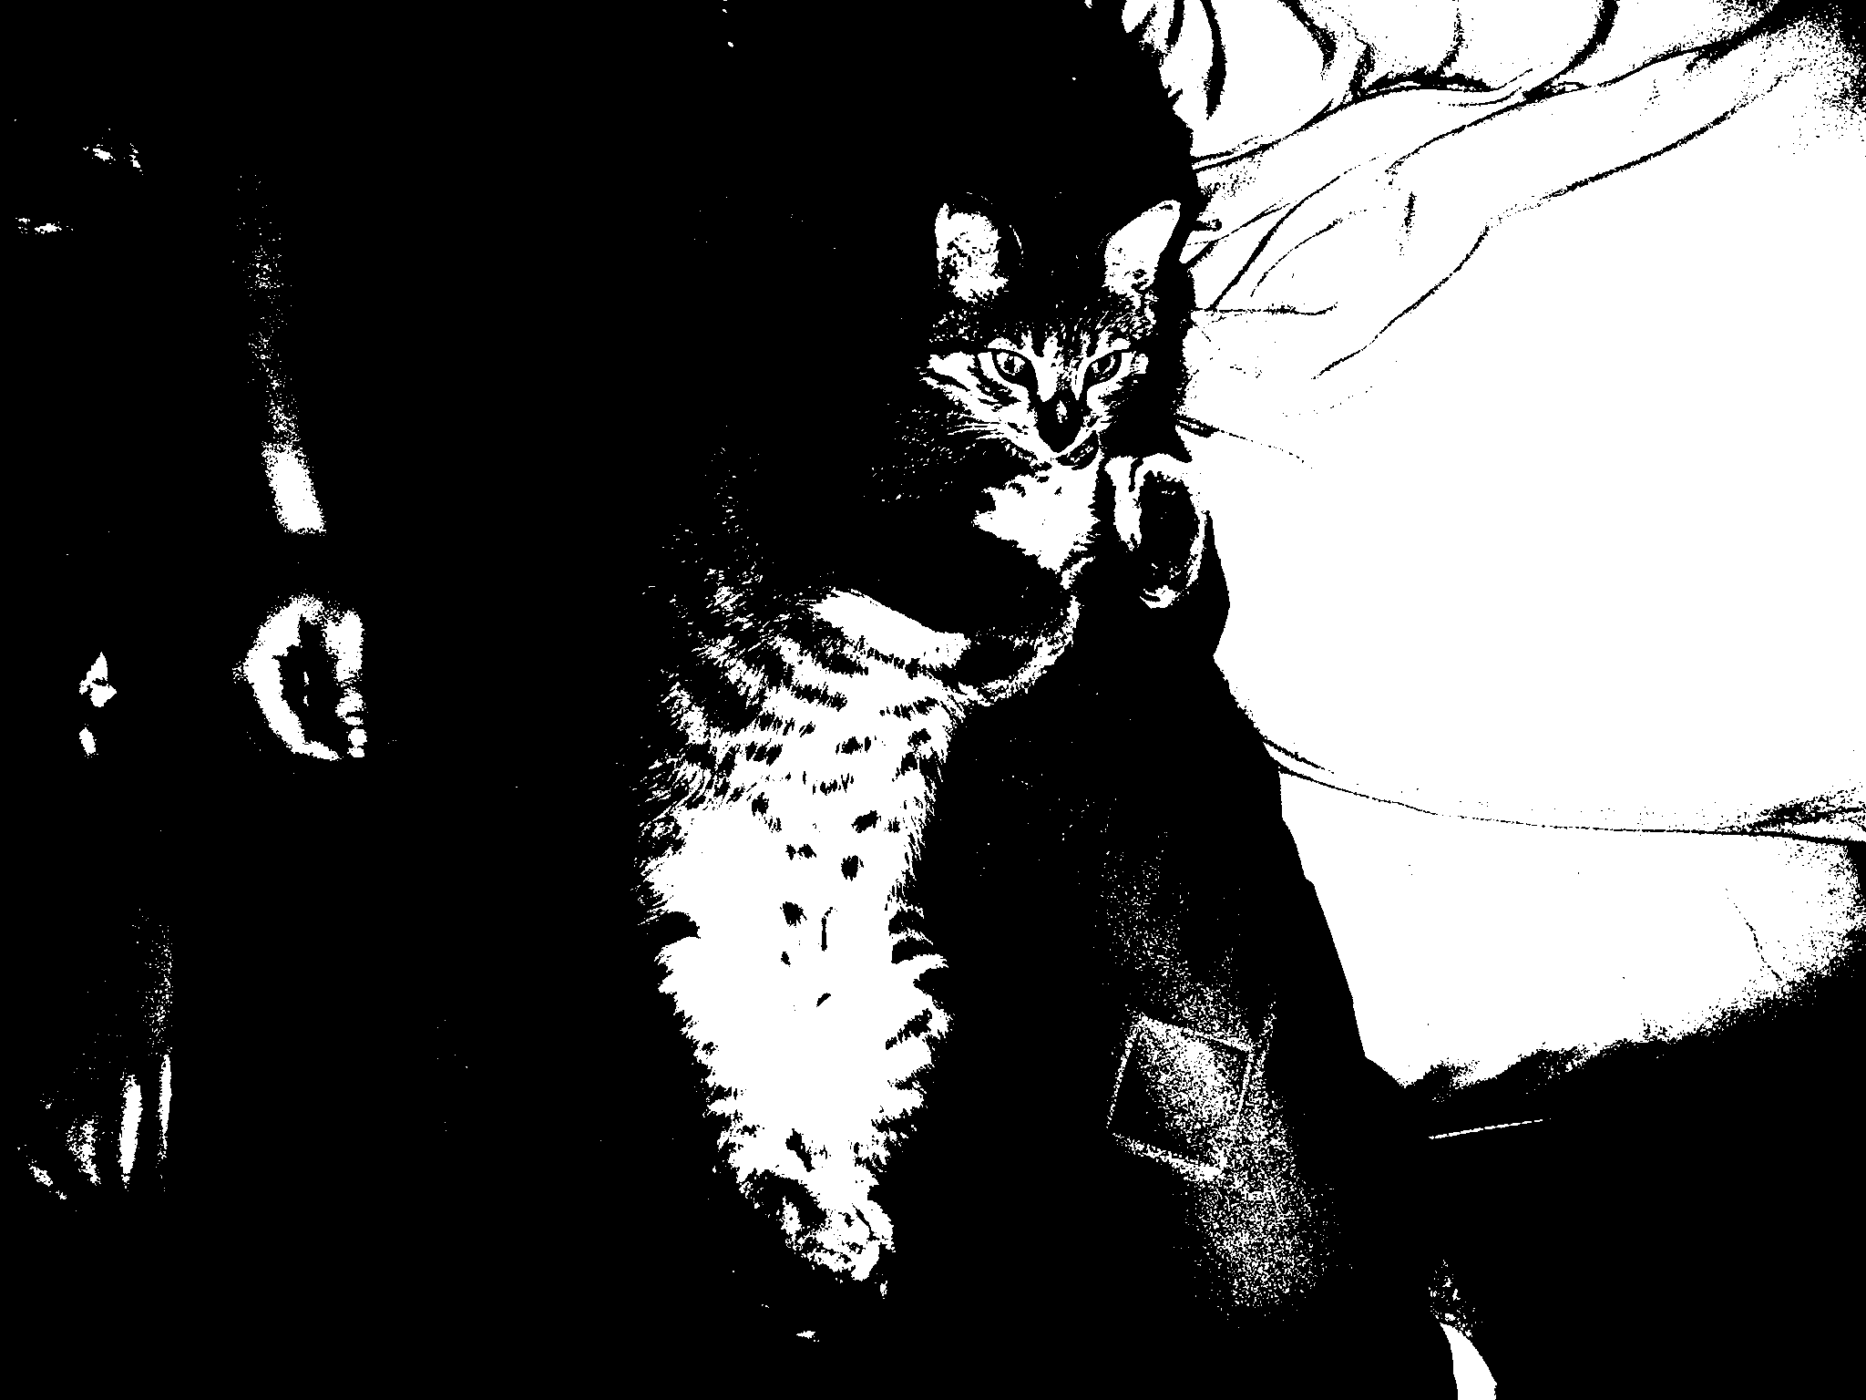
Threshold

Slide 27
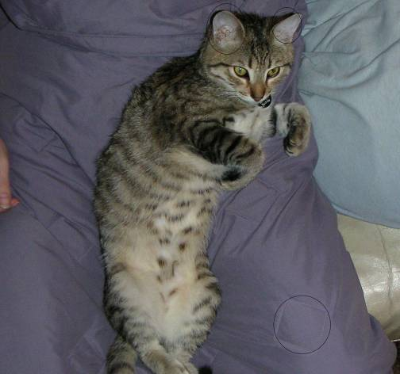
Ears and Square (note: not actual algorithm output)

Slide 28
How to use these features?
Distance could be L2 norm on histograms
Match by (nearest neighbor distance)/(2nd nearest neighbor distance) ratio
Object recognize with Hough of pose of points (ie, these three should be in line on object, gee… they are that’s the object all right)

Slide 29
But where does the magic end?
SIFT is relatively expensive (computationally) and copyrighted (the other type of expensive)
MSER doesn’t work well with images with any motion blur
Interesting alternatives:
  GLOH (Gradient Location and Orientation Histogram)
    larger initial descriptor + PCA
  SURF (Speeded Up Robust Features)
    possibly faster AND more robust?

Slide 30
Credits + References
MSER image from J. Matas, O. Chum, M. Urban, T. Pajdla “Robust Wide Baseline Stereo from Maximally Stable Extremal Regions”, BMVC, 2002
SIFT keypoint images from F. Estrada & A Jepson & D. Fleet ‘s SIFT tutorial, 2004
GLOH “A performance evaluation of local descriptors”, Krystian Mikolajczyk and Cordelia Schmid, IEEE tran. On Pattern Analysis and Machine Intelligence, pp 1615—1630, 2005
SURF “SURF: Speeded Up Robust Features”, Herbert Bay, Tinne Tuytelaars and Luc Van Gool Proceedings of the 9th European Conference on Computer Vision 2006

