Slide 1
The Role of
Swear Words in Toxicity Detection
How does the presence or absence of swear words affect the performance of toxicity detection systems?
LT2326 Machine learning for statistical NLP: Advanced
Eugene Wong
2026
Notes:
Do toxicity models actually understand human intent, or are they just hunting for swear words?
Real-world problem: Platforms ban innocent users while missing real, clean harassment.

Slide 2
Agenda
The Problem
Dataset & Lexicon
Evaluation Framework
Naïve Baselines
Classical ML vs Transformer
Future Work
Conclusion

Slide 3
Two Comments, Two Moderation Failures
1. THE PROBLEM
“You better watch your back when you walk home tonight.”
“This article is fucking amazing!”
Excitement
but
Flagged as Toxic ❌
Threat
but
Passed as Non-toxic ❌
False alarm
Blind spot
Notes:
Why do platforms still use keyword filters? Because they’re fast and cheap.
But they fail in two ways: false alarms on excitement, blind spots on threats.
The big question: Does deep learning actually fix this?

Slide 4
Dataset & Lexicon
2. DATASET & LEXICON
Toxicity Corpus
Kaggle Jigsaw Toxic Comment Classification
Human-labeled Wikipedia comments
Multi-label → Binary ground truth
(toxic, severe_toxic, obscene, threat, insult, identity_hate) → is_toxic
Removed unlabeled test data
labels value of -1
Profanity Lexicon
Sourced from noswearing.com
Whitelisted identity & anatomy
("gay", "lesbian", "queer", "anus", "penis", "testicle", "vagina", "mothafuckin\\\”)
Cleanup
Token Masking
URLs and IPs
Remove Wikipedia markup
e.g. == Section Heading ==
Collapse elongated words
e.g. sooooo → soo
Notes:
Identity and anatomy terms are legitimate words, not profanity—whitelisted so they aren't wrongly counted as swear words.
Collapsed 3+ repeated letters down to 2. English never has 3 letters in a row, and keeping 2 protects real double-letter words like good and cool.

Slide 5
2. DATASET & LEXICON
Data Overview
Dataset Key Metrics
159,571 train data
153,164 → 63,978 test data after filtering
Severe Class Imbalance
Train data
10.17% toxic comments (16,225)
Test data
9.76% toxic comments (6,243)
Notes:
160k train, 64k test.
Severe 90/10 class imbalance: only 10% is toxic.

Slide 6
3. EVALUATION FRAMEWORK
The 2x2 Sliced Evaluation Matrix (Test Data)
Without Swears
57,870 (90.45%)
With Swears
6,108 (9.55%)
Non-toxic
57,735
(90.24%)
Non-toxic without swears
54,861
(85.75%)
Non-toxic with swears
2,874
(4.49%)
51.80% of toxic comments contain swear words
(3,234 out of 6,243)
4.98% of non-toxic comments contain swear words
(2,874 out of 57,735)
Toxic without swears
3,009
(4.70%)
Toxic with swears
3,234
(5.05%)
Toxic
6,243
(9.76%)
Notes:
Sliced the test data to see the edge cases that overall averages hide.
Vertical (With Swears): 3,200 toxic vs 2,900 clean → If someone swears, it’s a 50/50 coin toss whether it's toxic or innocent (False Alarm).
Horizontal (Toxic Row): 3,200 with swears vs 3,000 without → If a comment is toxic, it’s ALSO a 50/50 coin toss whether it contains any swear words at all (Blind Spot).
Almost half of all toxicity is completely clean, and almost half of all swearing is completely innocent. Swearing ≠ toxicity.

Slide 7
3. EVALUATION FRAMEWORK
Two Metrics
ΔFPR
FPR(Non-toxic with Swears)
minus
FPR(Non-toxic without Swears)
Measures: False alarms
Intuition:
How much does casual swearing inflate false alarms?
Target: Ideal ΔFPR = 0.0%
Casual swearing should never trigger a false alarm.
ΔRecall
Recall(Toxic with Swears)
minus
Recall(Toxic without Swears)
Measures: Blind Spot
Intuition:
How much does detection drop when there are no swear words?
Target: Ideal ΔRecall = 0.0%
Identify toxic comments without swear words.
Notes:
Recall = TP / (TP + FN)
(Percentage of actual toxic comments correctly detected)
FPR = FP / (FP + TN) = = Wrongly Flagged / Total Innocent
(Percentage of innocent comments wrongly flagged as toxic)
Out of all innocent comments, what percentage did the model wrongly accuse? (The "False Alarm" rate).

Slide 8
4. NAÏVE BASELINES
Naive Baselines
Majority Baseline
Always predicts "Non-Toxic"
Results
Accuracy: 90.24%
Recall: 0%
F1: 0%
Rule-Based Lexicon Filter
Flag as “Toxic” when comment contains swear words
Results
Accuracy: 90.80%
Recall(Toxic with Swears): 100%
Recall(Toxic without Swears): 0%
Unable to identify toxic comments when there are no swear words
FPR (Non-toxic with Swears): 100%
FPR (Non-toxic without Swears): 0%
Unable to recognize non-toxic comments when there are swear words
Notes:
Majority Baseline
Why Recall = 0%: Caught zero toxic comments (TP = 0).
Why F1 = 0%: With zero toxic catches, F1 drops straight to zero.
Keyword Filter
Recall = 0% on clean text: Missed 100% of toxic threats that didn't have swear words (Total blind spot).
FPR = 100% on swearing: Falsely accused 100% of innocent users who swore casually (Total false alarm).

Slide 9
5. CLASSICAL ML VS TRANSFORMER
Results Comparison
TF-IDF + LR VS DeBERTa
F1: 57.93% VS 66.18% ✅
Recall (toxic without swear): 84.65% VS 88.60% ✅
FPR (non-toxic with swear): 65.00% VS 57.72% ✅
ΔRecall: 10.72% VS 8.21% ✅
ΔFPR: 54.61% VS 50.76% ✅
Surprisingly, both perform similarly
Even a transformer struggles to recognize non-toxic comments when they contain swear words (ΔFPR is high).
Notes:
DeBERTa still falsely flags innocent swearing 57.7% of the time.

Slide 10
5. CLASSICAL ML VS TRANSFORMER
Why Both Models Struggle with Swears
TF-IDF + LR
Feature weights + LR coefficients
fuck +22.72
fucking +19.76
stupid +18.67
shit +18.03
idiot +15.87
Swear words have too much weight. Any swear word instantly triggers toxicity
DeBERTa
Train data imbalance
78.22% of comments with swear words are toxic
This leads to the model taking the easy way out.
Notes:
TF-IDF: +22 weight makes it mathematically impossible to cancel out.
DeBERTa: 78% training skew teaches the model to use swearing as an easy shortcut.

Slide 11
5. CLASSICAL ML VS TRANSFORMER
Examples
False Alarm
“Well honestly I cant be fucking bothered tonight. So sleep wee all u editors ans admits . I'm off to bed. CU anaon”
Human label: Not toxic
Has swear words: Yes
TF-IDF + LR prediction: Toxic
99.43% chance of being toxic
DeBERTa prediction: Toxic
99.61% chance of being toxic
Blind Spot
“Nice job inserting your left-wing garbage in Jan Brewers article. I removed it and if you vandalize the article again you will be blocked from editing on Wikipedia.”
Human label: Toxic
Has swear words: No
TF-IDF + LR prediction: Non-toxic
47.32 % chance of being toxic
DeBERTa prediction: Non-toxic
8.63% chance of being toxic
Notes:
Blind Spot
DeBERTa predicts 8.63% toxic → means it is >91% confident this comment is safe!
It was completely blinded because the threat was disguised in formal, polite Wikipedia language without swear words.

Slide 12
6. FUTURE WORK
IMPROVEMENTS
Data Augmentation
Adding swear words to non-toxic comments without changing the intent and toxicity
“This is great!” → “This is fucking great!”
More non-toxic with swear words samples in the training data.
Adjusting Weights in the Loss
Adjust loss weights to account for data class imbalance
Bigger penalty for missing toxic comments without swear words.
Bigger penalty for falsely flagging non-toxic comments with swear words as toxic

Slide 13
7. CONCLUSION
Takeaways
Swear words ≠ Toxicity
PRESENCE of swear words (false alarm)
DeBERTa ΔFPR: 50.76%
False alarms on innocent comments surge by 50.76% when swear words are present
ABSENCE of swear words (blind spot)
DeBERTa ΔRecall: 8.21%
Detection of toxic comments drops by 8.21% when no swear words are present
"Effective moderation requires understanding conversational intent, not reacting to vocabulary."

Slide 14
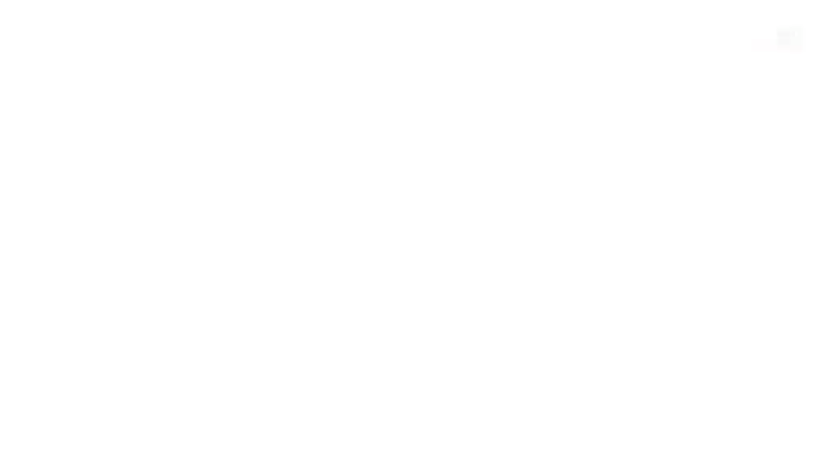
Thank you.

