Slide 1
Office Automation for HBCSE
Arshdeep Singh, ID: 2018AAPS0436H
Prince Ajmera, ID: 2018A3PS0906H
Mentors – Prof. Nagarjuna G, Mr. Surendra Patil, Ms. Adithi M.
PS Instructor: Dr. Rajib Ranjan Maiti, BITS Pilani -Hyderabad Campus

Slide 2
Acknowledgement
We are using this opportunity to express our gratitude to everyone who supported us throughout the course of the project.
We are thankful for their aspiring guidance, invaluably constructive criticism and friendly advice during the project work.
We would like to thank our Project In-Charge Prof. Nagarjuna G. who provided us all the facilities required and conductive conditions for accomplishment of this project .
We would like to thank Ms. Adithi for her constant guidance and valuable remarks.
We would also like to thank our project mentor Mr. Surendra Patil for his constant support during the project.
We would also like to thank our PS Faculty Dr. Rajib Ranjan Maiti for his support in completion of this project.

Slide 3
Abstract
Our project was aimed to collecting data from employees at HBCSE and generate reports.
All this work was previously done by hand but now it could be accomplished by the use of python scripts and a good data collecting platform.

Slide 4
Choosing the Platform for Data Collection
We first went with google forms. But we had to drop the idea of google forms due to the following reasons:
Google forms do not provide much flexibility for making forms.
Issue of data security since all the data is stored on google’s servers.
We were then suggested to use KoBoToolbox. It is free data collection platform that provides much more flexibility for making forms.

Slide 5
KoBoToolbox
KoBoToolbox is a suite of tools for field data collection. It is a free and open source software.
The forms on KoBoToolbox are based on XLSForm.
Forms can be made either by using the GUI provided by KoBo or simply can be made in XLS format and then uploaded.
However we suggest making the forms in XLS format as they align better to the scripts and are easy and quick to make.

Slide 6
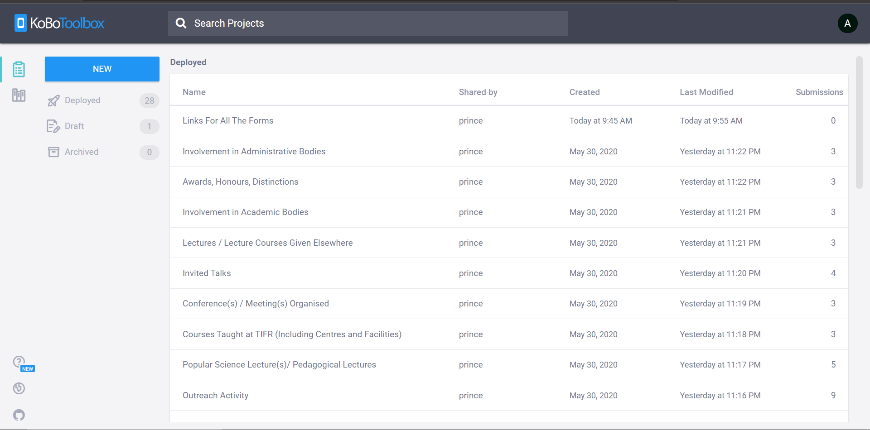
The UI for KoBoToolbox can be seen below.

Slide 7
Making Forms on KoBoToolbox using XLSForm
XLSForm is a form standard created to help simplify the authoring of forms in Excel. Authoring is done in a human readable format using a familiar tool that almost everyone knows - Excel. XLSForms provide a practical standard for sharing and collaborating on authoring forms. They are simple to get started with but allow for the authoring of complex forms by someone familiar with the syntax.
The XLSForm is then converted to an ODK XForm, a popular open form standard, that allows you to author a form with complex functionality like skip logic in a consistent way across a number of web and mobile data collection platforms.

Slide 8
Basic Format of XLSForm
Each Excel workbook usually has two worksheets: survey and choices. A third optional worksheet called settings can add additional specifications to your form.
The Syntax for XLSForm is case sensitive so the sheet names should be in lower case for the form to be properly executed.

Slide 9
The ‘survey’ Worksheet
This worksheet gives your form its overall structure and contains most of the content of the form. It contains the full list of questions and information about how they should appear in the form. Each row usually represents one question; however, there are certain other features described below that you can add to the form to improve the user experience.

Slide 10
The survey worksheet has 3 mandatory columns: type, name, and label.
The type column specifies the type of entry you are adding.
The name column specifies the unique variable name for that entry. No two entries can have the same name. Names have to start with a letter or an underscore. Names can only contain letters, digits, hyphens, underscores, and periods. Names are case-sensitive.
The label column contains the actual text you see in the form. Alternatively, label translation columns can be used.
Example of survey worksheet.
type | name | label
today | today
select_one gender | gender | Respondent's gender?
integer | age | Respondent's age?
surveychoicessettings

Slide 11
The ‘choices’ Worksheet
This worksheet is used to specify the answer choices for multiple choice questions. Each row represents an answer choice. Answer choices with the same list name are considered part of a related set of choices and will appear together for a question. This also allows a set of choices to be reused for multiple questions (for example, yes/no questions).

Slide 12
The choices worksheet has 3 mandatory columns as well: list_name, name, and label.
The list_name column lets you group together a set of related answer choices, i.e., answer choices that should appear together under a question.
The name column specifies the unique variable name for that answer choice.
The label column shows the answer choice exactly as you want it to appear on the form. Alternatively, label translation columns can be used.
Example of choices worksheet
list_name | name | label
gender | transgender | Transgender
gender | female | Female
gender | male | Male
gender | other | Other
surveychoicessettings

Slide 13
The ‘settings’ Worksheet
The settings worksheet is an optional worksheet that allows the user to define title, version, id etc. of the form. It also allows the user to change the theme of the form.

Slide 14
Question types available in XLSForm
There are many question types available for XLSForm. All the question types can be viewed on this link: Question types.
Some important question types that were used for our project are:
text – to get a text input
Integer – to get integral input
select_one [list name] - for multiple choice question with single option
date – to get input of date

Slide 15
Some Important Functionalities of XLSForm
There are several important functionalities of the XLSForm that were used for the project. We will go through them briefly one by one.
The whole documentation for XLSForm can be viewed at http://www.xlsform.org.
These functionalities are:
Hints
Constraints
Relevant
Required
Grouping Questions
Repeats

Slide 16
Creating Multiple Choice Questions
XLSForm supports both select_one (select only one answer) and select_multiple (select multiple answers) questions. Writing a multiple choice question requires adding a choices worksheet to your Excel workbook. Here is an example of a select_one question:
type | name | label
select_one yes_no | likes_pizza | Do you like pizza?
surveychoicessettings
list name | name | label
yes_no | yes | Yes
yes_no | no | No
surveychoicessettings

Slide 17
Hints
Sometimes you want to add a small hint to a question on your form, instructing the user how to answer the question, but you don't want the hint to be part of the question itself. It’s easy to add hints to questions in XLSForms. Simply add a hint column and add your hint message. See below for an example.
type | name | label | hint
text | name | What is the name of this store? | Look on the signboard if the store has a signboard.
geopoint | geopoint | Collect the GPS coordinates of this store.
surveychoicessettings

Slide 18
There are other types of hints also. They are called ‘guidance hints’. They do not appear in the form normally. They are visible only in special views.
They can be used for a form simply by adding a column ‘guidance_hint’.
type | name | label | guidance_hint | relevant
integer | age | Age?
text | name | Name? | This will only be shown for age > 18. | ${age} > 18
surveychoicessettings

Slide 19
Constraints
One way to ensure data quality is to add constraints to the data fields in your form. For example, when asking for a person's age, you want to avoid impossible answers, like -22 or 200. Adding data constraints in your form is easy to do. You simply add a new column, called constraint, and type in the formula specifying the limits on the answer. In the example below, the answer for the person's age must be less than or equal to 150.
A constraint message can also be added by including ‘constraint_message’ column in the survey worksheet.
type | name | label | constraint
integer | age | How old are you? | . <= 150
surveychoicessettings

Slide 20
Relevant
One great feature of XLSForm is the ability to skip a question or make an additional question appear based on the response to a previous question. Below is an example of how to do this by adding a relevant column for a select_one question
The favourite toppings field will only be displayed if the question ‘Do you like pizza?’ is opted as yes.
type | name | label | relevant
select_one yes_no | likes_pizza | Do you like pizza?
select_multiple pizza_toppings or_other | favorite_topping | Favorite toppings | ${likes_pizza} = 'yes'
surveychoicessettings

Slide 21
Required
It's simple to mark certain questions as required in your form. Marking them as required means the user will not be able to move on to the next question or submit the form without entering an answer for that question.
To make questions required, add a required column to your survey worksheet. Under that column, mark questions as required by writing yes. See the example below:
A message can also be displayed if a required question is not answered. It can be done by including ‘required_message’ column in survey worksheet
type | name | label | constraint | required
integer | age | How old are you? | . <= 150 | yes
surveychoicessettings

Slide 22
Grouping Questions
To create a group of questions in your form try the following:
This is a good way to group related questions for data export and analysis. Notice how end group doesn't require a name or label, because it is hidden in the form.
type | name | label
begin group | respondent | Respondent
text | name | Enter the respondent’s name
text | position | Enter the respondent’s position within the school.
end group
surveychoicessettings

Slide 23
Grouping Questions continued…
Groups can also be nested. This can be done by writing another ‘begin group’ tag within a group. Note that ‘end group’ closes the recent group created.
A particular can be skipped or made to appear under special conditions by using ‘relevant’ column.

Slide 24
Repeats
A user can repeat questions by using the begin repeat and end repeat construct:
type | name | label
begin repeat | child_repeat
text | name | Child's name
decimal | birthweight | Child's birthweight
select_one male_female | sex | Child's sex
end repeat
surveychoicessettings
list name | name | label
male_female | male | Male
male_female | female | Female
surveychoicessettings

Slide 25
Repeats continued…
In this example, the name, birthweight, and sex fields are grouped together in a repeat, and the user can collect the same information about multiple children by selecting the option in the form to add another repeat.
The label column is optional for begin repeat. Assigning a label to a repeat will add the label as a title to the block of repeat questions in the form.
It is always a good practice to group questions inside a repeat block by using ‘begin group’ and ‘end group’ construct inside a repeat construct.

Slide 26
The user can also assign fixed repeat counts for a particular repeat construct by adding ‘repeat_count’ column and specifying number of repeats.
Also repeat block can be skipped or made to appear under specific conditions by using ‘relevant’ column.
type | name | label | relevant
select_one yes_no | has_child | Do any children live here?
begin repeat | child_repeat |  | ${has_child} = 'yes'
text | name | Child's name
decimal | birthweight | Child's birthweight
end repeat
surveychoicessettings
list_name | name | label
yes_no | yes | Yes
yes_no | no | No
surveychoicessettings

Slide 27
Example of ‘Workshops’ Form
In workshops form, each category selected maps to a different set of questions. We will briefly explain the implementation of this form using XLSForm and also will clear some points to remember while making new forms.

Slide 28
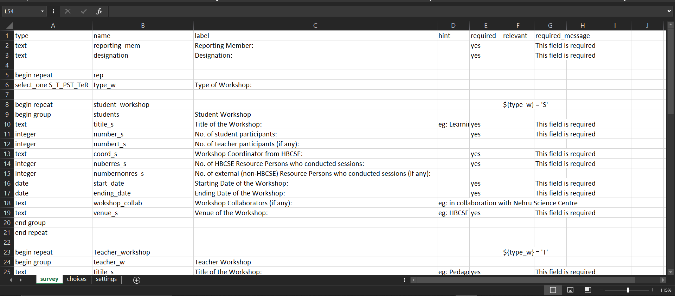
Here, the fields ‘Reporting Member’ an ‘Designation’ are written for the non-repeating part.
Then a multiple choice question asks for the category of workshop.
Also, note that the ‘begin repeat’ construct only appears if a particular category is selected. This is implemented using the relevant column of survey sheet.
It is always a good practice to include questions within a repeat construct to be within a group.
Also, take a look at the name table of repeat constructs. The name that is written for the repeat constructs in the name column, it appears as the ‘sheet name’ in the exported data for this form .So, for correct implementation of the script, it is advisable to type the name column similar to the label column

Slide 29
The forms we made
All the forms were implemented in a similar fashion.
Some forms had single set of repeating questions and some had none.
Now we will move to the script part of the project.

Slide 30
Script for Report Automation
The process by which the script generates the report is as follows:
First, the data is downloaded off from KoBoToolbox
Then a template file is created which contains all the column headers for all the different forms. That file can be edited for changing the order of columns or even deleting some columns. Also a tabular or a list format can be specified for a particular form in that file itself.
Then the report is generated in Markdown format following the template provided in the template. The report can be visualised in any markdown editor.
So, we made 3 different scripts for fulfilling the mentioned purposes.
Download_excel.py – for downloading data from KoBoToolbox.
Headers.py – for generating the template file.
Report.py – For generating the final report.
First we will explain the working of these 3 scripts in brief then we will demonstrate the working of these scripts.

Slide 31
Download_excel.py
This script features sample code/snippets to pull or push data using the new KoboToolBox API.
Data is first exported and the URL containing the latest excel file is generated.
All these URLs are then used to download all the excel files in the Excel Folder.

Slide 32
Headers.py
We have currently three different kinds of forms:
Forms with no repeating set of questions.
Forms with a single set of repeating questions.
Forms with multiple sets of repeating.
Headers.py works in different ways for these 3 different types of forms:
For forms with no repeating parts, data is present in only one excel sheet so it straightaway extracts the relevant columns from the spreadsheet.
For forms with single set of repeating questions, The questions under ‘repeat’ construct are present in a different sheet so the sheets are to be merged on the basis of the column containing unique id for each submission, which is ‘_uuid’, and then the column headers are extracted.
For forms with multiple sets of repeating questions, data for each repeating set is present in a separate sheet so the sheets are to be merged sequentially. By doing this we extract columns for each separate category separately and reports for each category is generated separately.

Slide 33
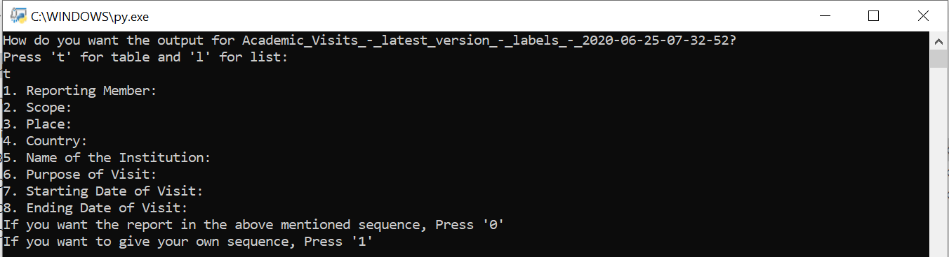
Headers.py continued…
When the script is run, it asks whether the report is to be generated in Table form or in List form which has to be entered by the user.
Also, templates for the forms are shown which can be changed by the user.
Preview:

Slide 34
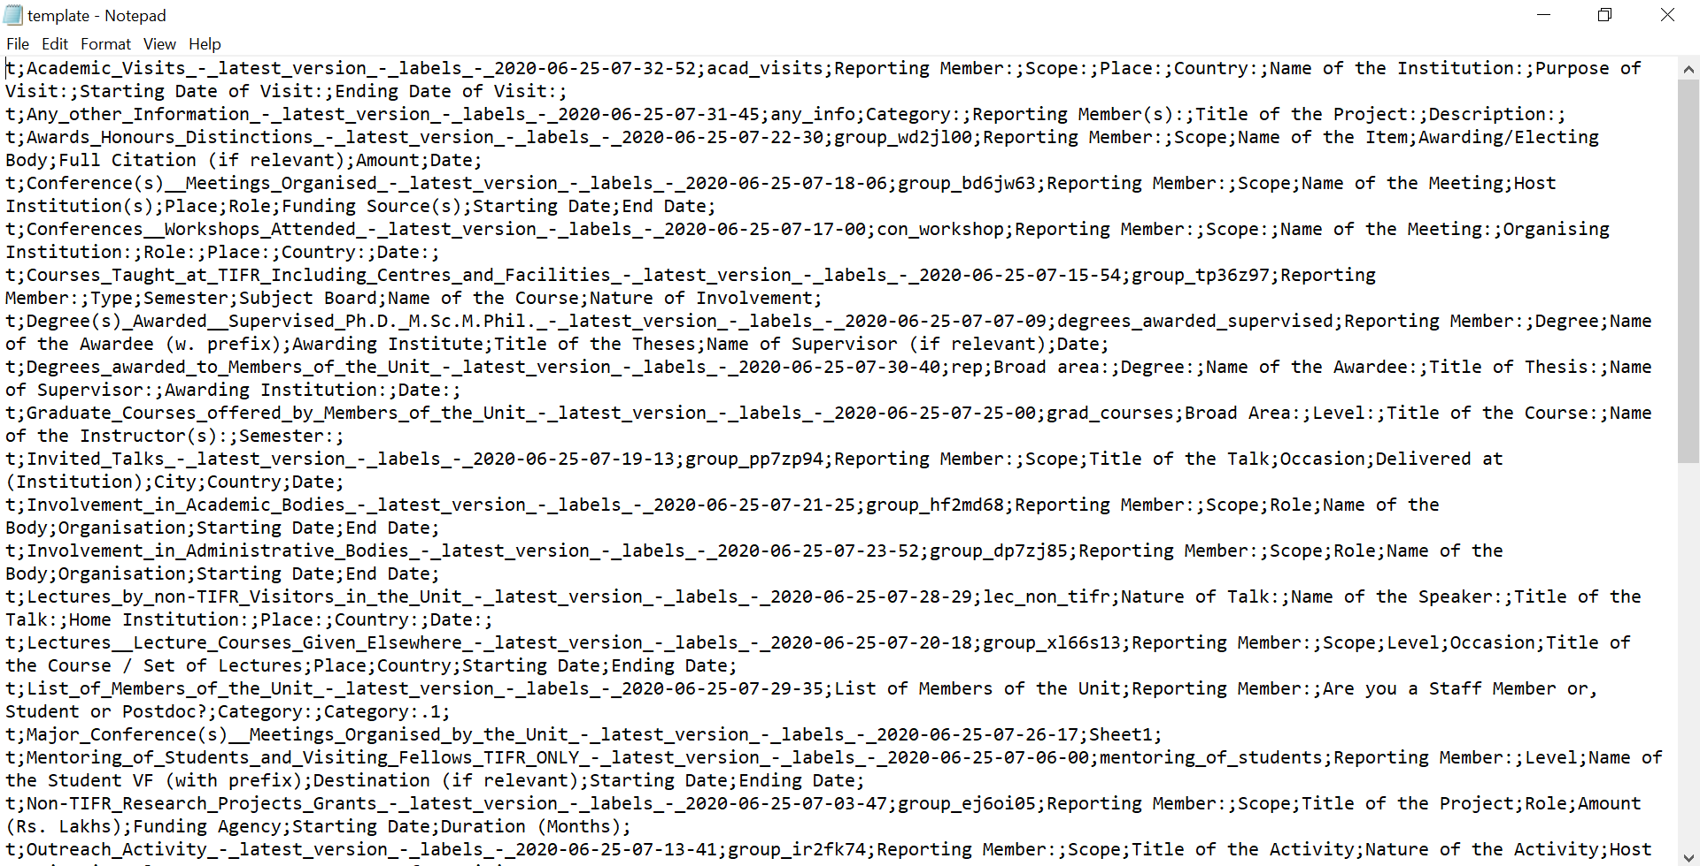
Example of template file
The template is generated in a text file called template.txt

Slide 35
Report.py
Report.py simply reads the template file for the sequence of the column headers and extracts the data accordingly.
It also sorts the data in descending order of ‘Date’ or ‘Year’ column, if any, in the form.

Slide 36

Sample Report Generated by our Script

Slide 37
Everything as a Git-Hub Repository
As suggested by our mentors, we have uploaded all the work on GitHub:
https://github.com/Ar5h71/XLS_to_MARKDOWN_REPORT

Slide 38
Concluding Remarks:
By the constant support and guidance by the mentors and our PS faculty, we have successfully completed the project.
We were successfully able to generate reports in the desired fashion with very less editing required from the user end.
We hope that this project will be carried forward and will help the people at HBCSE in a constructive way.

Slide 39
THANK YOU

