Slide 1
ThinQ
Presented By:
Himanshu Pandey
Prarabdh Garg
Unmesh Roy

Slide 2
Today’s Presentation
The Problem
A brief description of the framework
Overview of Concepts Used
Features of the Framework
Using the Framework to build applications
Challenges faced
Scope of Improvement

Slide 3

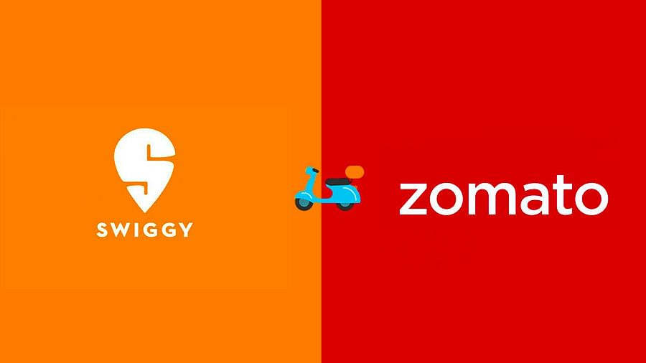

The Problem
Sectors moving towards aggregation
Leads to existence of centralized middlemen
Middlemen do nothing more than gather data from both parties and act as a bridge
Often leads to monopoly of middlemen, due to the existence of a very few of them, and because of the data they have collected
Puts a huge risk to the data privacy of the users
Higher prices for Consumers, Lower profits for Service Providers

Slide 4
Brief Description of the framework
A decentralized framework that connects consumers directly to service providers
Centralization is prevented by using a distributed file system
Data privacy is protected by ensuring data does not leave your device
Real-time communication between peers is done through Pub/Sub
Everything is treated as a file, inspired by the design of Linux
Data is stored in a Graph based format
Prioritization of requests based on behaviour on the IPFS network
Prevents monopoly by ensuring no central party in the transaction

Slide 5



Blockchain
IPFS
Overview of Concepts Used
Pub/Sub
GDF – Graph Data
Digest Format

Slide 6

IPFS
IPFS is a distributed file system
IPFS forms the backbone of our framework
It uses content hashing to store and identify files
Also uses the concept of Distributed Hash Tables to ensure the fact that any file can be accessed only through its hash
It uses a DAG to represent files, and incentivised block exchange to transfer files between users
Notes:
Do you want the IPFS hash or should it be removed?

Slide 7

GDF
UID | Subject | Subject_Qualifier | Predicate | Predicate_Qualifier | Object | Object_Qualifier
GDF is a Graph based data digest format which can be used to represent any form of data
GDF is based on the graph data model which represents every relation using three entities - subject, predicate and object.
It is a seven column fixed format, which makes it easy to store
The project uses GDF to store and transfer messages at all points
Notes:
Do you want the IPFS hash or should it be removed?

Slide 8
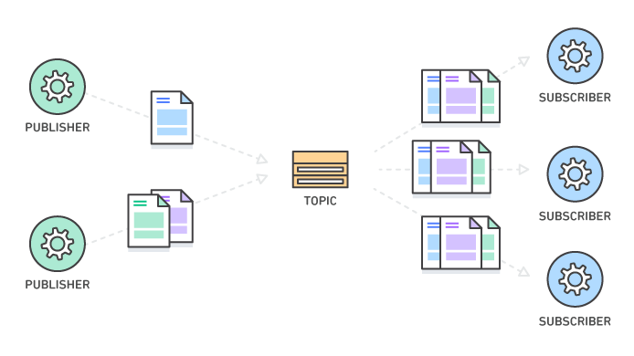
Pub/Sub
Pub/Sub, shorthand for publish/subscribe messaging
Asynchronous messaging service
Decouples services that produce events from services that process events.
publisher creates and sends messages to the topic.
Subscribers then create a subscription to a topic to receive messages from it.
Transfer of messages may be one-many/many-one/many-many fashion.
Notes:
Do you want the IPFS hash or should it be removed?

Slide 9
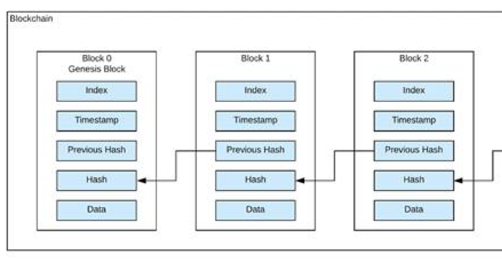
Blockchain
Used to store an immutable ledger in distributed systems
Necessary as we may require to store some internal information about users
Can be used to store ratings and Trust points (Discussed later) in a secure way
Can also be used to maintain a record of all the transactions that took place in a distributed manner
Notes:
Do you want the IPFS hash or should it be removed?

Slide 10
Features of the Framework

Slide 11


Address Book
Every user has a unique IPFS id
The id is hard to remember, so a mapping is made
Similar to the list of contacts in your phone
Helps establish initial trust between users
Helps peers discover each other on the network
Since IPFS id is just a long piece of text, it can be shared in multiple ways
QmUqUDPRH2UkdcdraMBXymqmBuXEZqa5dteqCMhvXpphu5
Notes:
Do you want the IPFS hash or should it be removed?

Slide 12

Real-Time Chatting
Text messages exchanged between users in real-time
Messages are converted to files in the IPFS file system
Hash of file is shared
Prevents data duplication
Pub/Sub mechanism used
Peers who are not online at the time of sending the message are delivered the message as soon as they come online

Slide 13

File Book and File Sharing
Upload and store files on the IPFS file system
These files can later be shared with other users on the network
While sharing files, only the hash of the files are shared
Same version of the file is viewed by everyone
The file never leaves your system
Option to pin the file, so that it is available even if you are offline

Slide 14

Service Requests
Similar to messages, with the difference being that they are computer generated
Meta-data can be added to requests, based on the application being developed
Services need to be closed, in order to ensure that transactions are completed
Closing of services is a three way procedure, to ensure both parties have an equal say
Ratings are given while closing requests, which help in prioritizing requests

Slide 15
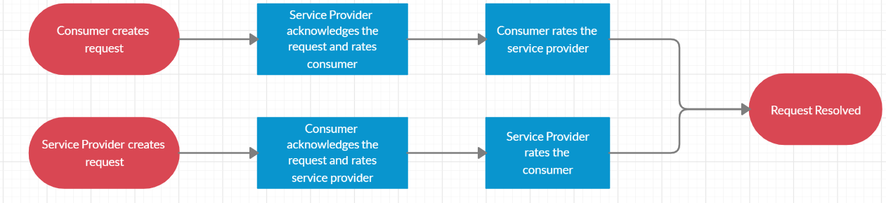
Process of closing requests

Slide 16

Ratings
Users rate each other after transactions on a scale of 1 to 5
Ratings help us prioritize requests of consumers
Also helps consumers select from multiple Service providers
Prevents nodes from behaving maliciously on the network by providing incentives
Currently stored in the IPFS file system of the user itself. Improvement suggested later

Slide 17

Request Prioritization
Service Providers generally have limited capacity
Introduced a concept of Social Trust Points (STP)
Currently STP is solely determined by a users rating
STP as well as timestamp are taken into account for deciding propriety
Timestamps are necessary to prevent starvation

Slide 18
Example of how prioritization works
New Request with rating 3
3
New Request with rating 1
3 | 1
Initial Queue
New Request with rating 5
Multiple Requests all with rating > 1
Request solved
5 | 5 | 2 | 1
3 | 1
5 | 3 | 1
Promotion of the oldest request
1 | 5 | 5 | 2

Slide 19

Encryption
Messages are passed through Pub/Sub mechanism, hence encryption is necessary
Since underlying medium is an untrusted one, asymmetric key cryptography was chosen
GPG encryption, using RSA keys is used
Currently only messages are being encrypted, but multiple layers of encryption can be implemented in the future

Slide 20
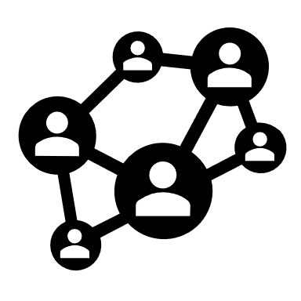
Example of how Encryption works
Encrypt
Decrypt
File Hash
Encrypted Hash
File Hash
IPFS Network
IPFS
Receiver's Public Key
Receiver’s Private Key
Message
Message
RSA Algorithm

Slide 21

Building apps with the framework
Demonstration of ThinQ App

Slide 22

Challenges Faced
IPFS is a framework currently under development and new versions are released frequently. Also no proper documentation is available
We had a lot of problems in setting up the node environment to run the app on different systems
Converting into an npm package was a bit challenging as we had to decide what all functions we should expose, and what all flexibility should be given to the developer

Slide 23
Scope of Improvement
The ratings that are currently stored with the user can be stored in a Blockchain to improve security
A method of improving the current STP system, based on the need of the application, so that the value of incentives can vary based on the use case
Implementation of various layers of encryption that can be chosen by the developer at the time of designing apps based on their requirements
Design and implement a model to capture the underlying social relationships between users, and make trust calculation a bit more indirect

Slide 24
Individual Contributions
Himanshu Pandey
Address Book Handler functions (Chat app)
Routers (Chat app)
File Sharing (Chat app)
File book (Chat app)
Service Request Closing System (ThinQ)
Rating System (ThinQ)
Prarabdh Garg
IPFS node setup (Chat App)
SQLite3 local database setup (Chat App)
FIFO Queue Management (Chat App)
Social Trust Points (ThinQ)
Prioritizing Service Requests (ThinQ)
Encryption (ThinQ and Chat app)

Slide 25
Unmesh Roy
GDF encoding functions (Chat App and ThinQ)
Web Sockets (Chat App)
IPFS and Database setup (ThinQ)
User Interface (ThinQ)
Updating Information and bio (ThinQ)
Sending and Receiving Requests (ThinQ)

Slide 26

Important Links
Framework Repository (https://github.com/PrarabdhGarg/thinq_lib)
Example Apps Repository (https://github.com/RUnmesh/ThinQ-Examples)
Chat Application Repository (https://github.com/PrarabdhGarg/ThinQ/tree/trial )

Slide 27


Thank You

