Slide 1
Project: HTTP JSON API Node.js Time Server
Master Of Science
Presented by MANICKAM RAVISEKAR ,
Master of Science in Computer Science,
19599 , Spring 2022
Guidance from Dr., Professor Henry Chang
TA : Zizhuo Huang
SAN FRANCISCO BAY UNIVERSITY
47671 WestingHouse Dr., Fremont, CA 94539

Slide 2
ACKNOWLEDGEMENT
One of our Master’s Degree Project for HTTP JSON using JavaScript for the time server was an Interesting, made me to learn new things, it is useful in designing web programming.
For deploying this project , I would like to thank Dr. Henry Chang and Zizhuo Huang.
Also, for all I would like to always pray to Almighty for giving us wisdom and power to understand things.

Slide 3
ABSTRACT
The main lesson about this assignment is to study JavaScript programming and deploy using HTTP JSON protocol.

Slide 4
Contents
1. Acknowledgments
2. Abstract
3. JavaScript Installation Details
4. JavaScript Program
5. Project : HTTP JSON API NODE.JS Time Server
6. Time Server running on ubuntu server
7. Request Output
8. Conclusion
9. Reference

Slide 5
JavaScript Installation on Ubuntu
HTTP JSON API Server have the following pre-requisites
Install Node.js on Ubuntu
Time Server Program
Set up Ubuntu
How to Check your Ubuntu Version
$ lsb_release -a
Enable the Node Source repository by running the following curl
$ curl -sL https://deb.nodesource.com/setup_10.x | sudo -E bash -
Install Node.js and npm
$ sudo apt install nodejs
Verify that the Node.js and npm were successfully
$ node --version
$ npm --version

Slide 6
JavaScript time_server.js
// HTTP serves JSON data when it gets request for current time
// receives a GET request to the path '/api/currenttme'.
// sends response as // {"year":2021,"month":09,"date":24,"hour":16,"minute":09}
var http = require('http')
var url = require('url')
// -Expect the request to contain a query the value // For example : /api/currenttme?
// The JSON response : {"year":2021,"month":09,"date":24,"hour":16,"minute":09}"
function currenttme () {
var d = new Date()
return "{Year:" + d.getFullYear() + " " + "Month : " + (d.getMonth() + 1) + " " + "Day :" + " " + d.getDate() +
" " + "Hours : " + d.getHours() + " " + "Minutes : " + d.getMinutes() + "}"
}
var server = http.createServer(function (req, res) {
// req.url = /api/currenttme?
var parsedUrl = url.parse(req.url, true)
// time = 2013-08-10T12:10:15.474Z
var result
// match req.url with the string /api/currenttme
if (/^\/api\/currenttme/)
// e.g., of time "2013-08-10T12:10:15.474Z"
result = currenttme()
if (result) {
res.writeHead(200, { 'Content-Type': 'application/json' })
res.end(JSON.stringify(result))
} else {
res.writeHead(404)
res.end()
}
}) server.listen(Number(process.argv[2]))

Slide 7
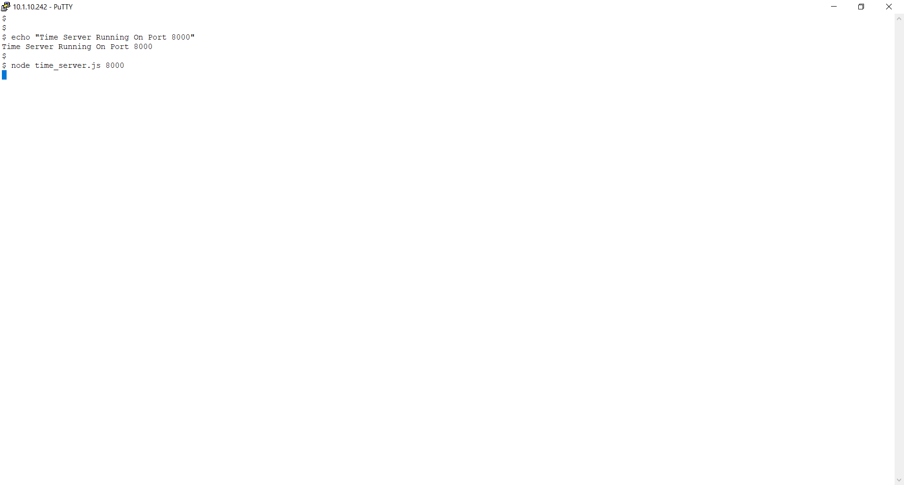
Java script time_server.js running on port 8000 of ubuntu server

Slide 8
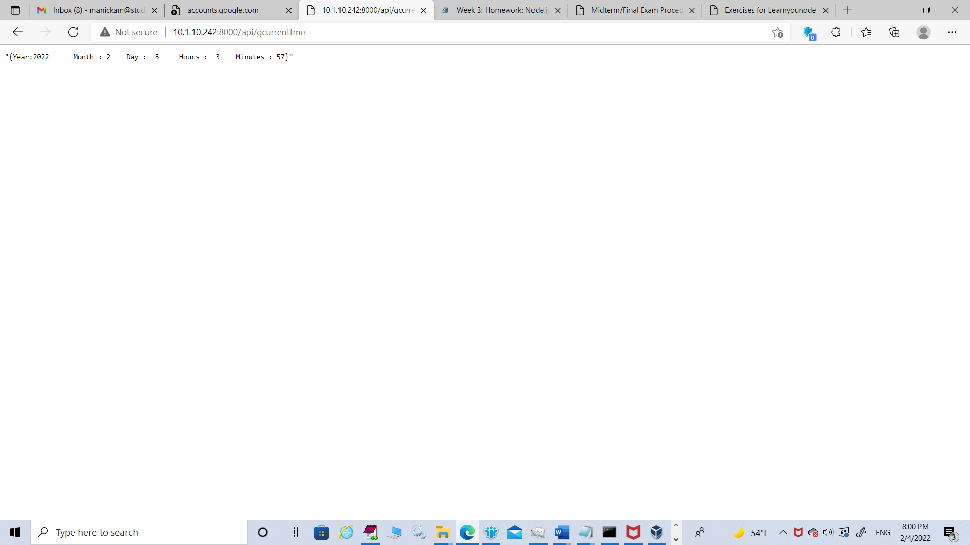
Output of http://10.1.10.242/api/currenttme

Slide 9
Conclusion
Application usage of time server script:
It can be used as plugin in many applications to get currentime.
Also web application server time can be accessed and customized.

Slide 10
Reference
SFBU Course Material

