Slide 1
SOLUTION INTRODUCTION · EI-ADS
AI-Enabled Employment Insurance Fraud Detection
Real-time AI fraud detection across Employment Insurance, Old Age Security and Canada Pension Plan benefits.
Challenge
AI-Enabled Employment Insurance Fraud Detection
Solicitation
EI-ADS
Classification
Protected B
HustleBench Advisory Services Inc. · EI-ADS

Slide 2
HOW THIS SESSION RUNS
Four movements, and the last one is a conversation
01
Orient
What problem this solves, the detection architecture, and the Requirements & Design grounding.
02
Walk the architecture
Intake to Kafka to Orchestrator to Six Engines to Ensemble Scorer to Investigator Dashboard; Requirements and Design are authoritative.
03
Watch it run
Live full-stack demo and static HTML demos; nothing is faked.
04
Agree what we need
Validation scenarios, readiness and next steps for the client's existing systems.

Slide 3
THE SITUATION
Three constraints that compound
Manual / legacy claim handling
Fragmented detection capability
Degraded data and sources
Claims today flow through manual and legacy review workflows rather than an AI detection pipeline.
Six engines, adapters and a scorer must be wired deliberately into one orchestrated pipeline.
External data sources can be unavailable; engines degrade honestly rather than fabricate confidence.

Slide 4
THE PROPOSITION
Detect. Explain. Decide.
Real-time AI fraud detection across EI, OAS and CPP — six parallel engines, ensemble scoring, SHAP explainability and bilingual output.
HustleBench Advisory Services Inc. · EI-ADS

Slide 5
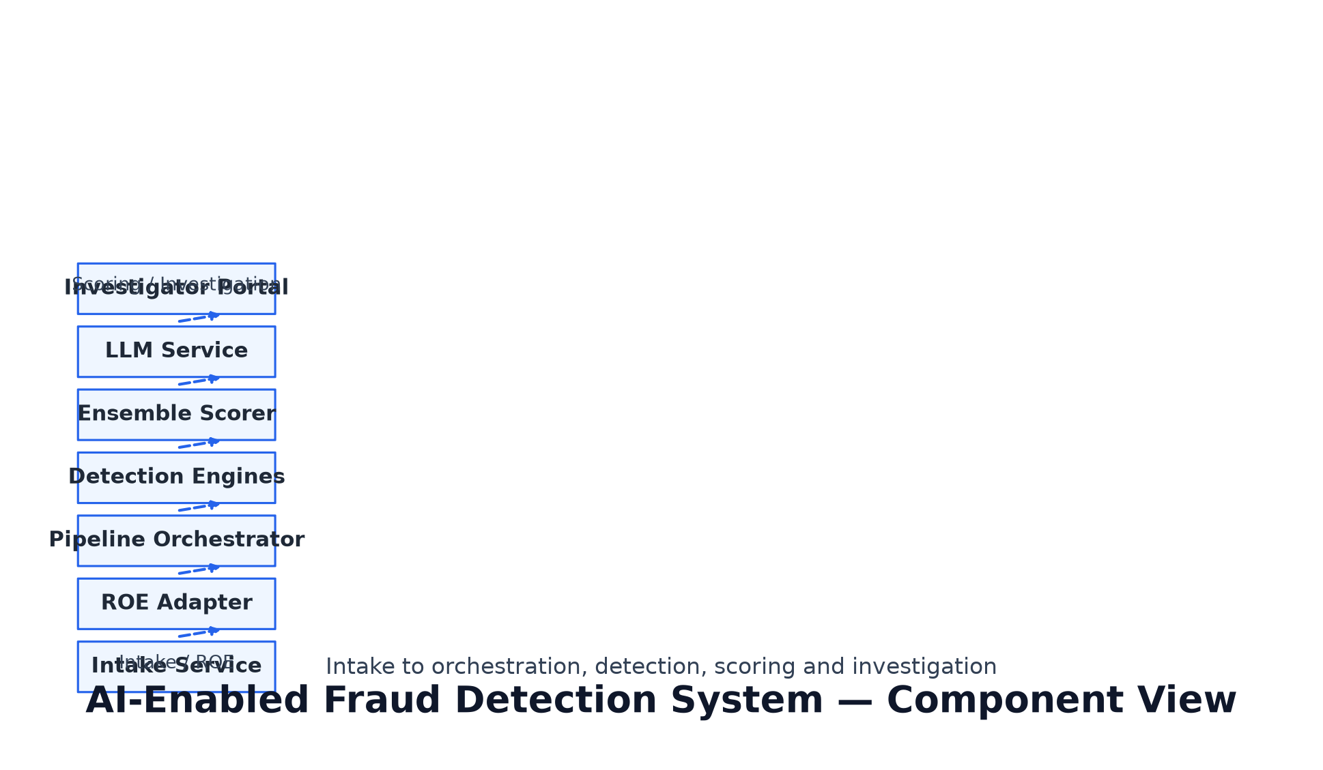
VIEW 01 — THE ARCHITECTURE
Intake to Kafka to Orchestrator to Six Engines to Ensemble Scorer to Investigator Dashboard
A claim flows from claimant intake and ROE ingestion through the detection pipeline into scored outcomes for investigator review.

Slide 6
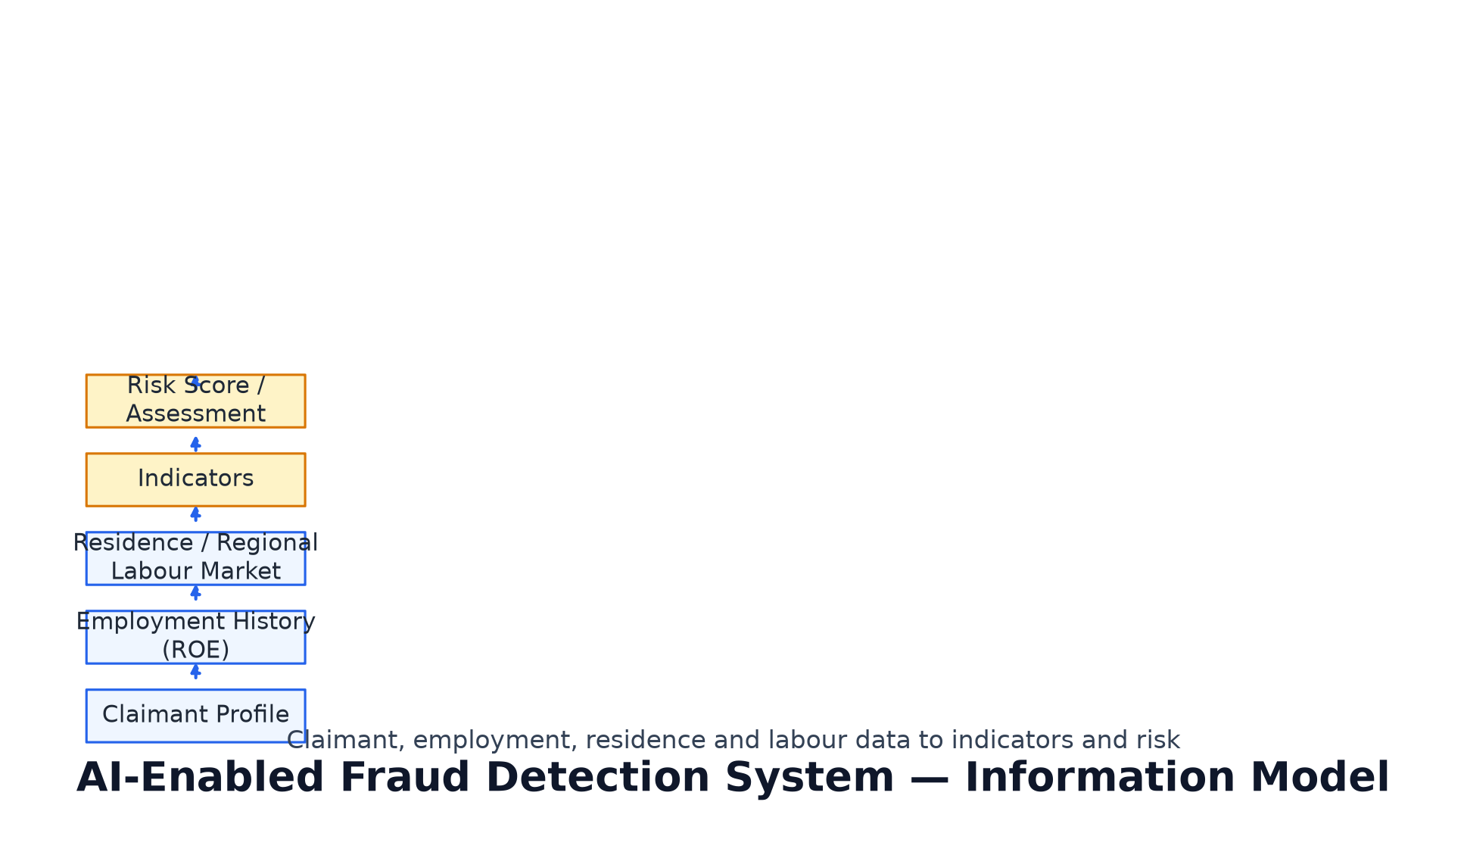
VIEW 02 — THE ARCHITECTURE
Layers and seams of the detection platform
External data adapters feed detection engines; the orchestrator sequences them; the ensemble scorer aggregates Indicators with SHAP attribution.

Slide 7
THE DECISION RULES
Four tenets that explain most of the design
01
Parallel by design
Six Detection_Engines run concurrently; the Ensemble Scorer aggregates Indicators into a Risk_Score with SHAP attribution.
02
Honest degradation
Engine or data-source failure yields PARTIAL_RESULT or INDETERMINATE; payment is halted rather than guessing.
03
Explainable outcomes
Every Risk_Decision ships with SHAP attributions and a bilingual LLM explanation.
04
Governed handling
Protected B, GCKey auth, immutable audit trail, bilingual output.

Slide 8
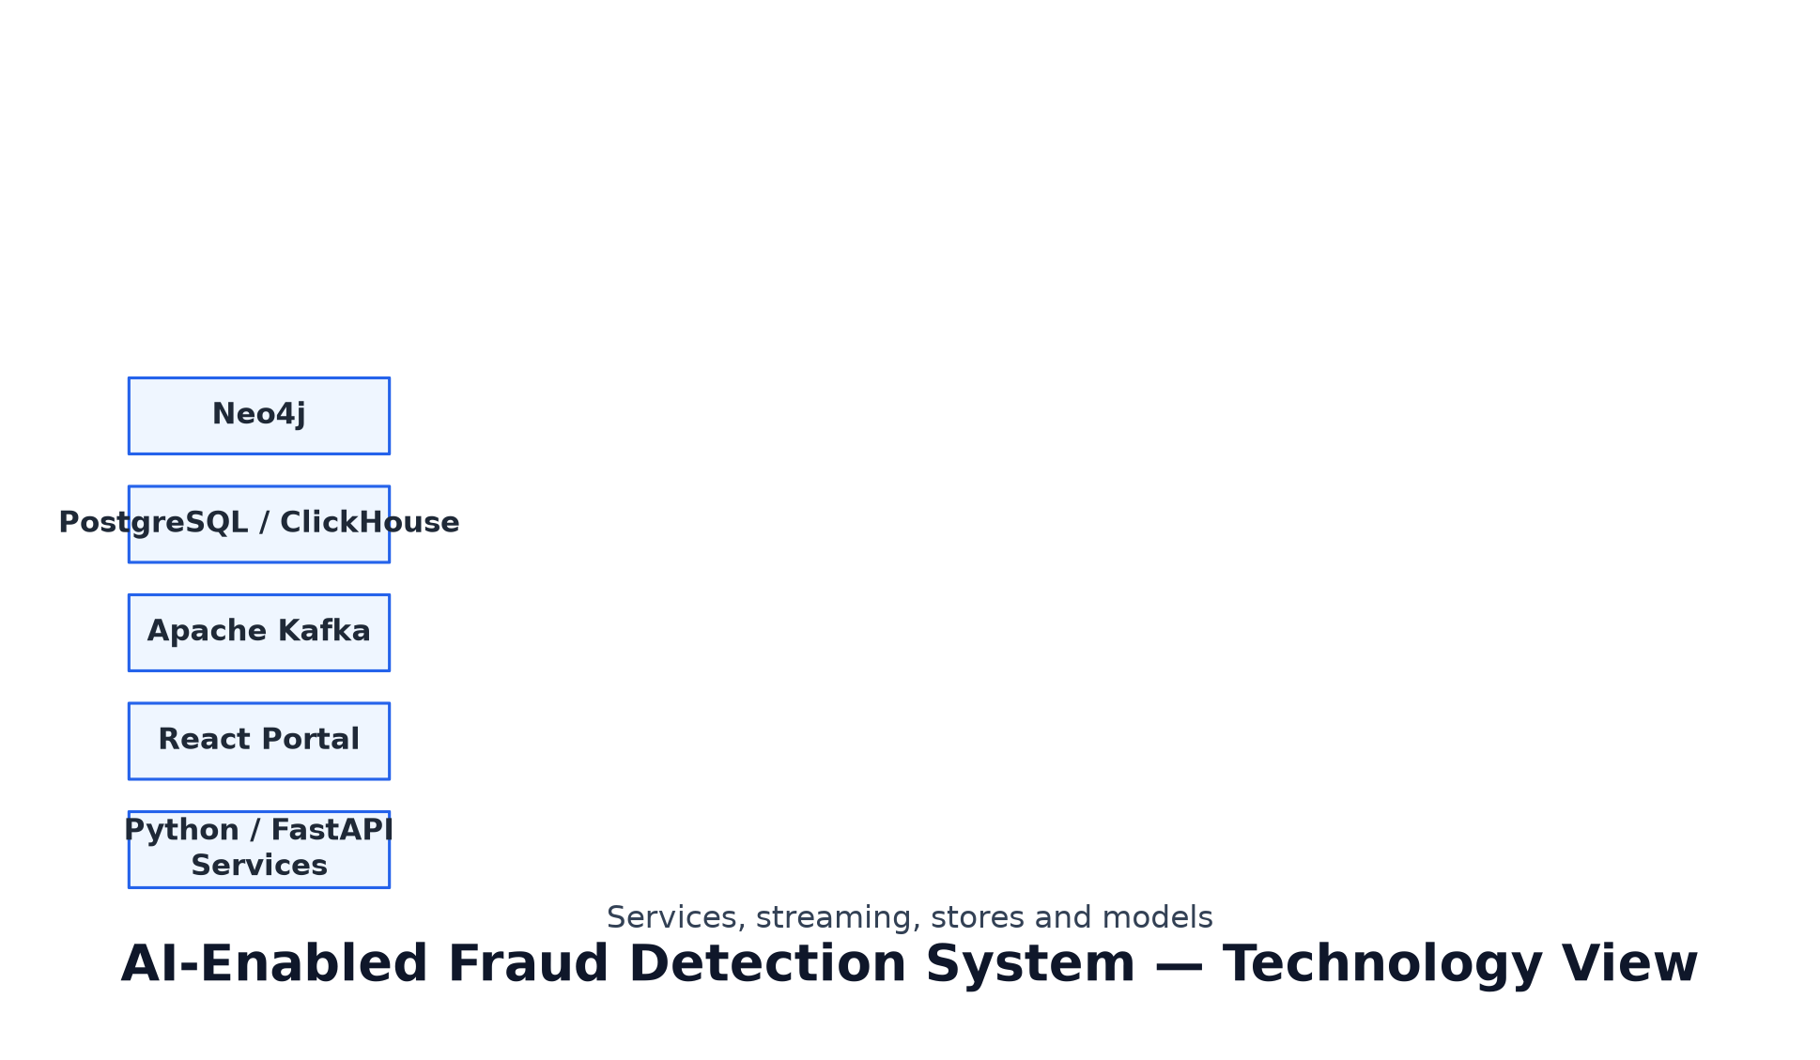
VIEW 03 — THE TECHNOLOGY VIEW
Technology stack of the AI-enabled fraud detection system
Python services and React portal, Apache Kafka event backbone, PostgreSQL and ClickHouse analytical stores, Neo4j graph store, Llama 3.1 LLM, XGBoost and Isolation Forest scoring — deployed on Protected B cloud.

Slide 9
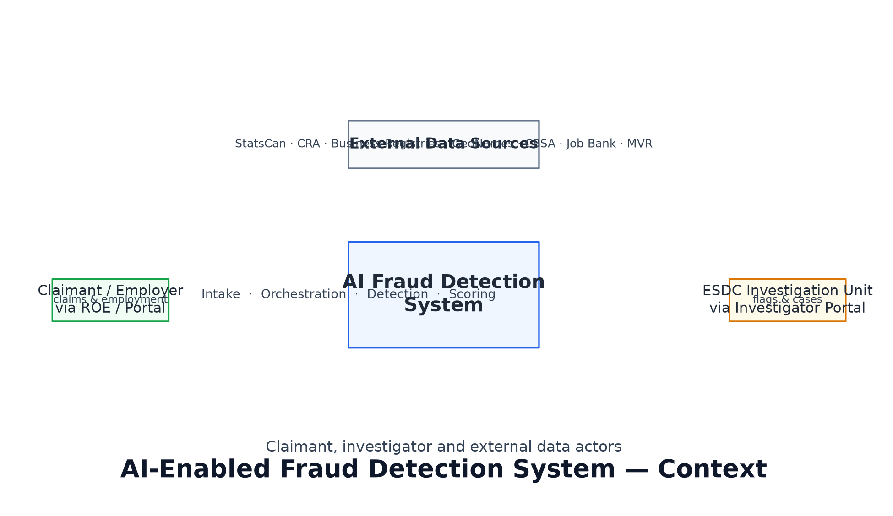
VIEW 04 — DEPLOYMENT & GOVERNMENT CONTEXT
Built for the Government of Canada context
Protected B classification, GCKey OAuth 2.0, Privacy Act and PIPEDA compliance, bilingual output and immutable audit.

Slide 10
WHAT WE HAVE MEASURED
Evidence of a working solution
All six Detection_Engines composed and integration-tested over real transports (Kafka, real HTTP, GCKey JWKS).
Ensemble Scorer wiring complete; real ML models pending.
Unit, property-based (P1-P15) and integration evidence assembled; live compose verified across slices.

Slide 11
WHERE THE EDGES ARE
What we are deliberately not claiming today
Ensemble real ML models pending.
Transit and economic signals, and document-registry sources, still to be fed into the pipeline.
Client-specific validation scenarios pending.

Slide 12
DEMONSTRATION - WHAT YOU ARE ABOUT TO WATCH
Six acts. Nothing is faked.
Every output comes from the real pipeline, the static demos, or the verification harness; which parts are live and which are test harnesses is stated openly.

Slide 13
WHAT WE NEED FROM YOU
The readiness package for your existing systems
Implementation verified against Requirements and Design; package supports your team evaluating integration with existing government systems.

Slide 14
NEXT STEPS & Q&A
Next steps and discussion
Real ensemble models, Kubernetes/OpenShift deployment, and client validation scenarios.

