Slide 1
Talk
An investigation of neural network methods for speech synthesis
Pablo Alvarez | William Ang
Randall Schwager | Tommy Yang

Slide 2
Overview
Problem description
Feature extraction
Accuracy results
Learning rate variation
Weight decay variation
Sparsity constraints
Alternate network configurations
Conclusion and next steps

Slide 3
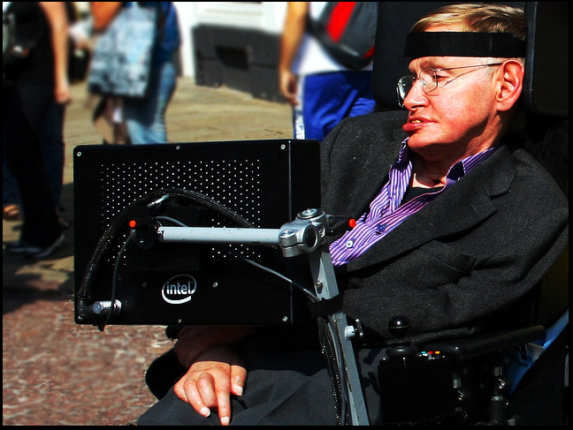
Problem Description
Quantum
kwantxm
Quantum
>1<<<0<
Image Credit: Flickr @Doug88888

Slide 4
Problem Description
Quantum
kwantxm
Quantum
>1<<<0<
Image Credit: Flickr @Doug88888

Slide 5
Problem Description
Quantum
kwantxm
Quantum
>1<<<0<
Image Credit: Flickr @Doug88888

Slide 6
Problem Description
Quantum
kwantxm
Quantum
>1<<<0<
Image Credit: Flickr @Doug88888

Slide 7
Network Description
189 Input Units
80 Hidden Units
34 Output Units
Training on first half of dictionary
Testing on the the last half of dictionary

Slide 8
Network Description
189 Input Units
80 Hidden Units
34 Output Units
Training on first half of dictionary
Testing on the the last half of dictionary

Slide 9




Tools Used

Slide 10
Tools Used

Slide 11
Tools Used

Slide 12
Tools Used

Slide 13
Tools Used

Slide 14
Network Replication
List of words

Slide 15
Network Replication
Individual word (ex. “machine”)
List of words

Slide 16
Network Replication
Individual word (ex. “machine”)
“---mach”
List of words
“--machi”
“-machin”
“machine”
“achine-”
“chine--”
“hine---”

Slide 17
Network Replication
Individual word (ex. “machine”)
“---mach”
000100...
List of words
“--machi”
“-machin”
“machine”
“achine-”
“chine--”
“hine---”

Slide 18
Network Replication
For each word...
Dataset of binary rep.
of letters and neighbors

Slide 19
Network Replication
For each word...
Dataset of binary rep.
of letters and neighbors
Train for each word
Neural Network

Slide 20
Network Replication
For each word...
Dataset of binary rep.
of letters and neighbors
Train for each word
Original paper method
Neural Network
Word just trained

Slide 21
Network Replication
For each word...
Dataset of binary rep.
of letters and neighbors
Train for each word
Original paper method
Neural Network
Activate network
Word just trained
Compare output to actual value
Error contribution

Slide 22
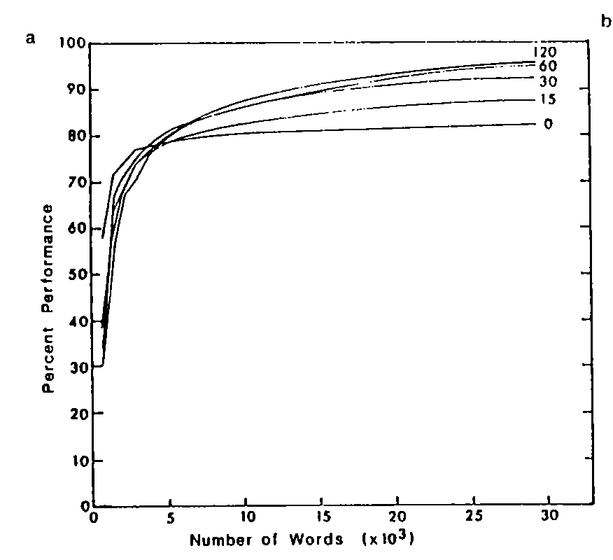
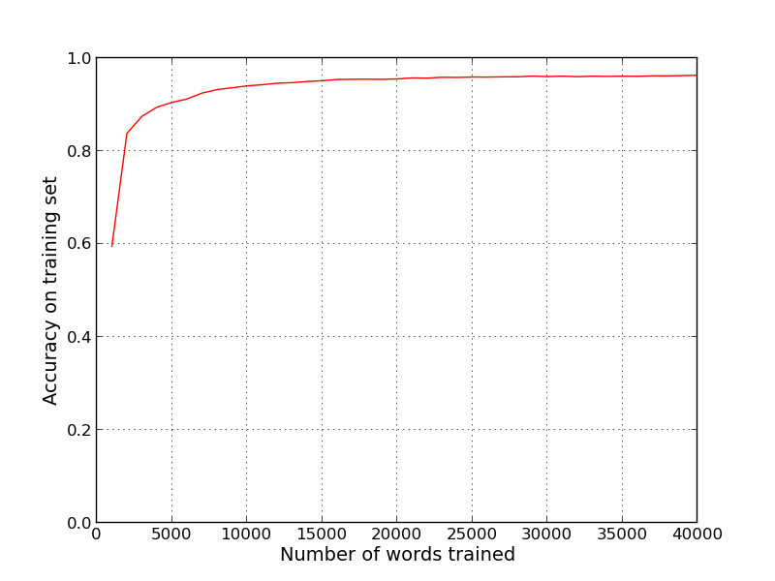
Nettalk performance vs ours

Slide 23
Network Replication
For each word...
Dataset of binary rep.
of letters and neighbors
Train for each word
Alternative: after x words trained, test on different dataset
Neural Network
Activate network
Generalization dataset
Compare outputs to actual value
Total error
contribution

Slide 24
Network Replication
For each word...
Dataset of binary rep.
of letters and neighbors
Train for each word
Alternative: after x words trained, test on different dataset
Neural Network
Generalization dataset

Slide 25
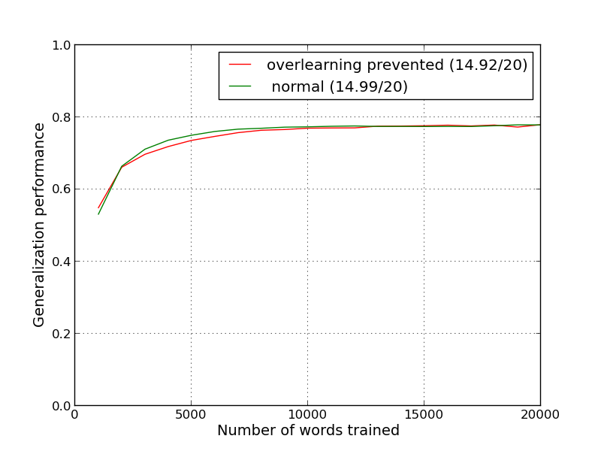
Preventing overlearning

Slide 26
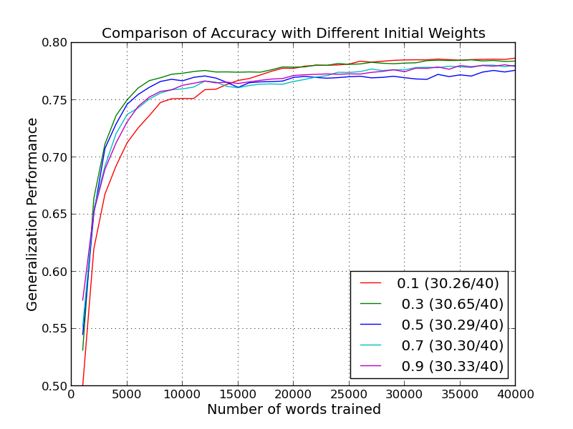
Varying initial weights

Slide 27
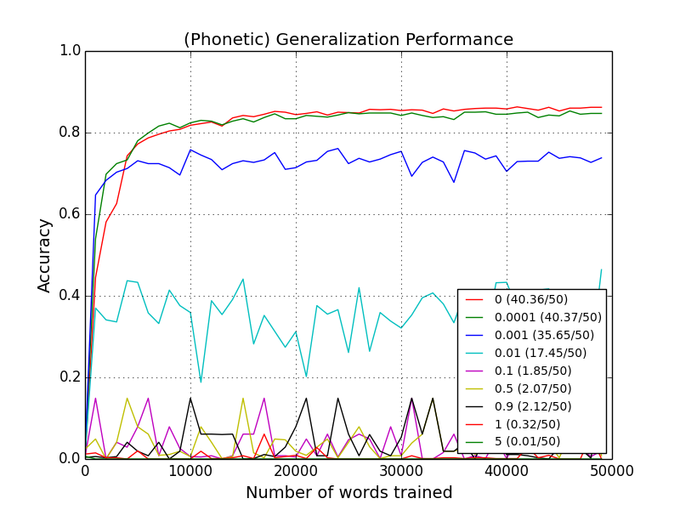
Varying Weight Decay

Slide 28
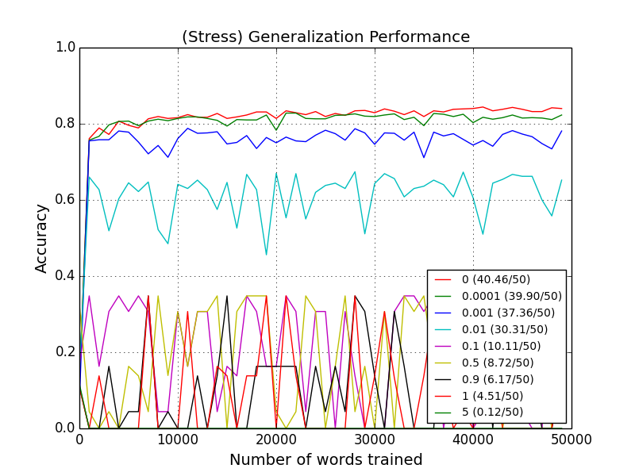
Varying Weight Decay

Slide 29
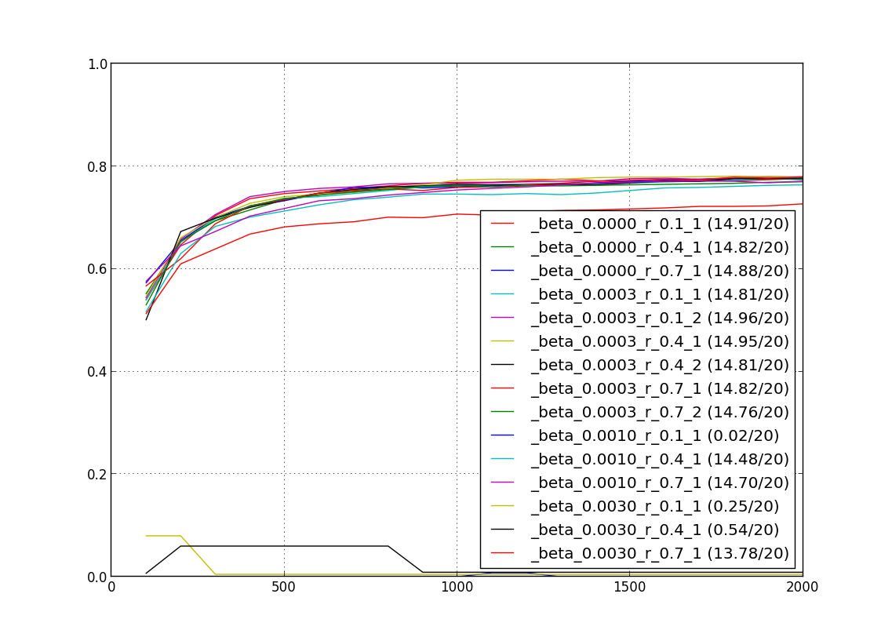
Varying sparsity parameters
Hidden layer:
Forward pass:
Save A=avg(a_{n})
Backward pass:
∂+=β∗(−r/A +(1-r)/(1-A))

Slide 30
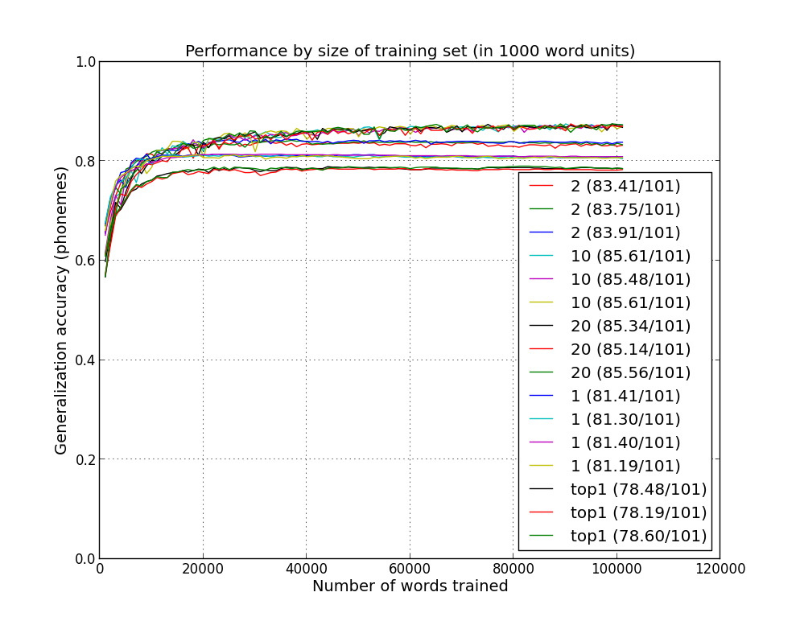
Varying training set size

Slide 31
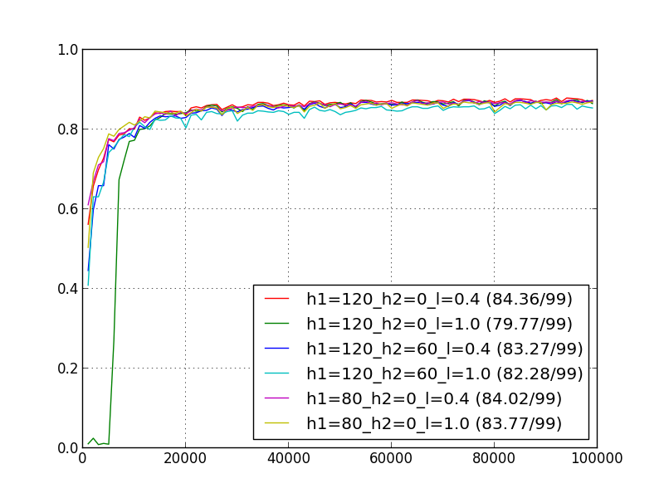
Varying network size

Slide 32
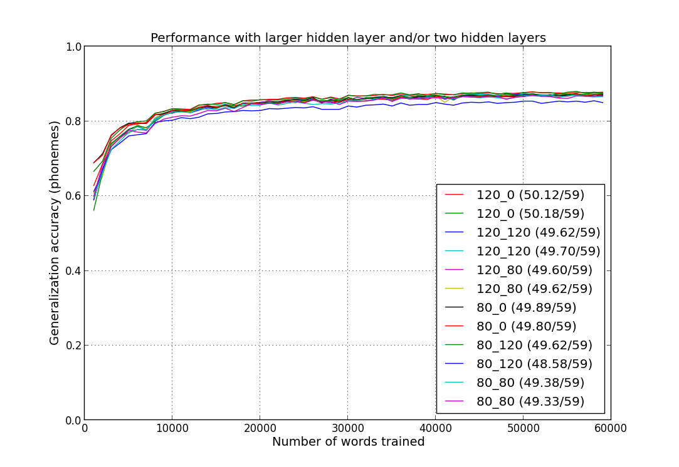
Varying network size

Slide 33
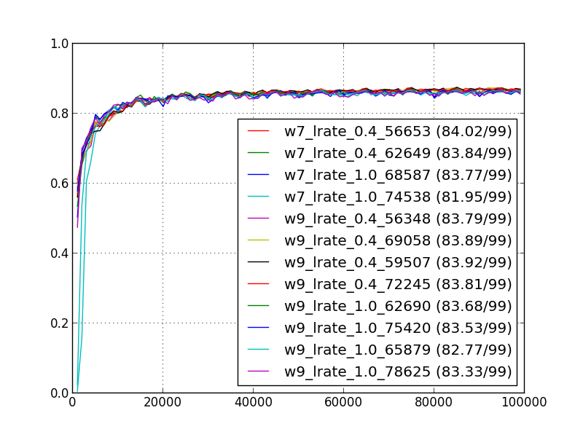
Varying window size around letter

Slide 34
Thanks!
Questions?
Pablo Alvarez | William Ang
Randall Schwager | Tommy Yang

