Slide 1
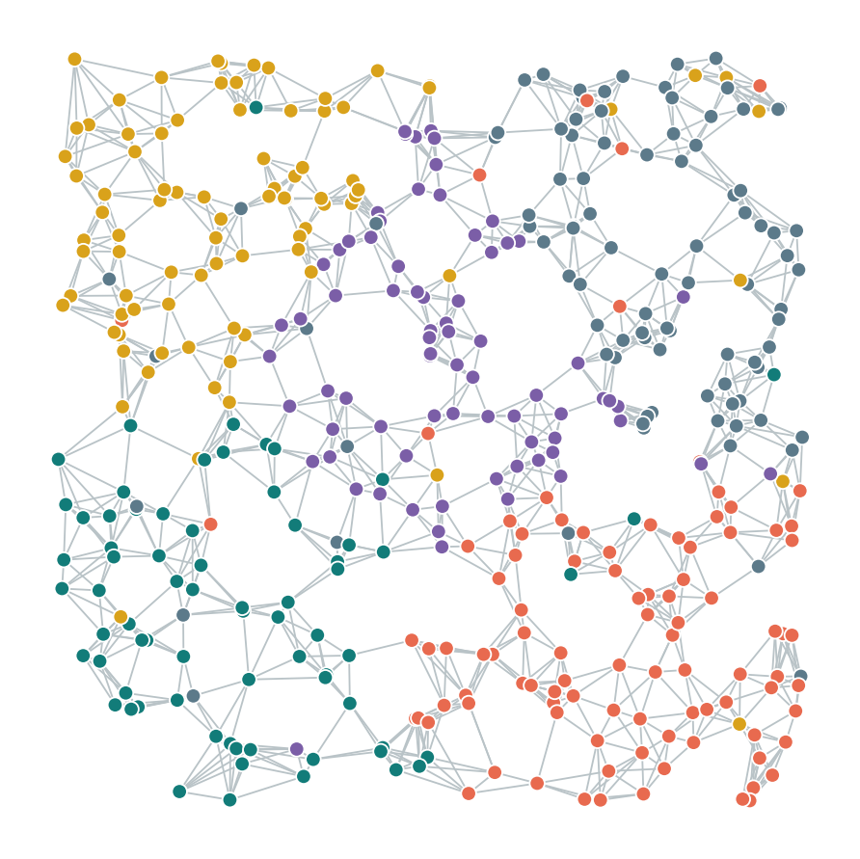

Graph Neural Network: An Introduction
BME 487: AI in BME
Gopal Narayan Srivastava
Postdoctoral Research Fellow
Chandrasekaran Lab
Dept. of Biomedical Engineering
University of Michigan
Notes:
biological systems are never isolated parts; context and interaction are the signal itself. “So the real question for today is how we build models that actually use those interactions, and that’s where we’re headed. Let me show you the plan.”

Slide 2
Overview
Goal : Explain how a biological dataset becomes a graph and compare a graph neural network (GNN) with a model that ignores graph connections.
What is a Graph?
Representing Graphs (Node Feature Matrix and Adjacency Matrix)
Types of Graphs (Directed vs. Undirected, Weighted vs. Unweighted)
Examples of graphs and graph representation
Deep learning with graphs?
Graph convolution
Message Passing in GNNs
A Core GNN Model : GCN
Notes:
Our primary goal today is twofold: first, to understand how a raw biological dataset gets converted into a mathematical graph, and second, to see how a GNN leverages those connections compared to a traditional model that ignores them.
We'll start with graph fundamentals and matrix representations, move into why standard neural networks struggle with graphs, derive the core Graph Convolutional Network (GCN) equations, and next class finish by setting up today's hands-on tutorial.
But first Lets understand what are graphs

Slide 3
What is a graph?
A graph (G) is a data structure that consists of two main components:
Set of Nodes (or vertices) ; V
Set of Edges (or links); E
2
Node/Vertex
1
Edge
4
Graphs encode relations between entities
G = (V, E)
3
5
Notes:
What is graph?
Mathematically, a graph $G$ is defined simply by two sets: a set of nodes (or vertices, $V$) and a set of edges (or links, $E$).
Nodes represent individual entities, and edges encode the relationships or interactions between them.

Slide 4
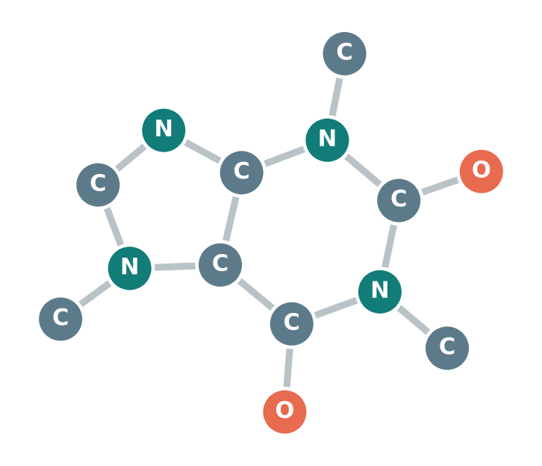
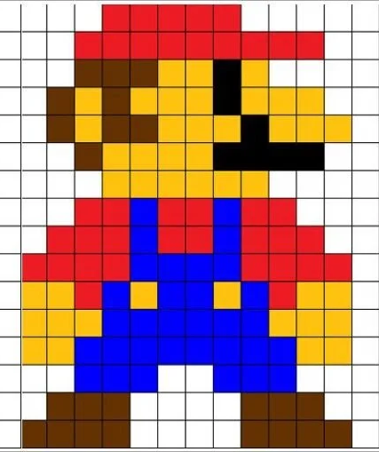
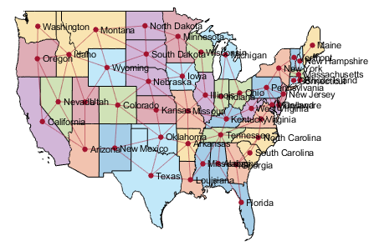
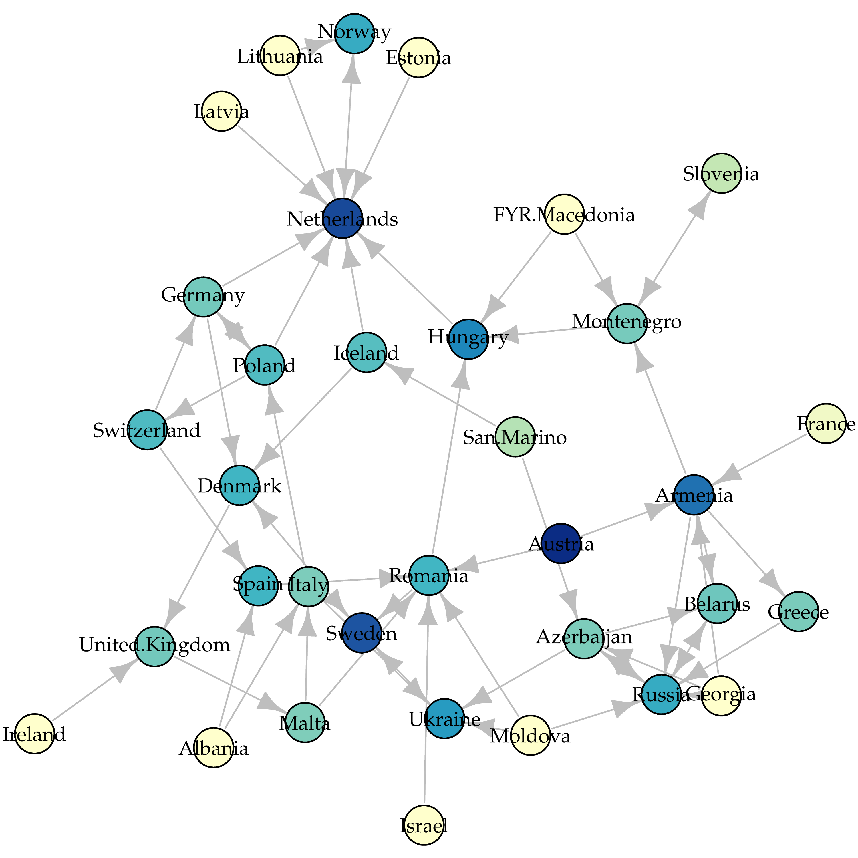
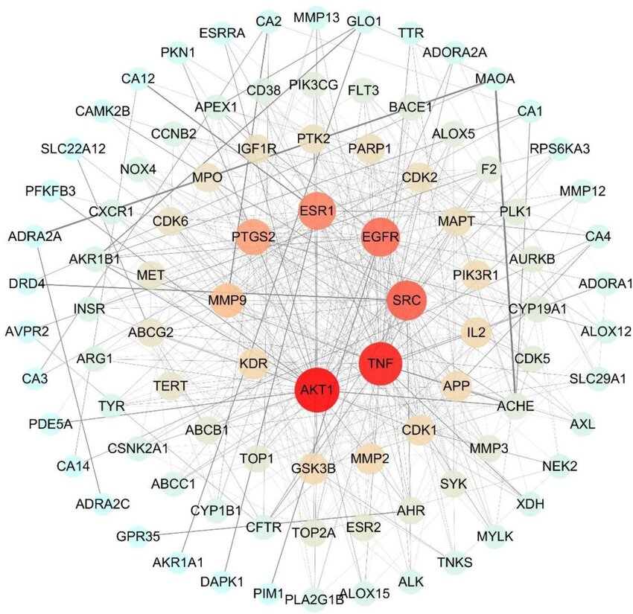
Where do we find graphs?
Images
Molecules
Maps
Biological networks
Eurovision
Notes:
Open with familiar examples before biology.
Images: every pixel is a node connected to its neighbouring pixels - a regular grid graph.
Molecules: atoms are nodes, bonds are edges (this is caffeine).
Maps: cities or intersections are nodes, roads are edges; edge weights can be distances or travel times.
The point: anything made of entities and relationships can be written as a graph.

Slide 5
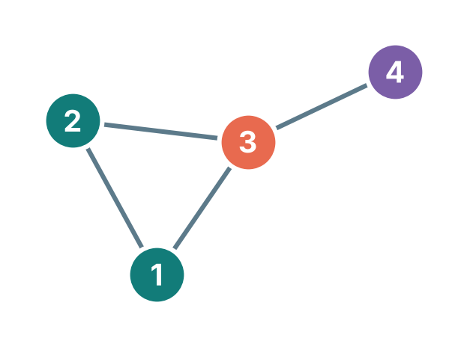
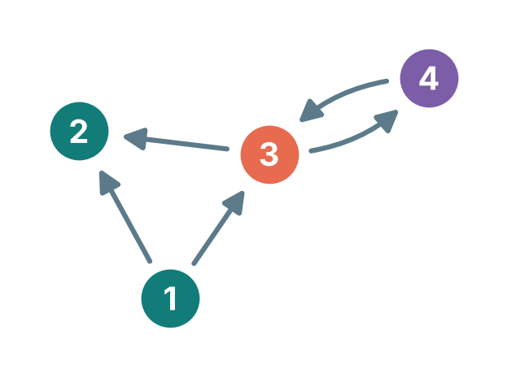
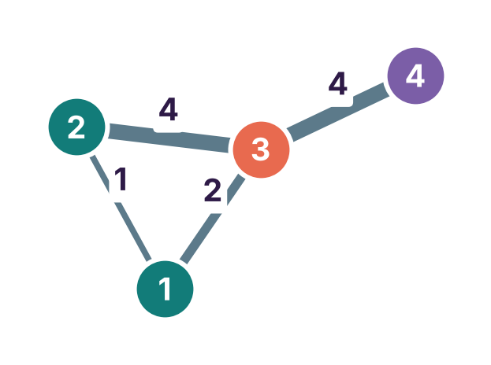
Type of Graphs
Undirected
Directed
Edges have a direction
E.g. transcription factor → target gene
Edges have no direction; A is symmetric
E.g. cells that are neighbours
Weighted
Unweighted
An edge is there (1) or not (0)
Edges carry a strength
E.g. PPI confidence
Notes:
Type of Graphs Depending on the biology we are modeling, graphs come in four main flavors:
Undirected: Edges have no arrowheads, meaning the relationship is mutual and the adjacency matrix is symmetric—for instance, two cells sitting next to each other in a tissue slice.
Facebook friendship
Directed: Edges have a specific direction, capturing causal or asymmetric relationships like a transcription factor binding to and regulating a target gene.
following on Instagram or TikTok. You can follow a celebrity who doesn’t follow you back.
Unweighted: Binary connections—an interaction either exists (1) or it doesn't (0).
Group chat membership or photo tags
Weighted: Edges carry numerical values representing interaction strength, such as protein-protein interaction confidence scores.
number of texts, or a Snapchat streak count. The connection carries a number that says how strong it is. Your best friend might be a snapchat 300-day streak while someone else is a 3-day streak; same edge type, very different weight,

Slide 6
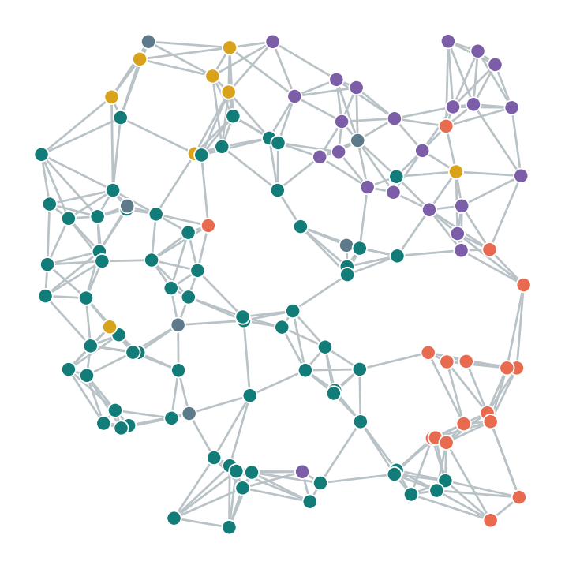
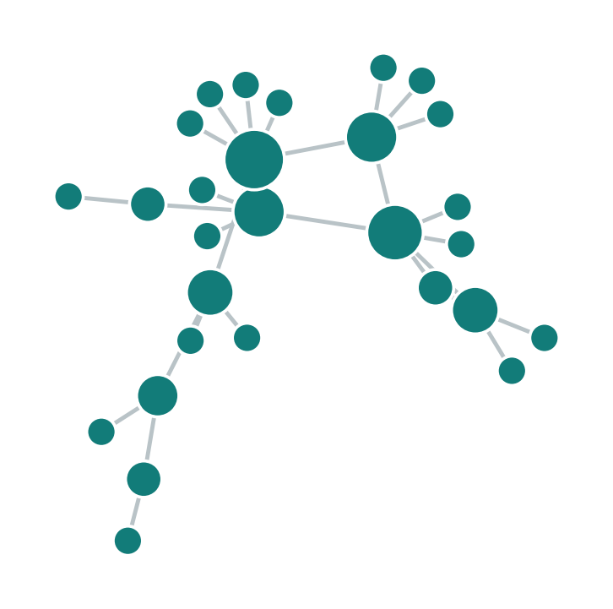
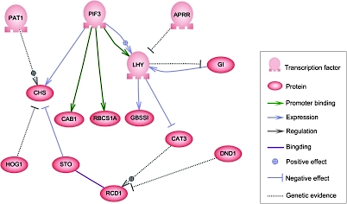
Graphs are a natural representation in biology and chemistry
Protein–protein interaction
Gene regulation
Spatial omics
Nodes: proteins
Edges: physical binding
Task: predict protein function
Nodes: genes and proteins
Edges: regulator → target
Task: predict regulatory targets and edge types
Nodes: cells in a tissue section
Edges: physically nearby cells
Task: predict cell type
Notes:
Same idea, three biological settings.
PPI: nodes are proteins, edges are physical interactions. Classic task: predict the function or disease association of an unannotated protein from the proteins it binds ("guilt by association").
Gene regulatory network: directed edges, transcription factor -> target. Tasks: predict targets, find regulators of a disease programme.
Spatial omics: nodes are cells measured in place in a tissue section; edges connect physically nearby cells. Task today: predict a cell's type.
in protein and gene networks the edges are handed to us, but in spatial omics we build the edges ourselves, so the graph is a modeling decision. And it doesn’t stop at cells and proteins; the same idea works all the way down at the molecular scale

Slide 7
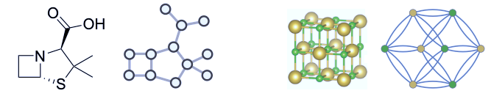
Graphs are a natural representation in biology and chemistry
Molecules
Crystals
Notes:
small molecules (like penicillin) and 3D crystal lattices, where atoms are nodes and chemical bonds are edges.
So almost anything can be written as a graph, which raises the real question: how do we actually hand one of these to a computer?

Slide 8
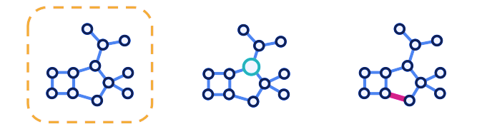
The types of problems tackled with graphs
Graph level
e.g. toxicity prediction
Node level
e.g. cell type prediction
Edge level
e.g. bond or PPI prediction
Notes:
The Types of Problems Tackled with Graphs (1:00)
Machine learning tasks on graphs generally fall into three levels of granularity:
Graph-level: Making a single prediction for an entire graph, like predicting whether a drug molecule is toxic.
Node-level: Predicting a property for each individual node, like determining a cell's type or an atom's state.
Edge-level: Predicting whether a link should exist between two nodes, such as discovering a new protein-protein interaction.

Slide 9
How do we represent Graphs?
A adjacency (N × N)
X features (N × d)
 | 1 | 2 | 3 | 4 | 5
1 | 0 | 1 | 1 | 0 | 0
2 | 1 | 0 | 1 | 1 | 0
3 | 1 | 1 | 0 | 0 | 1
4 | 0 | 1 | 0 | 0 | 1
5 | 0 | 0 | 1 | 1 | 0
 | Gene 1 | Gene 2 | … | Gene d
1 | 2.1 | 0 | … | 0.4
2 | 1.8 | 0.1 | … | 0.2
3 | 0 | 3.2 | … | 1.1
4 | 2.4 | 0.3 | … | 0
5 | 0.2 | 2.9 | … | 0.9
2
1
4
3
Node = one cell (or protein, gene)
Edge = a relationship; A is symmetric when edges are undirected
Node features = what we measured per node (gene expression)
Label y = what we want to predict (cell type), known only for training nodes
5
Notes:
Make this concrete with the 5- cells in represented as graphs. It has two types of cells, blue and maize
We already know that graph is represented as nodes and edges. And so, we use adjacency matrix to show edges in matrix format.
A (adjacency): N x N, A_ij = 1 if node i and j are connected. Undirected graph -> A is symmetric. Point to row 1: node 1 connects to 2 and 3.
X (features): N x d. For us, each row is a cell, each column one of 351 genes.
y (labels): one per node - the cell type. We only use the labels of training nodes.
"Which of these does a normal ML or MLP use?" -> only X.
A GNN uses A and X.

Slide 10
Deep learning with graphs?
Numbering 1
Numbering 2
2
 | 1 | 2 | 3 | 4
1 | 0 | 1 | 1 | 0
2 | 1 | 0 | 1 | 0
3 | 1 | 1 | 0 | 1
4 | 0 | 0 | 1 | 0
4
 | 1 | 2 | 3 | 4
1 | 0 | 1 | 1 | 1
2 | 1 | 0 | 0 | 0
3 | 1 | 0 | 0 | 1
4 | 1 | 0 | 1 | 0
1
3
3
1
4
A
2
A
Include adjacency matrix as features in a standard neural network
Issues: fixed size and sensitive to the order of nodes
Notes:
We understand so far that ordinary ML methods do not look at relations. But what if we only used adjacency as input. What will happen then? Will common ML methods work?
Left and right are the SAME graph - same cells, same connections. The only thing that changed is the order in which we numbered the nodes.
But the adjacency matrices look different. If we flattened A (and X) into a long list or vector and fed it to an MLP, the MLP would see two different inputs and could give two different answers for the same tissue.
Numbers: a graph with N nodes has N! possible orderings. For our 19,416 cells, that's a number with more than 70,000 digits - no amount of data augmentation covers that.
Also: an MLP on a flattened matrix needs a fixed input size, but every tissue section has a different number of cells.
So we need models whose answer does not depend on how we numbered the nodes. That property has a name - next slide.

Slide 11
Permutation invariance and equivariance
Terminology Alert
Invariance graph-level output
Equivariance node-level output
f( PX, PAPᵀ ) = f( X, A )
F( PX, PAPᵀ ) = P · F( X, A )
Renumber the cells (nodes): the single answer for the whole graph does not change.
Renumber the cells: each cell's answer moves with the cell.
Example: Is this tissue section from a mutant embryo?
Example: What type is each cell?
P = a permutation matrix. Each message-passing layer is equivariant; and pooling across all nodes (via sum, mean, or max) makes the final output invariant.
Notes:
a model whose output changes when you renumber the nodes is "permutation-VARIANT" - that's the MLP-on-a-flattened-matrix from the last slide, and it's what we want to avoid.
Permutation Invariance and Equivariance
To handle arbitrary node ordering, GNNs rely on two mathematical symmetries using a permutation matrix $P$:
Permutation Invariance ($f\left(PX,PAP^{T}\right)=f\left(X,A\right)$) is required for graph-level outputs. If you renumber the cells in a tissue slice, the overall diagnosis—like whether the tissue comes from a mutant embryo—must remain identical.
Permutation Equivariance ($F\left(PX,PAP^{T}\right)=P⋅F\left(X,A\right)$) is required for node-level outputs. If you swap the row order of two cells in your input matrix, their predicted cell-type labels simply swap positions in the output.
Message-passing layers are naturally equivariant, and pooling across all nodes (via sum, mean, or max) makes the final output invariant.

Slide 12
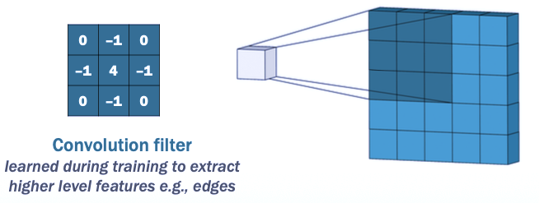
Deep learning with graphs?
A convolution filter transforms and combines pixel information from neighbors in an image
Convolution Filter
Notes:
A convolution filter combines a pixel with its neighbors.
So what will happen if we do the very same thing, but over graph neighbors instead of pixel neighbors?

Slide 13
Graph convolution
Can we extend the concept of convolutions to graphs?
2
1
Convolution from neighbors
3
to target node
4
Message passing

Slide 14
Message passing
 | Gene 1 | Gene 2 | … | Gene d
1
2
3
4
5
 | Gene 1 | Gene 2 | … | Gene d
1
2
3
4
5
2
2
1
1
3
3
3
3
4
4
Example graph
Node feature matrix
Updated embeddings
Updated Feature Matrix

Slide 15
What do neural networks do?
Neural networks decide:
Σ
Message
What message gets passed to another node
Pooling/Aggregation
How messages from neighbors are combined
Update
How nodes are updated given pooled message
Notes:
Let’s slow down and watch a single round of it actually happen.

Slide 16
Aggregation: order free summarizing neighbors
Neighbours' feature values
Order-free aggregators
2
Sum
15
How much signal, and how many neighbors?
4
Most expressive (counts neighbours)
v
Mean
5
Composition of the microenvironment, regardless of density
GCN ≈ degree-weighted mean
Max
9
9
Is there any neighbour with a strong signal?
Robust to many weak neighbours
AGG(2, 4, 9) = AGG(9, 2, 4)
Notes:
[22:00-24:30] Aggregation, made concrete. Cell v has three neighbours whose (transformed) feature - say, expression of one marker gene - is 2, 4 and 9.
Sum = 15, mean = 5, max = 9. All three give the same answer if the neighbours are listed in any order: AGG(2,4,9) = AGG(9,2,4). That's why these are allowed and, e.g., "take the first neighbour" or "concatenate the neighbours" are not.
What each captures, in seqFISH terms:
- Sum: grows with the number of neighbours, so it encodes density - dense tissue gives large sums. Most expressive in theory (Xu et al. 2019).
- Mean: the composition of the microenvironment - proportions, independent of how many neighbours there are. GCN is a degree-normalised weighted mean.
- Max: is there ANY neighbour with a strong signal - e.g., is there an endothelial cell next to me.
In practice the model applies this to all 64 hidden features at once, each with its own learned meaning. Attention (in two slides) learns the weights instead of fixing them.

Slide 17
Graph Convolutional Networks
A type of Graph Neural Network (GNN) that generalizes convolution to graph-structured data.
Aggregates and transforms information from neighbors to learn meaningful embeddings.
• Efficiently combines node features and graph structure.
• Handles tasks like node classification, link prediction, and graph classification.
• Scalable and foundational, inspiring many advanced GNN architectures.

Slide 18
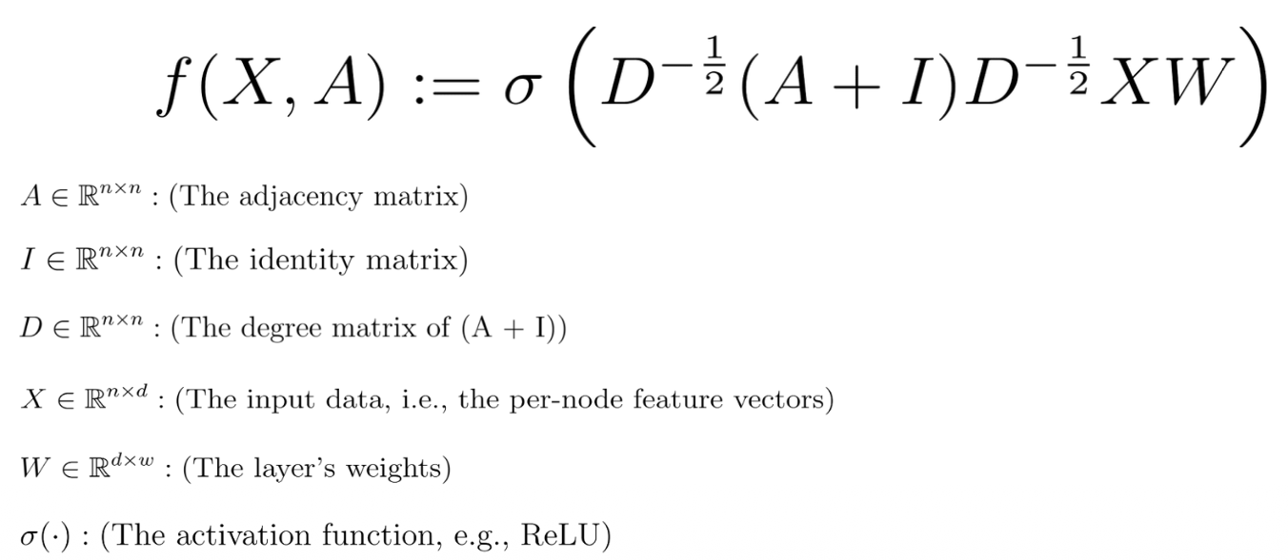
Graph Convolutional Networks
GCN expressed as function that accepts matrices A and X and outputs a matrix representing the updated vectors associated with each node.
Notes:
F is taking A and X in and giving updated node vectors out.

Slide 19
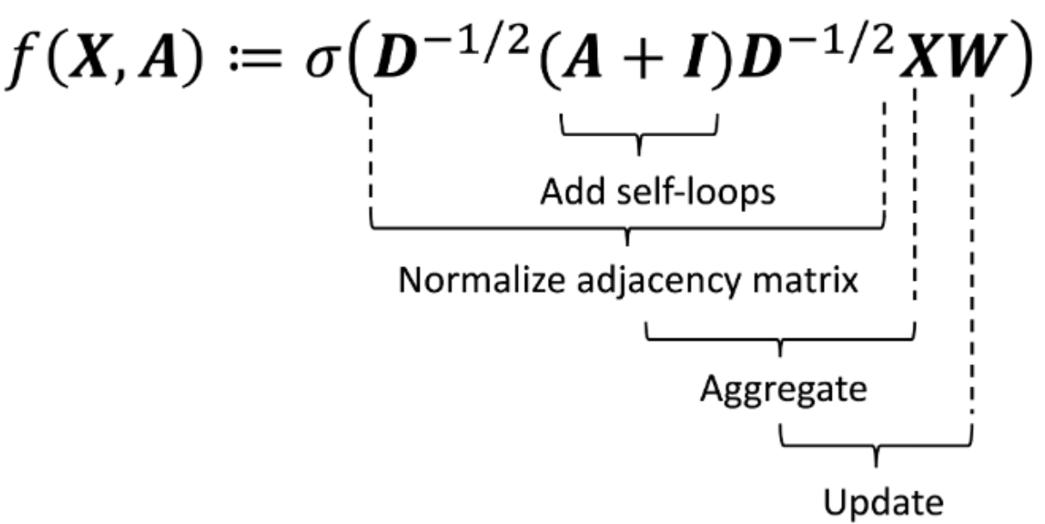
Graph Convolutional Networks
Notes:
The most naive version of that function is a single matrix multiply, A times X
That raw multiply has two problems, and happily each one has a clean fix.
Degree and normalization. The first problem is that a node forgets itself, which we fix with self-loops, turning A into A plus the identity. The second problem is that high-degree nodes dominate, which we fix by dividing by the degree, where d_ii is just the number of neighbors.
“Dividing on only one side isn’t quite enough, so we normalize symmetrically instead.”

Slide 20
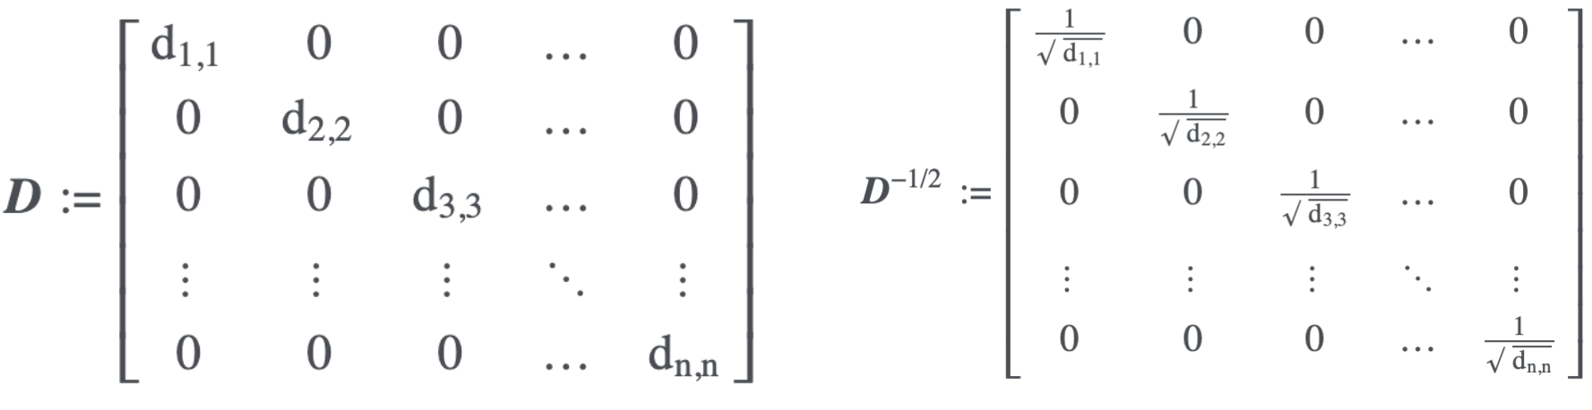
Graph Convolutional Networks
d_{ii}: number of adjacent nodes (i.e., direct neighbors) to node i

Slide 21
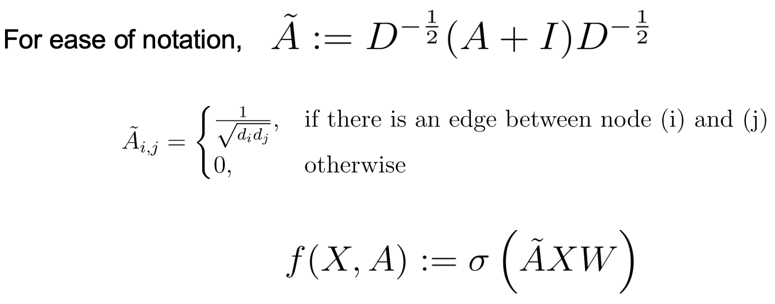
Graph Convolutional Networks
Notes:
This gives the weight of one over the square root of the product of the two degrees.

Slide 22
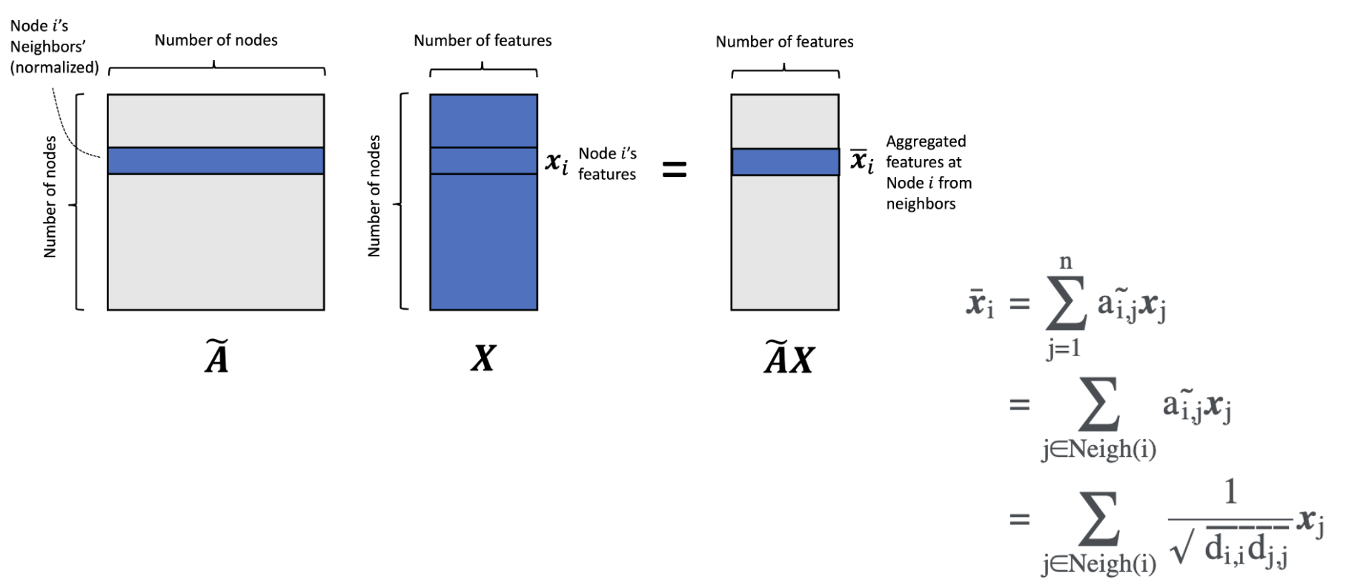
Graph Convolutional Networks

Slide 23
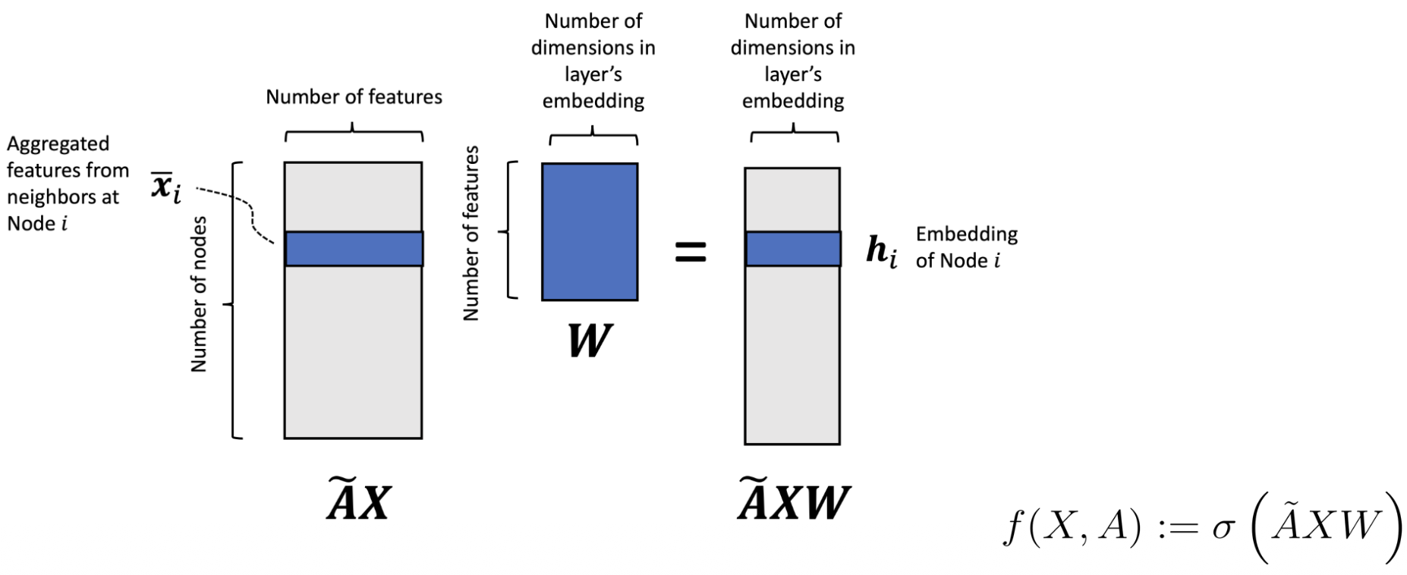
Graph Convolutional Networks
Notes:
We multiply by a learnable weight matrix W and pass the result through a nonlinearity, and that is one complete layer. Then say: “Stack a few of these layers together and you have a full network.”

Slide 24
One GCN layer example by hand
2
1
2
4
Update node 3 (neighbours 1, 2, 5 + itself)
from node | 1 | 2 | 3 (self) | 5
degree d | 3 | 4 | 4 | 3
weight 1/√(d₃ d) | 0.289 | 0.25 | 0.25 | 0.289
value x | 4 | 2 | 0 | 1
4
3
3
0
5
new(3) = 0.289·4 + 0.25·2 + 0.25·0 + 0.289·1 = 1.94
1
Large circle = feature value x; small dark tag = node number
Node 3 started at 0, the odd one out, and moves toward its neighbourhood.
node | 1 | 2 | 3 | 4 | 5
before: x | 4 | 2 | 0 | 3 | 1
after: Â x | 1.91 | 2.52 | 1.94 | 1.91 | 1.33
Values pooled together = smoothing. A real layer also multiplies by W and applies ReLU.
Notes:
Each node has one feature, say expression of one gene: 4, 2, 0, 3, 1.
Degrees with self-loops: nodes 1, 2, 5 have node 3;
The normalised weight between u and v is 1 / sqrt(d_u d_v): 1/sqrt(3x4) = 0.289, 1/sqrt(4x4) = 0.25, 1/sqrt(3x3) = 0.333.
Node 3 is connected to 1, 2, 5 and itself:
new(3) = 0.289 x 4 + 0.25 x 2 + 0.25 x 0 + 0.289 x 1 = 1.94.
Node 3 had 0 - it was the odd one out - and now looks more like its neighbourhood.
Bottom row: all five nodes before and after. Values are pulled together - that's smoothing. Do it too many times and everything becomes the same (over-smoothing, coming up).
Real layer: x is a 351-dimensional vector (one entry per gene), we multiply by W first (Â (X W) - same thing by associativity) and apply ReLU.

Slide 25
Try it yourself!
Node Classification Accuracy Comparison (GCN vs. MLP)
Graph Convolutional Network (GCN): A type of Graph Neural Network designed to capture both local and global dependencies by aggregating information from neighboring nodes.
PPI Data:
Nodes: proteins (≈2,245 per tissue). Each protein has 50 features (positional gene sets, motif gene sets, immunological signatures).
Edges: interactions between proteins.
Labels: 121 Gene Ontology (GO) terms. A protein can have several functions, so each protein gets 121 yes/no answers (multi-label).
PPI Data: Zitnik & Leskovec, 2017
Notes:
Use the toy graph from the start of the lecture. Each node has one feature, say expression of one gene: 4, 2, 0, 3, 1.
Degrees with self-loops: nodes 1, 4, 5 have 3; nodes 2 and 3 have 4. The normalised weight between u and v is 1 / sqrt(d_u d_v): 1/sqrt(3x4) = 0.289, 1/sqrt(4x4) = 0.25, 1/sqrt(3x3) = 0.333.
Node 3 is connected to 1, 2, 5 and itself:
new(3) = 0.289 x 4 + 0.25 x 2 + 0.25 x 0 + 0.289 x 1 = 1.94.
Node 3 had 0 - it was the odd one out - and now looks more like its neighbourhood.
Bottom row: all five nodes before and after. Values are pulled together - that's smoothing. Do it too many times and everything becomes the same (over-smoothing, coming up).
Real layer: x is a 351-dimensional vector (one entry per gene), we multiply by W first (Â (X W) - same thing by associativity) and apply ReLU.

Slide 26
Try it yourself!
Cell type Classification on Spatial Transcriptomics Data
seqFISH Dataset (Mouse Cortex):
• Nodes (Cells): 19,416 individual cells/spots, each represented by its gene expression profile (351 genes)
• Edges: constructed based on spatial proximity
• Labels: 22 annotated cell types
PPI Data: Zitnik & Leskovec, 2017
Notes:
Use the toy graph from the start of the lecture. Each node has one feature, say expression of one gene: 4, 2, 0, 3, 1.
Degrees with self-loops: nodes 1, 4, 5 have 3; nodes 2 and 3 have 4. The normalised weight between u and v is 1 / sqrt(d_u d_v): 1/sqrt(3x4) = 0.289, 1/sqrt(4x4) = 0.25, 1/sqrt(3x3) = 0.333.
Node 3 is connected to 1, 2, 5 and itself:
new(3) = 0.289 x 4 + 0.25 x 2 + 0.25 x 0 + 0.289 x 1 = 1.94.
Node 3 had 0 - it was the odd one out - and now looks more like its neighbourhood.
Bottom row: all five nodes before and after. Values are pulled together - that's smoothing. Do it too many times and everything becomes the same (over-smoothing, coming up).
Real layer: x is a 351-dimensional vector (one entry per gene), we multiply by W first (Â (X W) - same thing by associativity) and apply ReLU.

Slide 27
Three GNN layers, three ways to aggregate
Layer | How neighbours are weighted | How the cell's own features enter | Why use it for seqFISH
GCN | Fixed: 1 / √(dᵤ dᵥ), from node degrees | Mixed in through the self-loop (A + I) | Fast, simple, strong baseline. Used in today's lab
GraphSAGE | Mean, max or LSTM over (sampled) neighbours | Concatenated: [ hᵥ ‖ AGG(neighbours) ] | Keeps a cell's own expression separate from its niche; scales to millions of cells
GAT | Learned attention α, softmax over neighbours | Included as one of its own neighbours | Can learn to ignore neighbours across tissue boundaries
Kipf & Welling, ICLR 2017 · Hamilton et al., NeurIPS 2017 · Veličković et al., ICLR 2018
Same recipe, different AGG. In PyTorch Geometric these are drop-in layers: GCNConv, SAGEConv, GATConv.
Notes:
[31:00-32:30] FAST PATH: one-minute summary slide.
All three are the same message-passing recipe; they differ only in how neighbours are weighted and how the cell's own features enter.
GCN (Kipf & Welling 2017): fixed weights from degrees; self included via the self-loop. Fast, strong baseline - this is what we use in the lab.
GraphSAGE (Hamilton et al. 2017): aggregate neighbours (mean, max, or an LSTM over a random order), then CONCATENATE with the cell's own vector. Useful in seqFISH because it keeps the cell's own expression separate from the summary of its niche. Neighbour sampling lets it scale to millions of cells.
GAT (Velickovic et al. 2018): learned attention weights.
If students want to try one, PyTorch Geometric has GCNConv, SAGEConv and GATConv as drop-in layers.

