Slide 1
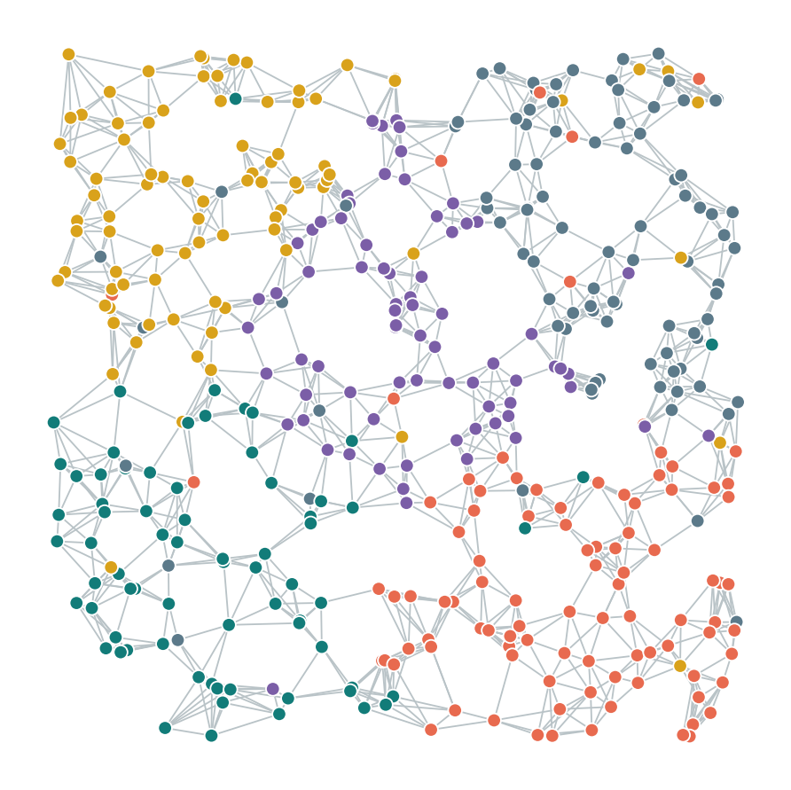

Graph Attention Networks
BME 487: AI in BME
Gopal Narayan Srivastava
Postdoctoral Research Fellow
Chandrasekaran Lab
Dept. of Biomedical Engineering
University of Michigan
Notes:
[0:00-1:00] Welcome. Today we start the AI-in-BME applications block with graphs.
One sentence to open: a lot of biomedical data is about how things are connected - proteins that bind, genes that regulate each other, cells that touch. Today we learn a model that uses those connections directly.
Format: about 45 minutes of concepts, then 2 hours 15 minutes of coding in Colab. (Slides marked FAST PATH in the notes can be shortened to bring the lecture to ~38 minutes.) Everyone should open the Lab notebook link now and run the first setup cell while I talk - the install takes a couple of minutes.

Slide 2
Overview
Standard GCN Bottlenecks
Relational graph convolution network (RGCN) & Decoders
Tutorials
Notes:
[1:00-2:30] Learning goal (read it aloud): by the end of today you can explain how a biological dataset becomes a graph, and compare a GNN with a model that ignores the connections.
Walk the timeline: 45 min concepts (how GNNs work, then how we apply them to seqFISH), a 25 min guided demo I run with you, then four exercises, then the assignment.
The three outcomes on the right are what the assignment will check.

Slide 3
Message passing
 | Gene 1 | Gene 2 | … | Gene d
1
2
3
4
5
 | Gene 1 | Gene 2 | … | Gene d
1
2
3
4
5
2
2
1
1
3
3
3
3
4
4
Example graph
Node feature matrix
Updated embeddings
Updated Feature Matrix

Slide 4
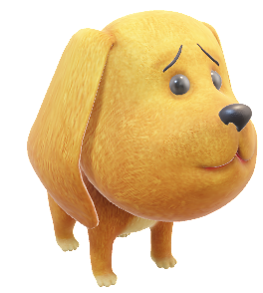

Standard GCN Bottlenecks
What happens when we keep propagating information through the graph, layer after layer?

Slide 5
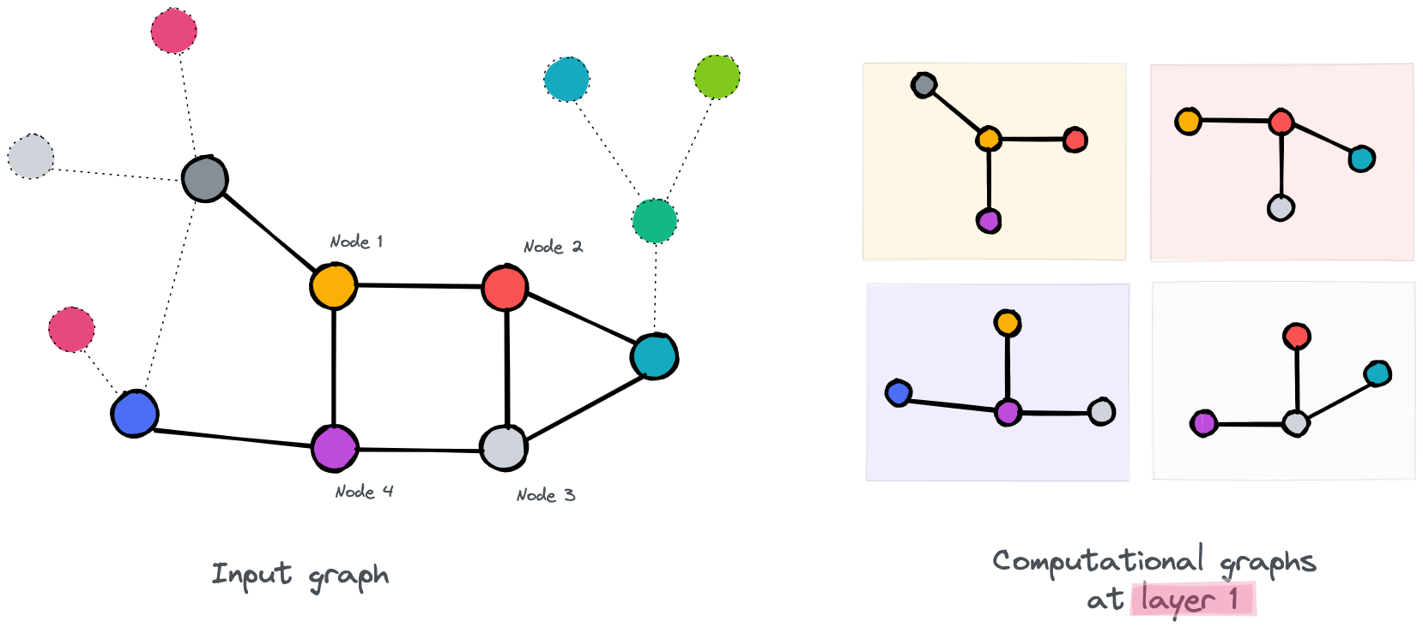
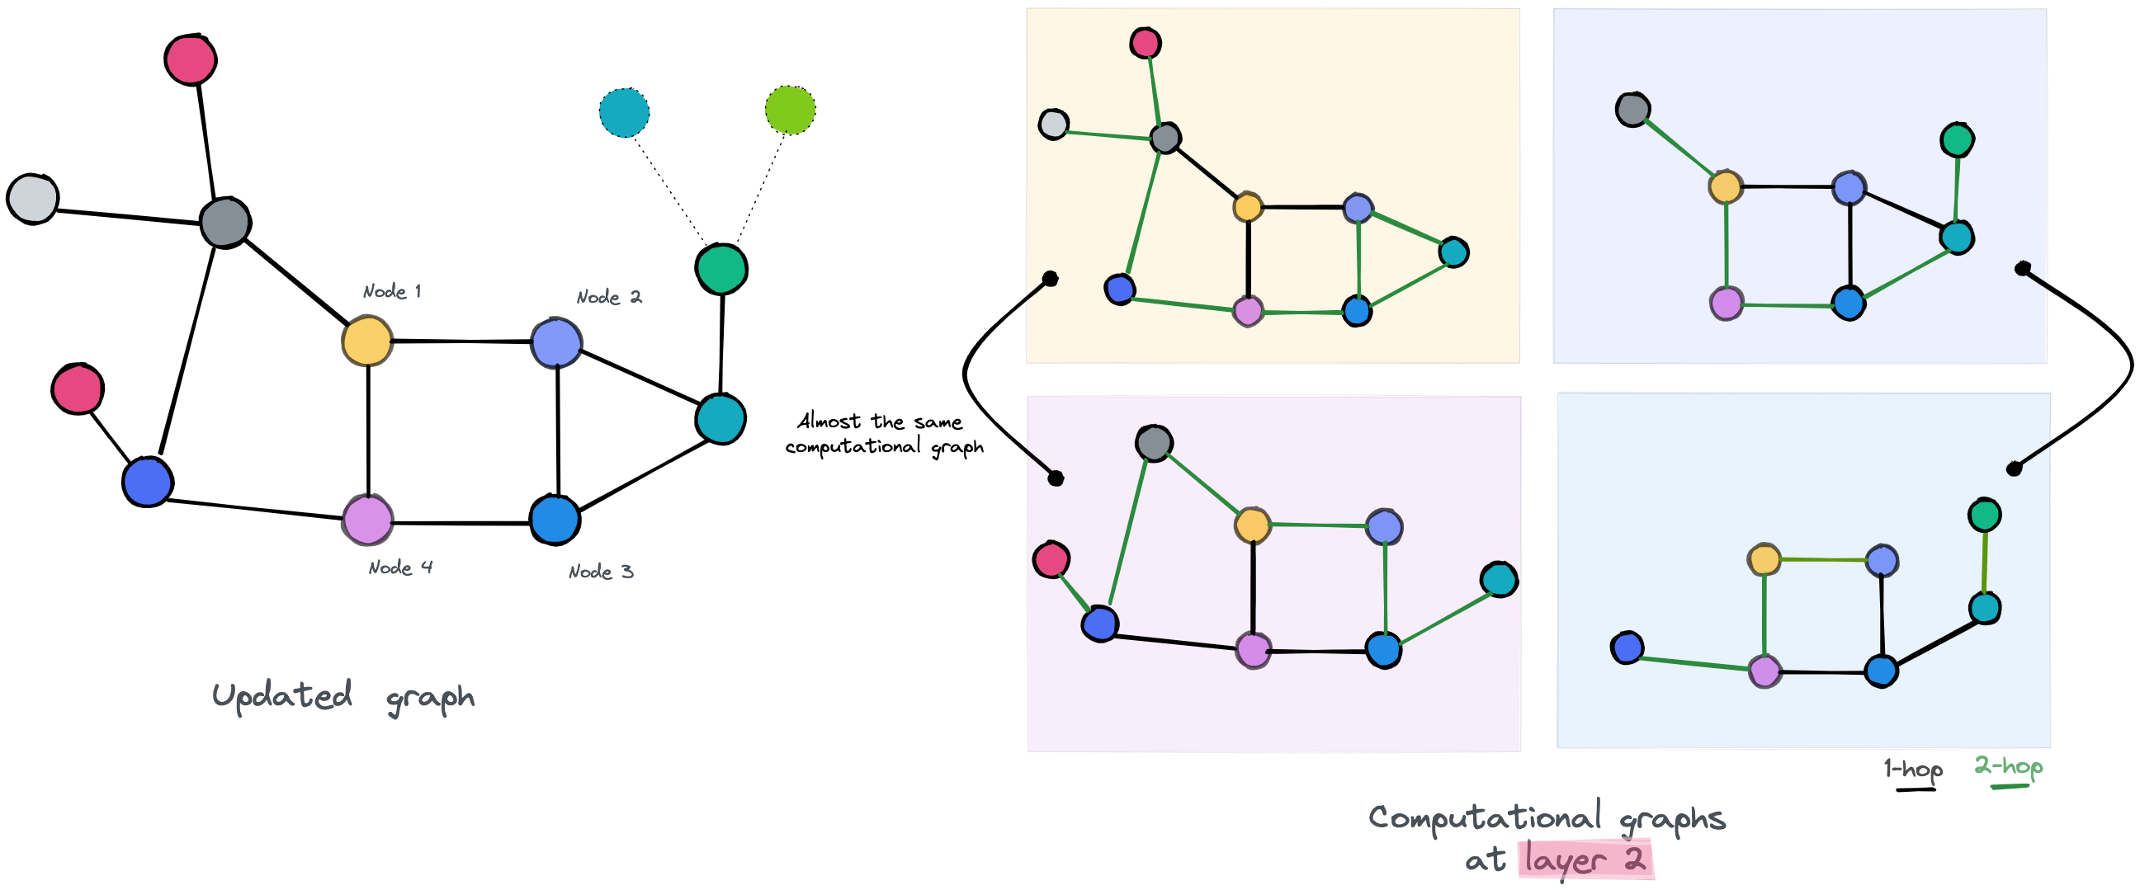
Standard GCN Bottlenecks
1 pass: Looking at directly connected neighbors
2 pass: Looking at 2 connected neighbors
Source: Over smoothing issue in graph neural network

Slide 6
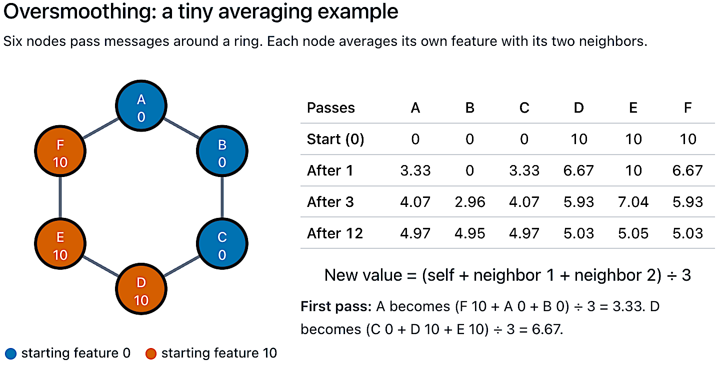
After first pass
A = (A:0 + B:0 + F:10) / 3 = 3.3
D = (D:10 + C:0 + E:10)/3 = 6.67

Slide 7
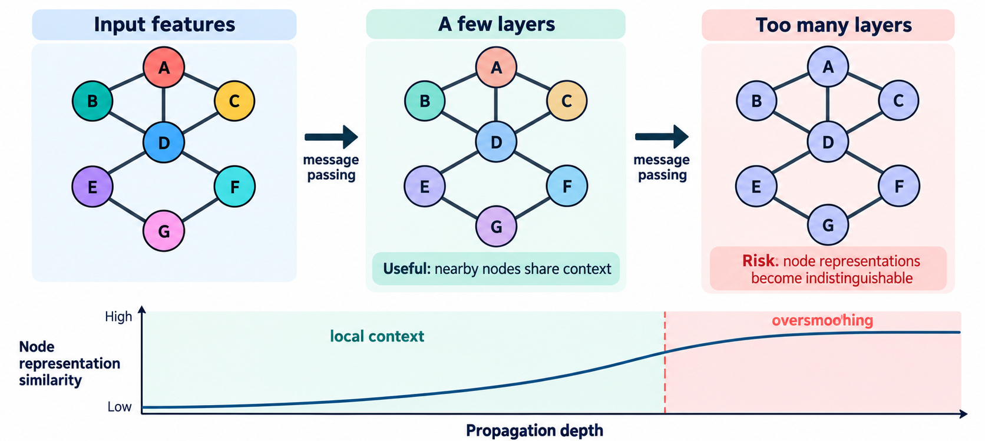
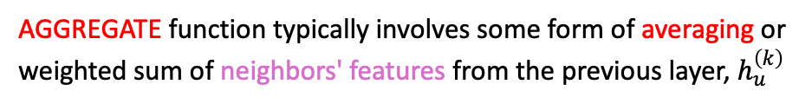
Standard GCN Bottlenecks
$$h_{v}^{\left(k+1\right)}=σ\left({\text{UPDATE}}^{\left(k\right)}\left(h_{v}^{\left(k\right)} , {\text{AGGREGATE}}^{\left(k\right)}\left(\left\{h_{u}^{\left(k\right)}:u∈𝒩\left(v\right)\right\}\right)\right)\right)$$
AGGREGATE function typically involves some form of averaging or weighted sum of neighbors' features from the previous layer, $h_{u}^{\left(k\right)}$
Source: apxml.com/courses/graph-neural-networks-gnns
Notes:
Oversmoothing is an inherent consequence of the standard message-passing mechanism employed by many GNNs. Recall the basic update rule for a node $v$ at layer $k+1$:
$$h_{v}^{\left(k+1\right)}=σ\left({\text{UPDATE}}^{\left(k\right)}\left(h_{v}^{\left(k\right)} , {\text{AGGREGATE}}^{\left(k\right)}\left(\left\{h_{u}^{\left(k\right)}:u∈𝒩\left(v\right)\right\}\right)\right)\right)$$
The AGGREGATE function typically involves some form of averaging or weighted sum of neighbors' features from the previous layer, $h_{u}^{\left(k\right)}$. For instance, in a simplified Graph Convolutional Network (GCN) layer, the aggregation can be seen as applying a normalized adjacency matrix $A_{norm}$ (like $D^{−1/2}AD^{−1/2}$) to the feature matrix $H^{\left(k\right)}$:
$$H^{\left(k+1\right)}=σ\left(A_{norm}H^{\left(k\right)}W^{\left(k\right)}\right)$$
This operation effectively averages the features of a node with those of its neighbors. When this averaging process is repeated over many layers ($k→∞$), the features of nodes within the same connected component tend to converge. Intuitively, each propagation step mixes the features of adjacent nodes. After $k$ steps, a node's representation becomes influenced by nodes up to $k$ hops away. As $k$ increases, the receptive field of each node expands to potentially cover a large portion, or even all, of its connected component. This repeated local averaging acts like a low-pass filter on the graph signal (node features), smoothing out the variations between nodes.

Slide 8
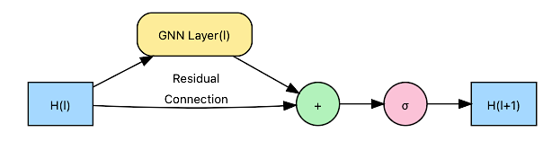
Standard GCN Bottlenecks
The Fix: Residual Connections
$$h_{v}^{\left(k+1\right)}=σ\left({\text{UPDATE}}^{\left(k\right)}\left(h_{v}^{\left(k\right)} , {\text{AGGREGATE}}^{\left(k\right)}\left(\left\{h_{u}^{\left(k\right)}:u∈𝒩\left(v\right)\right\}\right)\right)\right)$$
$$H^{\left(l+1\right)}=σ\left({\text{UPDATE}}^{\left(l\right)}\left(H^{\left(l\right)} , {\text{AGGREGATE}}^{\left(l\right)}\left(\left\{H_{u}^{\left(l\right)}:u∈𝒩\left(v\right)∪\left\{v\right\}\right\}\right)\right)+H^{\left(l\right)}\right)$$
Retains some of the information from the previous layer
Very deep models can still eventually smooth out
Source: apxml.com/courses/graph-neural-networks-gnns
Source: apxml.com/courses/graph-neural-networks-gnns
Notes:
A diagram illustrating a residual connection in a GNN layer. The input $H^{\left(l\right)}$ is fed directly into the addition operation alongside the output of the main GNN transformation.
The core idea is to add the input representation of a layer, $H^{\left(l\right)}$, to its output before the activation function.
For a generic GNN layer performing aggregation and update, the operation becomes:
$$H^{\left(l+1\right)}=σ\left({\text{UPDATE}}^{\left(l\right)}\left(H^{\left(l\right)} , {\text{AGGREGATE}}^{\left(l\right)}\left(\left\{H_{u}^{\left(l\right)}:u∈𝒩\left(v\right)∪\left\{v\right\}\right\}\right)\right)+H^{\left(l\right)}\right)$$

Slide 9
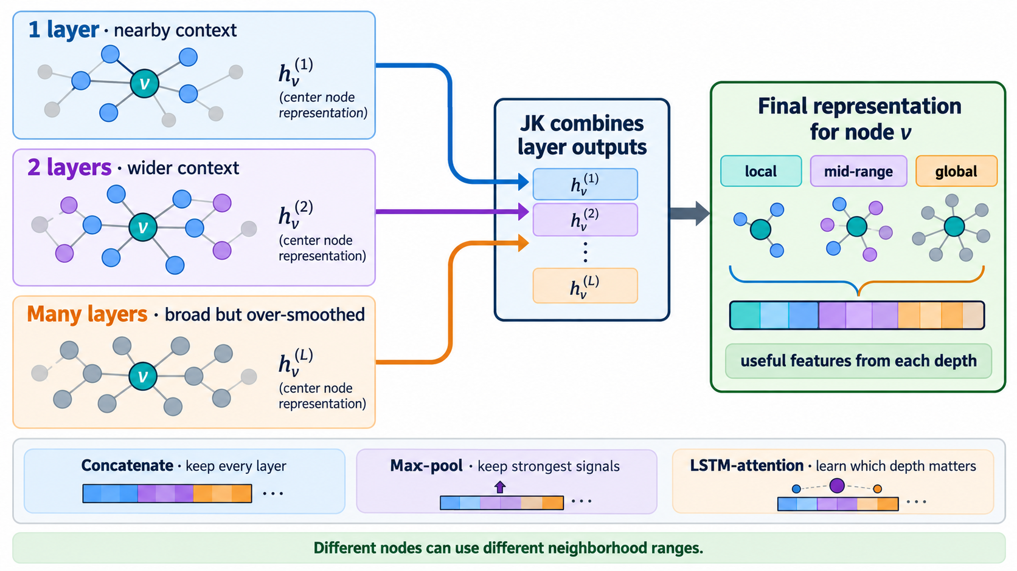
Standard GCN Bottlenecks
The Fix: Jumping Knowledge
Notes:
Layer-Wise Neighborhood Depth:
1 Layer ($h_{v}^{\left(1\right)}$): Captures immediate, local context (1-hop neighbors).
2 Layers ($h_{v}^{\left(2\right)}$): Captures wider, mid-range context (2-hop neighbors).
Many Layers ($h_{v}^{\left(L\right)}$): Captures global context across the graph, while explicitly noting the tradeoff—deep message passing risks becoming over-smoothed.
Aggregation Across Depths:
It highlights that JK-Net collects intermediate representations $h_{v}^{\left(1\right)},h_{v}^{\left(2\right)},…,h_{v}^{\left(L\right)}$ from alllayers rather than relying solely on the final layer $h_{v}^{\left(L\right)}$.
Core Aggregation Strategies (Bottom Section):
Concatenation: Preserves features from every depth by stacking vectors.
Max-Pooling: Selects the strongest feature signals across depths.
LSTM / Attention: Learns layer-wise weights to dynamically emphasize whichever depth is most relevant for a given task.

Slide 10
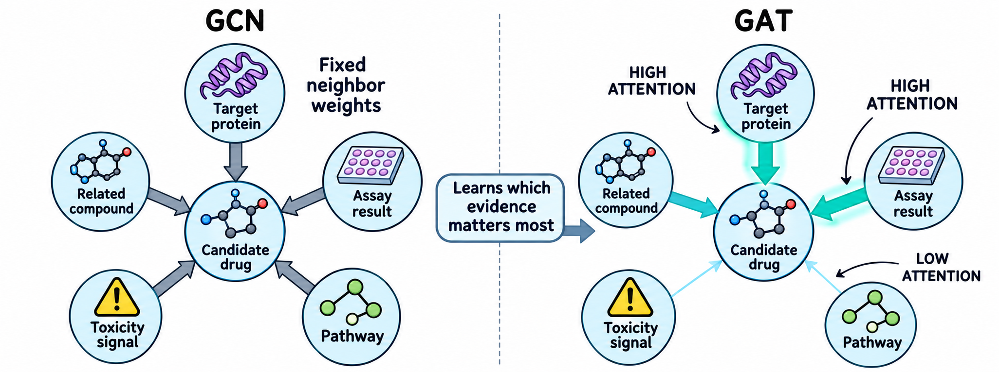
Standard GCN Bottlenecks
GAN was taken by Generative Adversarial Networks
The Fix: Attention
Let’s understand Graph Attention Networks (GATs)
GCNs treat all neighbors with uniform importance
GATs: Allow nodes to assign different levels of importance, or attention, to different nodes within their neighborhood during the aggregation
Notes:
Drug discovery question: Given a candidate drug and its connected evidence—such as target proteins, assay results, related compounds, toxicity signals, and pathways—which evidence should the model use most to predict whether the candidate is promising?

Slide 11
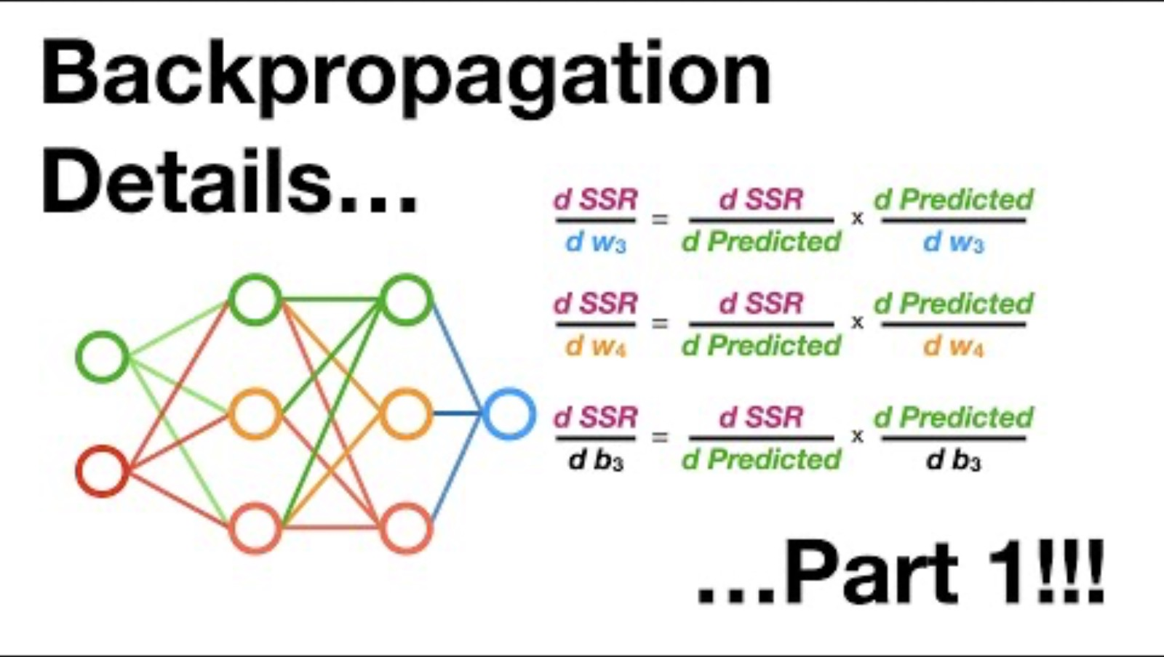
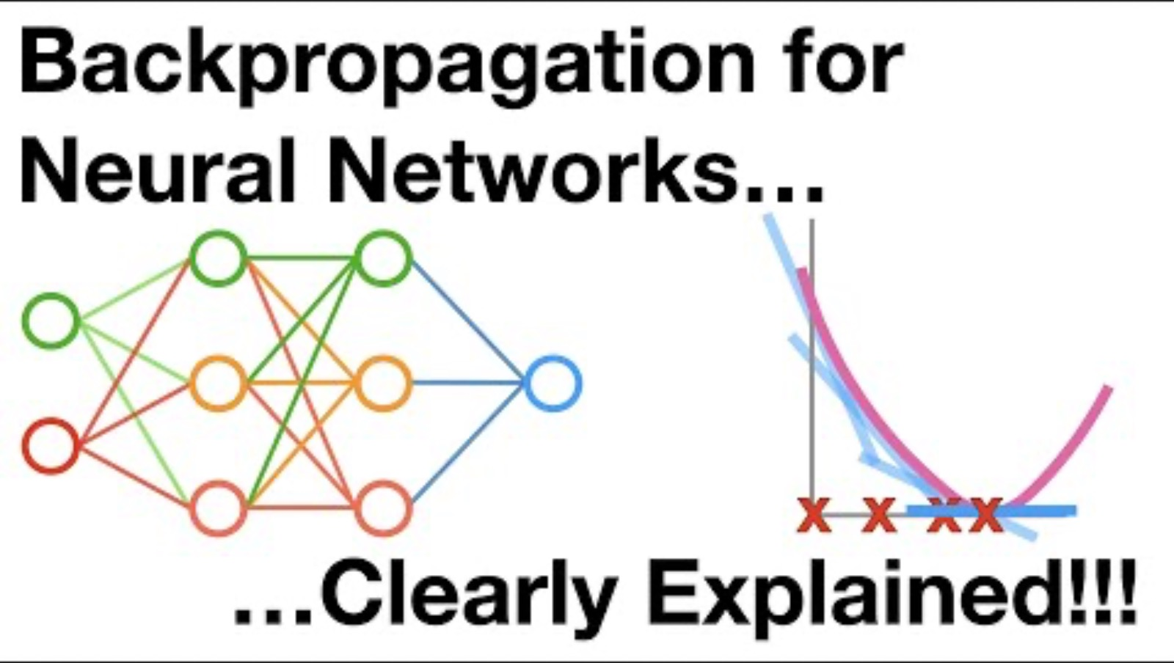
What is attention & how to calculate it?
Backpropagation
algorithm that trains neural networks by reducing prediction error
Make a prediction
Compare it with the correct answer
Send the error backward through the network
Adjust the weights
Try again
Let’s do a quick example
https://www.geeksforgeeks.org/machine-learning/backpropagation-in-neural-network
https://developers.google.com/machine-learning/crash-course/neural-networks/interactive-exercises
Resources:

Slide 12
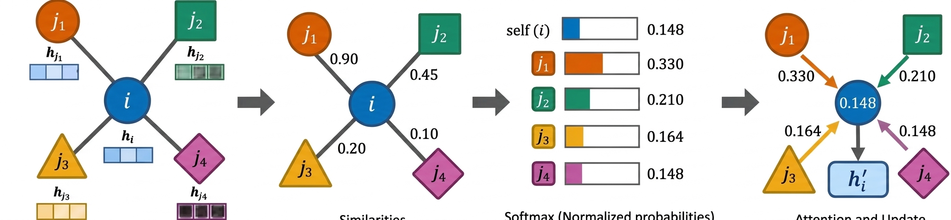
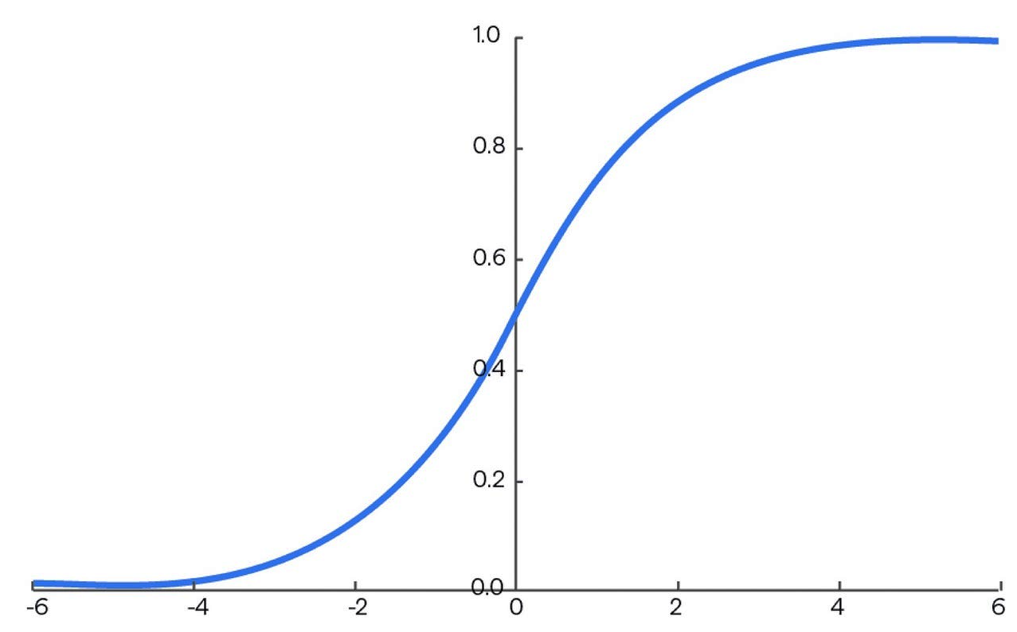
Graph Attention Networks (GATs)
Node features are transformed with learned weights
Attention computed based on the importance of each neighbor
Aggregation: weighted sum of neighbors to get updated features
Softmax to convert raw attention to attention which sum to 1

Slide 13
Let us see GATs in action

