Slide 1
NOAA CFS data analysis architecture
Giuseppe Tallini

Slide 2
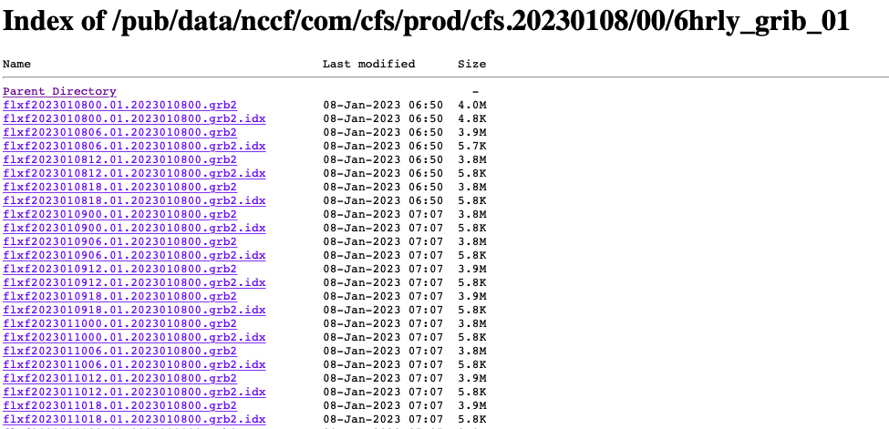
What does the data look like?
GRIB format
Divided into chunks
Several models in same folder
Multidimensional arrays

Slide 3
User requirements
Data Science team
data lake (raw) – access to entire archive once a month in 3hrs transfer time
data lake (processed) – slices of 7 days of predictions
Backend team
data lake (processed) – full prediction at 1000 locations within same 15deg slice of longitudes, JSON, every 1hr in 2 min transfer time
data lake (processed) – one full prediction of 1 location, JSON format 100 times per hour, 2 second limit

Slide 4
Serverless computing
Low cost
Pay-as-you-go model lets us separate compute from storage and keep infra for spark jobs up only as long as we need it
Flexible
Separation of concerns makes adding new components less complicated
Scalable
scale horizontally for more models to process with similar requirement
Scale vertically for changes in the size of input (e.g. larger binary chunks)
Green!

Slide 5
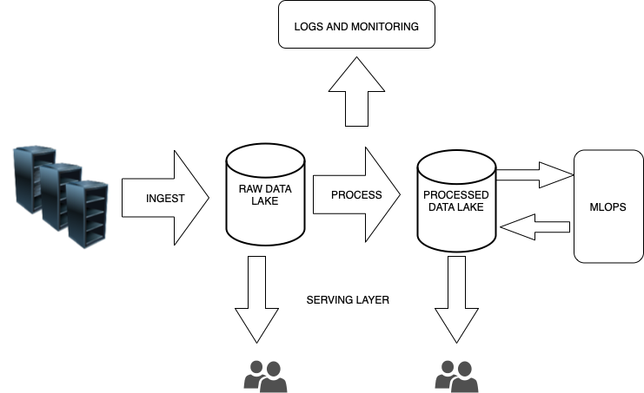
Pipeline overview

Slide 6
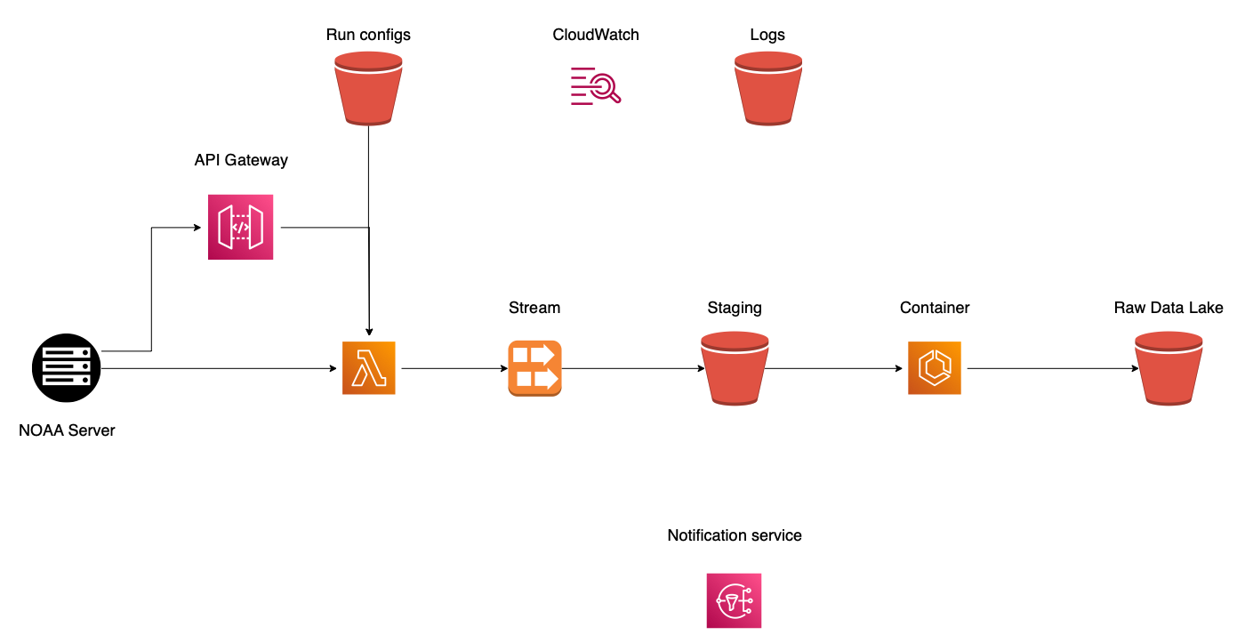
Ingestion

Slide 7
Ingestion
1. Webhook triggered when new root URL published

Slide 8
Ingestion
1. Webhook triggered when new root URL published
2. Lambda pushes individual GRIB files into stream

Slide 9
Ingestion
1. Webhook triggered when new root URL published
3. Kinesis dumps chunks into raw staging area
2. Lambda pushes individual GRIB files into stream

Slide 10
Ingestion
1. Webhook triggered when new root URL published
3. Kinesis dumps chunks into raw staging area
2. Lambda pushes individual GRIB files into stream
4.1 Perform data validation on grib data in staging area

Slide 11
Ingestion
1. Webhook triggered when new root URL published
3. Kinesis dumps chunks into raw staging area
2. Lambda pushes individual GRIB files into stream
4.1 Perform data validation on grib data in staging area
4.2 Clean data and save it to the raw data lake

Slide 12
Data lake storage format – zarr
Zarr
Chunk-based retrieval
Distributed computing
Flexibility with n-dimensional arrays
Optimize chunk sizes for different uses/lookups
Parquet
Similar compression benefits to zarr
Custom setup/partitioning for models with different levels
Slow random lookup

Slide 13
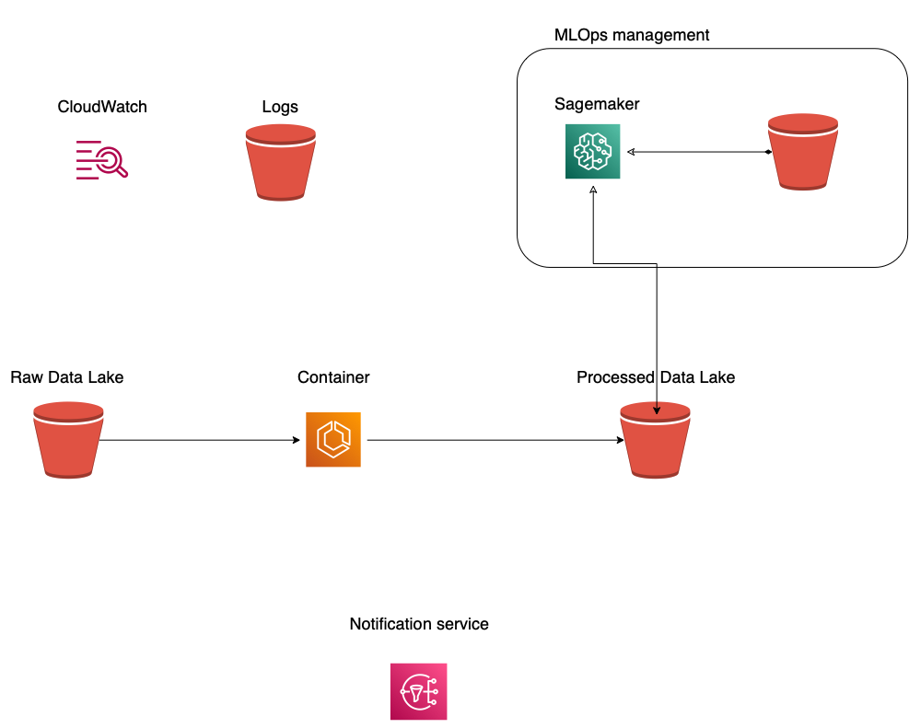
ML

Slide 14
ML
1. EMR container prepares data for ML processing

Slide 15
ML
2. Use MLOps infra for
Model CICD/registry
Metadata store
Data versioning
1. EMR container prepares data for ML processing

Slide 16
ML
2. Use MLOps infra for
Model CICD/registry
Metadata store
Data versioning
3. Model run containers run ML models on processed data
1. EMR container prepares data for ML processing

Slide 17
ML
2. Use MLOps infra for
Model CICD/registry
Metadata store
Data versioning
3. Model run containers run ML models on processed data
4. Model check containers run summary statistics on run output and check
1. EMR container prepares data for ML processing

Slide 18
Serving layer
Provide API for users to request data
Launch compute instance to aggregate slices of data
Use bulk transfer for monthly archive transfer operations

Slide 19
Common libraries
Run config/data definition
Data cleaning in ingest
Handle grib files (open with xarray, convert to zarr)
Validations
Checksums
Sanity checks (data types match, dimensions match for each model)
Quality checks (summary statistics, value ranges)
Check ETL run logs
For checking summary statistics in quality checks
Connector to datalake for access of zarr files
Fsspec, xarray, dask

Slide 20
Common libraries
ML run utils
pipeline objects
Model config access
log/monitoring app connector
output summary statistics to run logs
ML check utils
access model summary stats

