Slide 1
Advanced Web Hacking
  Petko D. Petkov
  Senior IT Security Consultant
  pdp@gnucitizen.org

Slide 2


Powered by...

Slide 3
Clarifications!!!
Not everything is in the slides!
The subject is quite big!
Talk to me after the presentation!
Check the references!

Slide 4
Topics to Discuss
Introductive
  Web Security since 2005
  The State of JavaScript Hacking
Main
  Web Security 2007
    Web Exploits
    Security Mashups
    Worms and Bots

Slide 5
Web Security since 2005
They have always been with us
  XSS
  CSRF
Browser Port Scanners
CSS History Stealers
Application State Scanners
Inter-protocol Communication Techniques
Same Origin Policy Unification Techniques
JIKTO – browser based security scanner

Slide 6
The State of JavaScript Hacking
JavaScript is a GLUE Technology
  Web Pages
  Adobe Products
  WSCRIPT and CSCRIPT
  Mobile Devices
One Language to Rule Them All
  Cross-site scripting
  Cross-zone scripting

Slide 7
Web Security 2007
Web Exploits
Security Mashups
Worms and Botnets

Slide 8
Web Exploits
The need for web exploits
  for testing purposes
  for demonstration purposes
  non-exploitative web app testing does not exist
    How to test for SQL Injection without exploiting the application?
    How to test for Cross-site scripting without exploiting the application?
    My name is O‘Neill.

Slide 9
Web Exploits
Hundreds of them available online already!
  Milw0rm
  Full-disclosure
Who is going to unify them?
  Exploit Environments
    Metasploit
      good but limiting
    The Browser
      probably what we want

Slide 10
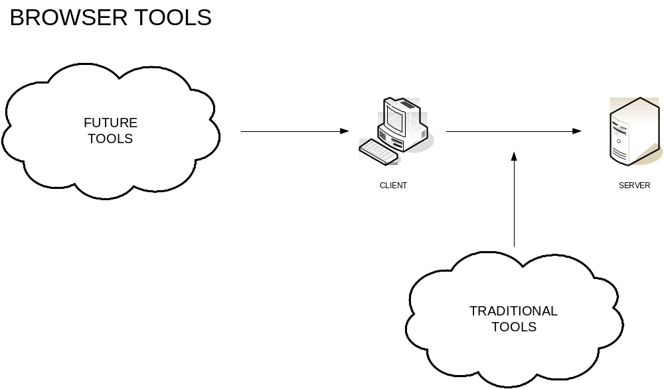
Web Exploits
The browser as exploit development framework

Slide 11
Web Exploits
Pragmatics
  Code
Semantics
  Database
  Services
All together
  Mashup

Slide 12
Security Mashups
A Mashup is…
  a website or application that combines content from more than one source into an integrated experience. Wikipedia
  largely based on online services and APIs.
  a way to circumvent various browser limitations.

Slide 13
Security Mashups
Technology
  XML – it all started with that
  XMLRPC – unifies the data structure
  SOAP – defines the transportation mechanism
  JSON – plays nice with browsers
Benefits
  Distributed Knowledge
  Distributed Processing Power

Slide 14
Security Mashups
A Security Mashup is…
  a way to create largely distributed testing infrastructures.
  a mechanism for instantly accruing dynamic knowledge.
  a mechanism that has a lot of potential for bad purposes.
  a way to bypass the Same Origin Policies to an extend.

Slide 15
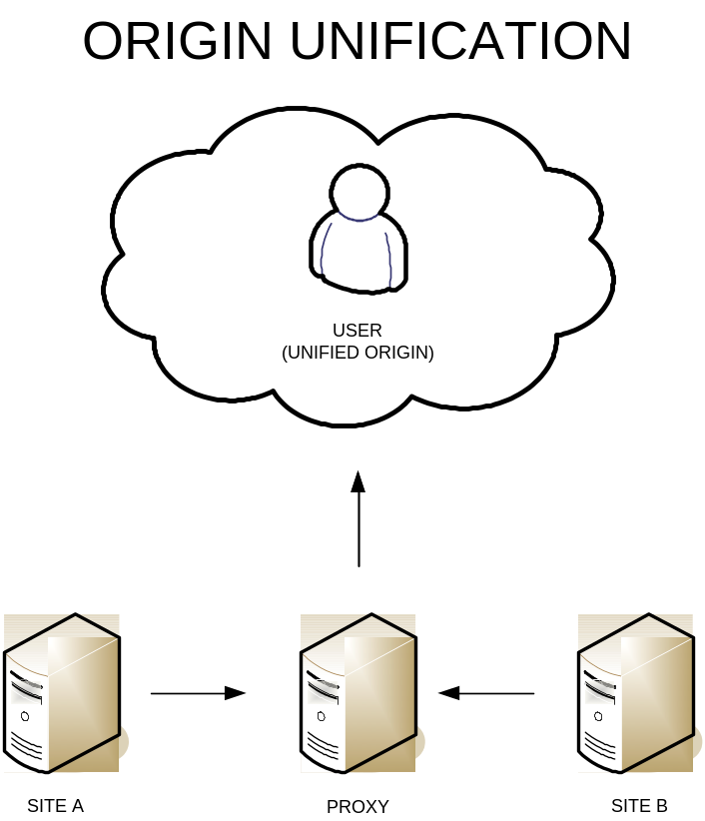
Security Mashups
Origin Unification with Proxies

Slide 16
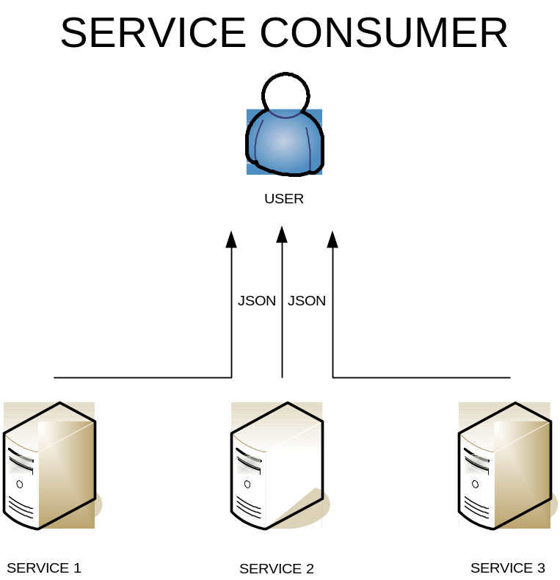
Security Mashups
Origin Unification with Services
  we are interested in the data not the data retrieving mechanism

Slide 17
Security Mashups
APIs
  Google
    AJAX Search API – search API
    AJAX Feed API – RSS feed API
  Yahoo
    Pipes – mashup power tool
  Dapper
    Dapper – screen scraping tool

Slide 18
Security Mashups
Services
  DIGG
    DIGG – user powered content
  TinyURL
    TinyURL – URL/data storage service

Slide 19
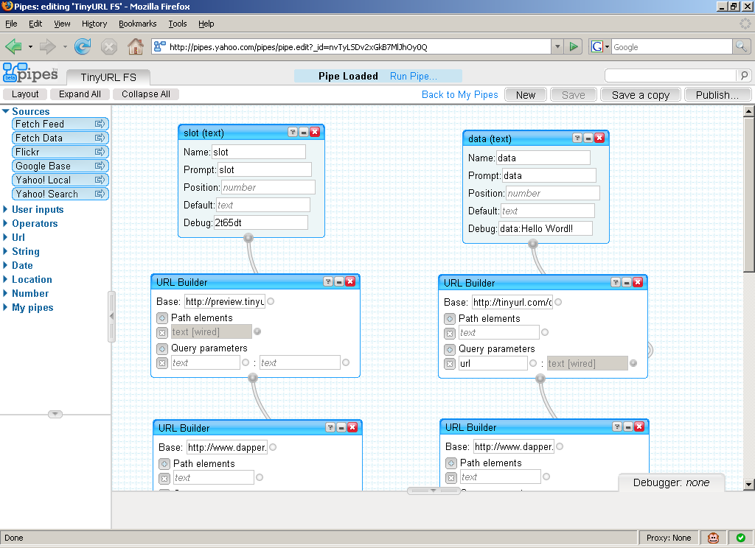
Security Mashups
Yahoo Pipes TinyURL FS

Slide 20
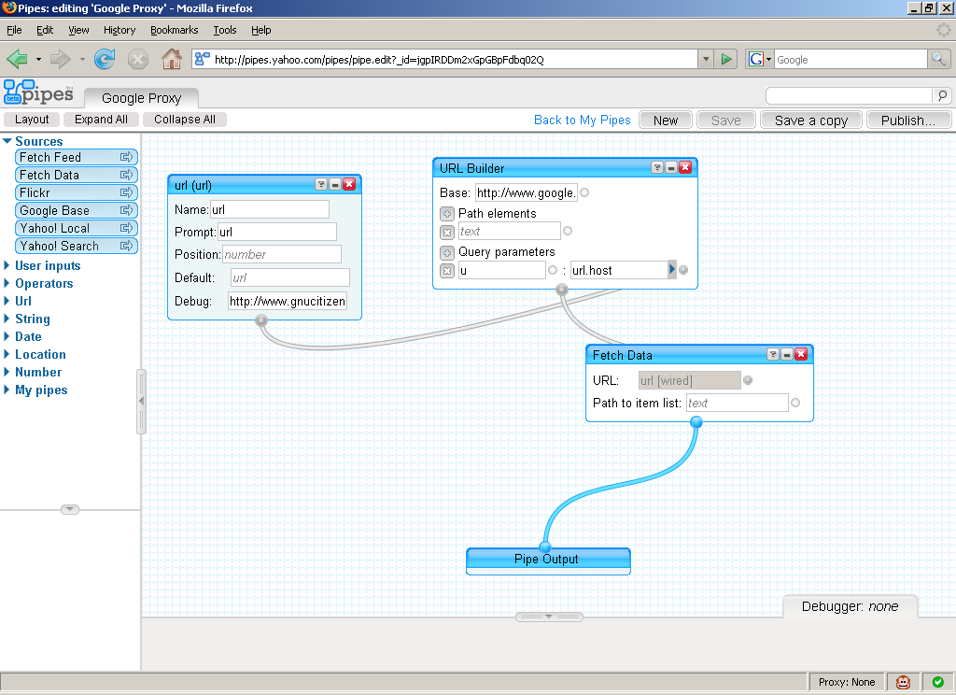
Security Mashups
Yahoo Pipes Google Proxy

Slide 21
Security Mashups
JIKTO in a lot less lines of code
  function handleData(d) {
  for (var i d.items)
  ypipeProxy(target + d.items[i]);
  }
  function handleYPipeProxy(d) {
  // read the data from here
  }
JavaScript on demand (aka JSON) in YPipes
  http://pipes.yahoo.com/pipes/pipe.run?_id=nvTyLSDv2xGkB7MlJhOy0Q&_run=1&_render=json&_callback=handleYPipeProxy&url=http%3A//example.com

Slide 22
Security Mashups
JavaScript Spider
  quite stable
  function spider(url, callback, conf) {
  var conf = (conf != undefined)?conf:{};
  conf.pipe = (conf.pipe != undefined)?conf.pipe:'lruY6uXk2xGdxK66l7okhQ';
  conf.depth = (conf.depth != undefined)?conf.depth:3;
  function walkJSON(j, c) {
  if (typeof(c) != 'function') {
  return;
  …

Slide 23
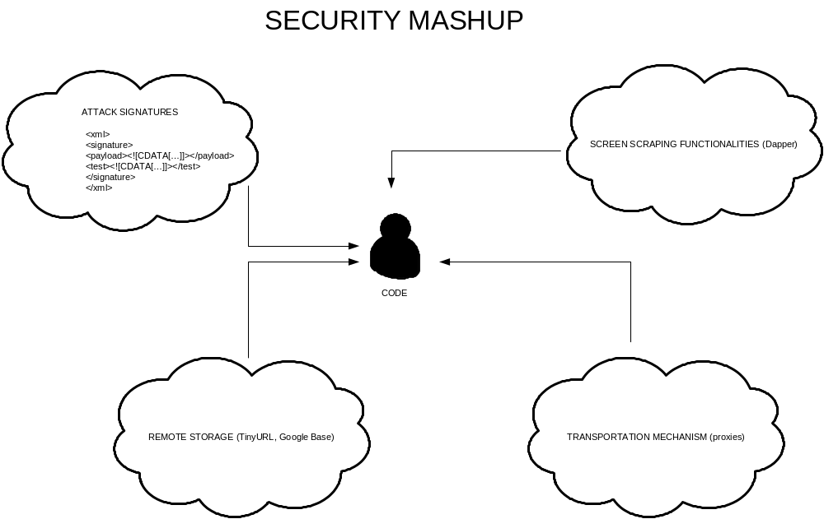
Security Mashups
Malicious code and security testing tools

Slide 24
Security Mashups
Possibilities are endless!
Time for a demo!

Slide 25
Worms and Bots
No hosting required
Totally distributed
Dynamically managed
Impossible to fight against
  Do you have any ideas?
  How shall we handle this problem?

Slide 26
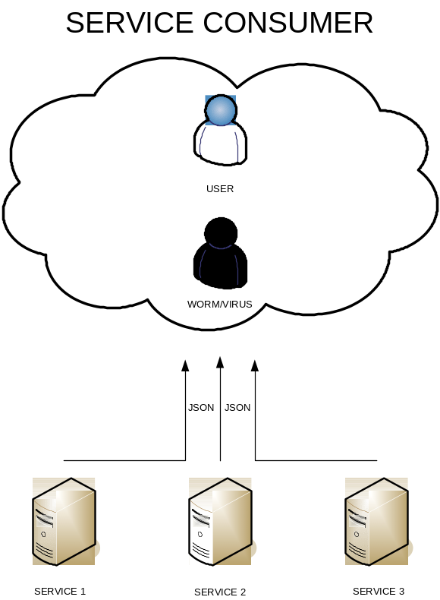
Worms and Bots
Worms and Bots look like normal Web applications
  JavaScript malware is too dynamic to be handled by signatures

Slide 27
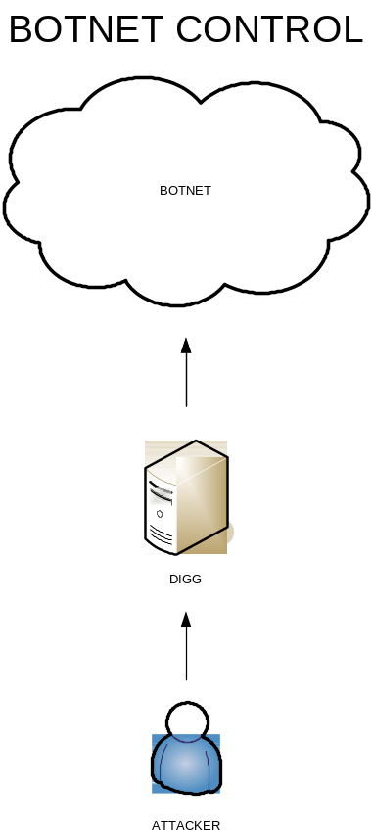
Worms and Bots
Controlling Botnets through DIGG

Slide 28
Worms and Bots
Where does this leave us?
  Even experts can’t tell.
What shell we do?
  Improve community awareness.
Will we see 2NG Sammy?
  It is inevitable.
How to protect against?
  Be very conscious with your Web Activities.

Slide 29
References
GNUCITIZEN
  http://www.gnucitizen.org
  http://www.gnucitizen.org/projects/6th-owasp-conference
Yahoo Pipes
  http://pipes.yahoo.com
Google APIs
  http://code.google.com
Dapper
  http://www.dapper.net

Slide 30

Questions?
Win a book.
Share your thoughts.

