Slide 1
http://www.gnucitizen.org

Slide 2
Before We Begin
Feel free to ask questions!
Do ask questions!
Embrace the mindset rather then the tech!
Have Fun!

Slide 3
CLIENT vs. SERVER

Slide 4
Server-side Issues
Occurs on the Server!
Compromises the business logic!
Compromises the data!
Compromises the user!
More severe!
Less likely to occur!
Less agile!

Slide 5
Client-side Issues
Occurs on the Client
Compromises the client-side business logic!
Compromises the client-side data!
Compromises the user!
Less severe! (individual cases)
More likely to occur!
More agile!

Slide 6
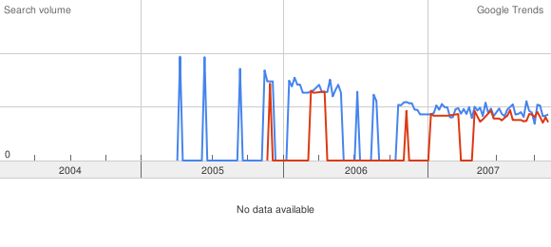
Trends
server-side client-side

Slide 7
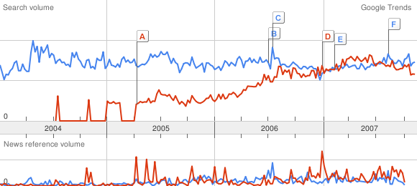
Trends
sql injection xss

Slide 8
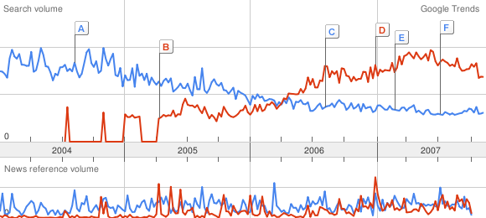
Trends
buffer overflow xss

Slide 9
TYPES OF ISSUES

Slide 10
CSRF (Cross-site Request Forgery)
Affects unprotected requests!
Affects both GET and POST!
JavaScript is not required!
Can fire from images!
Can fire from hot-linked resources!
Huge impact!
Easy to perform!
Hard to detect!

Slide 11
XSS (Cross-site Scripting)
Affects user supplied input!
Can perform any request to the server!
JavaScript is not required but often used!
Can fire from anything!
Enormous impact!
Often easy to perform!
50% of the attacks are easy to detect!
The other half are undetectable (so far)!

Slide 12
Cross-origin Scripting
Similar to Cross-site Scripting!
Affects the Client and its origins!
Relies on Client-side bugs or design issues!
JavaScript is required!
Compromises the security of the entire client!
Very hard to detect! (executes on the client)

Slide 13
Design Issues
Session Theft
CSS History Stealing
Browser Portscanning
State Scanning
Cross-origin communication (flash, java)
Local files Theft
DNS Rebinding
etc...

Slide 14
Client-side BUGS
Forgeries
Overflows
Scripting

Slide 15
LATEST DEVELOPMENTS

Slide 16
Modern Web Client Issues
XSS in Flash
Scripting in PDF
Java origin access abuse
  Trust problems
  Origin access problems
ActiveX controllers abuse
DNS Rebinding
Browser Bugs

Slide 17
WEB2.0 CONCERNS

Slide 18
Web2.0 Characteristics
Socially Oriented
User-supplied Content
Dynamic
Huge infrastructures
Integrated/tangled

Slide 19

Freebies

Slide 20
Q&A

Slide 21
THANK YOU

