Slide 1
Teams: 18x Tables
Organizer: 3x Tables
Area Length: 30 m
Length: 1.8 m
Track length: 20m
Area Width: 10 m
Track width: 7.9m
Example Racetrack
Length: 2.4m
Lane width: 1.2m

Slide 2
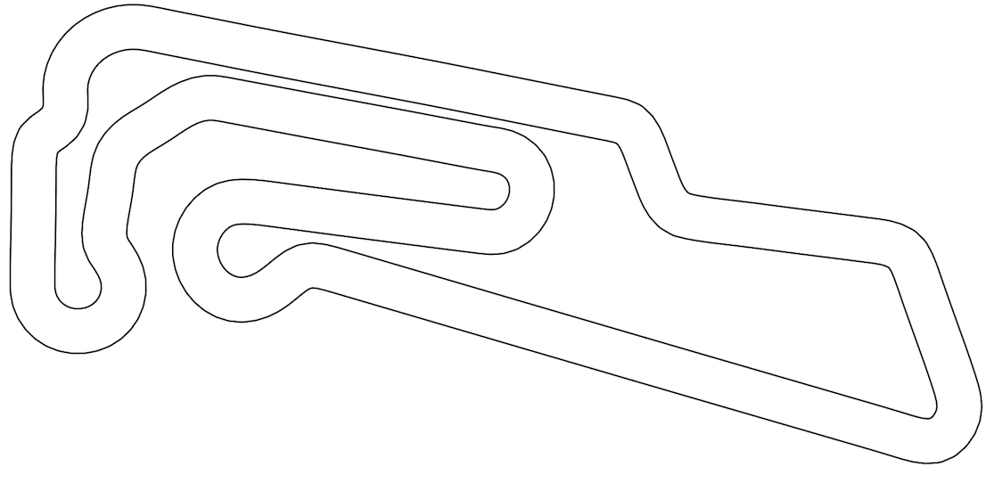
TV/Projector + Screen
72x Gray Stack Chairs (18”w x 18”d)
Teams: 20x Tables (6’ x 18” Classroom Table)
F1TENTH car
Area Length: 30m
Organizer: 3x Tables (8’ x 30” Standard Table)
Length: 1.8 m
Area Width: 10m
Length: 2.4m

Slide 3
F1TENTH car
Teams: 20x Tables (6’ x 18” Classroom Table)
Organizer: 3x Tables (8’ x 30” Standard Table)
72x Gray Stack Chairs (18”w x 18”d)
Area Length: 98’
TV/Projector + Screen
Area Width: 32.’

Slide 4
F1TENTH car
Teams: 32x Tables (6’ x 18” Classroom Table)
Organizer: 3x Tables (8’ x 30” Standard Table)
108x Gray Stack Chairs (18”w x 18”d)
Area Length: 98’
TV/Projector + Screen
Area Width: 32.’

Slide 5
Area Length: 98’
Area Width: 32.’

