Slide 1
INDEXING
Jehan-François Pâris
Spring 2015

Slide 2
Overview
Three main techniques
  Conventional indexes
    Think of a page table, …
  B and B+ trees
    Perform better when records are constantly added or deleted
  Hashing

Slide 3
Conventional indexes

Slide 4
Indexes
A database index is a data structure that improves the speed of data retrieval operations on a database table at the cost of additional writes and storage space to maintain the index data structure.
Wikipedia

Slide 5
Types of indexes
An index can be
  Sparse
    One entry per data block
    Identifies the first record of the block
    Requires data to be sorted
  Dense
    One entry per record
    Data do not have to be sorted

Slide 6
Respective advantages
Sparse
    Occupy much less space
    Can keep more of it in main memory
      Faster access
  Dense
    Can tell if a given record exists without accessing the file
    Do not require data to be sorted

Slide 7
Indexes based on primary keys
Each key value corresponds to a specific record
Two cases to consider:
  Table is sorted on its primary key
    Can use a sparse index
  Table is either non-sorted or sorted on another field
    Must use a dense index

Slide 8
Sparse Index
Alan
.
Ahmed
…
…
Dana
.
Amita
…
…
Gina
.
Brenda
…
…
Carlos
…
…
Dana
…
…
Dino
…
…
Emily
…
…
Frank
…
…

Slide 9
Dense Index
Ahmed
Ahmed
…
…
Amita
Frank
…
…
Brenda
Brenda
…
…
Carlos
Dana
…
…
Dana
Dino
Emily
…
…
Emily
Dino
…
…
Frank
Carlos
…
…
Amita
…
…

Slide 10
Indexes based on other fields
Each key value may correspond to more than one record
  clustering index
Two cases to consider:
  Table is sorted on the field
    Can use a sparse index
  Table is either non-sorted or sorted on another field
    Must use a dense index

Slide 11
Sparse clustering index
Austin
.
Ahmed
Austin
…
Dallas
.
Frank
Austin
…
Laredo
.
Brenda
Austin
…
Dana
Dallas
…
Emily
Dallas
…
Dino
Dallas
…
Carlos
Laredo
…
Amita
Laredo
…

Slide 12
Dense clustering index
Austin
Ahmed
Austin
…
Austin
Amita
Laredo
…
Austin
Brenda
Austin
…
Dallas
Carlos
Laredo
…
Dallas
Dallas
Dana
Dallas
…
Laredo
Dino
Dallas
…
Laredo
Emily
Dallas
…
Frank
Austin
…

Slide 13
Another realization
Austin
Ahmed
Austin
…
Dallas
.
Amita
Laredo
…
Laredo
.
Brenda
Austin
…
Carlos
Laredo
…
Dana
Dallas
…
We save space
and add one extra
level of indirection
Dino
Dallas
…
Emily
Dallas
…
Frank
Austin
…

Slide 14
A side comment
"We can solve any problem by introducing an extra level of indirection, except of course for the problem of too many indirections."
David John Wheeler

Slide 15
Indexing the index
When index is very large, it makes sense to index the index
  Two-level or three-level index
  Index at top level is called master index
    Normally a sparse index

Slide 16
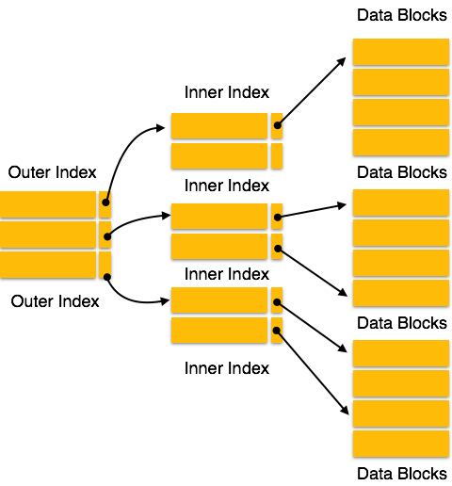
Two levels
AKA
Master Index
Top Index

Slide 17
Updating indexed tables
Can be painful
  No silver bullet

Slide 18
B-trees and B+ trees

Slide 19
Motivation
To have dynamic indexing structures that can evolve when records are added and deleted
  Not the case for static indexes
    Would have to be completely rebuilt
Optimized for searches on block devices
Both B trees and B+ trees are not binary
  Objective is to increase branching factor (degree or fan-out) to reduce the number of device accesses

Slide 20
Binary vs. higher-order tree
Binary trees:
  Designed for in-memory searches
  Try to minimize the number of memory accesses
Higher-order trees:
  Designed for searching data on block devices
  Try to minimize the number of device accesses
    Searching within a block is cheap!

Slide 21
B trees
Generalization of binary search trees
  Not binary trees
  The B stands for Bayer (or Boeing)
Designed for searching data stored on block-oriented devices

Slide 22
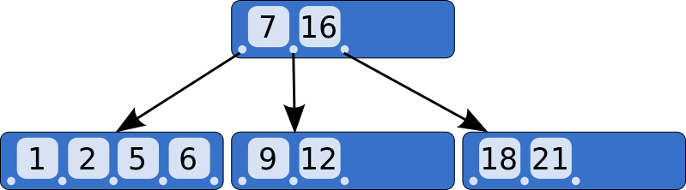
A very small B tree
Bottom nodes are leaf nodes: all their pointers are NULL

Slide 23
In reality
In
tree
ptr
Key
In
tree
ptr
Key
In
tree
ptr
Key
In
tree
ptr
Key
In
tree
ptr
Data ptr
Data ptr
Data ptr
Data ptr
To
Leaf
7
To
leaf
16
To
Leaf
--
Null
--
Null
Null
Null

Slide 24
Organization
Each non-terminal node can have a variable number of child nodes
  Must all be in a specific key range
  Number of child nodes typically vary between d and 2d
    Will split nodes that would otherwise have contained 2d + 1 child nodes
    Will merge nodes that contain less than d child nodes

Slide 25
Searching the tree
keys < 7
keys > 16
7 < keys < 16

Slide 26
Balancing B trees
Objective is to ensure that all terminals nodes be at the same depth

Slide 27
Insertions
Assume a tree where each node can contain three pointers (non represented)
Step 1:
Step 2:
Step 3:
  Split node in middle
1
1
2
1
2
3
2
1
3

Slide 28
Insertions
Step 4:
Step 5:
  Split
  Move up
2
1
3
4
2
1
3
4
5
2
4
1
3
5

Slide 29
Insertions
Step 6:
Step 7:
2
4
1
3
5
6
2
4
1
3
5
6
7

Slide 30
Step 7 continued
2
4
  Split
  Promote
1
3
6
5
7
2
4
6
1
3
5
7

Slide 31
Step 7 continued
Split after
the promotion
2
4
6
1
3
5
7
4
2
6
1
3
5
7

Slide 32
Two basic operations
5
6
7
Split:
  When trying to add to a full node
  Split node at central value
Promote:
  Must insert root of split
  node higher up
  May require a new split
6
5
7

Slide 33
B+ trees
Variant of B trees
Two types of nodes
  Internal nodes have no data pointers
  Leaf nodes have no in-tree pointers
    Were all null!

Slide 34
B+ tree nodes
In
tree
ptr
Key
In
tree
ptr
Key
In
tree
ptr
Key
In
tree
ptr
Key
In
tree
ptr
Key
In
tree
ptr
Key
Key
Key
Key
Key
Key
Data ptr
Data ptr
Data ptr
Data ptr
Data ptr
Data ptr

Slide 35
More about internal nodes
Consist of n -1 key values K₁, K₂, …, K_{n-1} ,and n tree pointers P₁, P₂, …, P_{n} :
  < P₁,K₁, P₂, K₂, P₃, …, P_{n-1}, K_{n-1,}, P_{n}>
The keys are ordered K₁ < K₂ < … < K_{n-1}
For each tree value X in the subtree pointed at by tree pointer P_{i}, we have:
  X > K_{i-1} for 1 ≤ i ≤ n
  X ≤ K_{i} for 1 ≤ i ≤ n - 1

Slide 36
Warning
Other authors assume that
  For each tree value X in the subtree pointed at by tree pointer P_{i}, we have:
    X ≥ K_{i-1} for 1 ≤ i ≤ n
    X < K_{i} for 1 ≤ i ≤ n - 1
Changes the key value that is promoted when an internal node is split

Slide 37
Advantages
Removing unneeded pointers allows to pack more keys in each node
  Higher fan-out for a given node size
    Normally one block
Having all keys present in the leaf nodes allows us to build a linked list of all keys

Slide 38
Properties
If m is the order of the tree
  Every internal node has at most m children.
  Every internal node (except root) has at least ⌈m ⁄ 2⌉ children.
  The root has at least two children if it is not a leaf node.
  Every leaf has at most m − 1 keys
  An internal node with k children has k − 1 keys.
  All leaves appear in the same level

Slide 39
Best cases and worst cases
A B+ tree of degree m and height h will store
  At most m^{h – 1}(m – 1) = m^{h} – m records
  At least 2⌈m ⁄ 2⌉^{h – 1} records

Slide 40
Searches
def search (k) :
return tree_search (k, root)

Slide 41
Searches
def tree_search (k, node) :
if node is a leaf :
return node
elif k < k_0 :
return tree_search(k, p_0)
…
elif k_i ≤ k < k_{i+1}
return tree_search(k, p_{i+1})
…
elif k_d ≤ k
return tree_search(k, p_{d+1});

Slide 42
Insertions
def insert (entry) :
  Find target leaf L
  if L has less than m – 2 entries :
    add the entry
  else :
    Allocate new leaf L'
    Pick the m/2 highest keys of L and move them to L'
    Insert highest key of L and corresponding address leaf into the parent node
    If the parent is full :
      Split it and add the middle key to its parent node
    Repeat until a parent is found that is not full

Slide 43
Deletions
def delete (record) :
  Locate target leaf and remove the entry
  If leaf is less than half full:
    Try to re-distribute, taking from sibling (adjacent node with same parent)
    If re-distribution fails:
      Merge leaf and sibling
      Delete entry to one of the two merged leaves
      Merge could propagate to root

Slide 44
Insertions
Assume a B+ tree of degree 3
Step 1:
Step 2:
Step 3:
  Split node in middle
1
1
2
1
2
3
2
1
2
3

Slide 45
Insertions
Step 4:
Step 5:
  Split
  Move up
2
1
2
3
4
2
1
2
3
4
5
2
4
1
2
3
4
5

Slide 46
Insertions
Step 6:
Step 7:
2
4
1
2
3
4
5
6
2
4
1
2
3
4
5
6
7

Slide 47
Step 7 continued
2
4
  Split
  Promote
1
2
3
4
6
5
6
7
2
4
6
1
2
3
4
5
6
7

Slide 48
Step 7 continued
Split after
the promotion
2
4
6
1
3
5
7
4
2
6
1
3
5
7

Slide 49
Importance
B+ trees are used by
  NTFS, ReiserFS, NSS, XFS, JFS, ReFS, and BFS file systems for metadata indexing
  BFS for storing directories.
  IBM DB2, Informix, Microsoft SQL Server, Oracle 8, Sybase ASE, and SQLite for table indexes

Slide 50
An interesting variant
Not on
Spring 2015
first quiz
Can simplify entry deletion by never merging nodes that have less than ⌈m ⁄ 2⌉ entries
Wait instead until there are empty and can be deleted
Requires more space
Seems to be a reasonable tradeoff assuming random insertions and deletions

Slide 51
Hashing

Slide 52
Fundamentals
Define m target addresses (the "buckets")
Create a hash function h(k) that is defined for all possible values of the key k and returns an integer value h such that 0 ≤ h ≤ m – 1
h(k)
Key

Slide 53
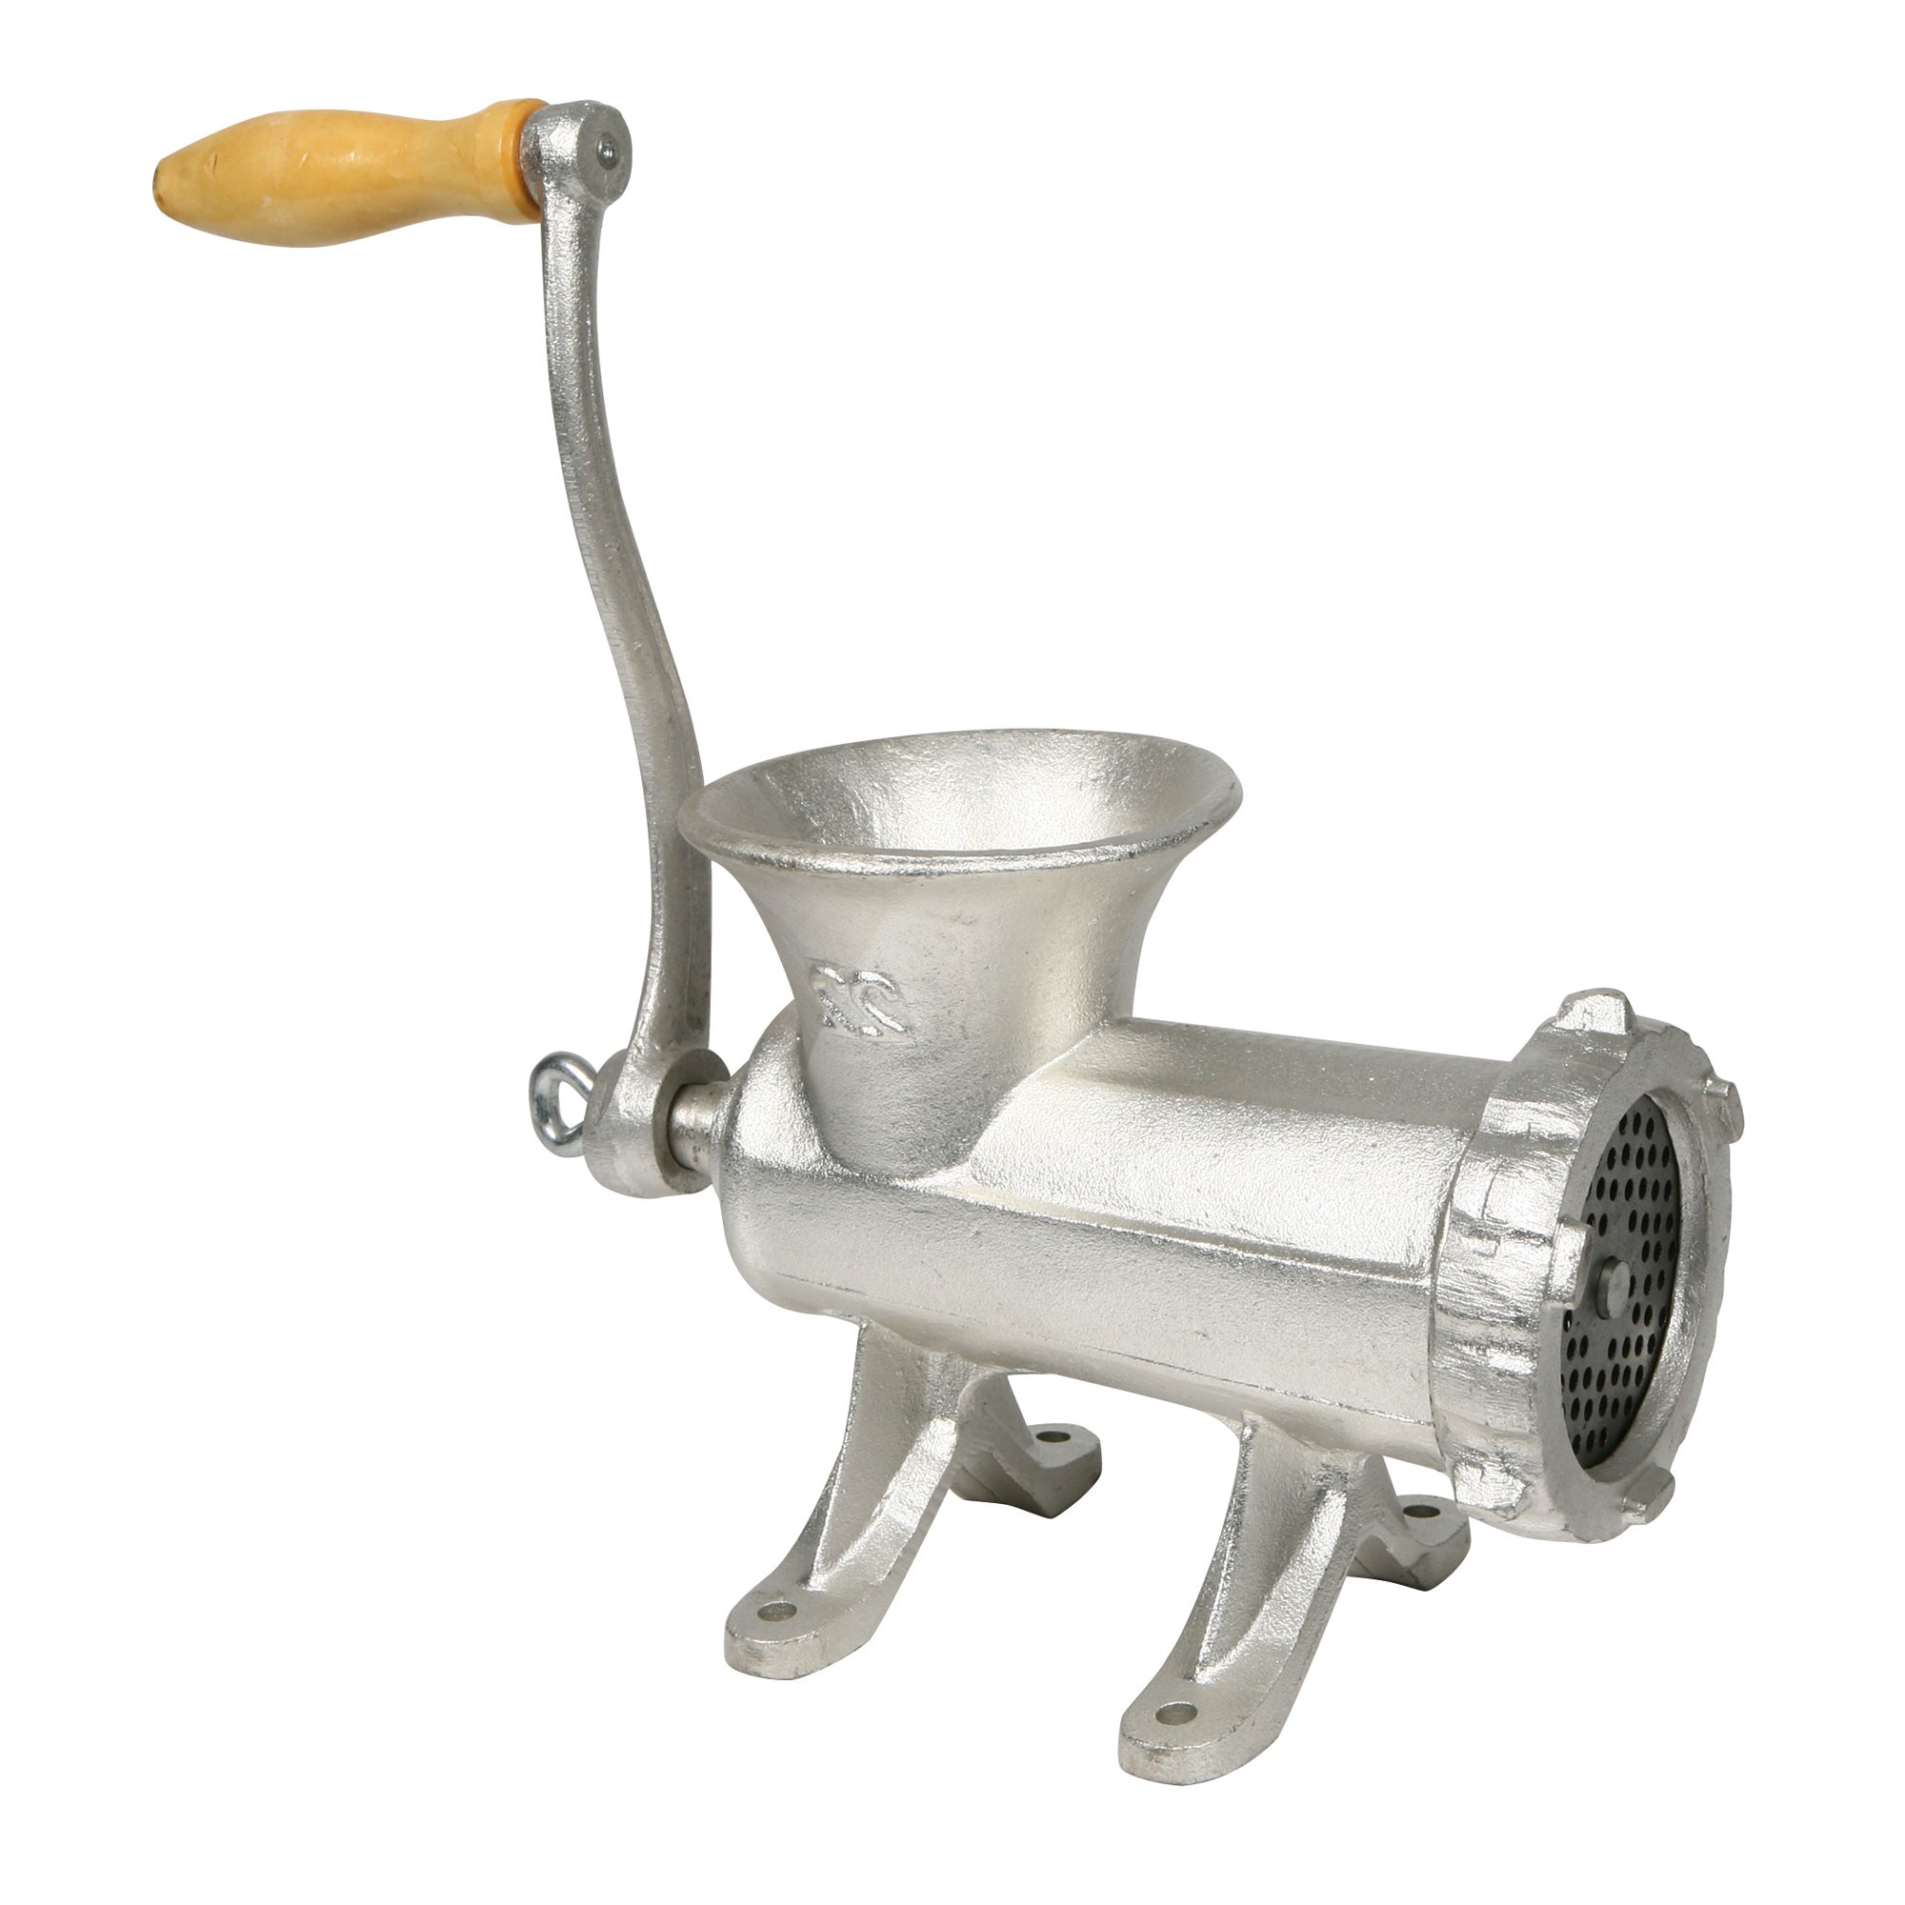
The idea
Key
Hash
value
is
Bucket
address

Slide 54
Bucket sizes
Each bucket consists of one or more blocks
  Need some way to convert the hash value into a logical block address
Selecting large buckets means we will have to search the contents of the target bucket to find the desired record
  If search time is critical and the database infrequently updated, we should consider sorting the records inside each bucket

Slide 55
Bucket organization
Two possible solutions
  Buckets contain records
    When bucket is full, records go to an overflow bucket
  Buckets contain pairs <key, address>
    When bucket is full, pairs <key, address> go to an overflow bucket

Slide 56
Buckets contain records
Assume each
bucket contains
two records
Overflow bucket

Slide 57
Buckets contain records
A record
KEY
A bucket can
contain many
more keys
than records
Many
more
records
KEY

Slide 58
Finding a good hash function
Should distribute records evenly among the buckets
  A bad hash function will have too many overflowing buckets and too many empty or near-empty buckets

Slide 59
A good starting point
If the key is numeric
  Divide the key by the number of buckets
    If the number of buckets is a power of two,
    this means selecting log₂ m least significant bits of key
Otherwise
  Transform the key into a numerical value
  Divide that value by the number of buckets

Slide 60
Looking further
Hashing works best when the number of buckets is a prime number
If performance matters, consult
  Donald Knuth's Art of Computer Programming
  http://en.wikipedia.org/wiki/Hash_function

Slide 61
Selecting the load factor
Percentage of used slots
  Best range is between 0.5 and 0.8
If load factor < 0.5
  Too much space is wasted
If load factor > 0.8
  Bucket overflows start becoming a problem
    Depending on how evenly the hash function distributes the keys among the buckets

Slide 62
Dynamic hashing
Conventional hashing techniques work well when the maximum number of records is known ahead of time
Dynamic hashing lets the hash table grow as the number of records grow
Two techniques:
  Extendible hashing
  Linear hashing

Slide 63
Extendible hashing
Represent hash values as bit strings:
  100101, 001001, …
Introduce an additional level of indirection, the directory
  One entry per key value
  Multiple entries can point to the same bucket

Slide 64
Extendible hashing
We assume a three-bit key
Directory
K = 010
Records with
key = 0*
000
d = 1
001
010
K = 111
Records with
key = 1*
001
d = 1
100
101
110
Both buckets are at same depth d
101

Slide 65
Extendible hashing
When a bucket overflows, we split it
Directory
K = 000
Records with
key = 00*
d = 2
000
001
010
K = 111
Records with
key = 1*
d = 1
001
100
101
Records with
key = 01*
K = 010
d = 2
110
K = 011
101

Slide 66
Explanations (I)
Choice of a bucket is based on the most significant bits (MSBs) of hash value
Start with a single bit
  Will have two buckets
    One for MSB = 0
    Other for MSB = 1
    Depth of bucket is 1

Slide 67
Explanations (II)
Each time a bucket overflows, we split it
  Assume first bucket overflows
    Will add a new bucket containing records with MSBs of hash value = 01
    Older bucket will keep records with MSBs of hash value = 00
    Depths of these two bucket is 2

Slide 68
Explanations (III)
At any given time, the hash table will contain buckets at different depths
  In our example, buckets 00 and 01 are at depth 2 while bucket 1 is at depth 1
Each bucket will include a record of its depth
  Just a few bits

Slide 69
Discussion
Extendible hashing
  Allows hash table contents
    To grow, by splitting buckets
    To shrink by merging buckets
but
  Adds one level of indirection
    No problem if the directory can reside in main memory

Slide 70
Linear hashing
Does not add an additional level of indirection
Reduces but does not eliminate overflow buckets
Uses a family of hash functions
  h_{i}(K) = K mod m
  h_{i+1}(K) = K mod 2m
  h_{i+2}(K) = K mod 4m
  …

Slide 71
How it works (I)
Start with
  m buckets
  h_{i}(K) = K mod m
When any bucket overflows
  Create an overflow bucket
  Create a new bucket at location m
  Apply hash function h_{i+1}(K)= K mod 2m to the contents of bucket 0
    Will now be split between buckets 0 and m

Slide 72
How it works (II)
When a second bucket overflows
  Create an overflow bucket
  Create a new bucket at location m + 1
  Apply hash function h_{i+1}(K)= K mod 2m to the contents of bucket 1
    Will now be split between buckets 1 and
    m + 1

Slide 73
How it works (III)
Each time a bucket overflows
  Create an overflow bucket
  Apply hash function h_{i+1}(K)= K mod 2m to the contents of the successor s + 1 of the last bucket that was split
    Contents of bucket s + 1 will now be split between buckets s and m + s – 1
The size of the hash table grows linearly at each split until all buckets use the new hash function

Slide 74
Advantages
The hash table goes linearly
As we split buckets in linear order, bookkeeping is very simple:
  Need only to keep track of the last bucket s that was split
    Buckets 0 to s use the new hash function
    h_{i+1}(K)= K mod 2m
    Buckets s + 1 to m – 1 still use the old hash function h_{i}(K)= K mod m

Slide 75
Example (I)
Assume m = 4 and one record per bucket
Table contains two records
Hash value = 0
Hash value = 2

Slide 76
Example (II)
We add one record with hash value = 2
Overflow bucket
Hash value = 2
Hash value = 2
New bucket
Hash value = 4
We assume that the contents of bucket 0 were migrated to bucket 4

Slide 77
Multi-key indexes
Not covered this semester

